Slide 1


Element Locators for Selenium Automation & Best Practices
2-Aug-2016
Notes:
The below and following notes on the template slides are to guide you only. In your final presentation, you may delete these notes and add relevant notes if any.
Title slide:
Title – should not exceed beyond 3 lines, font size 30-34, Arial Headings
(Font size for the title of the PPT can vary between 30-34, Arial Headings, Bold depending on the amount of text, however should not be smaller than 30 font size)
Name should not exceed beyond 1 line, Designation; font size to remain at 18, Arial Headings
Please keep the title slide simple, just the logo, title and name and designation to appear. No other graphic elements or any design, photograph, image can be added to this slide, alignment to remain the same

Slide 2
Agenda
Elements of XPATH
XPATH Hierarchy and Terminologies
XPATH Operators, Functions, Selectors, Axes
Do’s & Dont's in XPATH Locators
Examples
Notes:
Agenda slide
Heading – Agenda - Font size 30, Arial Headings
Agenda points to be in Arial Body (font size 28)
Please restrict this slide with just 5 agenda points.
If you have more than 5 points on the agenda slide please add another slide.
If you have only 3 then you can use just one slide and delete the other 2 points.

Slide 3
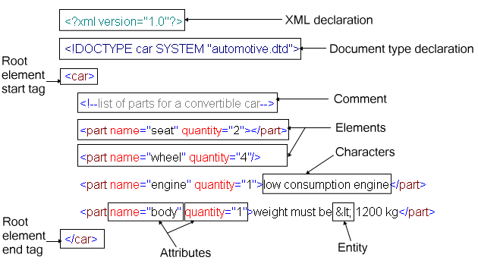
Elements of XML/HTML Document
/ Nodes
/ Node Text
/ Attribute Value
Notes:
Content Slide: This is usually the most frequently used slide in every presentation.
Use this slide for Text heavy slides. Text can only be used in bullet points
Title Heading – font size 30, Arial Heading
Slide Content – Should not reduce beyond Arial body font 16
If you need to use sub bullets please use the indent buttons located next to the bullets buttons in the tool bar and this will automatically provide you with the second, third, fourth & fifth level bullet styles and font sizes
Please note you can also press the tab key to create the different levels of bulleted content

Slide 4
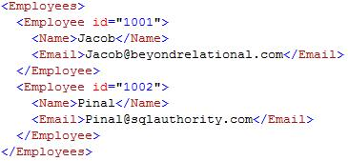
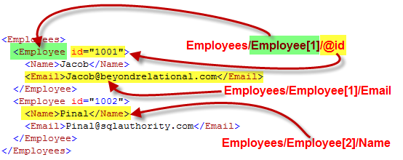
Identifying an Element in XML/HTML Doc
Notes:
Content Slide: This is usually the most frequently used slide in every presentation.
Use this slide for Text heavy slides. Text can only be used in bullet points
Title Heading – font size 30, Arial Heading
Slide Content – Should not reduce beyond Arial body font 16
If you need to use sub bullets please use the indent buttons located next to the bullets buttons in the tool bar and this will automatically provide you with the second, third, fourth & fifth level bullet styles and font sizes
Please note you can also press the tab key to create the different levels of bulleted content

Slide 5
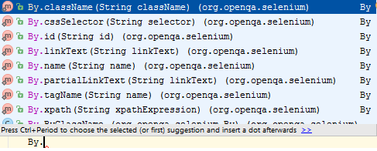
Methods in Selenium for various Locators
8 different ways to specify locators in Selenium API
Notes:
Content Slide: This is usually the most frequently used slide in every presentation.
Use this slide for Text heavy slides. Text can only be used in bullet points
Title Heading – font size 30, Arial Heading
Slide Content – Should not reduce beyond Arial body font 16
If you need to use sub bullets please use the indent buttons located next to the bullets buttons in the tool bar and this will automatically provide you with the second, third, fourth & fifth level bullet styles and font sizes
Please note you can also press the tab key to create the different levels of bulleted content

Slide 6
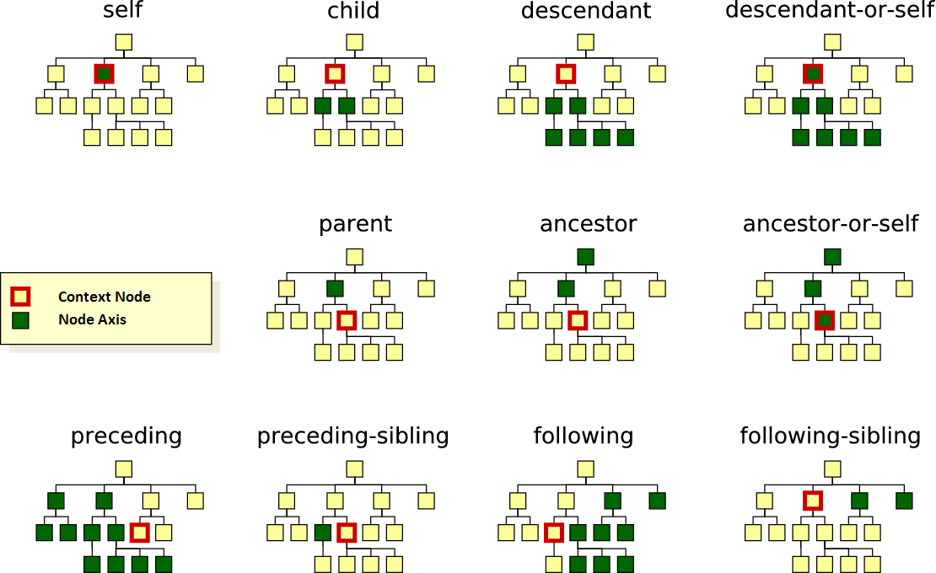
XPath Node Axis Relationship Terminologies
Notes:
Content Slide: This is usually the most frequently used slide in every presentation.
Use this slide for Text heavy slides. Text can only be used in bullet points
Title Heading – font size 30, Arial Heading
Slide Content – Should not reduce beyond Arial body font 16
If you need to use sub bullets please use the indent buttons located next to the bullets buttons in the tool bar and this will automatically provide you with the second, third, fourth & fifth level bullet styles and font sizes
Please note you can also press the tab key to create the different levels of bulleted content

Slide 7
XPath Functions
count() | Returns number of matches found for a given xpath
contains() | //td[contains(text(),' E-Mail:')]/following-sibling::td/input
starts-with() | Matches the starting text of a node nameor an attribute
translate() | //a[contains(translate(@title, 'abcdefghijklmnopqrstuvwxyz', 'ABCDEFGHIJKLMNOPQRSTUVWXYZ'), 'GIFT WITH PURCHASE')]
normalize-space() | Removes beginning and trailing spaces and any extra spaces in between words //label[normalize-space(.)='Email Address']/following-sibling::input[1]
position() | Returns the position integer value of a node compared to it’s siblings (position starts from 1)
Notes:
Content Slide: This is usually the most frequently used slide in every presentation.
Use this slide for Text heavy slides. Text can only be used in bullet points
Title Heading – font size 30, Arial Heading
Slide Content – Should not reduce beyond Arial body font 16
If you need to use sub bullets please use the indent buttons located next to the bullets buttons in the tool bar and this will automatically provide you with the second, third, fourth & fifth level bullet styles and font sizes
Please note you can also press the tab key to create the different levels of bulleted content

Slide 8
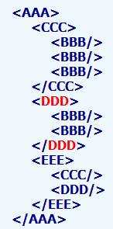
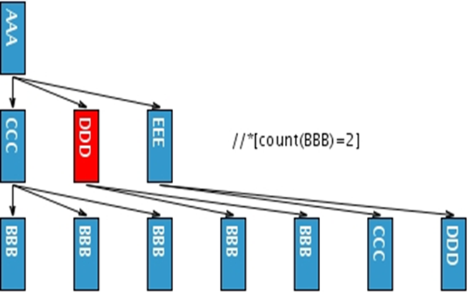
XPATH Functions - count() 1/3
Function count() counts the number of selected elements
Select elements which have two children BBB
//*[count(BBB)=2]
// selector [ predicates ]

Slide 9
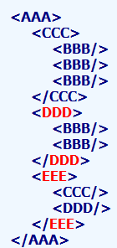
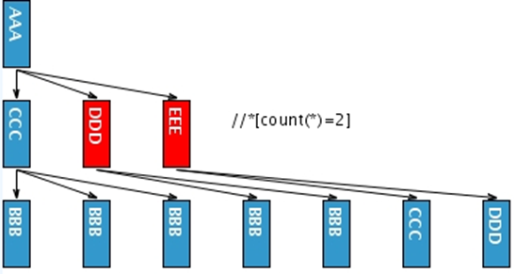
XPATH Functions - count() 2/3
Select elements which have 2 children
//*[count(*) = 2]

Slide 10
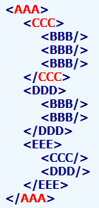
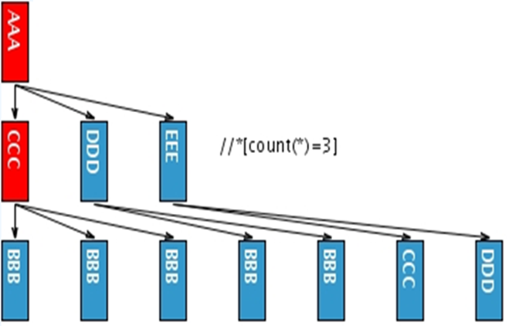
XPATH Functions - count() 3/3
Select elements which have 3 children
//*[count(*) = 3]

Slide 11
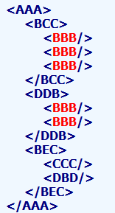
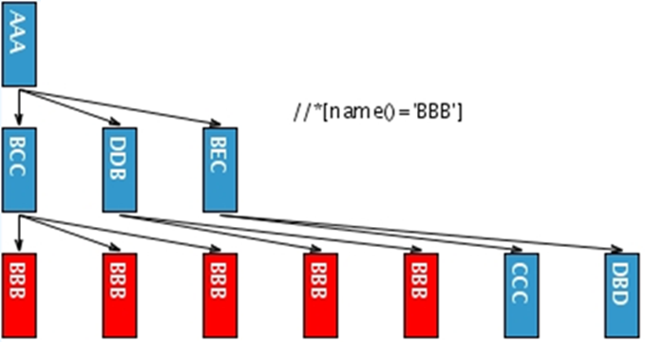
XPATH Functions - name() 1/3
Function name() returns name of the element, the starts-with function returns true if the first argument string starts with the second argument string, and the contains function returns true if the first argument string contains the second argument string.
Select all elements with name BBB, equivalent with //BBB
//*[name() = 'BBB']

Slide 12
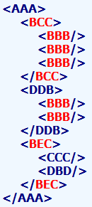
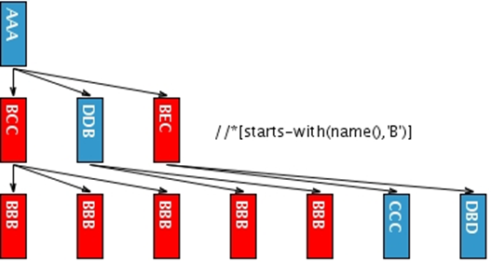
XPATH Functions - name() 2/3
//*[starts-with(name(), 'B')] function returns true if the first argument string starts with the second argument string
Select all elements name of which starts with letter B
//*[starts-with(name(),'B')]

Slide 13
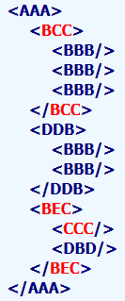
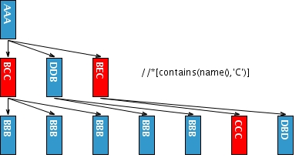
XPATH Functions - name() 3/3
Select all elements name of which contain letter C
//*[contains(name(),'C')]

Slide 14
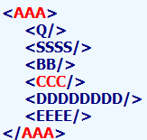
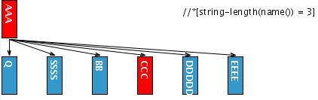
XPATH Functions – string-length() 1/3
The string-length function returns the number of characters in the string. You must use &lt; as a substitute for < and &gt; as a substitute for >
Select elements with three-letter name
//*[string-length(name()) = 3]

Slide 15
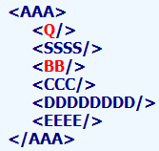
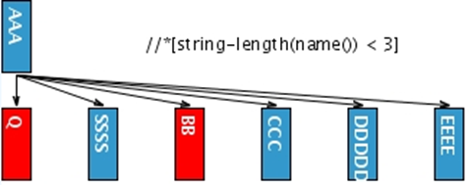
XPATH Functions – string-length() 2/3
Select elements name of which has one or two characters
//*[string-length(name()) < 3]

Slide 16
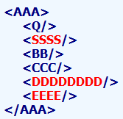
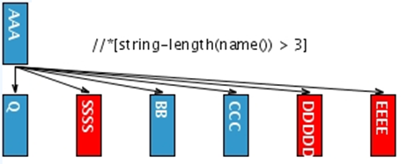
XPATH Functions – string-length() 3/3
The string-length function returns the number of characters in the string
Select elements with name longer than three characters
//*[string-length(name()) > 3]

Slide 17
XPath Operators
and, [ ][ ] | //input[@name='email' and @value='Email or Phone'] Alternatively [ ][ ][ ] … can be used to include multiple conditions //input[@name='email'] [@value='Email or Phone'] //bookstore/book[price>30] [price < 40]/price
or | //*[@id='email' or @name='email']
mod | The mod operator returns the remainder from a truncating division
| | Computes two node-sets //book | //cd
Note: We can make use of OR, | (pipe) and translate() to handle changes in locators between different builds / releases
//a[.='GIFT WITH PURCHASE' or .='Gift With Purchase']
//a[.='GIFT WITH PURCHASE' | //a[.='Gift With Purchase']
//a[contains(translate(@title, 'abcdefghijklmnopqrstuvwxyz','ABCDEFGHIJKLMNOPQRSTUVWXYZ'), 'GIFT WITH PURCHASE')]
Notes:
Content Slide: This is usually the most frequently used slide in every presentation.
Use this slide for Text heavy slides. Text can only be used in bullet points
Title Heading – font size 30, Arial Heading
Slide Content – Should not reduce beyond Arial body font 16
If you need to use sub bullets please use the indent buttons located next to the bullets buttons in the tool bar and this will automatically provide you with the second, third, fourth & fifth level bullet styles and font sizes
Please note you can also press the tab key to create the different levels of bulleted content

Slide 18
XPath Operators
+ | Addition | price + 10 | //bookstore/book[price + 10 = 40]/price
- | Subtraction | price - 9.99 | //bookstore/book[price - 9.99 = 40]/price
* | Multiplication | price * 2 | //bookstore/book[price * 2 = 60]/price
div | Division | price div 2 | //bookstore/book[price div 2 = 15]/price
= | Equal | price=49.99 | //bookstore/book[price=49.99]/price
!= | Not equal | price!=30 | //bookstore/book[price!=30]/price
< | Less than | price<30 | //bookstore/book[price<30]/price
<= | Less than or equal to | price<=30 | //bookstore/book[price<=30]/price
> | Greater than | price>35 | //bookstore/book[price>35]/price
>= | Greater than or equal to | price>=30 | //bookstore/book[price>=30]/price
Notes:
Content Slide: This is usually the most frequently used slide in every presentation.
Use this slide for Text heavy slides. Text can only be used in bullet points
Title Heading – font size 30, Arial Heading
Slide Content – Should not reduce beyond Arial body font 16
If you need to use sub bullets please use the indent buttons located next to the bullets buttons in the tool bar and this will automatically provide you with the second, third, fourth & fifth level bullet styles and font sizes
Please note you can also press the tab key to create the different levels of bulleted content

Slide 19
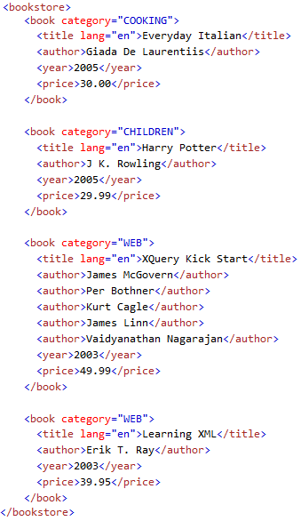
XPath Operators
Notes:
Content Slide: This is usually the most frequently used slide in every presentation.
Use this slide for Text heavy slides. Text can only be used in bullet points
Title Heading – font size 30, Arial Heading
Slide Content – Should not reduce beyond Arial body font 16
If you need to use sub bullets please use the indent buttons located next to the bullets buttons in the tool bar and this will automatically provide you with the second, third, fourth & fifth level bullet styles and font sizes
Please note you can also press the tab key to create the different levels of bulleted content

Slide 20
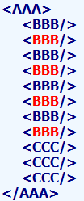
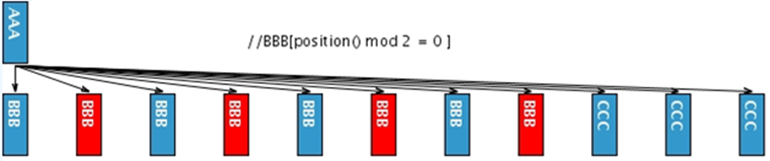
XPATH Operators - mod
The mod operator returns the remainder from a truncating division.
//BBB[position() mod 2 = 0 ]
Select even position BBB elements
//BBB[position() mod 2 = 1 ]
Select odd position BBB elements

Slide 21
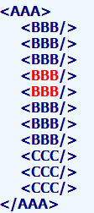
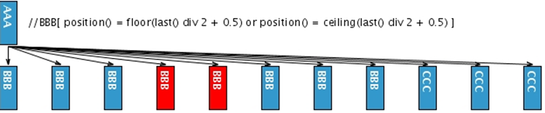
XPATH Operators – div
The div operator performs floating-point division.
The floor function returns the largest (closest to positive infinity) number that is not greater than the argument and that is an integer. The ceiling function returns the smallest (closest to negative infinity) number that is not less than the argument and that is an integer.
Select middle BBB element(s)
//BBB[ position() = floor(last() div 2 + 0.5) or position() = ceiling(last() div 2 + 0.5) ]

Slide 22
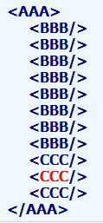
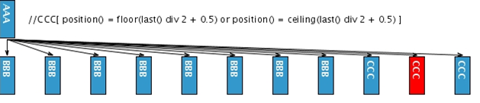
XPATH Operators – div
Select middle CCC element(s)
//CCC[ position() = floor(last() div 2 + 0.5) or position() = ceiling(last() div 2 + 0.5) ]

Slide 23
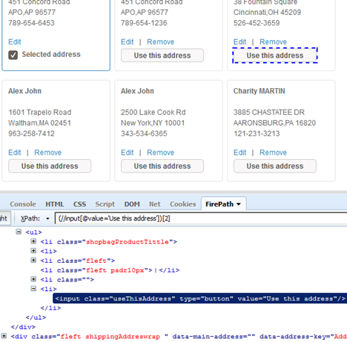
XPath Grouping / Precedence override - ()
XPath grouping is necessary when all the matching elements that are referred to are spread across different parent nodes and hence unable to address using position value
//input[@value=‘Use this address’] works, but
//input[@value=‘Use this address’][2] does not
As this locator is spread across different div tags and not occurring as siblings
Group with () to make it work
(//input[@value=‘Use this address’])[2]
Notes:
Content Slide: This is usually the most frequently used slide in every presentation.
Use this slide for Text heavy slides. Text can only be used in bullet points
Title Heading – font size 30, Arial Heading
Slide Content – Should not reduce beyond Arial body font 16
If you need to use sub bullets please use the indent buttons located next to the bullets buttons in the tool bar and this will automatically provide you with the second, third, fourth & fifth level bullet styles and font sizes
Please note you can also press the tab key to create the different levels of bulleted content

Slide 24
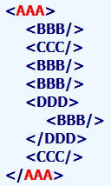
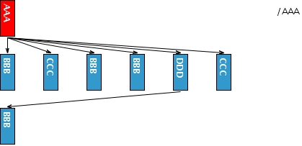
XPath Root / Selector
If the path starts with the slash / , then it represents an absolute path to the required element
Select the root element AAA
/HTML/BODY/AAA
Notes:
Content Slide: This is usually the most frequently used slide in every presentation.
Use this slide for Text heavy slides. Text can only be used in bullet points
Title Heading – font size 30, Arial Heading
Slide Content – Should not reduce beyond Arial body font 16
If you need to use sub bullets please use the indent buttons located next to the bullets buttons in the tool bar and this will automatically provide you with the second, third, fourth & fifth level bullet styles and font sizes
Please note you can also press the tab key to create the different levels of bulleted content

Slide 25
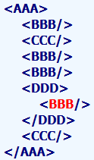
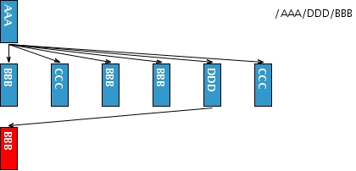
XPath Root / Selector [Contd.,]
Select all elements BBB which are children of DDD which are children of the root element AAA
/HTML/BODY/AAA/DDD/BBB
Notes:
Content Slide: This is usually the most frequently used slide in every presentation.
Use this slide for Text heavy slides. Text can only be used in bullet points
Title Heading – font size 30, Arial Heading
Slide Content – Should not reduce beyond Arial body font 16
If you need to use sub bullets please use the indent buttons located next to the bullets buttons in the tool bar and this will automatically provide you with the second, third, fourth & fifth level bullet styles and font sizes
Please note you can also press the tab key to create the different levels of bulleted content

Slide 26
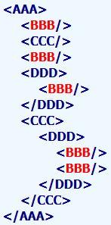
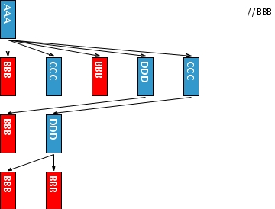
XPath Recursive Search // Selector
If the path starts with // then all elements in the document which fulfill following criteria are selected
Select all elements BBB
//BBB
Notes:
Content Slide: This is usually the most frequently used slide in every presentation.
Use this slide for Text heavy slides. Text can only be used in bullet points
Title Heading – font size 30, Arial Heading
Slide Content – Should not reduce beyond Arial body font 16
If you need to use sub bullets please use the indent buttons located next to the bullets buttons in the tool bar and this will automatically provide you with the second, third, fourth & fifth level bullet styles and font sizes
Please note you can also press the tab key to create the different levels of bulleted content

Slide 27
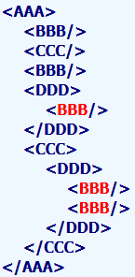
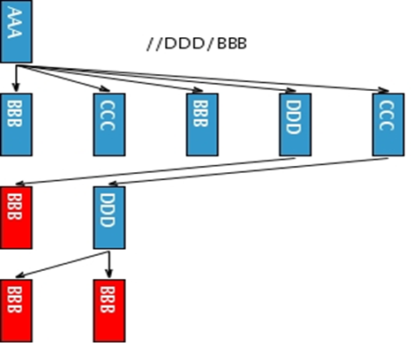
XPath Recursive Search // Selector [Contd.,]
Select all elements BBB which are children of DDD
//DDD/BBB
Notes:
Content Slide: This is usually the most frequently used slide in every presentation.
Use this slide for Text heavy slides. Text can only be used in bullet points
Title Heading – font size 30, Arial Heading
Slide Content – Should not reduce beyond Arial body font 16
If you need to use sub bullets please use the indent buttons located next to the bullets buttons in the tool bar and this will automatically provide you with the second, third, fourth & fifth level bullet styles and font sizes
Please note you can also press the tab key to create the different levels of bulleted content

Slide 28
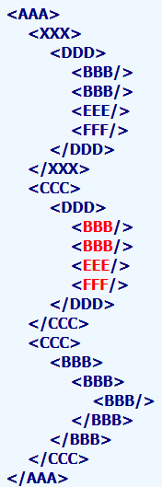
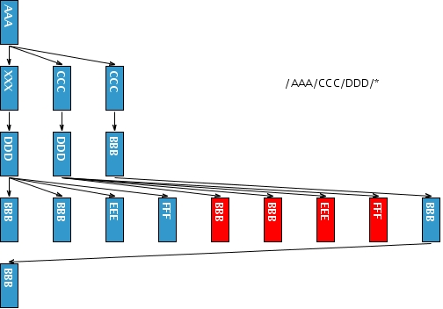
XPath All Elements * Selector
The star * selects all elements located by preceding path
//AAA/CCC/DDD/*
Select all elements enclosed by elements
Notes:
Content Slide: This is usually the most frequently used slide in every presentation.
Use this slide for Text heavy slides. Text can only be used in bullet points
Title Heading – font size 30, Arial Heading
Slide Content – Should not reduce beyond Arial body font 16
If you need to use sub bullets please use the indent buttons located next to the bullets buttons in the tool bar and this will automatically provide you with the second, third, fourth & fifth level bullet styles and font sizes
Please note you can also press the tab key to create the different levels of bulleted content

Slide 29
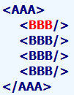
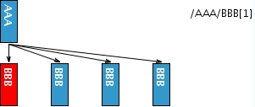
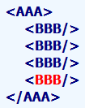
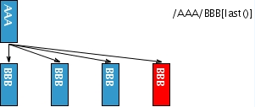
XPath Position [n] Selector
A number in the brackets gives the position of the element in the selected set
//AAA/BBB[1]
//AAA/BBB[position() = 1]
Select the first BBB child of element AAA
The function last() selects the last element in the selection
//AAA/BBB[last()]
//AAA/BBB[position() = last()]
Select the last BBB child of element AAA
Notes:
Content Slide: This is usually the most frequently used slide in every presentation.
Use this slide for Text heavy slides. Text can only be used in bullet points
Title Heading – font size 30, Arial Heading
Slide Content – Should not reduce beyond Arial body font 16
If you need to use sub bullets please use the indent buttons located next to the bullets buttons in the tool bar and this will automatically provide you with the second, third, fourth & fifth level bullet styles and font sizes
Please note you can also press the tab key to create the different levels of bulleted content

Slide 30
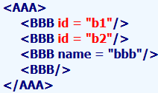
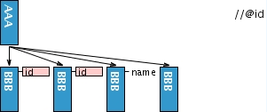
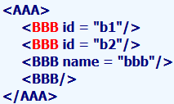
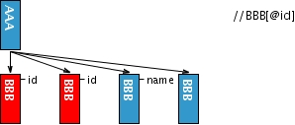
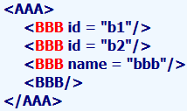



XPath Attribute @ Selector
Attributes are specified by @ prefix
//@id
Select all attributes @id
//BBB[@id]
Select BBB elements which have attribute id
//BBB[@*]
Select BBB elements which have any attribute
//BBB[ not(@*) ]
Select BBB elements without an attribute
Notes:
Content Slide: This is usually the most frequently used slide in every presentation.
Use this slide for Text heavy slides. Text can only be used in bullet points
Title Heading – font size 30, Arial Heading
Slide Content – Should not reduce beyond Arial body font 16
If you need to use sub bullets please use the indent buttons located next to the bullets buttons in the tool bar and this will automatically provide you with the second, third, fourth & fifth level bullet styles and font sizes
Please note you can also press the tab key to create the different levels of bulleted content

Slide 31




XPath Multi Combination |
Multiple XPaths are combined using |
//CCC | //BBB
Select all elements CCC and BBB
//AAA/EEE | //BBB
Select all elements BBB and elements EEE which are children of root element AAA
Notes:
Content Slide: This is usually the most frequently used slide in every presentation.
Use this slide for Text heavy slides. Text can only be used in bullet points
Title Heading – font size 30, Arial Heading
Slide Content – Should not reduce beyond Arial body font 16
If you need to use sub bullets please use the indent buttons located next to the bullets buttons in the tool bar and this will automatically provide you with the second, third, fourth & fifth level bullet styles and font sizes
Please note you can also press the tab key to create the different levels of bulleted content

Slide 32


XPath Multi Combination | [Contd.,]
Multiple XPaths are combined using | to return a node-set of required collection
//AAA/EEE | //DDD/CCC | //AAA | //BBB
There are 3 separate XPaths combined here. Number of combinations is not restricted
Notes:
Content Slide: This is usually the most frequently used slide in every presentation.
Use this slide for Text heavy slides. Text can only be used in bullet points
Title Heading – font size 30, Arial Heading
Slide Content – Should not reduce beyond Arial body font 16
If you need to use sub bullets please use the indent buttons located next to the bullets buttons in the tool bar and this will automatically provide you with the second, third, fourth & fifth level bullet styles and font sizes
Please note you can also press the tab key to create the different levels of bulleted content

Slide 33
XPath Axes
Forward Axis
An axis that only ever contains the context node or nodes that are after the context node in document order is a forward axis
following::
following-sibling::
descendant::
descendant-or-self::
Reverse Axis
An axis that only ever contains the context node or nodes that are before the context node in document order is a reverse axis
preceding::
preceding-sibling::
ancestor::
ancestor-or-self::
parent::
Notes:
Content Slide: This is usually the most frequently used slide in every presentation.
Use this slide for Text heavy slides. Text can only be used in bullet points
Title Heading – font size 30, Arial Heading
Slide Content – Should not reduce beyond Arial body font 16
If you need to use sub bullets please use the indent buttons located next to the bullets buttons in the tool bar and this will automatically provide you with the second, third, fourth & fifth level bullet styles and font sizes
Please note you can also press the tab key to create the different levels of bulleted content

Slide 34


XPath Axes – descendant::
The descendant axis contains the descendants of the context node; a descendant is a child or a child of a child and so on. Strictly tracks through the hierarchy unlike following::
//CCC/descendant::DDD
Select elements DDD which have CCC among its ancestors
Notes:
Content Slide: This is usually the most frequently used slide in every presentation.
Use this slide for Text heavy slides. Text can only be used in bullet points
Title Heading – font size 30, Arial Heading
Slide Content – Should not reduce beyond Arial body font 16
If you need to use sub bullets please use the indent buttons located next to the bullets buttons in the tool bar and this will automatically provide you with the second, third, fourth & fifth level bullet styles and font sizes
Please note you can also press the tab key to create the different levels of bulleted content

Slide 35


XPath Axes – parent::
The parent axis contains the parent of the context node, if there is one
//DDD/parent::*
Select all parents of DDD element
Notes:
Content Slide: This is usually the most frequently used slide in every presentation.
Use this slide for Text heavy slides. Text can only be used in bullet points
Title Heading – font size 30, Arial Heading
Slide Content – Should not reduce beyond Arial body font 16
If you need to use sub bullets please use the indent buttons located next to the bullets buttons in the tool bar and this will automatically provide you with the second, third, fourth & fifth level bullet styles and font sizes
Please note you can also press the tab key to create the different levels of bulleted content

Slide 36


XPath Axes – ancestor::
The ancestors of the context node consist of the parent of context node and the parent's parent and so on; Strictly follows the hierarchy unlike preceding::
//AAA/BBB/DDD/CCC/EEE/ancestor::*
Notes:
Content Slide: This is usually the most frequently used slide in every presentation.
Use this slide for Text heavy slides. Text can only be used in bullet points
Title Heading – font size 30, Arial Heading
Slide Content – Should not reduce beyond Arial body font 16
If you need to use sub bullets please use the indent buttons located next to the bullets buttons in the tool bar and this will automatically provide you with the second, third, fourth & fifth level bullet styles and font sizes
Please note you can also press the tab key to create the different levels of bulleted content

Slide 37


XPath Axes – ancestor:: [Contd.,]
//FFF/ancestor::*
Select ancestors of FFF element
Notes:
Content Slide: This is usually the most frequently used slide in every presentation.
Use this slide for Text heavy slides. Text can only be used in bullet points
Title Heading – font size 30, Arial Heading
Slide Content – Should not reduce beyond Arial body font 16
If you need to use sub bullets please use the indent buttons located next to the bullets buttons in the tool bar and this will automatically provide you with the second, third, fourth & fifth level bullet styles and font sizes
Please note you can also press the tab key to create the different levels of bulleted content

Slide 38


XPath Axes – following::
The following:: axis contains all the following of the context node in document order, excluding any descendants and excluding attribute nodes and namespace nodes
//AAA/XXX/following::*
Notes:
Content Slide: This is usually the most frequently used slide in every presentation.
Use this slide for Text heavy slides. Text can only be used in bullet points
Title Heading – font size 30, Arial Heading
Slide Content – Should not reduce beyond Arial body font 16
If you need to use sub bullets please use the indent buttons located next to the bullets buttons in the tool bar and this will automatically provide you with the second, third, fourth & fifth level bullet styles and font sizes
Please note you can also press the tab key to create the different levels of bulleted content

Slide 39


XPath Axes – following:: [Contd.,]
The following:: axis contains all the following of the context node
//ZZZ/following::*
Notes:
Content Slide: This is usually the most frequently used slide in every presentation.
Use this slide for Text heavy slides. Text can only be used in bullet points
Title Heading – font size 30, Arial Heading
Slide Content – Should not reduce beyond Arial body font 16
If you need to use sub bullets please use the indent buttons located next to the bullets buttons in the tool bar and this will automatically provide you with the second, third, fourth & fifth level bullet styles and font sizes
Please note you can also press the tab key to create the different levels of bulleted content

Slide 40


XPath Axes – following-sibling::
The following-sibling axis contains all the following siblings of the context node
//AAA/BBB/following-sibling::*
Notes:
Content Slide: This is usually the most frequently used slide in every presentation.
Use this slide for Text heavy slides. Text can only be used in bullet points
Title Heading – font size 30, Arial Heading
Slide Content – Should not reduce beyond Arial body font 16
If you need to use sub bullets please use the indent buttons located next to the bullets buttons in the tool bar and this will automatically provide you with the second, third, fourth & fifth level bullet styles and font sizes
Please note you can also press the tab key to create the different levels of bulleted content

Slide 41


XPath Axes – following-sibling:: [Contd.,]
//CCC/following-sibling::*
Notes:
Content Slide: This is usually the most frequently used slide in every presentation.
Use this slide for Text heavy slides. Text can only be used in bullet points
Title Heading – font size 30, Arial Heading
Slide Content – Should not reduce beyond Arial body font 16
If you need to use sub bullets please use the indent buttons located next to the bullets buttons in the tool bar and this will automatically provide you with the second, third, fourth & fifth level bullet styles and font sizes
Please note you can also press the tab key to create the different levels of bulleted content

Slide 42


XPath Axes – preceding::
The preceding axis contains all nodes in the same document as the context node that are before the context node in document order ( in other words, it’s the reverse operation of following::)
//AAA/XXX/preceding::*
Notes:
Content Slide: This is usually the most frequently used slide in every presentation.
Use this slide for Text heavy slides. Text can only be used in bullet points
Title Heading – font size 30, Arial Heading
Slide Content – Should not reduce beyond Arial body font 16
If you need to use sub bullets please use the indent buttons located next to the bullets buttons in the tool bar and this will automatically provide you with the second, third, fourth & fifth level bullet styles and font sizes
Please note you can also press the tab key to create the different levels of bulleted content

Slide 43


XPath Axes – preceding:: [Contd.,]
//GGG/preceding::*
Notes:
Content Slide: This is usually the most frequently used slide in every presentation.
Use this slide for Text heavy slides. Text can only be used in bullet points
Title Heading – font size 30, Arial Heading
Slide Content – Should not reduce beyond Arial body font 16
If you need to use sub bullets please use the indent buttons located next to the bullets buttons in the tool bar and this will automatically provide you with the second, third, fourth & fifth level bullet styles and font sizes
Please note you can also press the tab key to create the different levels of bulleted content

Slide 44


XPath Axes – preceding-sibling:: [Contd.,]
//CCC/preceding-sibling::*
Notes:
Content Slide: This is usually the most frequently used slide in every presentation.
Use this slide for Text heavy slides. Text can only be used in bullet points
Title Heading – font size 30, Arial Heading
Slide Content – Should not reduce beyond Arial body font 16
If you need to use sub bullets please use the indent buttons located next to the bullets buttons in the tool bar and this will automatically provide you with the second, third, fourth & fifth level bullet styles and font sizes
Please note you can also press the tab key to create the different levels of bulleted content

Slide 45


XPath Axes – descendant-or-self::
The descendant-or-self axis contains the context node and the descendants of the context node. Strictly tracks through the hierarchy unlike following::
//AAA/XXX/descendant-or-self::*
Notes:
Content Slide: This is usually the most frequently used slide in every presentation.
Use this slide for Text heavy slides. Text can only be used in bullet points
Title Heading – font size 30, Arial Heading
Slide Content – Should not reduce beyond Arial body font 16
If you need to use sub bullets please use the indent buttons located next to the bullets buttons in the tool bar and this will automatically provide you with the second, third, fourth & fifth level bullet styles and font sizes
Please note you can also press the tab key to create the different levels of bulleted content

Slide 46


XPath Axes – descendant-or-self:: [Contd.,]
//CCC/descendant-or-self::*
Notes:
Content Slide: This is usually the most frequently used slide in every presentation.
Use this slide for Text heavy slides. Text can only be used in bullet points
Title Heading – font size 30, Arial Heading
Slide Content – Should not reduce beyond Arial body font 16
If you need to use sub bullets please use the indent buttons located next to the bullets buttons in the tool bar and this will automatically provide you with the second, third, fourth & fifth level bullet styles and font sizes
Please note you can also press the tab key to create the different levels of bulleted content

Slide 47
Examples for using Element label as anchor
KOHLS.com Locators for Sign-in Page
//label[normalize-space(.)='Email Address']/following-sibling::input[1]
//label[normalize-space(.)='Password']/following-sibling::input[1]
//label[normalize-space(.)='PASSWORD' or normalize-space(.)='Password' ]/following-sibling::input[1]
Notes:
Content Slide: This is usually the most frequently used slide in every presentation.
Use this slide for Text heavy slides. Text can only be used in bullet points
Title Heading – font size 30, Arial Heading
Slide Content – Should not reduce beyond Arial body font 16
If you need to use sub bullets please use the indent buttons located next to the bullets buttons in the tool bar and this will automatically provide you with the second, third, fourth & fifth level bullet styles and font sizes
Please note you can also press the tab key to create the different levels of bulleted content

Slide 48

Cross Referencing in Web Table
Select ‘Age’ for a given ‘Lastname’ from a Web Table
//th[. = 'Lastname']/../following-sibling::tr/td[(position() = count(//th[. = 'Lastname']/preceding-sibling::th)+1) and text()='Doe']/../td[position() = count(//th[. = 'Age']/preceding-sibling::th)+1]
Notes:
Content Slide: This is usually the most frequently used slide in every presentation.
Use this slide for Text heavy slides. Text can only be used in bullet points
Title Heading – font size 30, Arial Heading
Slide Content – Should not reduce beyond Arial body font 16
If you need to use sub bullets please use the indent buttons located next to the bullets buttons in the tool bar and this will automatically provide you with the second, third, fourth & fifth level bullet styles and font sizes
Please note you can also press the tab key to create the different levels of bulleted content

Slide 49
Do’s & Don’ts in forming a Locator
Carefully ANALYSE the DOM Structure and pattern of elements SORROUNDING the element of interest and understand the hierarchy / relationship between the key/anchor LABEL and the element to be interacted with
Use of visible text / element label as the anchor point in taking a XPath is the MOST IMPORTANT Best Practices
Use // or descendant-or-self:: in the XPath hierarchy with reference to a key label / text in UI in order to avoid ending up with a very lengthy locator
Use ../ or parent:: or preceding:: in the XPath hierarchy with reference to a key label / text in UI in order to avoid ending up with a very lengthy locators
Use XPath AXES as much as possible if applicable for element referred to
Try to address the correct node by relating the elements type of interaction and corresponding HTML tag. eg. Textbox <input type=‘text’>, Checkbox <input type=‘checkbox’>, Dropdown lists <select><option>
Use By.linkText() or By.partialLinkText() for link elements
Notes:
Content Slide: This is usually the most frequently used slide in every presentation.
Use this slide for Text heavy slides. Text can only be used in bullet points
Title Heading – font size 30, Arial Heading
Slide Content – Should not reduce beyond Arial body font 16
If you need to use sub bullets please use the indent buttons located next to the bullets buttons in the tool bar and this will automatically provide you with the second, third, fourth & fifth level bullet styles and font sizes
Please note you can also press the tab key to create the different levels of bulleted content

Slide 50
Do’s & Don’ts in forming a Locator… [Contd.,]
DO NOT Just COPY / PASTE the locator from add-ons like FireBug / FirePath etc.,
Avoid lengthy XPath with lots of div/div[2]/div/… which are prone to break quickly
Notes:
Content Slide: This is usually the most frequently used slide in every presentation.
Use this slide for Text heavy slides. Text can only be used in bullet points
Title Heading – font size 30, Arial Heading
Slide Content – Should not reduce beyond Arial body font 16
If you need to use sub bullets please use the indent buttons located next to the bullets buttons in the tool bar and this will automatically provide you with the second, third, fourth & fifth level bullet styles and font sizes
Please note you can also press the tab key to create the different levels of bulleted content

Slide 51
References
https://www.w3.org/TR/xpath/
Notes:
Content Slide: This is usually the most frequently used slide in every presentation.
Use this slide for Text heavy slides. Text can only be used in bullet points
Title Heading – font size 30, Arial Heading
Slide Content – Should not reduce beyond Arial body font 16
If you need to use sub bullets please use the indent buttons located next to the bullets buttons in the tool bar and this will automatically provide you with the second, third, fourth & fifth level bullet styles and font sizes
Please note you can also press the tab key to create the different levels of bulleted content

Slide 52

Notes:
Thank you slide with customer logo
Thank you slide with the customer logo:
Should have only the details shown here. Logo placement cannot be changed. Wipro logo to appear on the left as per our corporate guidelines.
Thank you– font size 30, Arial Headings
Name & Designation – font size 18, Arial Headings, not to exceed beyond 2 lines
Your/contact email id – font size 18, Arial Headings

