Slide 1
Digital Portfolio
STUDENT NAME: NERUPHA.G.K
REGISTER NO AND NMID: 2428N0030&ASBRUBD24BSCCY30
DEPARTMENT: Department of Computer Science Application
COLLEGE: Shree Venkateshwara Arts and Science (co-edu)college
Bharathiyar university

Slide 2
PROJECT TITLE
DIGITAL PORTFOLIO

Slide 3


AGENDA
Problem Statement
Project Overview
End Users
Tools and Technologies
Portfolio design and Layout
Features and Functionality
Results and Screenshots
Conclusion
Github Link
3/21/2024 Annual Review

Slide 4

PROBLEM STATEMENT
📌 Problem Statement for Digital PortfolioIn today’s digital era, traditional paper-based resumes and physical portfolios are no longer sufficient to showcase an individual’s skills, achievements, and professional identity.
Recruiters, educators, and industry professionals increasingly prefer interactive and easily accessible digital platforms that highlight not only qualifications but also practical work, creativity, and technical ability.However, many students and professionals lack a structured, user-friendly, and professional medium to present their competencies effectively. This creates a gap between their actual abilities and how they are perceived by employers or evaluators.

Slide 5

PROJECT OVERVIEW
A Digital Portfolio is an organized collection of an individual’s skills, achievements, experiences, and creative work presented through digital platforms. It acts as a modern resume and showcase, allowing students, professionals, and creators to highlight their competencies using multimedia such as documents, images, videos, and interactive elements.

Slide 6

WHO ARE THE END USERS?
Student
To showcase academic achievements, projects, and extracurricular activities for higher studies or job opportunities.
2. Job Seekers / Professionals
To highlight skills, work experience, and certifications to employers or clients.
3. Teachers / Academicians
To present research papers, teaching experience, and academic contributions.
4. Freelancers / Creators (Designers, Developers, Artists, Writers, etc.)
To display creative work, portfolios, and client projects.
5. Employers / Recruiters
As viewers who access the portfolio to evaluate a candidate’s skills and suitability.

Slide 7

TOOLS AND TECHNIQUES
Digital portfolio tools include website builders like Wix, Behance, and Adobe Portfolio, as well as platforms like Seesaw for younger students, while techniques involve curating your best work, telling your story through reflections and case studies, showcasing growth, and creating a user-friendly, mobile-responsive design. The goal is to use these tools and techniques to create an interactive and dynamic online space that highlights your skills and achievements to a target audience.

Slide 8
POTFOLIO DESIGN AND LAYOUT
A digital portfolio's design and layout should create an appealing, user-friendly presentation of your best work that reflects your unique style and professional brand. Key elements include choosing the right platform, curating high-quality content, deciding on an appealing visual structure, adding distinct branding, and ensuring intuitive navigation and a positive user experience.
Website Builders: Use platforms like Wix.com or Canva that offer templates and tools to build a professional-looking site.
Specialized Platforms: Depending on your field, consider platforms like Adobe InDesign for more interactive, customized portfolios, or a simple video channel for visual work.
8

Slide 9
FEATURES AND FUNCTIONALITY
A digital portfolio showcases work, skills, and accomplishments in an online, organized collection, with key features including a diverse multimedia content (text, images, videos), organized project descriptions, a skills section, testimonials, and reflective elements. Functionality includes professional customization, easy sharing across platforms, mobile-friendliness, and the ability to track progress and reflect on one's learning journey, providing employers, clients, and educators with a comprehensive view of an individual's capabilities.

Slide 10
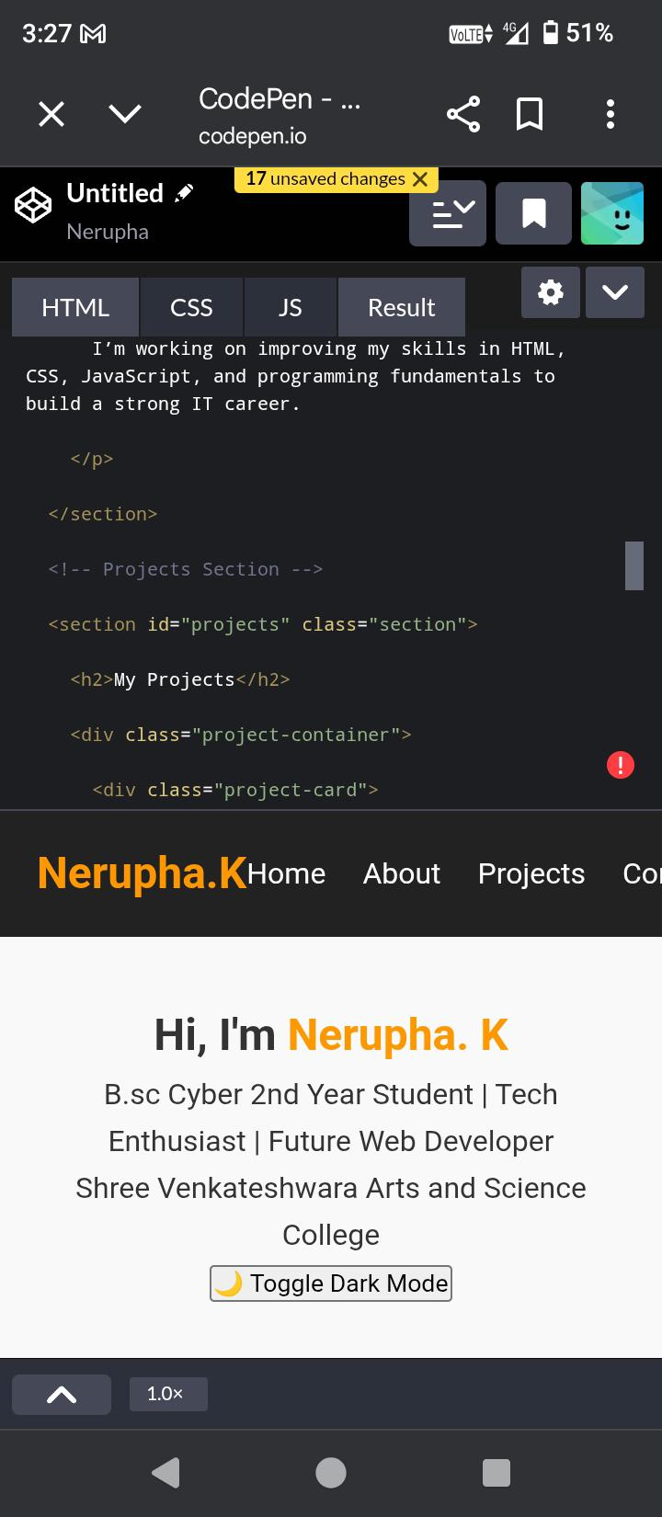
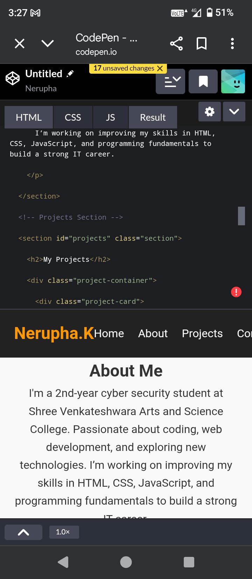
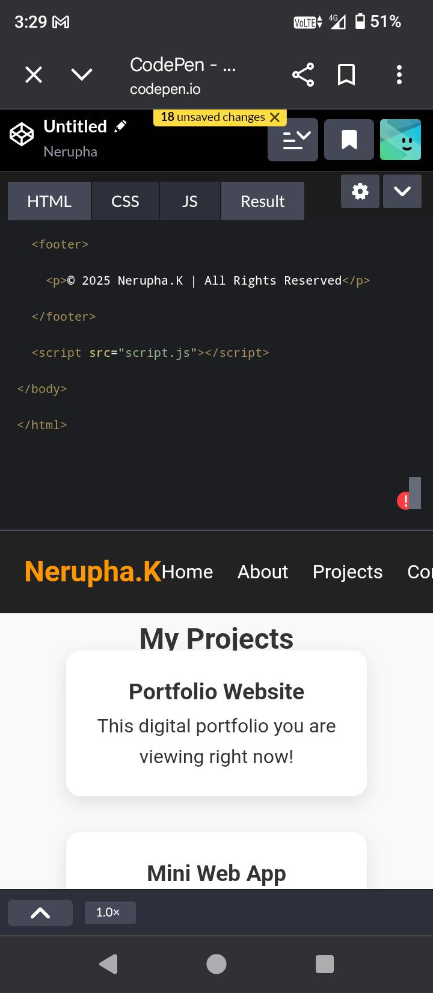
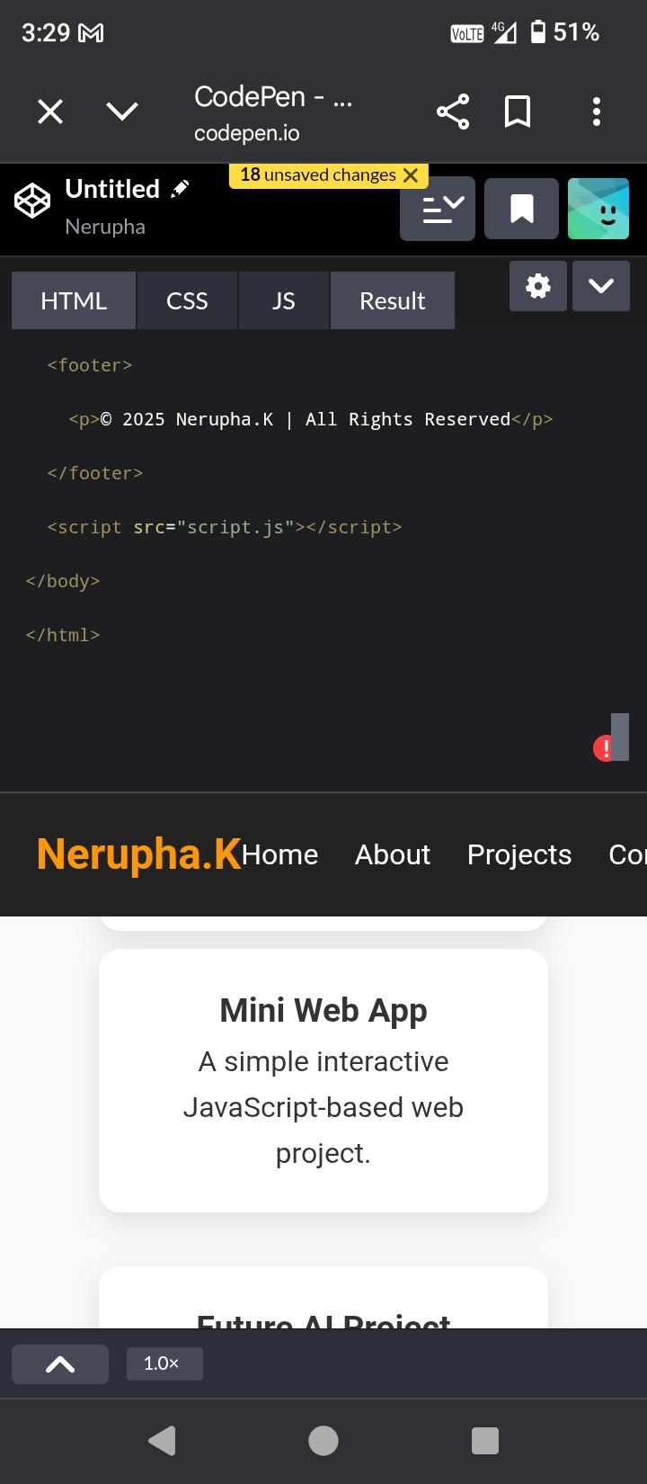

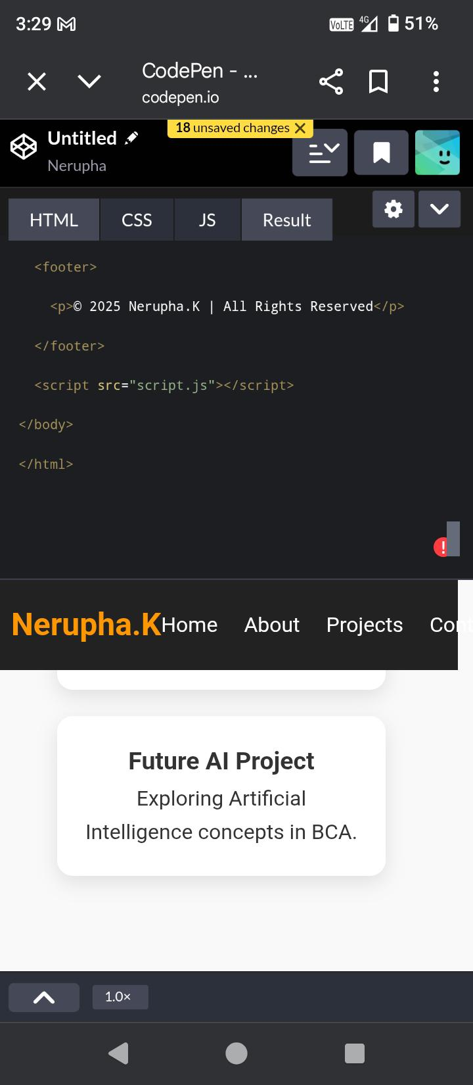
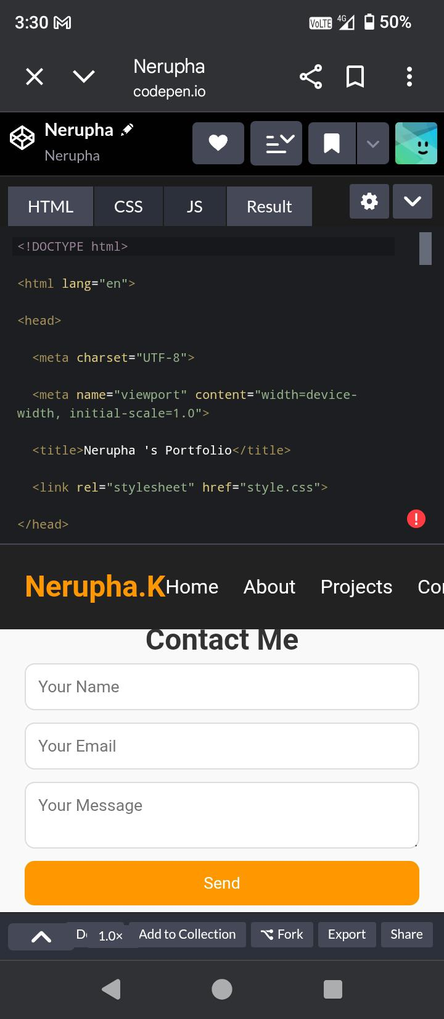
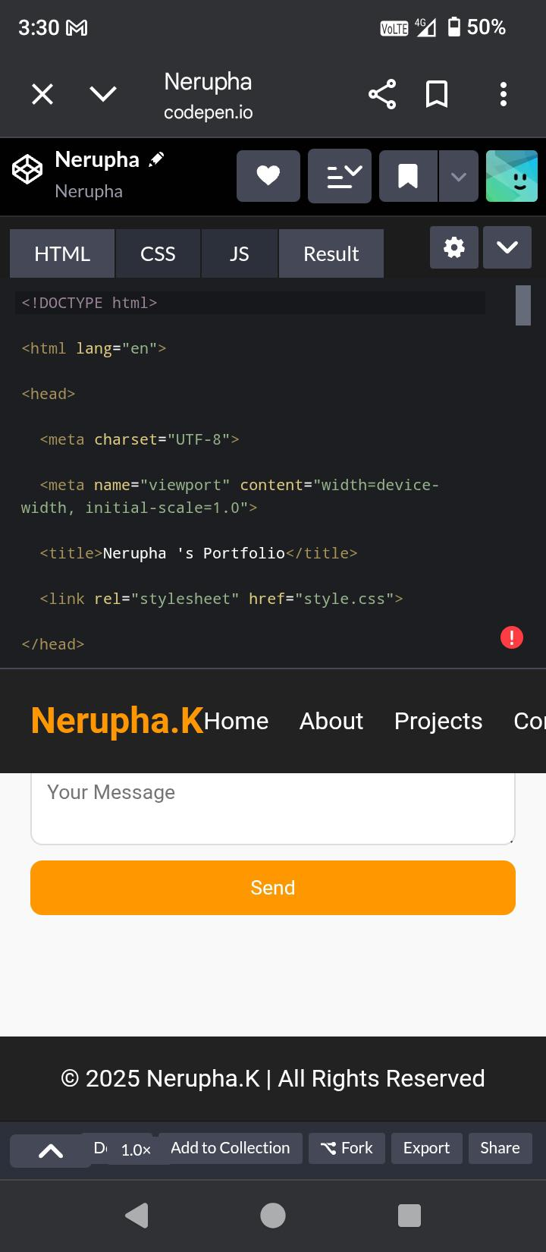
RESULTS AND SCREENSHOTS
3/21/2024 Annual Review
10

Slide 11
CONCLUSION
A digital portfolio's conclusion should provide a reflective summary of your key skills, accomplishments, and growth, reinforcing your personal brand and career goals to potential employers or clients. It should highlight the visual proof of your abilities, the ease of sharing, and your unique perspective, ultimately serving as a concise and persuasive representation of your qualifications and potential contribution.
11

Slide 12
GITHUB LINK
https://github.com/neruphak-star/Nerupha-.git

