Slide 1
White pine growth efficiency over time under different thinning regimes
Nathan Rutenbeck, Adam Bland
Advanced Biometry, Spring 2013

Slide 2
Introduction
Growth efficiency is a measure of tree vigor, measured as stem growth per unit leaf area (Assmann 1970, Waring et al. 1980)
Growth efficiency interacts with leaf area to drive productivity.
  Not just how much leaf area, but leaf area utilization!
  Possible explanation of universally observed production decline with age at the stand level (Ryan et al 1997)
  Effects of density on GE? (Sterba et al 1998, Mainwaring and Maguire 2004)

Slide 3
Research Question
What are the patterns of growth efficiency over time in stands of differing stem densities, and under different thinning regimes?
Two components:
Patterns of GE in a chronosequence
Effects of thinning on these patterns

Slide 4
Field Methods
Location: Demeritt Forest
8 stands
Thinning experiment
  Control
  B-line
  Low Density
Chronosequence
  Range of initial stem densities
  Self-thinning
Data sources:
Littertraps
  Annual collection, autumn and spring, 1993-2011
Growth plots
  Periodic remeasurement 1993-2011
  DOB, height, crown characteristics
Increment cores
  2 cores per tree (2011)
  Annual DIB increment

Slide 5
Data Analysis
GE = VINC/LAI …so we need annual estimates of leaf area and volume at the plot level!
Annual LAI comes from litter traps
  Scale up directly from trap weights using expansion factors
Annual VINC must be estimated by applying a taper equation to interpolated heights and diameters.
  Interpolation using ring widths and growth measurements within mixed models

Slide 6
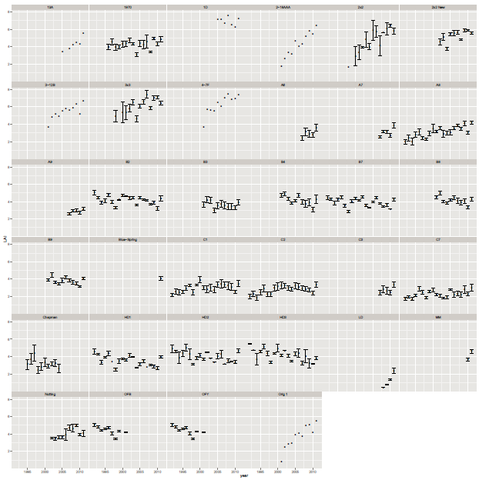
Data Analysis: Leaf Area Index
Scaled up to the plot level for each measurement period ± SE
Notes:
Here are leaf area patterns at the plot level – see three patterns – obviously increasing, flatlined, and slightly decreasing. This would theoretically

Slide 7
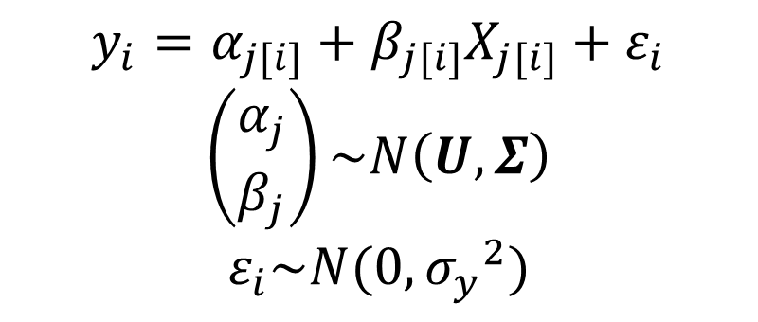
Data Analysis: Height and Diameter Models
$$y_{i}=α_{j[i]}+β_{j[i]}X_{j[i]}+ε_{i}$$
$$\left({α_{j} \atop β_{j}}\right)\sim N\left(U,Σ\right)$$
$$ε_{i}\sim N(0,{σ_{y}^{}}_{}^{2})$$
For each tree in each year:
Height model - predict height from age
Diameter model - predict DOB from DIB
Slope and intercept in each model
Bi-normally distributed random variables
U is parameter means matrix
Σ is covariance matrix
Data level errors are normally distributed

Slide 8
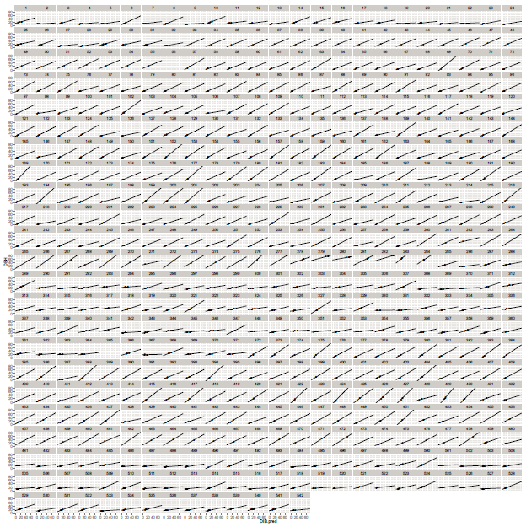
Diameter model random effects

Slide 9
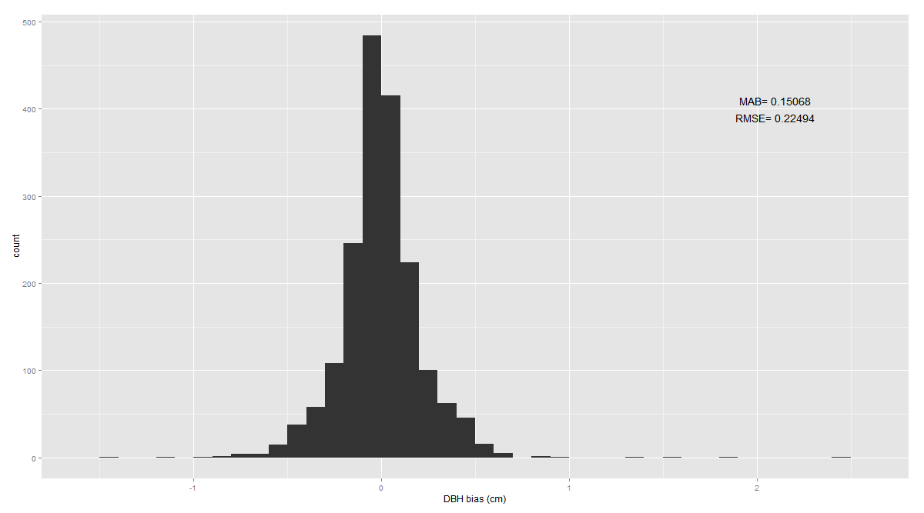
Diameter Model Bias

Slide 11
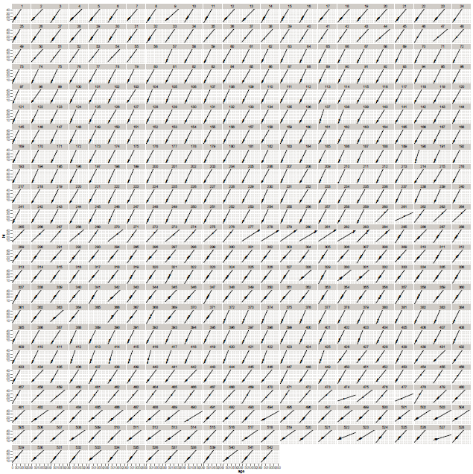
Height model random effects

Slide 12
Height Model Bias

Slide 14
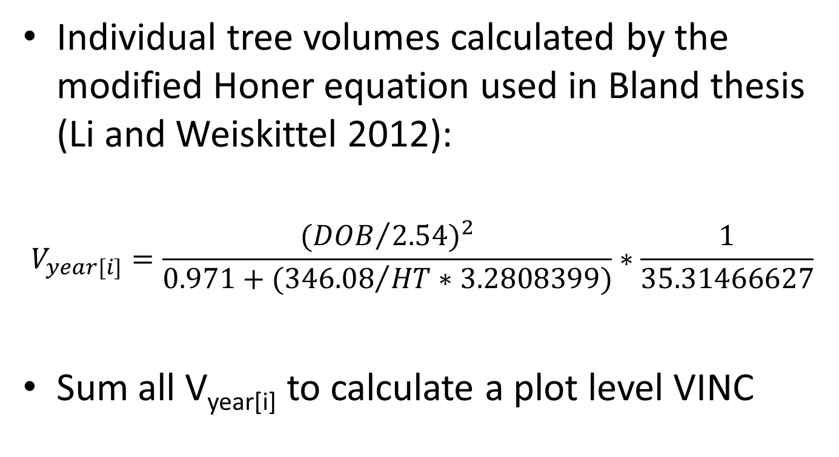
Volume from Taper Equation
Individual tree volumes calculated by the modified Honer equation used in Bland thesis (Li and Weiskittel 2012):
$$V_{year[i]}=\frac{{{(DOB}/{2.54})}^{2}}{0.971+{(346.08}/{HT∗3.2808399)}}∗\frac{1}{35.31466627}$$
Sum all V_{year[i]} to calculate a plot level VINC

Slide 15
Results: Plot-level Growth Efficiency

Slide 16
Discussion: What’s left?
Instead of predicting DOB from DIB, could measure a ‘within bark’ GE from DIB directly to reduce bias
Calculate confidence intervals around growth efficiency estimates based on LAI CIs
Devise a modeling framework within which to more formally test the effect of stand density and thinning treatment on GE patterns?
Notes:
Need to examine the volume equation I am using a bit more closely – I am using it out of the box here, and want to be sure that there isn’t something better.

Slide 17
Discussion
To the extent that density represents a chronosequence, we can stitch together a tentative pattern of GE over time in these stands
No declines in GE except in heavily thinned stands (Low density treatments) and possibly the Mature Monoculture (not much data…)
In fact, slight increases in GE?
Notes:
These conclusions are provisional, obviously…

Slide 18
Citations
Assmann, E., 1970. The Principles of Forest Yield Study. Pergamon Press, Oxford.
Ryan, M.G., Binkley, D., Fownes, J.H., 1997. Age-Related Decline in Forest Productivity: Pattern and Process. Advances in Ecological Research 27, 214–262.
Sterba, H., Amateis, R.L., 1998. Crown efficiency in a loblolly pine (Pinus taeda) spacing experiment. Canadian Journal of Forest Research 28, 1344–1351.
Waring, R.H., Thies, W.G., Muscato, D., 1980. Stem Growth per Unit of Leaf Area: A Measure of Tree Vigor. Forest Science 26, 112–117.

