Slide 1
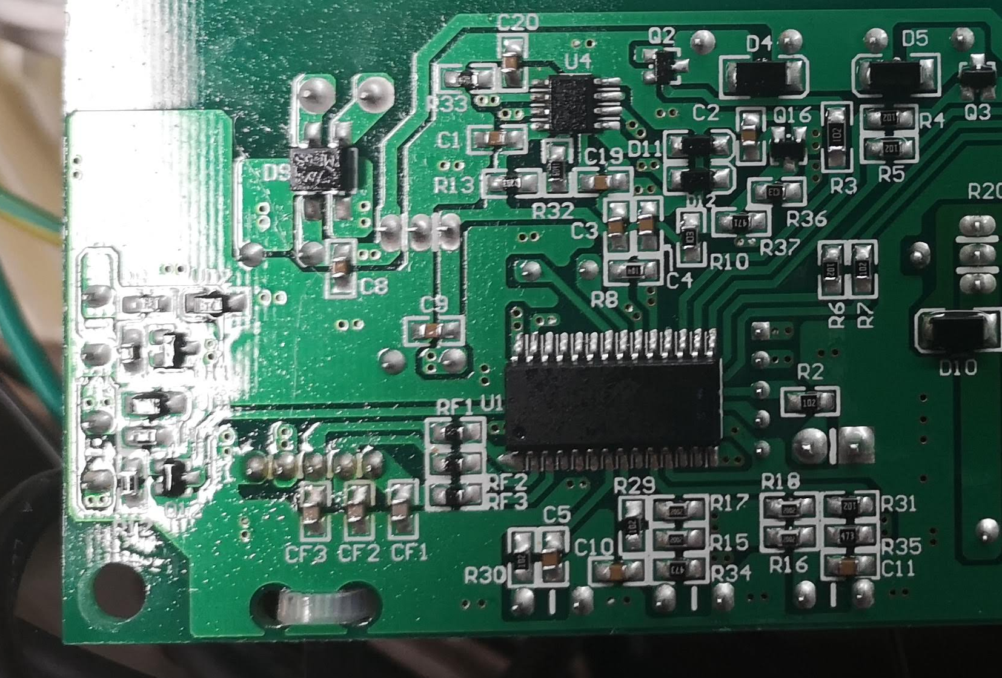
5V outputs
R3 : Water pump state (filtration)
R4 : Jet pump state (bubbles)
R5 : Heater state

Slide 2
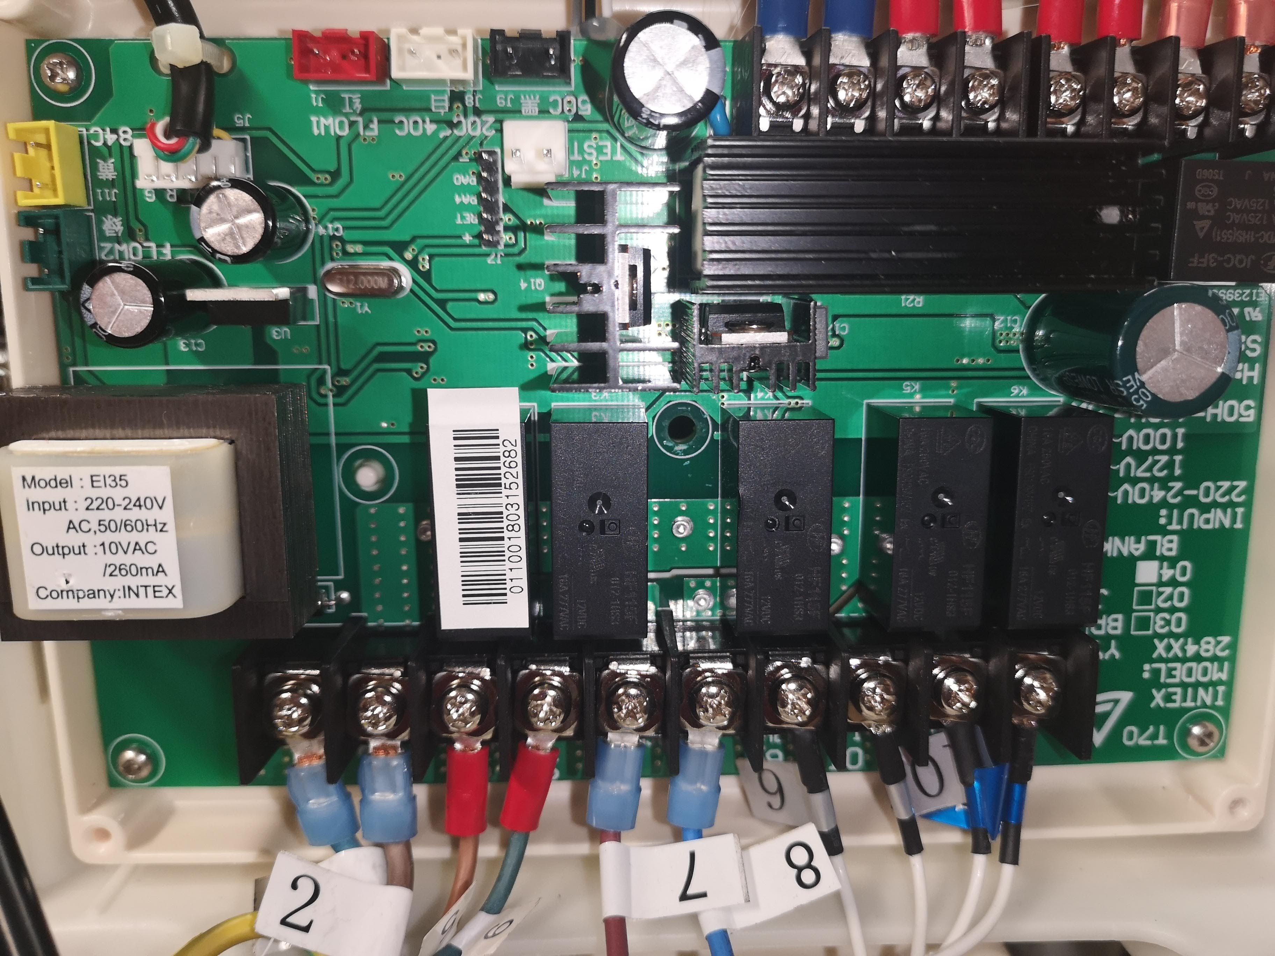
ESP8266 power supply location
GND
+5V

Slide 3
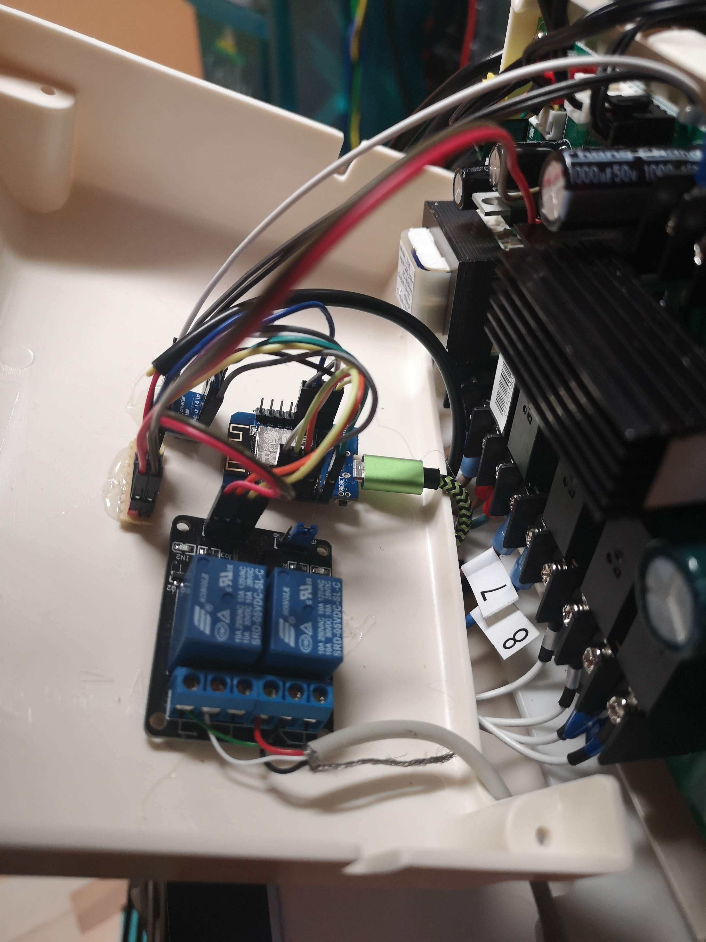
To main PCB outputs
3.3v/5v level converter
To DS18B20 (temp. Sensor)
Supply headers
+5V
ESP 8266 (Wemos D1 mini)
GND
2x relay board
To control PCB

