Slide 1
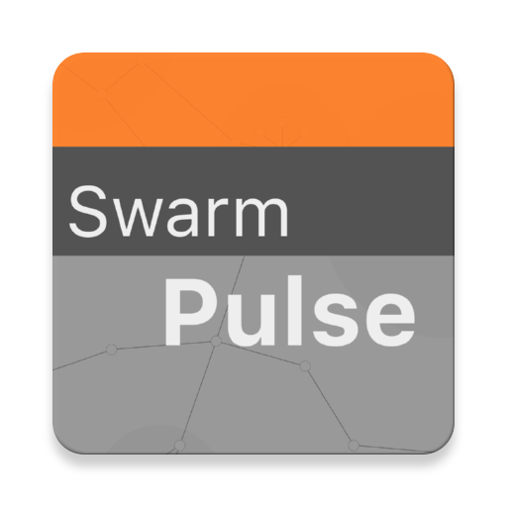
SwarmPulse mapping the world together….
www.Swarmpulse.net
author: prasad.pulikal@gess.ethz.ch

Slide 2
What is it?
Built as part of a research initiative at the ETH Zurich, Professorship of Computational Social Science (COSS)
Part of the Planetary Nervous System platform, a large-scale distributed research platform that provides real-time social sensing services as a public good
Allows users to visualize and anonymously share data and digital content (sensors values, media, web links etc.)
User generated content and data.

Slide 3
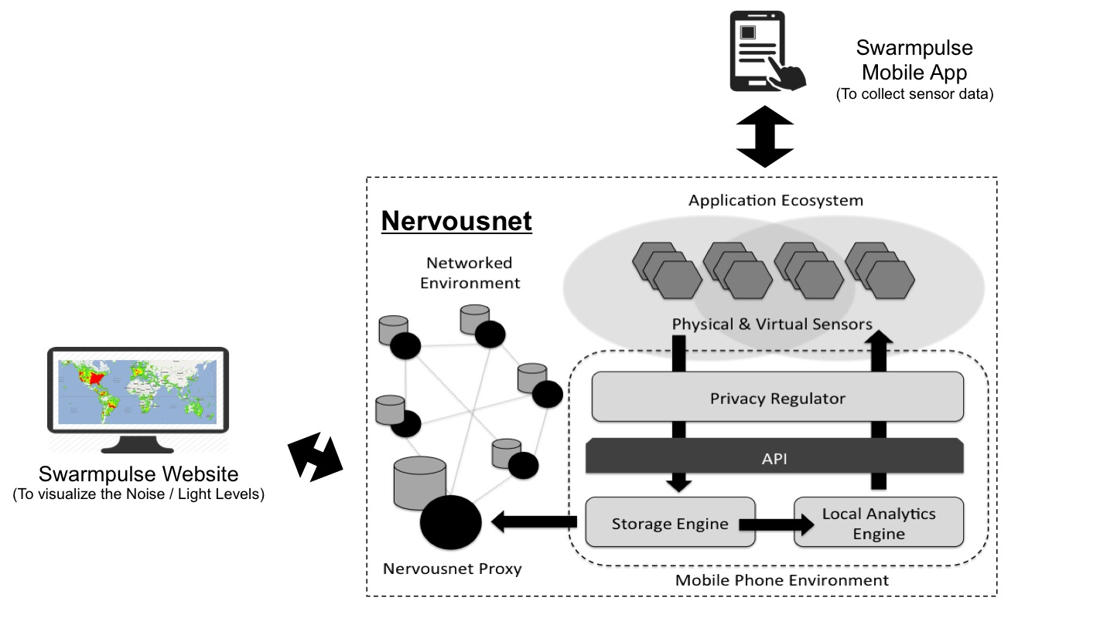
System Architecture

Slide 4
Features
Current
version 1.0
Real-time view
Visualize data as it is shared by users in real time.
Markers are cleared from the map after 5 minutes (300 seconds) to avoid the possibility of large amount of data being shown on the map.
Time-Machine
Go back in time to view data as was shared by users at specific times.
Time range is limited to 30 minutes window period from the start time chosen by the user.
Sensors
Light, Noise
Visualize light and noise levels at various geo locations.
Sharing
Text Message and web links.
Share links, favorites websites directly from external apps and browser on Android and iOS devices.
Data Retention
Allow for users to choose how long their data remains on the server.

Slide 5
Features
To be implemented
in version 2.0
Allow for sharing of images, audio and video clips of limited duration.
Rate Shared content.
Report inappropriate content. Auto Upload of Sensor data at specific time intervals.

Slide 6
How – to?
Mobile Client Download (Android & iOS):
On you mobile phone, use the download mobile app button in the right corner on the website at www.swarmpulse.net.
Visit the following URL on your :
Android phone / tablet:
https://play.google.com/store/apps/details?id=ch.ethz.coss.nervous.pulse
iPhone / iPad:
https://itunes.apple.com/us/app/swarmpulse/id1053129873?mt=8
Website for visualization:
View website at: www.swarmpulse.net

Slide 7
Limitations
Web Browsers limitations
Large amount of data (> 20000 markers) causes problems with the browser performance.
To avoid this Clusters have been used to group together markers that are close. This is useful to an extent i.e. 60000 markers.
Secondly the pulse of the system is set to 5 minutes, i.e. data is removed after 5 minutes in Real-Time view and in the Time-Machine view the results are limited to only 30 minutes from the start time chosen by the user.

Slide 8
Screenshots
Website & Mobile Client

Slide 9
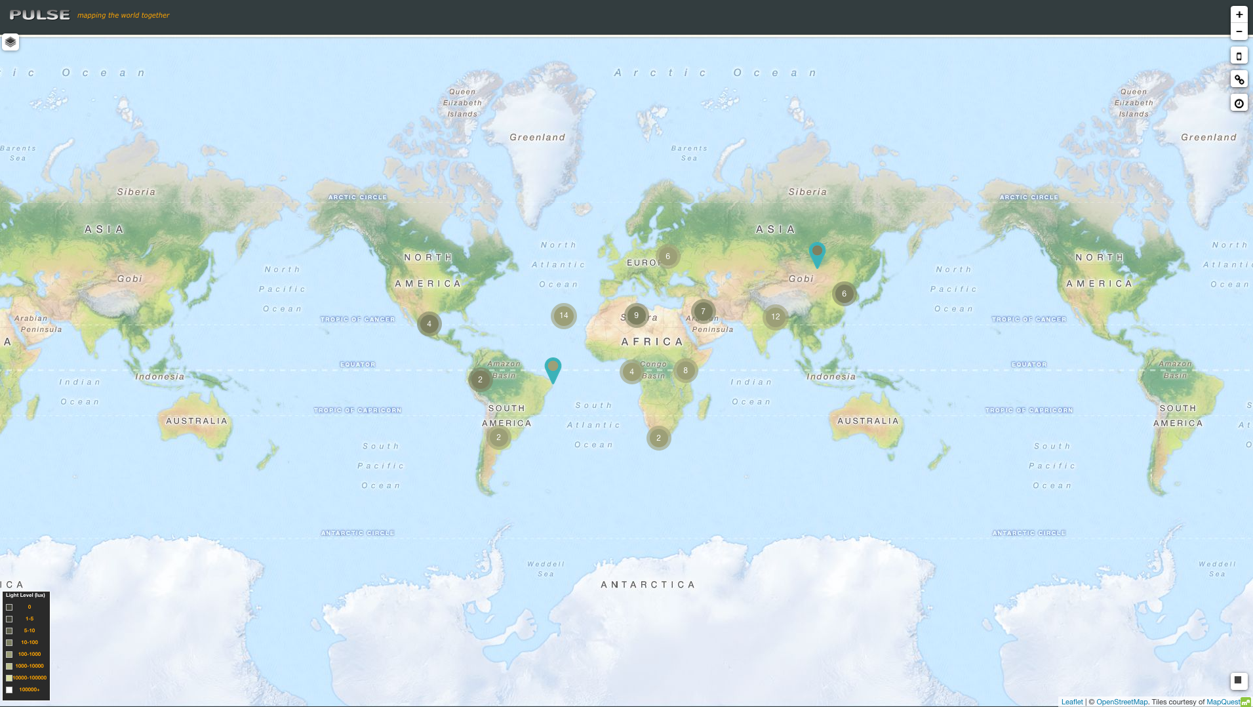

Slide 10
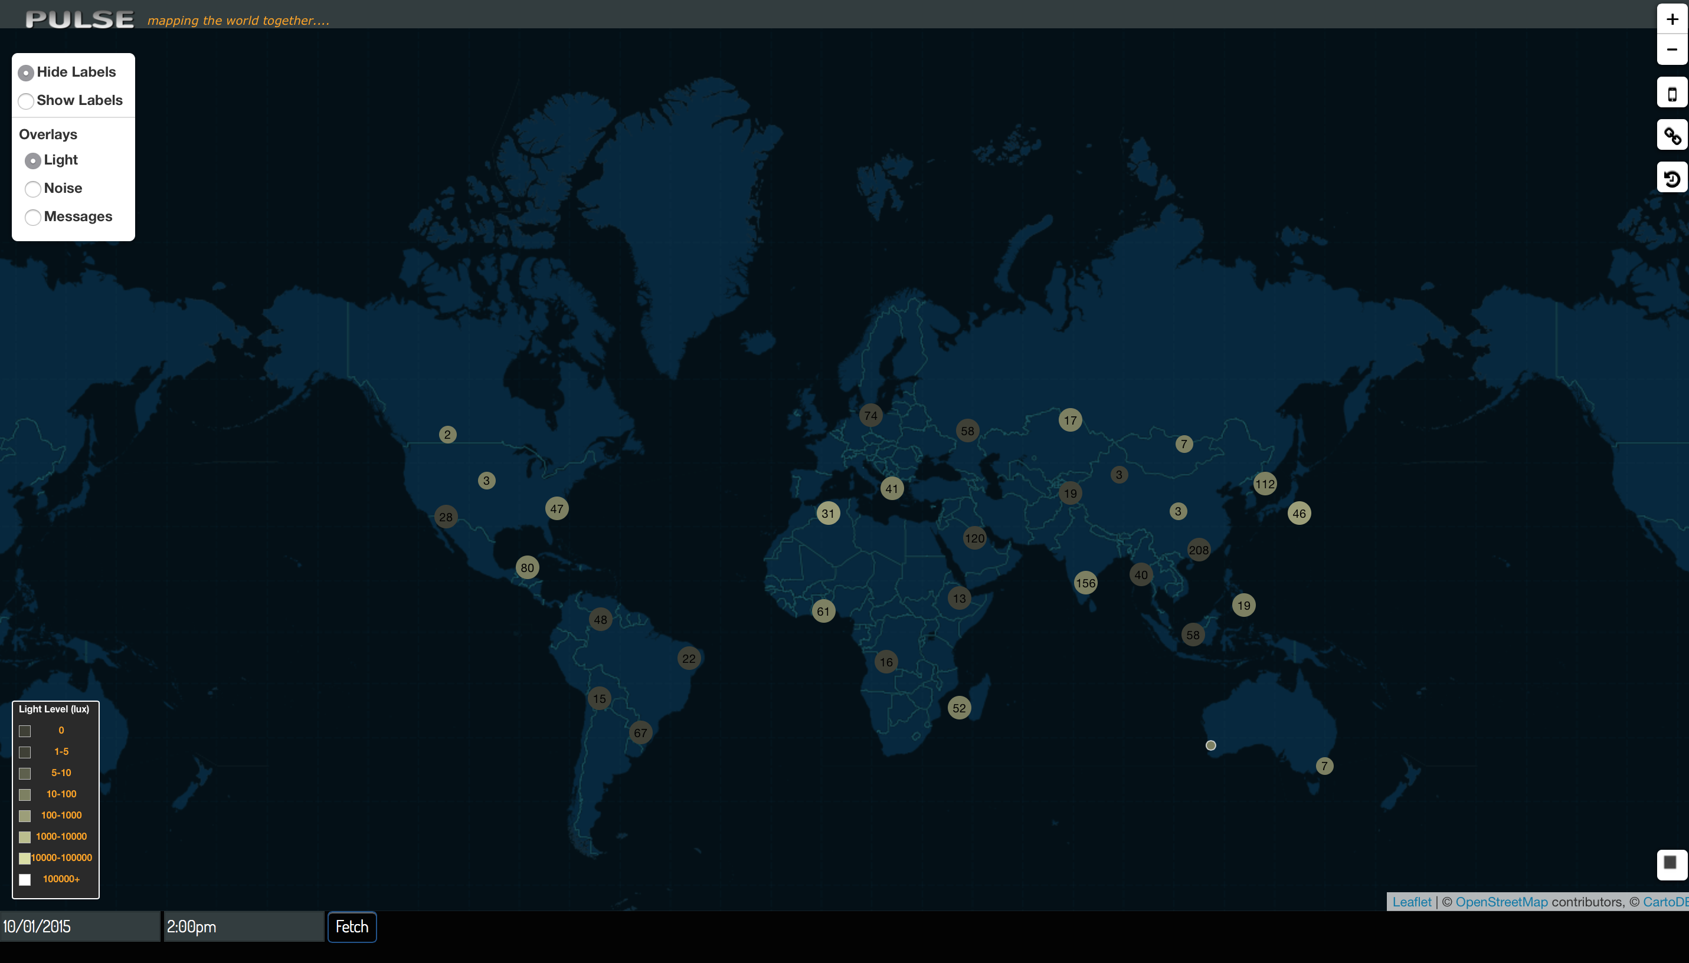

Slide 11
Download Mobile App button
Layers
Server Connection Status Indicator
Real-time or Time-Machine button / indicator
Sensor values & Colors
Time-Machine.
(Select Date & Time to visualize data from the past)

Slide 12
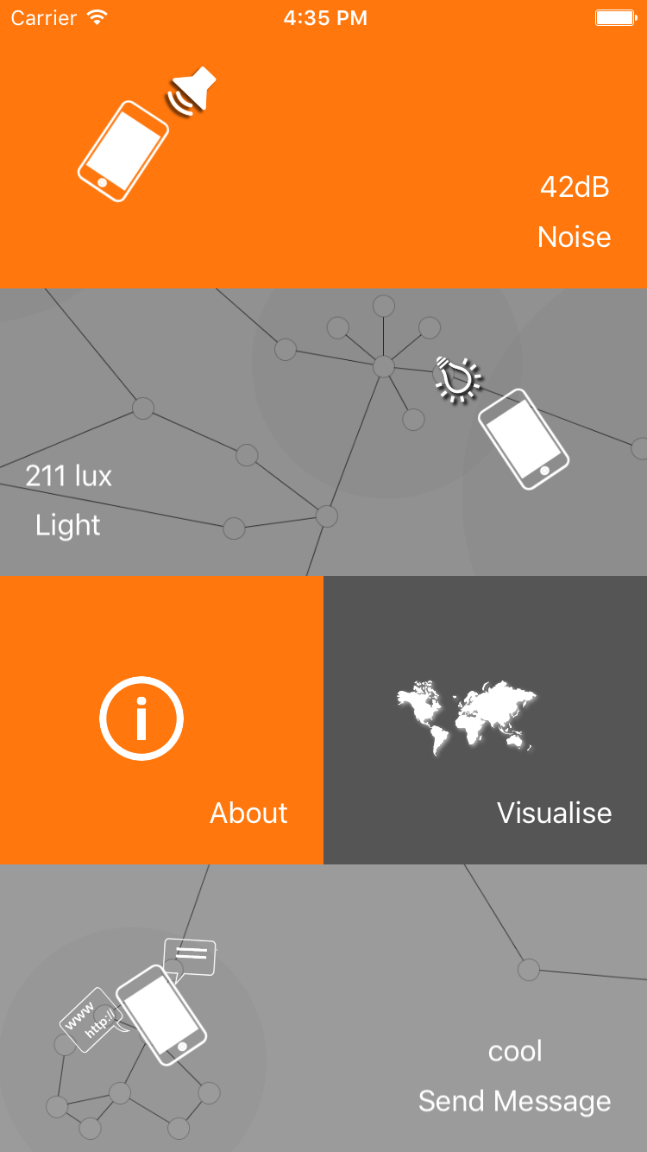
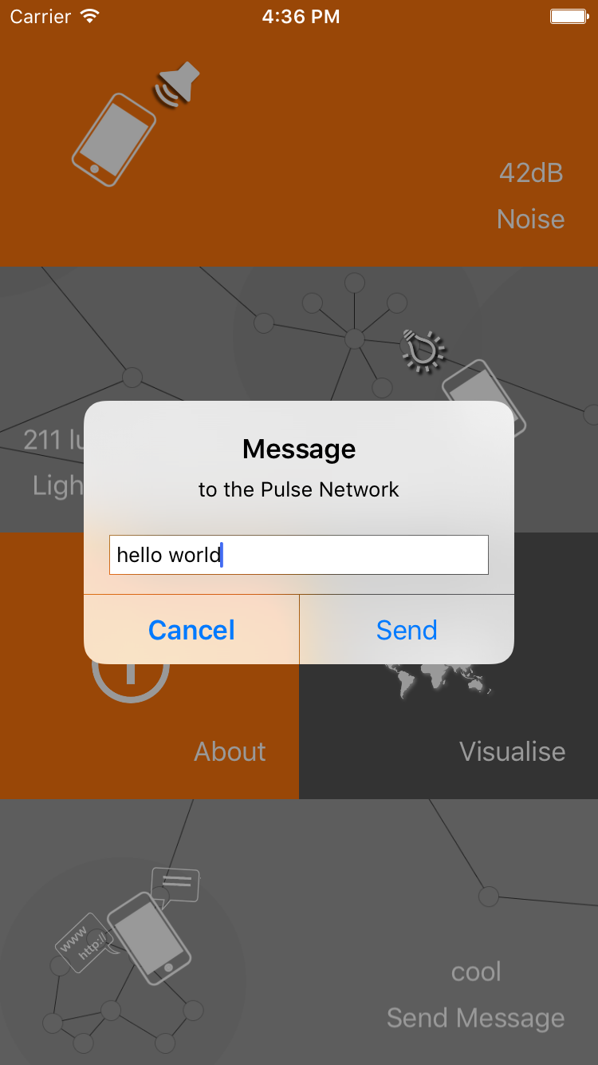
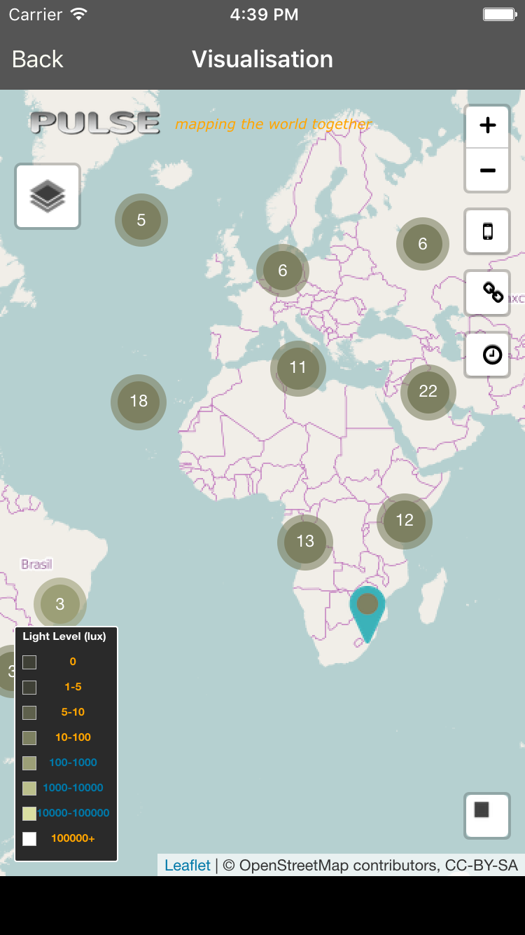

Slide 13
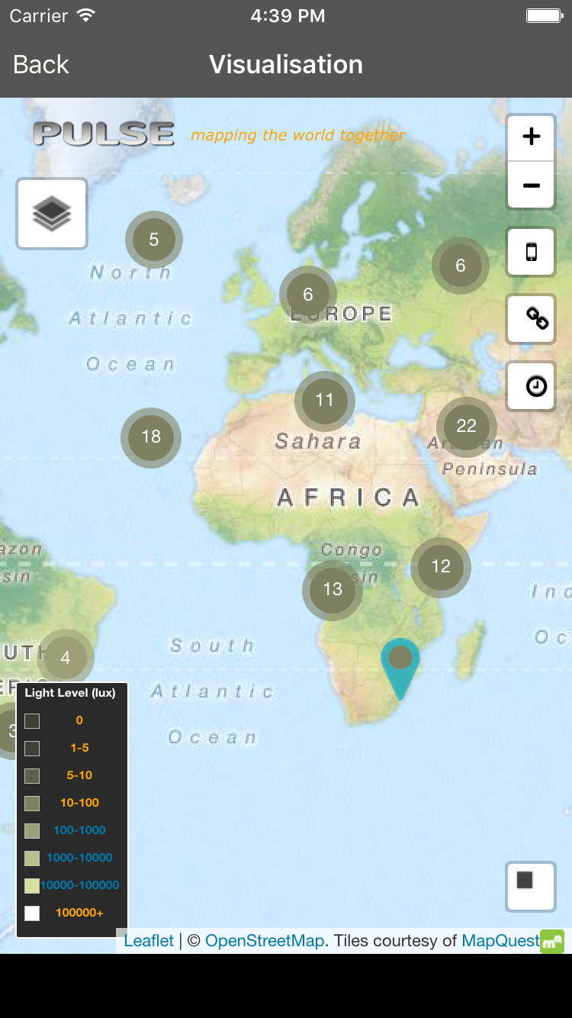
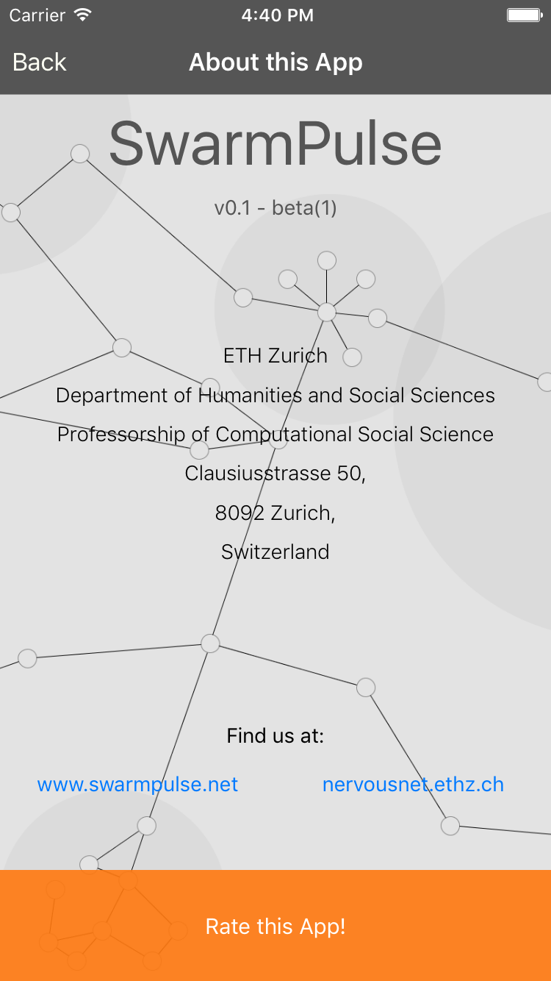

Slide 14
Sample Video
https://youtu.be/lU_3XKqWesE

