Slide 1
Evaluating Compositionality of Sentence
Representation Model
Group 11
Khadija-Tul-Kobra
ID:17301018
Farhan Shahoriar
ID:18101682
Avijit GHaramy
ID:19101519

Slide 2
Introduction
Language is inherently compositional
Shows the way human solve problems
Propose evaluation metrics for compositional understanding
Related work
semantic understanding (Ettinger et al.,2016),
lexical composition (Shwartz and Dagan,2019), synonym substitution
(Hupkes et al., 2020),
and divergence (Keysers et al., 2020)
Generalization
data efficiency
and interpretability.

Slide 3
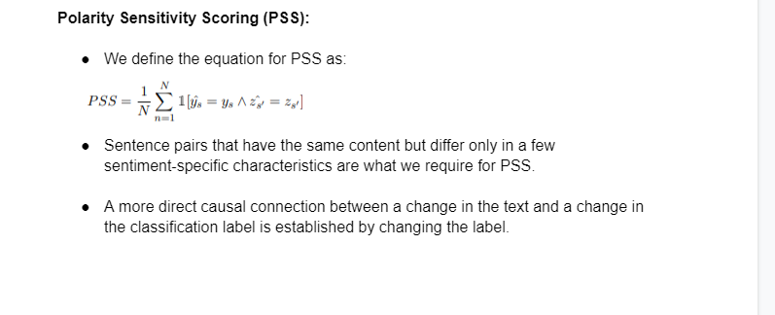

Slide 4
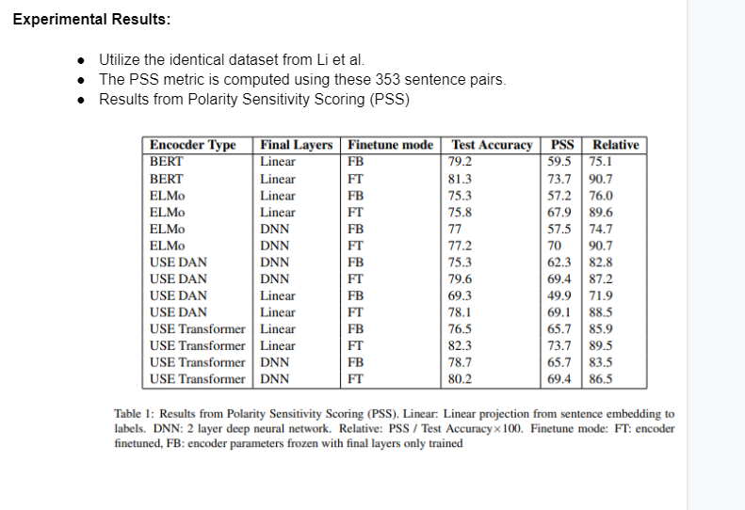

Slide 5
Tree Reconstruction Error (TRE)
Tree Impurity
To compute the Tree Impurity, we take the absolute difference between the root label and the average of all phrase labels within a tree.
Weighted Node Switching (WNS)
for every subtree where both children have a sentiment label, we calculate the absolute difference between the sentiment label of the root of the subtree and the average sentiment labels of its children.

Slide 6
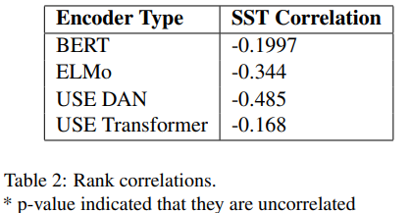
Experimental Results
Using TRE, they evaluated the compositionality of sentence representations from BERT (Devlin et al., 2019), ELMo (Peters et al., 2018), Universal Sentence Encoder (USE) deep averaging network (DAN) and USE Transformer (Cer et al., 2018).
The lower the value of TRE, the more compositional a given phrase or sentence is.

Slide 7
Discussion
PSS and TRE have differing results but could be measuring different types of compositionality:where TRE is more ontological and PSS is more functional
Similar phrases in vector space can have opposite effect on sentiment
PSS is the better metric to determine compositionality
Conclusion
contribution was proposing polarity switching as a possible measure of compositionality
For TRE came up with a heuristic approximation of a compositional score for a sentence

Slide 8
THANK YOU

