Slide 1



TEAM NAME:MASALA DOSA
WHERE AI MEETS SEAMLESS GOVERNANCE.
NAVA
TEAM MEMBERS:
NESARA HARISH
DEEPAK H D
NAYANA AILI
NISCHAY
PROLEM STATEMENT - 3. SIMPLIFYING COMPLEX GOVERNMENT SERVICES INTO ONE VERIFIED, PERSONALISED ROADMAP FOR EVERY CITIZEN.

Slide 2

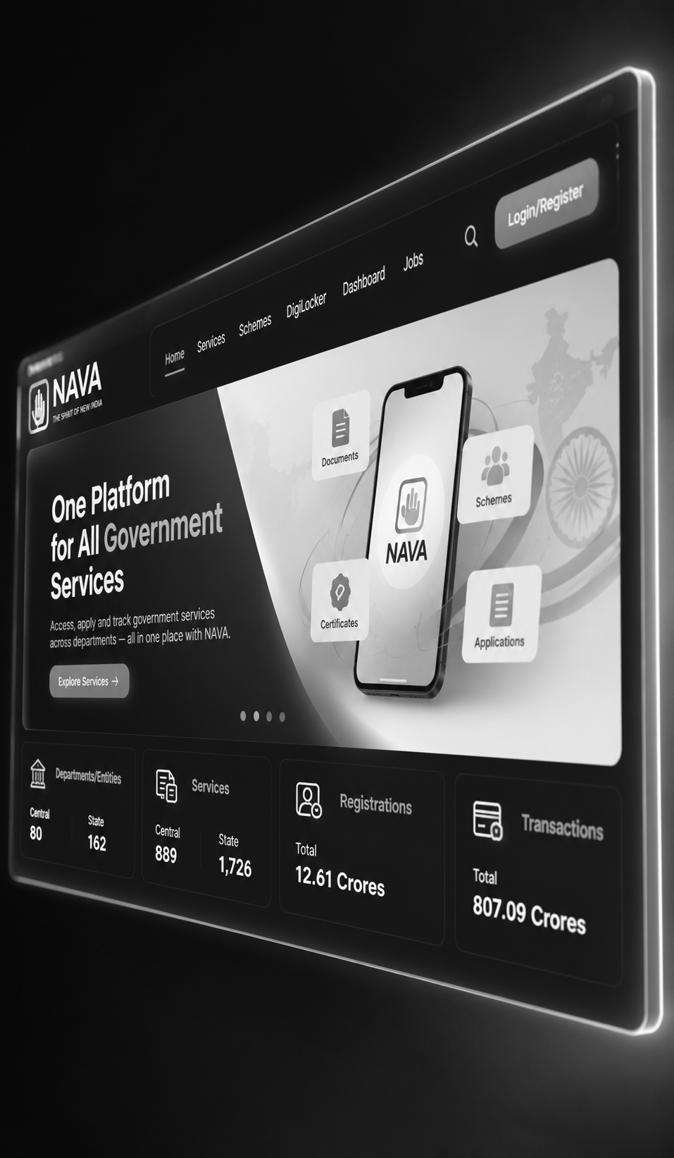
UNDERSTANDS CITIZEN NEEDS
VERIFIES GOVERNMENT SERVICES
ADAPTS TO CHANGES
MAPS SERVICE DEPENDENCIES
WHAT IS
NAVA?
NAVA (Navigation Assistant for Verified Access) is an AI-powered government service navigator that helps citizens find the right government services and converts their needs into verified, personalised, step-by-step action plans. It identifies service dependencies, handles changing circumstances, and guides citizens through complex government procedures without inventing requirements.

Slide 3





06
05
01
HOW NAVA WORKS
ADAPT & TRACK
UPDATES THE PLAN WHEN CIRCUMSTANCES CHANGE AND TRACKS THE CITIZEN'S PROGRESS.
GENERATE A PLAN
CREATES A PERSONALISED, STEP-BY-STEP ROADMAP WITH REQUIREMENTS, DEADLINES, AND OFFICIAL SOURCES.
UNDERSTAND
CITIZENS DESCRIBE THEIR NEEDS IN NATURAL LANGUAGE, INCLUDING VOICE INPUT.
From Citizen Needs to Clear Action Plans
04
02
03
CLARIFY
NAVA asks relevANT QUESTIONS TO UNDERSTAND THE CITIZEN'S SITUATION.
RECOGNITION
MAP DEPENDENCIES
Determines prerequisites, identifies conflicts, and orders dependent tasks.
DISCOVER
Identifies relevANT GOVERNMENT SERVICES USING A VERIFIED SERVICE RULEBOOK.
LEARNING MODELS

Slide 4
OUR VIEW

Slide 5
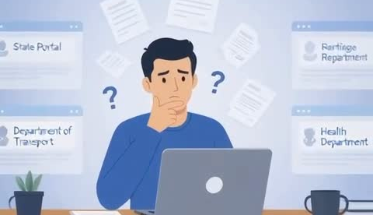

Slide 6





CHALLENGES
Citizens face complex procedures, fragmented information, and interconnected requirements when accessing government services.
UNVERIFIED INFORMATION
OUTDATED REQUIREMENTS AND CONFLICTING SERVICE DETAILS.
BIAS IN
COMPLEX DEPENDENCIES
UNCLEAR PREREQUISITES AND THE CORRECT ORDER OF APPLICATIONS.
FRAGMENTED SERVICES
INFORMATION SPREAD ACROSS MULTIPLE DEPARTMENTS AND PORTALS.
CHANGING CIRCUMSTANCES
LifE EVENTS CAN CHANGE REQUIREMENTS AND DISRUPT EXISTING PLANS

Slide 7

WHAT MAKES NAVA DIFFERENT?
NAVA goes beyond traditional government service portals by understanding citizens’ goals, identifying relevant services, mapping dependencies, and generating personalised, step-by-step action plans. It provides verified information, explains why each service is needed, and dynamically ada
pts recommendations when circumstances change.
WHAT MAKES NAVA DIFFERENT?
  Goal-Based Discovery: Identifies services based on citizens’ needs.
  Dependency Mapping: Connects services and identifies prerequisites.
  Personalised Action Plans: Creates clear, step-by-step roadmaps.
  Verified Information: Grounds recommendations in official sources.
  Dynamic Replanning: Adapts plans when circumstances change.
  Explainable Guidance: Explains why each service is needed and what to do next.

Slide 8
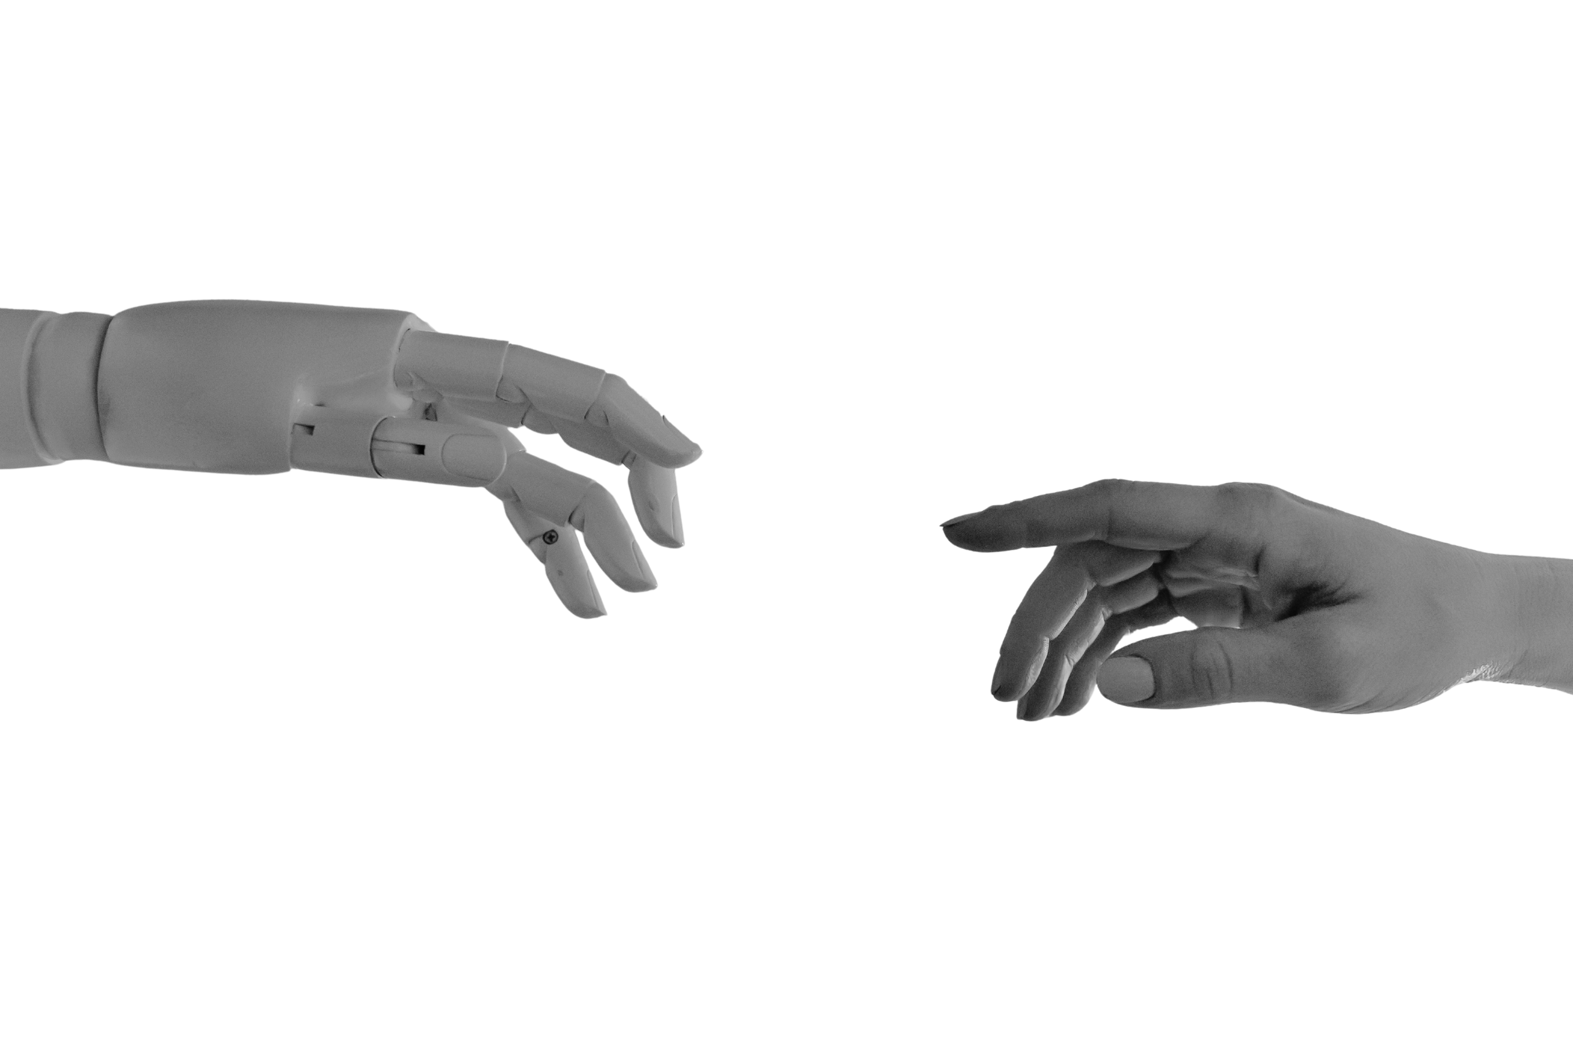


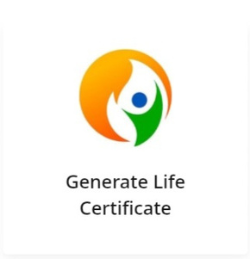
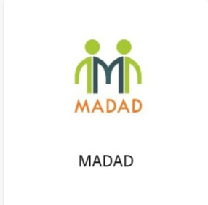


EXISTING SERVICES V/S NAVA

Slide 9



The Situation:
Priya moves from Karnataka to Andhra Pradesh after marriage and needs to update her surname and address across relevant official records.
How NAVA Helps:
UNDERSTANDS: Identifies the two changes—interstate relocation and surname change.
CLARIFIES: Asks which documents Priya holds, her new address, and which records need updating.
IDENTIFIES SERVICES: Finds relevant services for updating records, based on verified official requirements.
MAPS DEPENDENCIES: Determines which updates require supporting documents or must be completed first.
CREATES A ROADMAP: Organises the applications into a personalised sequence, showing required documents, official links, and dependencies.
ADAPTS: If Priya receives a new document midway, NAVA reassesses the remaining steps and updates her plan.
THE OUTCOME:
One coordinated, verified action plan instead of navigating multiple government departments without knowing what to do first.epartments without knowing what to do first.

Slide 10

FUTURE IMPACT
NAVA aims to transform government service navigation by simplifying complex procedures through verified information, personalised action plans, and intelligent dependency mapping. It will help citizens reduce confusion, avoid unnecessary delays, and make informed decisions while adapting to changing circumstances. By connecting citizens with the right services at the right time, NAVA envisions a more accessible, transparent, and citizen-centric government service experience.

Slide 11


