Slide 2
Introduction to IP Routing

Slide 3
Table of Contents
Routing Basics
IP Routing Process
Static and Dynamic Routing

Slide 4
Routing Basics
1

Slide 5
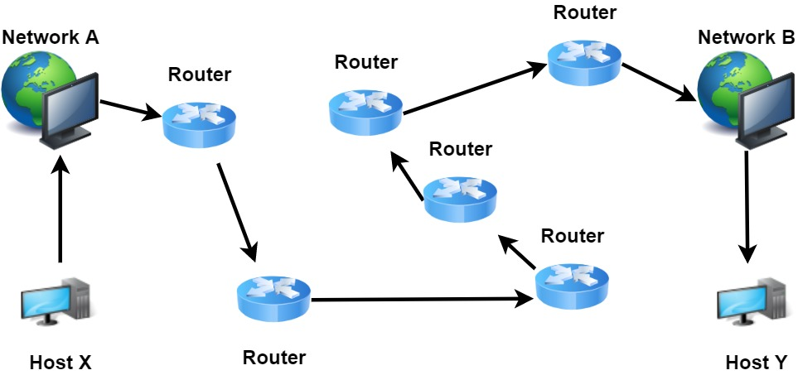
Routing Basics
IP routing is the process of sending packets from a host on one network to another host on a different remote network
This process is usually done by routers
Routers use routing tables
Routers don’t really care about hosts—they care only about networks and the best path to each network
Notes:
IP routing is the process of sending packets from a host on one network to another host on a different remote network.
This process is usually done by routers. Routers examine the destination IP address of a packet , determine the next-hop address, and forward the packet. Routers use routing tables to determine a next hop address to which the packet should be forwarded.
Routers don’t really care about hosts—they care only about networks and the best path to each network
Consider the example of IP routing: Host X wants to communicate with host Y, but host Y is on another network. Host X is configured to send all packets destined for remote networks to router R1. Router R1 receives the packets, examines the destination IP address and forwards the packet to the outgoing interface associated with the destination network.

Slide 6
Routing Basics
To be capable of routing packets, a router must know at least the following information:
Destination network address
Neighbor routers from which it can learn about remote networks
Possible routes to all remote networks
The best route to each remote network
How to maintain and verify routing information
Notes:
If your network has no routers, then it should be apparent that, well, you are not routing. But if you do have them, they’re there to route traffic to all the networks in your internetwork. To be capable of routing packets, a router must know at least the following information:
Destination network address
Neighbor routers from which it can learn about remote networks
Possible routes to all remote networks
The best route to each remote network
How to maintain and verify routing information

Slide 7
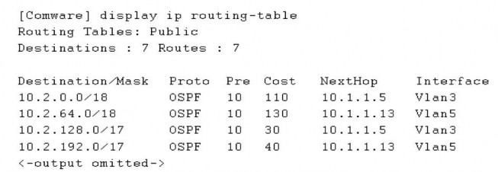
Routing Basics
Each router maintains a routing table
Routing table is used to determine the path to the destination network
Each routing table consists of:
Network destination and subnet mask
Remote router – IP address of the router
Outgoing interface
Notes:
Each router maintains a routing table and stores it in RAM. A routing table is used by routers to determine the path to the destination network. Each routing table consists of the following entries:
network destination and subnet mask – specifies a range of IP addresses.
remote router – IP address of the router used to reach that network.
outgoing interface – outgoing interface the packet should go out to reach the destination network.

Slide 8
IP Routing Process
2

Slide 9
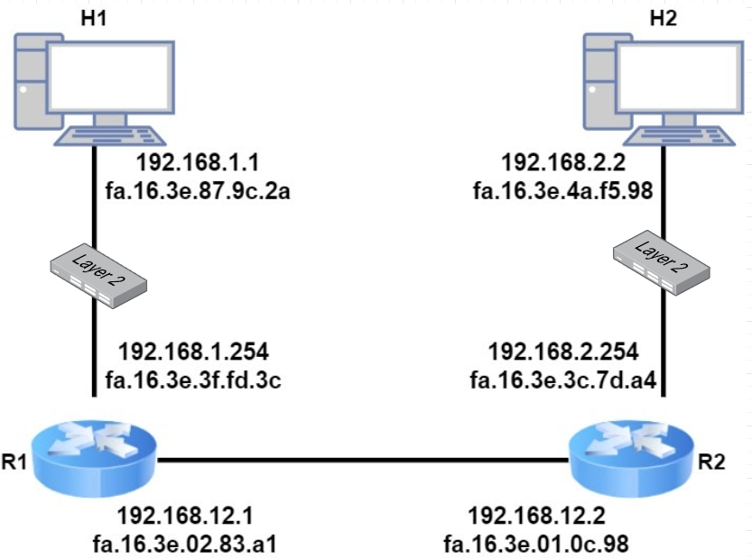
IP Routing Process
Notes:
We will walk through an example and show all the steps that occur. To do this, we will use the topology on the screen. In the diagram we have two host computers and two routers. H1 is going to send an IP packet to H2 which has to be routed by R1 and R2.

Slide 10
IP Routing Process
H1
IP Packet
Source:
192.168.1.1
Destination:
192.168.2.2
Data
Is the destination local or remote?
Looks own IP Address
and Subnet Mask
Network ID is 192.168.1
Destination is remote
C:\Users\H1>ipconfig
Windows IP Configuration
Ethernet adapter Ethernet 1:
Connection-specific DNS Suffix . : nwl.local
Link-local IPv6 Address . . . . . : fe80::88fd:962a:44d6:3a1f%4
IPv4 Address. . . . . . . . . . . : 192.168.1.1
Subnet Mask . . . . . . . . . . . : 255.255.255.0
Default Gateway . . . . . . . . . : 192.168.1.254
Notes:
Let’s start with H1. This host creates an IP packet with its own IP address (192.168.1.1) as the source and H2 (192.168.2.2) as the destination. The first question that H1 will ask itself is: Is the destination local or remote?
It answers this question by looking at its own IP address, its subnet mask, and the destination IP address:
H1 is in the network 192.168.1.0/24 so all IP addresses in the 192.168.1.1 – 254 range are local. Our destination (192.168.2.2) is outside of the local subnet so that means we have to use the default gateway.

Slide 11
IP Routing Process
H1
The destination host is on another network, so I have to build an ethernet frame but do I know the destination MAC address of the default gateway?
Checks ARP Table
C:\Users\H1>arp -a
Interface: 192.168.1.1 --- 0x4
Internet Address Physical Address Type
192.168.1.254 fa-16-3e-3f-fd-3c dynamic
192.168.1.255 ff-ff-ff-ff-ff-ff static
224.0.0.22 01-00-5e-00-00-16 static
224.0.0.251 01-00-5e-00-00-fb static
224.0.0.252 01-00-5e-00-00-fc static
239.255.255.250 01-00-5e-7f-ff-fa static
Ethernet Frame
Source:
FA16.3E87.9C2A
Destination:
FA16.3E3F.FD3C
Source:
192.168.1.1
Destination:
192.168.2.2
Data
Notes:
H1 will now build an Ethernet frame, enters its own source MAC address and asks itself the second question, do I know the destination MAC address of the default gateway?
It checks its ARP (Address Resolution Table) table to find the answer. H1 has an ARP entry for 192.168.1.254. If not, it would have sent an ARP request. We now have an Ethernet frame that carries an IP packet with the following addresses:

Slide 12
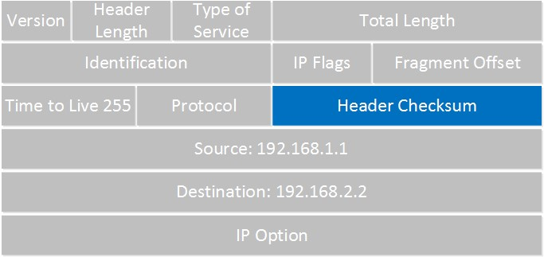
IP Routing Process
R1
I just received a frame. First, let’s check if Frame Check Sequence (FCS) is correct or not.
FCS is wrong!
FCS is correct! Process the frame
Drop the frame
(No error recovery)
Preamble
SFD
Destination
Source
Type
IP Packet
FCS
Check destination MAC Address
The frame is addressed to me.
I need to de-encapsulate the IP packet.
Notes:
This Ethernet frame makes it to R1 which has more work to do than our host. The first thing it does is check if the FCS (Frame Check Sequence) of the Ethernet frame is correct or not.
If the FCS is incorrect, the frame is dropped right away. There is no error recovery for Ethernet, this is something that is done by protocols on upper layers, like TCP on the transport layer.
If the FCS is correct, we will process the frame if:
The destination MAC address is the address of the interface of the router. The destination MAC address is a broadcast address of the subnet that the router interface is connected to. The destination MAC address is a multicast address that the router listens to.
In this case, the destination MAC address matches the MAC address of R1 so we will process it. We de-encapsulate (extract) the IP packet out of the Ethernet frame which is then discarded.

Slide 13
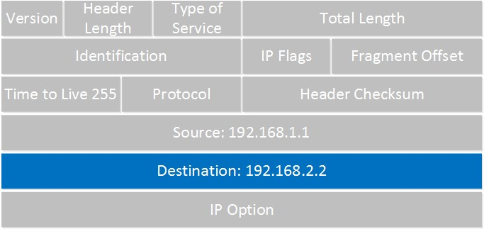
IP Routing Process
R1
Checksum is wrong!
Drop the IP packet
(No error recovery)
Checksum is correct! Look at destination
address
Notes:
The router will now look at the IP packet, and the first thing it does is check if the header checksum is OK:
If the header checksum is not correct, the IP packet is dropped right away. There is also no error recovery on the network layer, we rely on upper layers for this. If the header checksum is correct, we continue by looking at the destination IP address.

Slide 14
IP Routing Process
R1
Check routing table if destination address matches any
R1#show ip route
Gateway of last resort is not set
192.168.1.0/24 is variably subnetted, 2 subnets, 2 masks
C 192.168.1.0/24 is directly connected, GigabitEthernet0/1
L 192.168.1.254/32 is directly connected, GigabitEthernet0/1
S 192.168.2.0/24 [1/0] via 192.168.12.2
192.168.12.0/24 is variably subnetted, 2 subnets, 2 masks
C 192.168.12.0/24 is directly connected, GigabitEthernet0/2
L 192.168.12.1/32 is directly connected, GigabitEthernet0/2
Notes:
The router will now look at the IP packet, and the first thing it does is check if the header checksum is OK:
If the header checksum is not correct, the IP packet is dropped right away. There is also no error recovery on the network layer, we rely on upper layers for this. If the header checksum is correct, we continue by looking at the destination IP address.
Above you can see that R1 knows how to reach the 192.168.2.0/24 network, the next-hop IP address is 192.168.12.2. It will now do a second routing table lookup to see if it knows how to reach 192.168.12.2, we call this recursive routing. As you can see, there is an entry for 192.168.12.0/24.

Slide 15
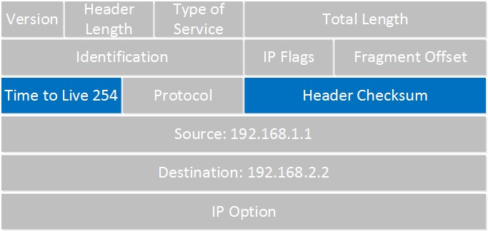
IP Routing Process
R1
Decrease TTL by 1
Check ARP table if destination address (192.168.12.2) matches any
R1#show ip arp
Protocol Address Age (min) Hardware Addr Type Interface
Internet 192.168.1.1 58 fa16.3e87.9c2a ARPA GigabitEthernet0/1
Internet 192.168.1.254 - fa16.3e3f.fd3c ARPA GigabitEthernet0/1
Internet 192.168.12.1 - fa16.3e02.83a1 ARPA GigabitEthernet0/2
Internet 192.168.12.2 95 fa16.3e01.0c98 ARPA GigabitEthernet0/2
Notes:
There is one thing left to do with the IP packet before we can forward it. Since we are routing it, we have to decrease the TTL (Time to Live) field by one. R1 will do this and since this changes the IP header, we have to calculate a new header checksum.
Once this is done, R1 checks its ARP table to see if there is an entry for 192.168.12.2.
No problem there, we have an entry in the ARP table. If not, R1 will send an ARP request to find the MAC address of 192.168.12.2.

Slide 16
IP Routing Process
R1
Build a new frame and send to R2
R2
Check the FCS of the Ethernet frame
De-encapsulate the IP packet, discard the frame
Check the IP header checksum
Check the destination IP address
Source:
FA16.3E02.83A1
Destination:
FA16.3E01.0C98
Source:
192.168.1.1
Destination:
192.168.2.2
Data
Notes:
R1 builds a new Ethernet frame with its own MAC address of the GigabitEthernet 0/2 interface and R2 as the destination. The IP packet is then encapsulated in this new Ethernet frame. And the frame will be on its way towards R2.

Slide 17
IP Routing Process
R2 Check its routing table for destination IP address
Source:
FA16.3E87.9C2A
Destination:
FA16.3E01.0C98
Source:
192.168.1.1
Destination:
192.168.2.2
Data
R2#show ip route
S 192.168.1.0/24 [1/0] via 192.168.12.1
192.168.2.0/24 is variably subnetted, 2 subnets, 2 masks
C 192.168.2.0/24 is directly connected, GigabitEthernet0/1
L 192.168.2.254/32 is directly connected, GigabitEthernet0/1
192.168.12.0/24 is variably subnetted, 2 subnets, 2 masks
C 192.168.12.0/24 is directly connected, GigabitEthernet0/2
L 192.168.12.2/32 is directly connected, GigabitEthernet0/2
Decrease TTL to 253 and check the ARP table if destination address (192.168.2.2) matches any
R2#show ip arp
Protocol Address Age (min) Hardware Addr Type Interface
Internet 192.168.2.2 121 fa16.3e4a.f598 ARPA GigabitEthernet0/1
Internet 192.168.2.254 - fa16.3e3c.7da4 ARPA GigabitEthernet0/1
Internet 192.168.12.1 111 fa16.3e02.83a1 ARPA GigabitEthernet0/2
Internet 192.168.12.2 - fa16.3e01.0c98 ARPA GigabitEthernet0/2
Notes:
There is one thing left to do with the IP packet before we can forward it. Since we are routing it, we have to decrease the TTL (Time to Live) field by one. R1 will do this and since this changes the IP header, we have to calculate a new header checksum.
Once this is done, R1 checks its ARP table to see if there is an entry for 192.168.12.2.
No problem there, we have an entry in the ARP table. If not, R1 will send an ARP request to find the MAC address of 192.168.12.2.
Network 192.168.2.0/24 is directly connected to R2 on its GigabitEthernet 0/1 interface. R2 will now reduce the TTL of the IP packet from 254 to 253, recalculate the IP header checksum and checks its ARP table to see if it knows how to reach 192.168.2.2. There is an ARP entry there.

Slide 18
IP Routing Process
R2
Build a new frame and send to H2
H2
Checks the FCS
Finds its own MAC address as the destination MAC address
De-encapsulates the IP packet from the frame
Finds its own IP address as the destination in the IP packet
Source:
FA16.3E3C.7DA4
Destination:
FA16.3E4A.F598
Source:
192.168.1.1
Destination:
192.168.2.2
Data
Notes:
The new Ethernet frame is created, the IP packet encapsulated and it has the following addresses.
H2 receives the Ethernet frame and will:
Check the FCS
Find its own MAC address as the destination MAC address.
De-encapsulates the IP packet from the frame.
Finds its own IP address as the destination in the IP packet.
H2 then looks for the protocol field to figure out what transport layer protocol we are dealing with, what happens next depends on the transport layer protocol that is used.

Slide 19
IP Routing Process
The host has a simple decision to make:
Is the destination on the local network?
Check ARP table for destination IP address, if empty, send an ARP request.
Is the destination on a remote network?
Check ARP table for default gateway IP address, if empty, send an ARP request.
Notes:
Let’s summarize this process.
The host has a simple decision to make:
Is the destination on the local subnet?
Check ARP table for destination IP address, if empty, send an ARP request.
Is the destination on a remote subnet?
Check ARP table for default gateway IP address, if empty, send an ARP request.
The router has to perform a number of tasks:

Slide 20
IP Routing Process
The router has to perform a number of tasks:
When it receives an Ethernet frame, checks if the FCS is correct. If not, drops the frame
Checks if the destination address of the frame is:
destined to router’s MAC address
destined to a broadcast address of the network router’s interface is in
destined to a multicast address that the router listens to
De-encapsulates the IP packet from the frame, discard the Ethernet frame
Looks for a match in the routing table for the destination IP address, figures out what the outgoing interface and optionally, the next hop IP address is
Decreases the TTL field in the IP header, recalculates the header checksum
Encapsulates the IP packet in a new Ethernet frame
Checks the ARP table for the destination IP address or next hop IP address
Transmits the frame
Notes:
The router has to perform a number of tasks:
When it receives an Ethernet frame, check if the FCS (Frame Check Sequence) is correct. If not, drop the frame.
Check if the destination address of the frame is:
destined to our MAC address
destined to a broadcast address of the subnet our interface is in.
destined to a multicast address that we listen to.
De-encapsulate the IP packet from the frame, discard the Ethernet frame.
Look for a match in the routing table for the destination IP address, figure out what the outgoing interface and optionally, the next hop IP address is.
Decrease the TTL (Time to Live) field in the IP header, recalculate the header checksum.
Encapsulate the IP packet in a new Ethernet frame.
Check the ARP table for the destination IP address or next hop IP address.
Transmit the frame.

Slide 21
IP Routing Flow Chart - Remote Network
H1
R1
R2
H2
FCS OK?
FCS OK?
FCS OK?
Remote Network?
Recursive lookup for next hop
Reduce TTL by 1
Valid MAC?
Reduce TTL by 1
Extract IP Packet
Get MAC for destination
MAC for Router?
Verify Destination MAC Address
N
ARP Request for MAC address
Get MAC for next hop
Header checksum OK?
Re-create & Send Ethernet Frame
Extract IP packet
Extract IP Packet
Create & Send Ethernet Frame
Re-create & Send Ethernet Frame
Header checksum OK?
Verify local IP and get MAC
Verify destination IP

Slide 22
Static and Dynamic Routing
3

Slide 23
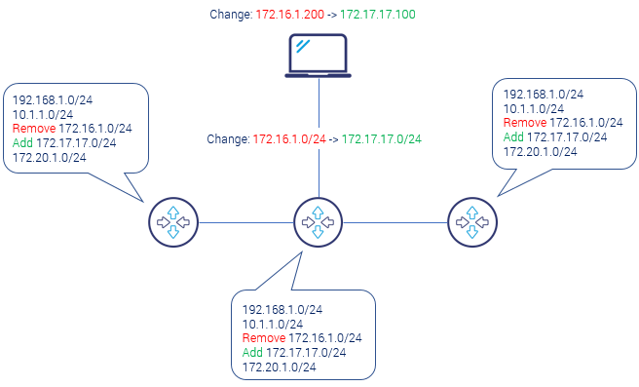
Static and Dynamic Routing
How routers know the IP destinations?
In static routing (or non-adaptive) routing, tables created and updated manually
Notes:
Static Routing:
How routers know the IP destinations? One way to achieve full information is to tell the router manually about specific destination. This process of telling about specific destination by the human is called static routing information. Setting the single static route is very quick administrative task. But take a note that when deciding to go with static routing solution, network admin is responsible for informing every router about:
every change in topology,
every new prefix,
every prefix removal
So in our picture if there is only one change of IP subnet address from 172.16.1.0/24 to 172.17.17.0/24, administrator needs to make six operations: remove old prefix, put the new one, and make it three times.

Slide 24
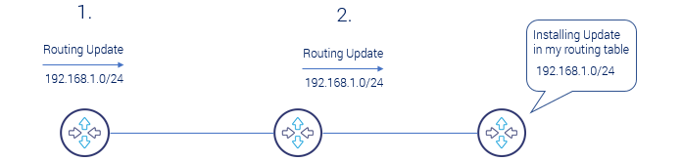
Static and Dynamic Routing
In dynamic routing (or adaptive) routing, tables created and updated automatically using routing protocols
Dynamic routing is used in larger networks
Finds the optimal route (fastest path)
Reacts to topology changes and failures, recalculates optimal path
Notes:
Now, imagine that your network consists of 100 routers and you have to add only 2 new different subnets to the network because there is an opening of new office in your company. You would need to add 200 static routing entries. Imagine another example that there is Internet routing change with thousands of routers managed by different Internet Service Providers and routing tables have over 600 000 prefixes.
Dynamic routing is used for larger networks. With dynamic routing there is an automatic process running between all routers. The process is called routing protocol and is designed to
exchange IP prefixes between routers,
find the optimal (shortest) path to destination,
speed up the process of administrative tasks
react to topology changes and failures and recalculate optimal path

Slide 25
Static and Dynamic Routing
Static | Dynamic
Routes are user defined | Routes are updated according to the topology
Does not use complex routing algorithms | Uses complex routing algorithms
Provides high or more security | Provides less security
Manual | Automated
Implemented in small networks | Implemented in large networks
Additional resources are not required | Additional resources are required

Slide 26
THANKS!
Any questions?

