Slide 2
IP Subnetting

Slide 3
Table of Contents
Subnetting Basics

Slide 4
Subnetting Basics
1

Slide 5
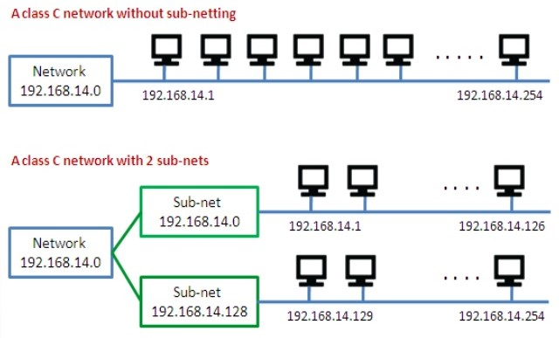
Subnetting Basics
The process of taking an extensive network and splitting into smaller networks is known as subnetting
Notes:
During the early stages of the internet, organizations assigned IP addresses like crazy until we nearly ran out. Luckily, the designers of IP addressing came up with a way to end this wasteful practice: Dividing networks using subnetting.
The process of taking an extensive network and splitting into smaller networks is known as subnetting — and it’s freeing up more public IPv4 addresses.

Slide 6
Subnetting Basics
Why to use subnetting?
Reduced Network Traffic
Optimized Network Performance
Simplified Management - Easier to identify and isolate network problems
Facilitated Spanning of Large Geographical Distances - Connecting multiple smaller networks makes the system more efficient
Notes:
There are loads of reasons in favor of subnetting, including the following benefits:
Reduced Network Traffic - We all appreciate less traffic in networks. Without trusty routers, packet traffic could grind the entire network down to a near standstill. With routers, most traffic will stay on the local network; only packets destined for other networks will pass through the router. Routers create broadcast domains. The more broadcast domains you create, the smaller the broadcast domains and the less network traffic on each network segment.
Optimized Network Performance
Simplified Management - It’s easier to identify and isolate network problems in a group of smaller connected networks than within one gigantic network.
Facilitated Spanning of Large Geographical Distances - Because WAN links are considerably slower and more expensive than LAN links, a single large network that spans long distances can create problems in every area previously listed. Connecting multiple smaller networks makes the system more efficient.

Slide 7
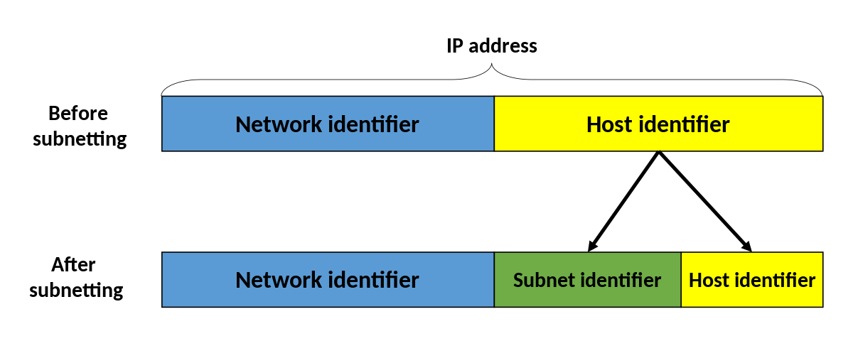
Subnetting Basics
IPv4 address is divided into network ID and host ID by using octets
In subnetting we can borrow some bits from host ID to use as subnetwork

Slide 8
Subnetting Basics
Subnetting IPv4 Address:
A Class A, B, or C TCP/IP network can be further divided, or subnetted, by a system administrator
For example, you have 150 hosts on three networks that are connected by a router
You are allocated a Class C address:
You can use from to
(Just remember that the first and last address in any network or subnet cannot be assigned to any individual host, so you cannot use 192.168.123.0 and 192.168.123.255)
192.168.123
Network ID
.0
Host ID
192.168.123
.1
192.168.123
.254
Notes:
A Class A, B, or C TCP/IP network can be further divided, or subnetted, by a system administrator. This becomes necessary as you reconcile the logical address scheme of the Internet (the abstract world of IP addresses and subnets) with the physical networks in use by the real world.
A system administrator who is allocated a block of IP addresses may be administering networks that are not organized in a way that easily fits these addresses. For example, you have a wide area network with 150 hosts on three networks (in different cities) that are connected by a TCP/IP router. Each of these three networks has 50 hosts. You are allocated the class C network 192.168.123.0. This means that you can use the addresses 192.168.123.1 to 192.168.123.254 for your 150 hosts.
Two addresses that cannot be used in our example are 192.168.123.0 and 192.168.123.255 because binary addresses with a host portion of all ones and all zeros are invalid. The zero address is invalid because it is used to specify a network without specifying a host. The 255 address (in binary notation, a host address of all ones) is used to broadcast a message to every host on a network. Just remember that the first and last address in any network or subnet cannot be assigned to any individual host.

Slide 9
Subnetting Basics
Subnetting IPv4 Address:
With the allocated Class C IP address we can map 254 hosts on one network
But our 150 hosts are located 0n three separate networks
Instead of requesting more address blocks for each network, we can divide our block into three subnets
But how?
Notes:
You should now be able to give IP addresses to 254 hosts. This works fine if all 150 computers are on a single network. However, your 150 computers are on three separate physical networks. Instead of requesting more address blocks for each network, you divide your network into subnets that enable you to use one block of addresses on multiple physical networks.

Slide 10
Subnetting Basics
Subnetting IPv4 Address:
Remember we can create subnets by borrowing bits from Host ID
We need 3 subnets in total, so if we borrow 1 bit we will get 2 subnets which is not enough
So we need more bits, if we borrow 2 bits we will get 4 subnets and our subnet mask will be:
11111111.11111111.11111111.11000000 255.255.255.192
Notes:
In this case, you divide your network into four subnets by using a subnet mask that makes the network address larger and the possible range of host addresses smaller. In other words, you are 'borrowing' some of the bits usually used for the host address, and using them for the network portion of the address.

Slide 11
Subnetting Basics
Subnetting IPv4 Address:
Since we borrowed 2 bits, there are only 6 bits left for Host ID which makes 2⁶ - 2 = 62 hosts (first and last numbers are reserved)
Our company has 3 networks and 50 hosts on each network
We have 4 subnets, and 62 host IDs for each subnet (that means 1 subnet with 62 host IDs will be reserved for future use)
Notes:
The subnet mask 255.255.255.192 gives you four networks of 62 hosts each. This works because in binary notation, 255.255.255.192 is the same as 1111111.11111111.1111111.11000000. The first two digits of the last octet become network addresses, so you get the additional networks 00000000 (0), 01000000 (64), 10000000 (128) and 11000000 (192). In these four networks, the last 6 binary digits can be used for host addresses.

Slide 12
Subnetting Basics
Subnetting IPv4 Address:
Using subnet mask 255.255.255.192, our 192.168.123.0 network will become 4 networks:
192.168.123.0
192.168.123.64
192.168.123.128
192.168.123.192
Valid host addresses will be:
192.168.123.1-62 192.168.123.129-190
192.168.123.65-126 192.168.123.193-254
(Remember, again, that binary host addresses with all 1s or all 0s are reserved, so you cannot use addresses with the last octet of 0, 63, 64, 127, 128, 191, 192, and 255)
11111111.11111111.11111111.00
000000
11111111.11111111.11111111.01
000000
11111111.11111111.11111111.10
000000
11111111.11111111.11111111.11
000000
Notes:
Using a subnet mask of 255.255.255.192, your 192.168.123.0 network then becomes the four networks 192.168.123.0, 192.168.123.64, 192.168.123.128 and 192.168.123.192. These four networks would have as valid host addresses:
192.168.123.1-62
192.168.123.65-126
192.168.123.129-190
192.168.123.193-254
Remember, again, that binary host addresses with all ones or all zeros are invalid, so you cannot use addresses with the last octet of 0, 63, 64, 127, 128, 191, 192, or 255.

Slide 13
Subnetting Basics
Let’s see how this works:
Assume we have two IP addresses:
192.168.123.71 and 192.168.123.133
If we used default subnet mask of Class C which is 255.255.255.0 both addresses should be on the same network
However we use subnet mask of 255.255.255.192 so
192.168.123.71 host will be on the 192.168.123.64 network
192.168.123.133 host will be on the 192.168.123.128 network
Well done!
Notes:
You can see how this works by looking at two host addresses, 192.168.123.71 and 192.168.123.133. If you used the default Class C subnet mask of 255.255.255.0, both addresses are on the 192.168.123.0 network. However, if you use the subnet mask of 255.255.255.192, they are on different networks; 192.168.123.71 is on the 192.168.123.64 network, 192.168.123.133 is on the 192.168.123.128 network.

Slide 14
Subnetting Basics
Default gateways
If a host needs to communicate with a host on another network, it will communicate through a router
A router specified on a host is called default gateway
So how does TCP/IP knows if the destination host is on the same network or not?
Notes:
You already know, if a TCP/IP computer needs to communicate with a host on another network, it will usually communicate through a device called a router. In TCP/IP terms, a router that is specified on a host, which links the host's subnet to other networks, is called a default gateway. This section explains how TCP/IP determines whether or not to send packets to its default gateway to reach another computer or device on the network. In other words how TCP/IP knows the destination host is on the same network or not?

Slide 15
Subnetting Basics
Default gateways
When a host wants to communicate with another device, it performs a comparison process using the defined subnet mask with the destination IP address and its own IP address
local
Send packets to local subnet
Destination host
Send packets to router through default gateway
remote
Notes:
When a host attempts to communicate with another device using TCP/IP, it performs a comparison process using the defined subnet mask and the destination IP address versus the subnet mask and its own IP address. The result of this comparison tells the computer whether the destination is a local host or a remote host.
If the result of this process determines the destination to be a local host, then the computer will simply send the packet on the local subnet. If the result of the comparison determines the destination to be a remote host, then the computer will forward the packet to the default gateway defined in its TCP/IP properties. It is then the responsibility of the router to forward the packet to the correct subnet.

Slide 16
Subnetting Basics
Source host : 192.168.123.72
Subnet mask : 255.255.255.192
Destination host : 192.168.123.109
Source IP : 11000000.10101000.01111011.01001000
Subnet mask : 11111111.11111111.11111111.11000000
Network ID 11000000.10101000.01111011.01000000(192.168.123.64)
Destination IP : 11000000.10101000.01111011.01101101
Subnet mask : 11111111.11111111.11111111.11000000
Network ID 11000000.10101000.01111011.01000000(192.168.123.64)
Logical
AND
Logical
AND
Same result! Two hosts are on the same network.
Notes:
Remember our company with 3 networks and a Class C address block. We divided Class C address block into 3 subnets using subnet mask: 255.255.255.192 (11111111.11111111.11111111.11000000)

Slide 17
Subnetting Basics
Source host : 192.168.123.46
Subnet mask : 255.255.255.192
Destination host : 192.168.123.202
Source IP : 11000000.10101000.01111011.00101110
Subnet mask : 11111111.11111111.11111111.11000000
Network ID 11000000.10101000.01111011.00000000 (192.168.123.0)
Destination IP : 11000000.10101000.01111011.11001010
Subnet mask : 11111111.11111111.11111111.11000000
Network ID 11000000.10101000.01111011.11000000 (192.168.123.192)
Logical
AND
Logical
AND
Not the same! Two hosts are on different networks.
Notes:
Remember our company with 3 networks and a Class C address block. We divided Class C address block into 3 subnets using subnet mask: 255.255.255.192 (11111111.11111111.11111111.11000000)

Slide 18
Subnetting Basics
Classless Inter-Domain Routing (CIDR)
In order to reduce the wastage of IP addresses, a new concept of CIDR is introduced
CIDR provides the flexibility of borrowing bits of Host part of the IP address
By using subnetting, one single Class A address can be used to have smaller sub-networks which provides better network management capabilities
Notes:
In order to reduce the wastage of IP addresses, a new concept of Classless Inter-Domain Routing (CIDR) is introduced. Nowadays IANA is using this technique to provide the IP addresses. Whenever any user asks for IP addresses, IANA is going to assign that many IP addresses to the User.
Classless Inter Domain Routing provides the flexibility of borrowing bits of Host part of the IP address and using them as Network in Network, called Subnet. By using subnetting, one single Class A IP address can be used to have smaller sub-networks which provides better network management capabilities.

Slide 19
Subnetting Basics
CIDR notation examples:
IP address: 192.168.1.142
Subnet mask: 255.255.255.0 or 11111111.11111111.11111111.00000000
CIDR: 192.168.1.142 /24
IP address: 172.16.56.140
Subnet mask: 255.255.255.240 or 11111111.11111111.11111111.11110000
CIDR: 172.16.56.140 /28
24 turned on bits (1s)
28 turned on bits (1s)
Notes:
The subnet mask is used by the TCP/IP protocol to determine whether a host is on the local subnet or on a remote network.

Slide 20
THANKS!
Any questions?

