Slide 1
AI in Healthcare
Transforming Patient Outcomes and Operational Efficiency

Slide 2
Introduction to AI in Healthcare
• Overview of AI technology.
• Significance of AI in modern healthcare.
• Potential to enhance patient care.
• Driving innovation in medical practices.

Slide 3
Current Landscape
• Integration of AI is accelerating.
• Key players in the market.
• Government initiatives supporting AI.
• Healthcare institutions adopting AI tools.

Slide 4
Market Growth
• AI in healthcare market projected to reach $45.2 billion by 2026.
• Estimated compound annual growth rate (CAGR) of 42%.
• Increasing investments in AI healthcare startups.
• Expanding applications in diagnostics and treatment.

Slide 5
Key Benefits of AI
• Improved diagnostic accuracy by 15-20%.
• Personalized treatment plans through predictive analytics.
• Efficiency in administrative tasks.
• Enhanced patient engagement levels by up to 30%.

Slide 6
Trends in AI Adoption
• Growing use of AI in clinical settings.
• Integration of AI with telemedicine services.
• Development of ethical AI practices.
• Investment trends in AI healthcare.

Slide 7
Challenges Faced
• Data privacy concerns regarding patient information.
• Resistance from healthcare professionals.
• Need for high-quality data for AI model training.
• Complex regulatory environment.

Slide 8
Opportunities for Growth
• Advancements in precision medicine.
• Cost reduction through AI efficiencies.
• Innovation potential in medical research.
• Increased telehealth accessibility.

Slide 9
AI in Diagnostics
• AI assists in early disease detection.
• Role in medical imaging and pathology.
• Case studies demonstrating improved outcomes.
• AI-driven diagnostic tools gaining traction.

Slide 10
AI in Treatment Personalization
• Data-driven patient insights.
• Adjusting treatment plans in real-time.
• Impact on chronic disease management.
• Case studies of successful personalized treatments.

Slide 11
AI in Administrative Efficiency
• Reduction of administrative burdens.
• Streamlined operations for healthcare providers.
• Enhanced scheduling and patient management.
• Impact on healthcare costs.

Slide 12
Future Projections
• Expected growth of AI applications in healthcare.
• Emerging technologies reshaping healthcare.
• Forecast for the next five years.
• Investment patterns in AI technologies.

Slide 13
Conclusion
• AI presents vast opportunities in healthcare.
• Addressing challenges is critical for success.
• Continued investment essential for growth.
• Future of healthcare will be significantly shaped by AI.

Slide 14
Key Takeaways
• AI is set to redefine healthcare delivery.
• Stakeholder collaboration is essential for maximizing benefits.

Slide 15
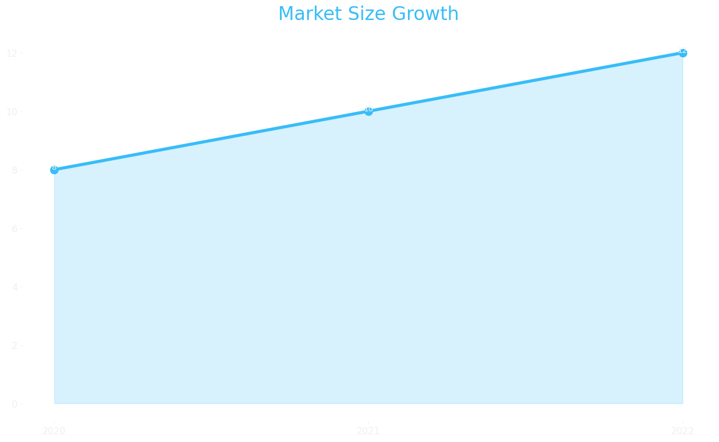
Market Size

Slide 16
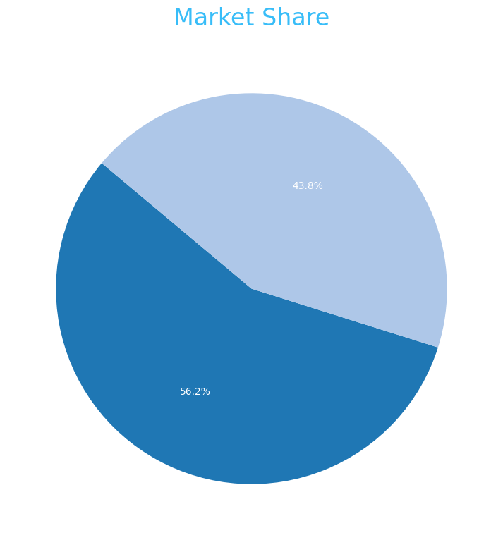
Market Share

Slide 17
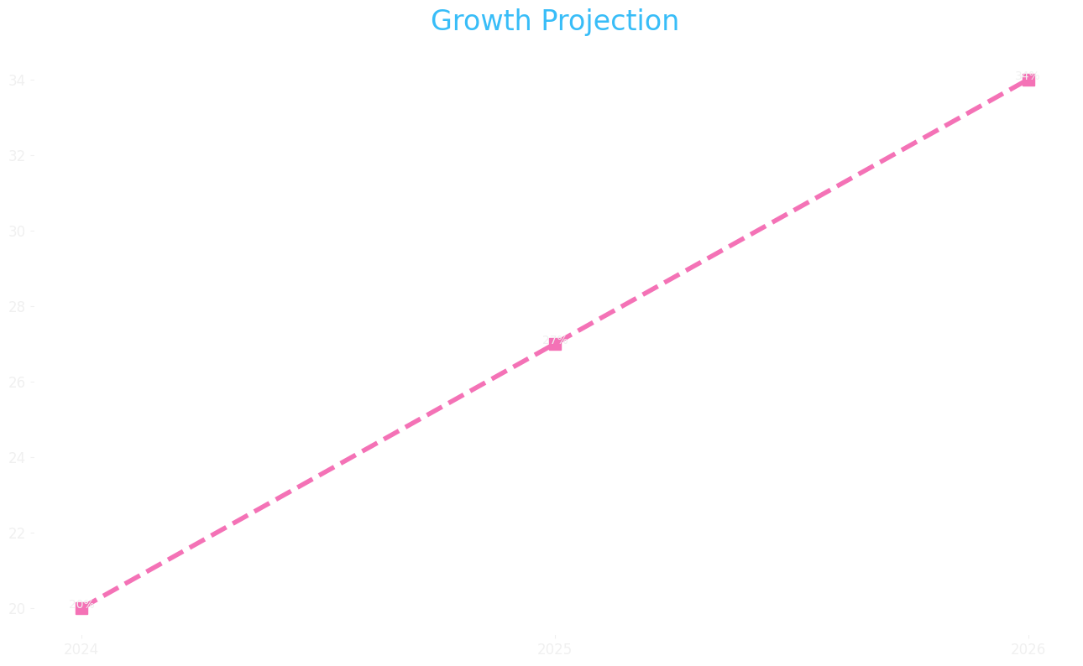
Growth Projection

