Slide 1
AI in Healthcare
Transforming Patient Care through Advanced Technologies

Slide 2
Introduction to AI in Healthcare
• Overview of AI technologies in healthcare.
• Importance of AI for patient outcomes.
• Role of AI in cost reduction and operational efficiency.
• Trends driving AI adoption in healthcare.

Slide 3
Market Overview
• Market size in 2021 estimated at $10 billion.
• Projected growth to $107 billion by 2028.
• Factors driving market expansion.
• Investment opportunities in AI technologies.

Slide 4
Key Points of AI Integration
• Enhancement of diagnostic accuracy and speed.
• Machine learning for predictive analytics.
• AI tools for drug discovery and development.
• Telemedicine and AI for effective patient management.

Slide 5
Statistics on AI Impact
• AI can improve diagnostic accuracy by up to 20%.
• Potential for 30% reduction in operational costs.
• Growing use of AI in various medical fields.
• Significant increase in investment in AI healthcare solutions.

Slide 6
Current Trends
• Adoption of AI in diagnostics and imaging.
• Expansion of telehealth solutions using AI.
• AI applications in mental and behavioral health.
• Development of regulatory frameworks for AI.

Slide 7
Challenges in AI Adoption
• Concerns around data privacy and security.
• Integration with existing healthcare systems.
• Need for healthcare professional training.
• Addressing potential bias in AI algorithms.

Slide 8
Opportunities with AI
• Personalized treatment plans leveraging AI insights.
• AI in remote patient monitoring expansions.
• Faster drug discovery through enhanced processes.
• Utilizing predictive analytics to refine care pathways.

Slide 9
Competitive Landscape
• Key players in the AI healthcare market.
• Analysis of competitive strengths and weaknesses.
• Impact of competition on market dynamics.
• Future outlook for new entrants.

Slide 10
Technological Innovations
• Latest advancements in AI algorithms.
• Integration of AI with IoT in healthcare.
• Emerging AI applications in surgery.
• Role of AI in clinical trials.

Slide 11
Regulatory Environment
• Overview of current regulations affecting AI in healthcare.
• Impact of regulations on AI adoption.
• Future regulatory trends to watch.
• Importance of compliance for AI implementations.

Slide 12
Patient Perspectives
• Patient acceptance of AI technologies.
• Impact of AI on patient experience.
• Patients' awareness of AI applications in healthcare.
• Comparing traditional vs. AI-enhanced care.

Slide 13
Case Studies
• Successful AI integration examples in hospitals.
• Impact of AI on specific health outcomes.
• Lessons learned from AI implementations.
• Future projects involving AI in healthcare.

Slide 14
Future of AI in Healthcare
• Predictions for AI advancements in the next 5 years.
• Evolving role of AI in patient care.
• Integration challenges expected in the future.
• Potential for global AI healthcare initiatives.

Slide 15
Key Takeaways
• AI is crucial for the future of effective healthcare.
• Strategic planning is essential to navigate AI challenges.

Slide 16
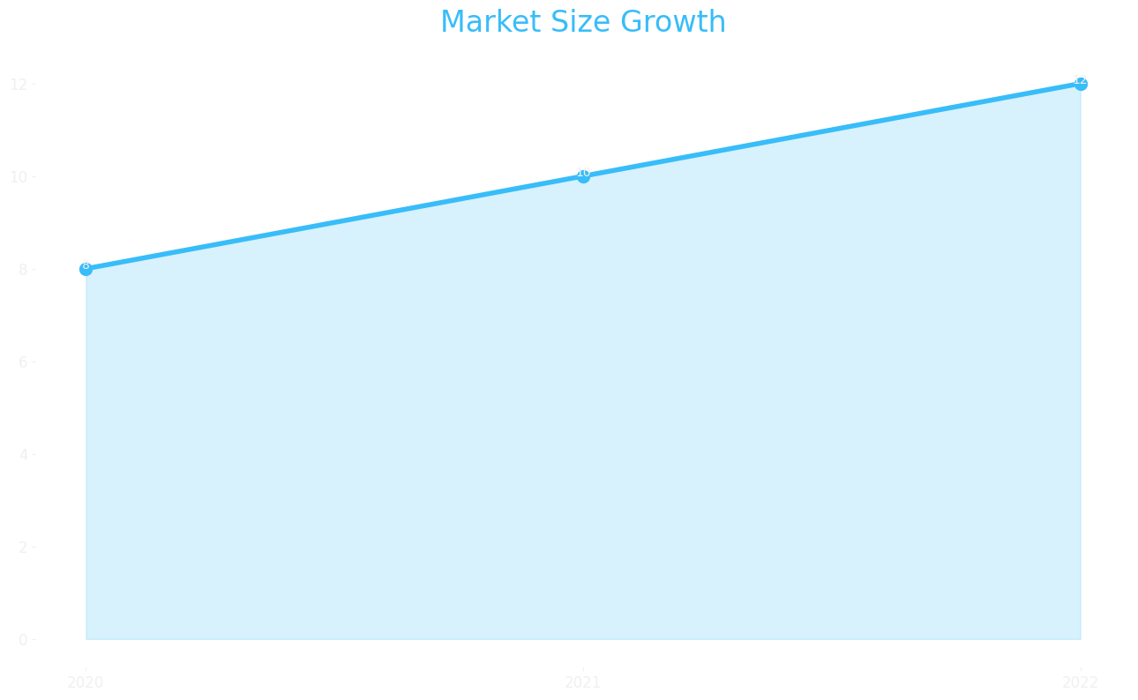
Market Size

Slide 17
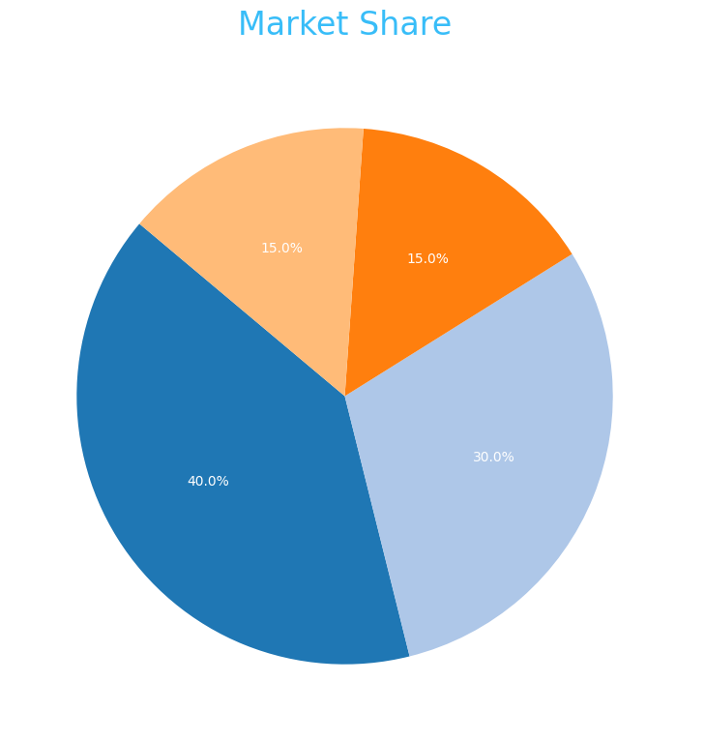
Market Share

Slide 18
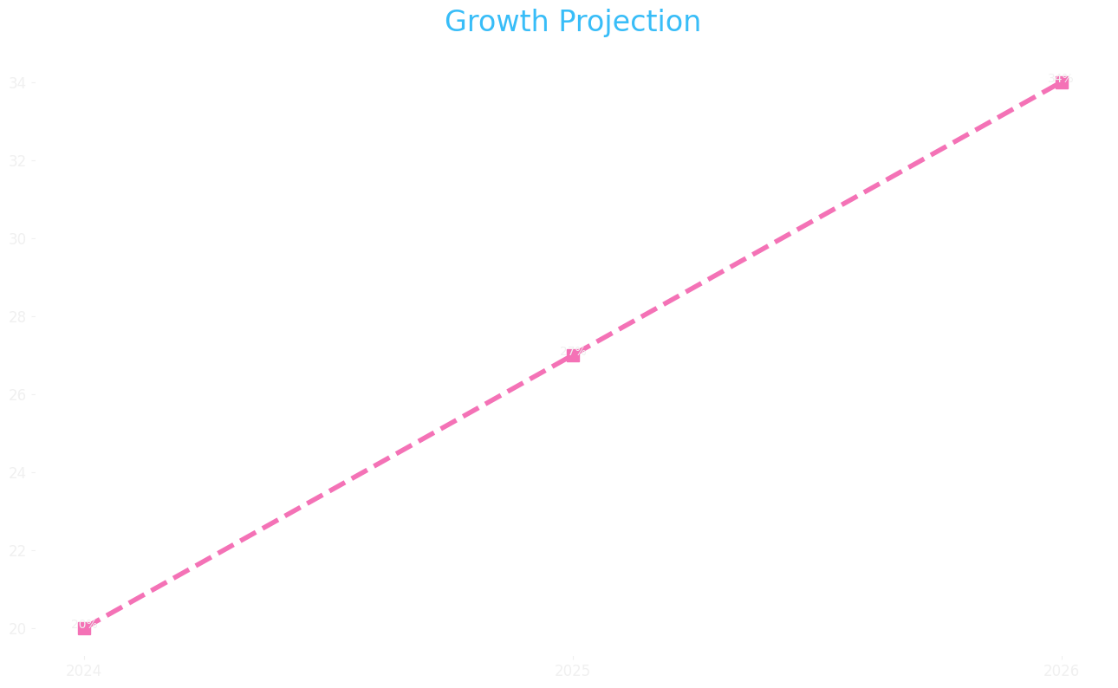
Growth Projection

