Slide 1
AI in Healthcare
Transforming Patient Care and Operational Efficiency

Slide 2
Introduction to AI in Healthcare
• Overview of AI technologies in health sector.
• Importance of AI for improving clinical outcomes.
• Key areas of impact: diagnosis, treatment, and operations.
• Current landscape and market potential.

Slide 3
Market Growth and Projections
• AI in healthcare market projected at $45.2 billion by 2026.
• Consistent annual growth rate of 30%.
• Impact of COVID-19 on AI adoption.
• Increased investment from both public and private sectors.

Slide 4
Key Technologies in AI Healthcare
• Machine learning algorithms for diagnostics.
• Natural language processing for patient interactions.
• Predictive analytics to foresee disease outbreaks.
• AI tools for drug discovery and clinical trials.

Slide 5
AI and Disease Diagnosis
• Achieving up to 95% accuracy in diagnostics.
• AI's role in early disease detection.
• Examples of successful AI diagnostic tools.
• Case studies highlighting real-world applications.

Slide 6
Operational Efficiency through AI
• Streamlining administrative tasks.
• Reducing wait times for patients.
• Enhancing resource allocation.
• AI-driven insights for strategic decision-making.

Slide 7
Key Trends in AI Adoption
• Rise of telemedicine solutions.
• Increasing investments in AI startups.
• Integration with electronic health records.
• Shift toward value-based care models.

Slide 8
Challenges in Implementing AI
• Data privacy concerns impacting adoption.
• Ethical dilemmas in AI decision-making.
• Integration with existing healthcare systems.
• Need for regulatory frameworks.

Slide 9
Opportunities for Growth
• Personalized medicine for better patient outcomes.
• Reducing healthcare costs through efficiency.
• Expanding access in underserved areas.
• Harnessing AI for training and education.

Slide 10
Competitor Landscape
• Key players in AI healthcare market.
• Comparative strengths of top competitors.
• Emerging startups and innovative solutions.
• Partnerships and collaborations driving growth.

Slide 11
Case Studies of AI Success
• Example 1: AI in radiology diagnostics.
• Example 2: Predictive analytics in patient care.
• Example 3: AI in clinical trial management.
• Lessons learned from successful integrations.

Slide 12
Regulatory and Compliance Considerations
• Overview of current regulations.
• Implications for AI deployment.
• Ensuring patient safety and data integrity.
• Future trends in regulatory landscape.

Slide 13
Future of AI in Healthcare
• Predicted advancements in technology.
• Long-term impacts on healthcare systems.
• Potential for global health improvements.
• Ongoing commitments to ethical standards.

Slide 14
Conclusion
• AI is a transformative force in healthcare.
• Strategic investments and thoughtful implementation are vital.
• The future holds immense potential for innovation and expansion.

Slide 15
Key Takeaways
• AI will redefine patient care and operational efficiency.
• Collaboration is key for overcoming challenges and maximizing benefits.

Slide 16
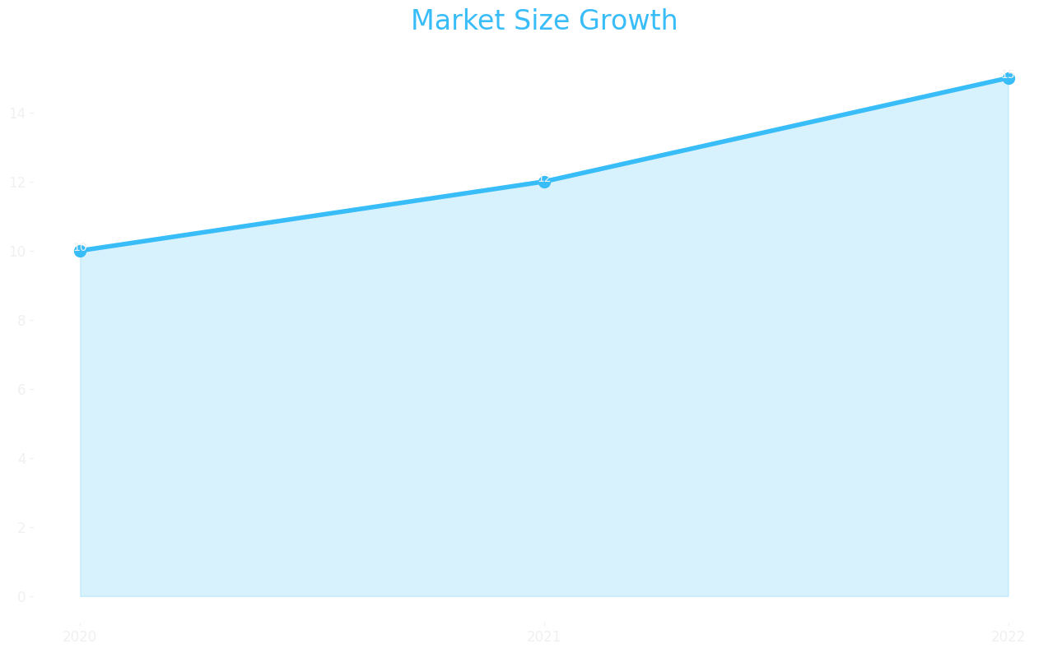
Market Size

Slide 17
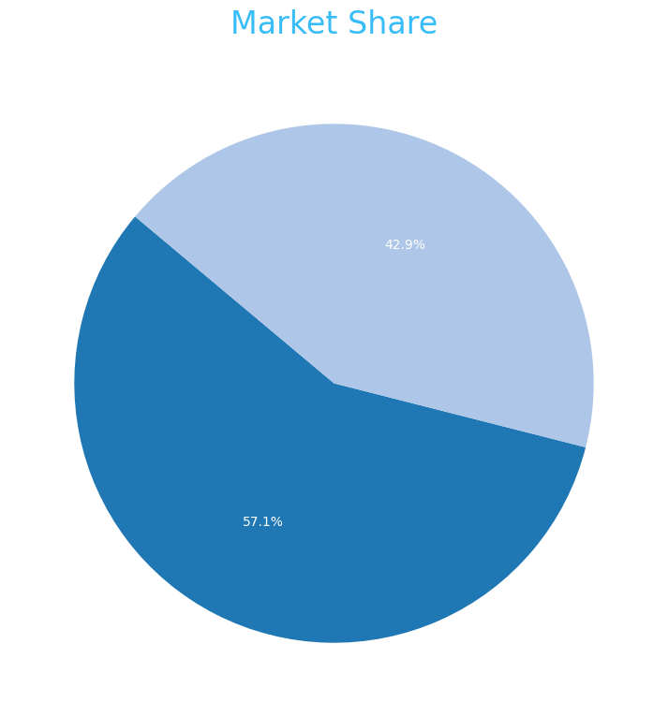
Market Share

Slide 18
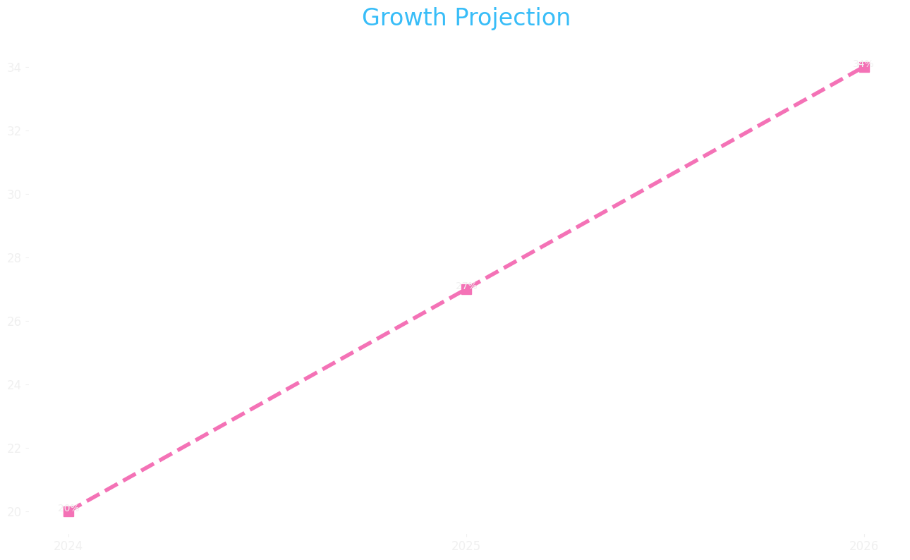
Growth Projection

