Slide 1
AI in Healthcare
Transforming the Future of Medicine

Slide 2
Introduction to AI in Healthcare
• Overview of AI technology in medical applications.
• Importance of AI in diagnosing and treating patients.
• Growth trends in the AI healthcare sector.
• Key players in the AI healthcare market.

Slide 3
AI Market Size and Growth
• Global AI in healthcare market projected to reach $36.1 billion by 2025.
• CAGR of 40% expected from 2021 to 2025.
• Significant investments from tech companies and healthcare organizations.
• Market trends driving the adoption of AI solutions.

Slide 4
Key Benefits of AI in Healthcare
• Improved diagnostic accuracy by up to 20%.
• Increased operational efficiency by 30% in AI-integrated hospitals.
• Enhanced patient engagement through personalized treatment.
• Reduced administrative burdens through automation.

Slide 5
AI Trends in Healthcare
• Rise of telemedicine incorporating AI tools.
• Integration of AI in electronic health records (EHR).
• Focus on predictive analytics for proactive care.
• Usage of natural language processing for patient interactions.

Slide 6
Challenges Facing AI Adoption
• Data privacy and security concerns critical to patient safety.
• Integration with existing healthcare systems poses technical hurdles.
• Need for effective training of healthcare professionals.
• Resistance to change among traditional medical practices.

Slide 7
Opportunities for Healthcare Providers
• Optimize resource allocation to reduce costs.
• Enhance research capabilities in drug discovery.
• Collaboration with tech companies to innovate healthcare solutions.
• Transforming clinical decision-making processes.

Slide 8
AI Case Studies in Healthcare
• Successful implementations in diagnostic imaging.
• Reduction of hospital readmission rates through predictive analytics.
• Telehealth systems using AI for remote monitoring.
• Noteworthy successes in personalized medicine initiatives.

Slide 9
Regulatory Landscape of AI in Healthcare
• Overview of FDA regulations for AI technologies.
• Compliance requirements for AI developers.
• Future regulations expected to support safe AI deployment.
• Importance of ethical considerations in AI algorithms.

Slide 10
Market Share of Major Players
• Company A: 40% market share.
• Company B: 30% market share.
• Emerging startups disrupting industry norms.
• Partnerships and collaborations among key players.

Slide 11
Competitive Strengths Analysis
• Competitor A: 80% strength based on innovation.
• Competitor B: 65% strength tied to market reach.
• Strategies for maintaining competitive advantage.
• Responses to emerging market trends.

Slide 12
Future Projections for AI in Healthcare
• Growth projection of $20 billion by 2024.
• Increased AI integration expected in daily healthcare activities.
• Potential for disruptive innovations in patient care.
• Long-term benchmarks for success measurement.

Slide 13
Investment Trends in AI Healthcare
• Venture capital influx into AI startups.
• Public and private funding sources supporting AI technology.
• Investment focus areas for future growth.
• ROI analysis for AI implementation in healthcare settings.

Slide 14
Conclusion and Call to Action
• AI innovations are key to healthcare evolution.
• Urgent need for collaboration between tech and healthcare sectors.
• Proactive approach necessary to overcome obstacles.
• Investment in AI is essential for future global health improvements.

Slide 15
Key Takeaways
• AI is poised to revolutionize the healthcare landscape.
• Strategic partnerships and investments will drive advancements.

Slide 16
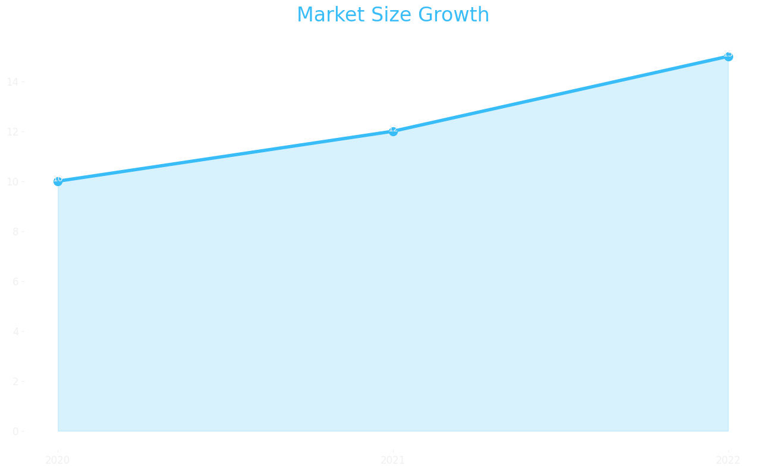
Market Size

Slide 17
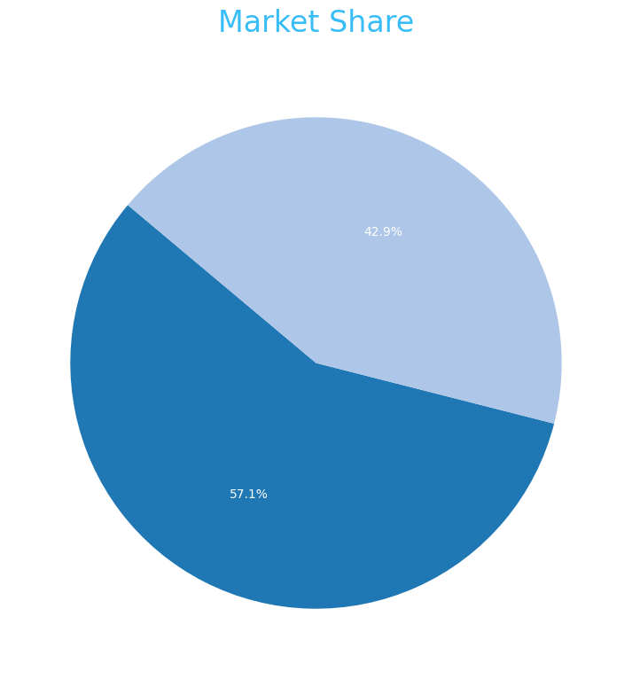
Market Share

Slide 18

Growth Projection

