Slide 1
AI in Healthcare
Transforming Patient Care and Operational Efficiency

Slide 2
Introduction
• Overview of AI's role in healthcare.
• Significance of AI in enhancing diagnosis and treatment.
• Transformation of operational processes.
• Market potential for AI technologies.

Slide 3
Key Trends in AI
• Increased adoption of telemedicine combined with AI.
• AI's growing role in drug discovery.
• Integration of AI with wearable devices.
• Rising demand for predictive analytics.

Slide 4
AI Enhancements in Diagnostics
• Image recognition technologies improving accuracy.
• Data analysis leading to more accurate diagnoses.
• Impact on disease detection and management.
• Use cases in various medical fields.

Slide 5
Personalized Treatment Plans
• Machine learning tailoring therapies.
• Consideration of patient-specific data.
• Potential to improve patient outcomes.
• Examples of AI applications in treatment.

Slide 6
AI in Patient Engagement
• Chatbots improving patient interaction.
• Streamlining administrative tasks.
• Positive impacts on patient satisfaction.
• Enhancements in communication with patients.

Slide 7
Operational Efficiency
• Reduction of operational costs by 30%.
• AI aiding in resource management.
• Enhancing decision-making processes.
• Case studies of successful implementations.

Slide 8
Market Analysis
• Global market size projected at USD 11 billion by 2024.
• Current landscape of competitors.
• Analysis of market share distribution.
• Growth projections for the next 5 years.

Slide 9
Challenges in AI Adoption
• Data privacy and security concerns.
• Integration with existing healthcare systems.
• Need for regulatory compliance.
• Ethical guidelines surrounding AI use.

Slide 10
Opportunities for Growth
• AI applications in rural healthcare access.
• Enhancing patient outcomes and safety.
• Startup potential in AI innovations.
• Investments in technology development.

Slide 11
Competitive Landscape
• Current strengths of major players.
• Comparison of competitor advantages.
• Identifying strategic gaps in the market.
• Future outlook on competition.

Slide 12
Future Projections
• Expected growth trajectory of AI in healthcare.
• Forecasting market trends for 2025 and beyond.
• Investment opportunities.
• The role of AI in future healthcare delivery.

Slide 13
Conclusion
• AI is revolutionizing healthcare delivery.
• Addressing challenges is crucial for adoption.
• Opportunities for significant impact remain.
• Continued investment in AI is essential.

Slide 14
Key Takeaways
• Strategic initiatives can leverage AI benefits effectively.
• Collaboration among stakeholders is vital.

Slide 15

Market Size

Slide 16
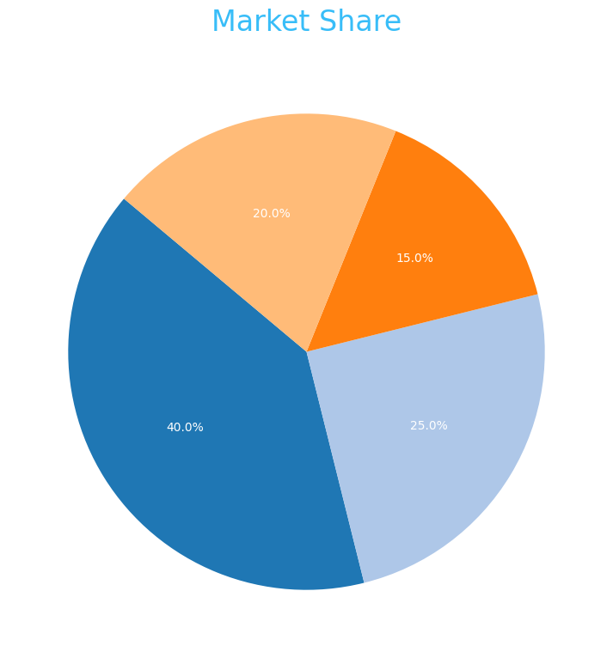
Market Share

Slide 17
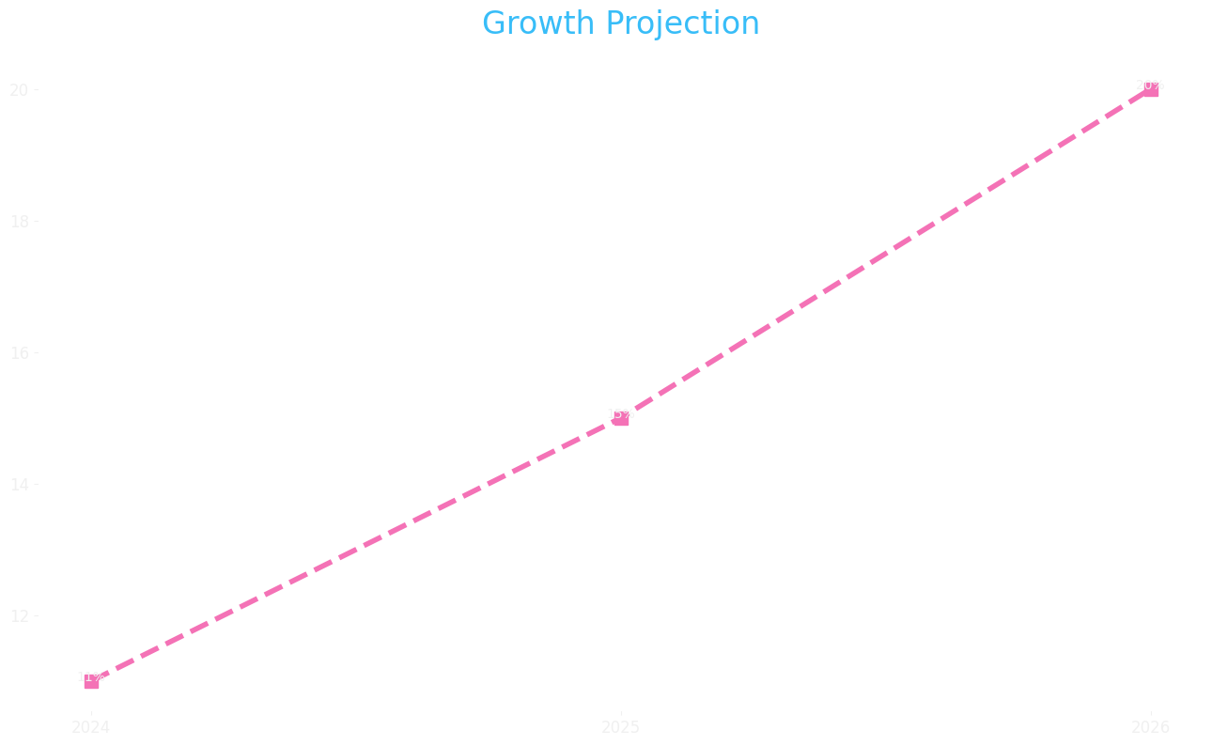
Growth Projection

