Slide 1
AI in Healthcare
Revolutionizing Patient Care and Operational Efficiency

Slide 2
Introduction to AI in Healthcare
• Overview of AI technology.
• Impact of AI on various healthcare domains.
• Rapid growth of AI applications in healthcare.
• Integration challenges in current systems.

Slide 3
Current Trends in AI Adoption
• Increased investment in AI healthcare startups.
• Growing telehealth services powered by AI.
• Emergence of AI virtual health assistants.
• Shift towards patient-centric care models.

Slide 4
AI Applications in Diagnostics
• Machine learning for rapid disease diagnosis.
• Enhanced accuracy in diagnostics.
• AI-driven imaging analysis.
• Predictive analytics for disease outbreaks.

Slide 5
Personalized Treatment Plans
• Use of AI in genetic data analysis.
• Tailored medication plans based on patient data.
• Monitoring patient responses using AI technology.
• Improving adherence through personalized care.

Slide 6
Operational Efficiencies
• Streamlining administrative tasks.
• Enhanced data management practices.
• Reducing operational costs with AI solutions.
• Automating routine healthcare processes.

Slide 7
AI in Drug Discovery
• Accelerated drug development timelines.
• AI-driven simulations for efficacy testing.
• Reducing costs through predictive modeling.
• Collaborations between tech firms and pharmaceutical companies.

Slide 8
Challenges in Implementing AI
• Data privacy and security concerns.
• Integration issues with existing healthcare systems.
• Ethical considerations in AI-driven decisions.
• Need for regulatory compliance.

Slide 9
Market Overview
• Global AI healthcare market size.
• Projected growth rates till 2025.
• Key players in the market.
• Investment trends and opportunities.

Slide 10
Statistics and Insights
• Market growth projected to $190 billion by 2025.
• AI diagnostics improve accuracy by 20%.
• Trends affecting market dynamics.
• Impact of AI on operational costs.

Slide 11
Market Share Analysis
• Distribution of market share among key players.
• Competitor landscape.
• Emerging players in AI healthcare.
• Potential for mergers and acquisitions.

Slide 12
Future Growth Projections
• Expected trends in AI adoption.
• Anticipated developments in AI technologies.
• Forecasted growth from 2023 to 2026.
• Long-term implications for healthcare providers.

Slide 13
Regulatory Landscape
• Current regulations affecting AI in healthcare.
• Importance of compliance for businesses.
• Global regulatory differences.
• Future trends in healthcare regulations.

Slide 14
Concluding Remarks
• AI's transformative potential in healthcare.
• Importance of addressing challenges proactively.
• Future outlook and innovations in AI.
• Call to action for healthcare stakeholders.

Slide 15
Key Takeaways
• AI is reshaping the healthcare landscape.
• Stakeholders must navigate challenges for successful deployment.

Slide 16
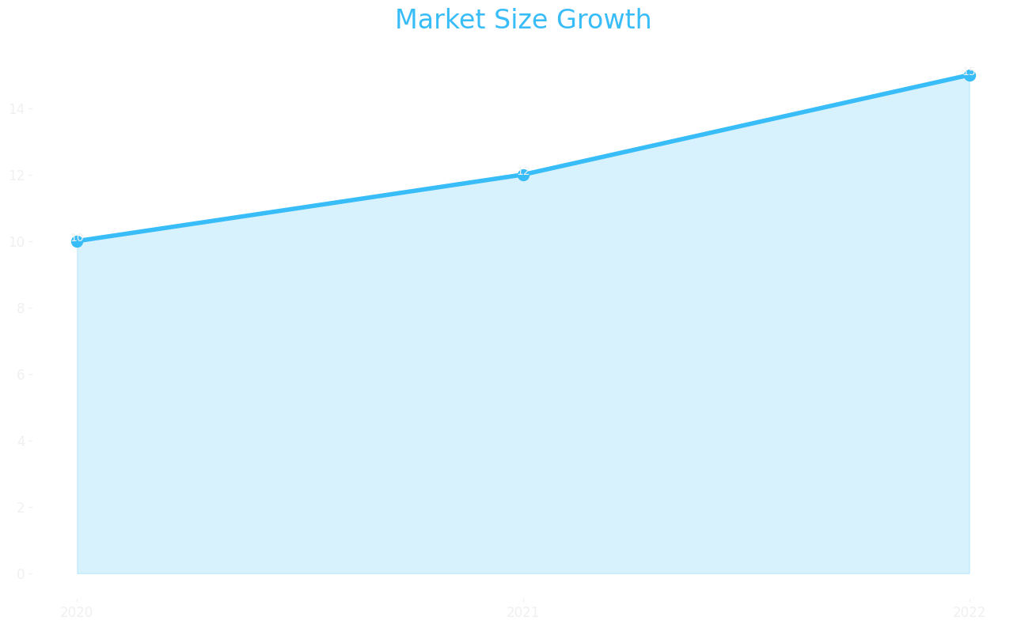
Market Size

Slide 17
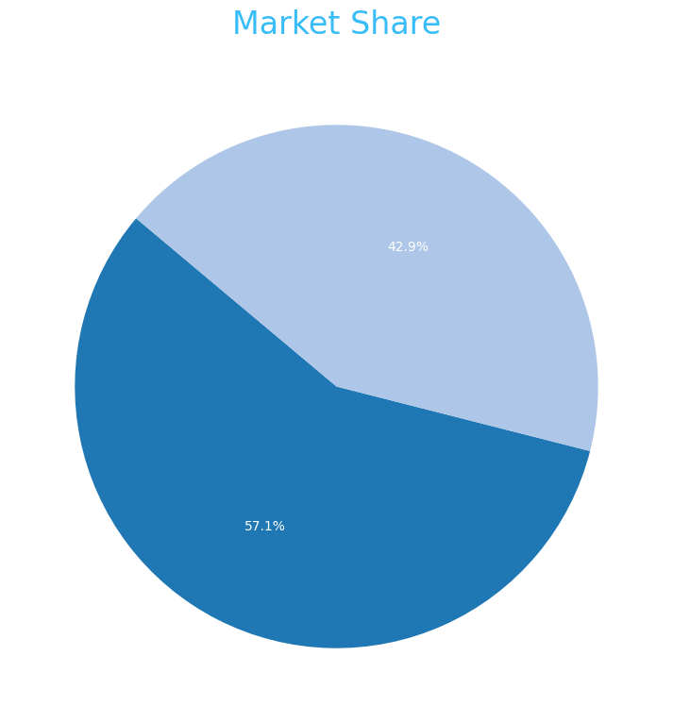
Market Share

Slide 18
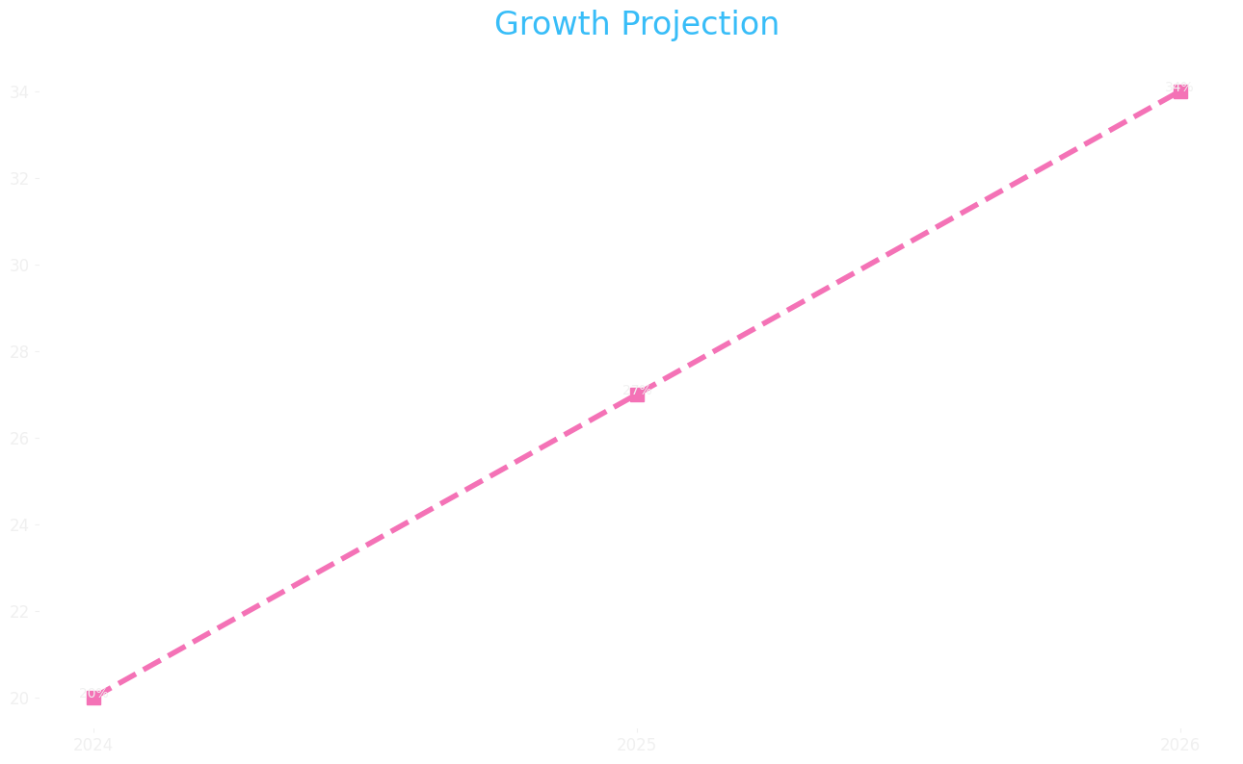
Growth Projection

