Slide 1
AI in Healthcare
Revolutionizing Healthcare through Artificial Intelligence

Slide 2
Introduction to AI in Healthcare
• Overview of AI technology and its application in healthcare.
• Importance of AI in enhancing healthcare outcomes.
• Current landscape of AI adoption in the sector.

Slide 3
Key Enhancements through AI
• Improved diagnostic accuracy with machine learning.
• Accelerated data processing via Natural Language Processing.
• Facilitated remote patient monitoring through telemedicine.

Slide 4
Diagnostic Improvements
• AI improves diagnostic accuracy by up to 30%.
• Reduction in misdiagnosis rates.
• Streamlined radiology and imaging processes.

Slide 5
AI and Predictive Analytics
• AI-driven analytics for disease outbreak predictions.
• Identification of high-risk patients.
• Forecasting patient admission rates.

Slide 6
Operational Efficiency Gains
• AI can reduce operational costs in hospitals by 20%.
• Automation of administrative tasks.
• Enhanced resource allocation.

Slide 7
Current Adoption Rates
• 45% of healthcare organizations have adopted AI technologies.
• Majority of healthcare leaders favor AI integration.
• Growth trajectory of AI adoption in the next five years.

Slide 8
Key Trends in AI Healthcare
• Increased investment in AI healthcare startups.
• Growing use in personalized medicine.
• Expansion in imaging and diagnostics.

Slide 9
Challenges in AI Adoption
• Data privacy concerns and regulatory compliance.
• Integration with existing healthcare systems.
• Requirement for skilled professionals.

Slide 10
Opportunities for Growth
• Enhancing patient care via predictive analytics.
• Improving operational efficiency within healthcare facilities.
• Expanding telehealth access in underserved areas.

Slide 11
Chart Data Overview
• Analysis of market trends and competitors.
• Understand growth projections for AI in healthcare.

Slide 12
Market Size and Growth
• Current market size and growth potential.
• Key players and market share insights.
• Future growth projections.

Slide 13
Competitor Analysis
• Strengths of key competitors in AI healthcare.
• Market positioning and competitive landscape.
• Lessons learned from leading players.

Slide 14
Future Outlook
• Projected growth in AI healthcare until 2026.
• Emerging technologies and innovations.
• Continuous evolution of healthcare practices.

Slide 15
Conclusion
• AI is vital for the future of healthcare.
• Strategic investments are necessary for adoption.

Slide 16
References
• Source: Synthetic example on AI in Healthcare.
• Additional resources for further reading.

Slide 17
Key Takeaways
• AI technology is revolutionizing healthcare delivery.
• Future investment will shape effective and equitable healthcare.

Slide 18
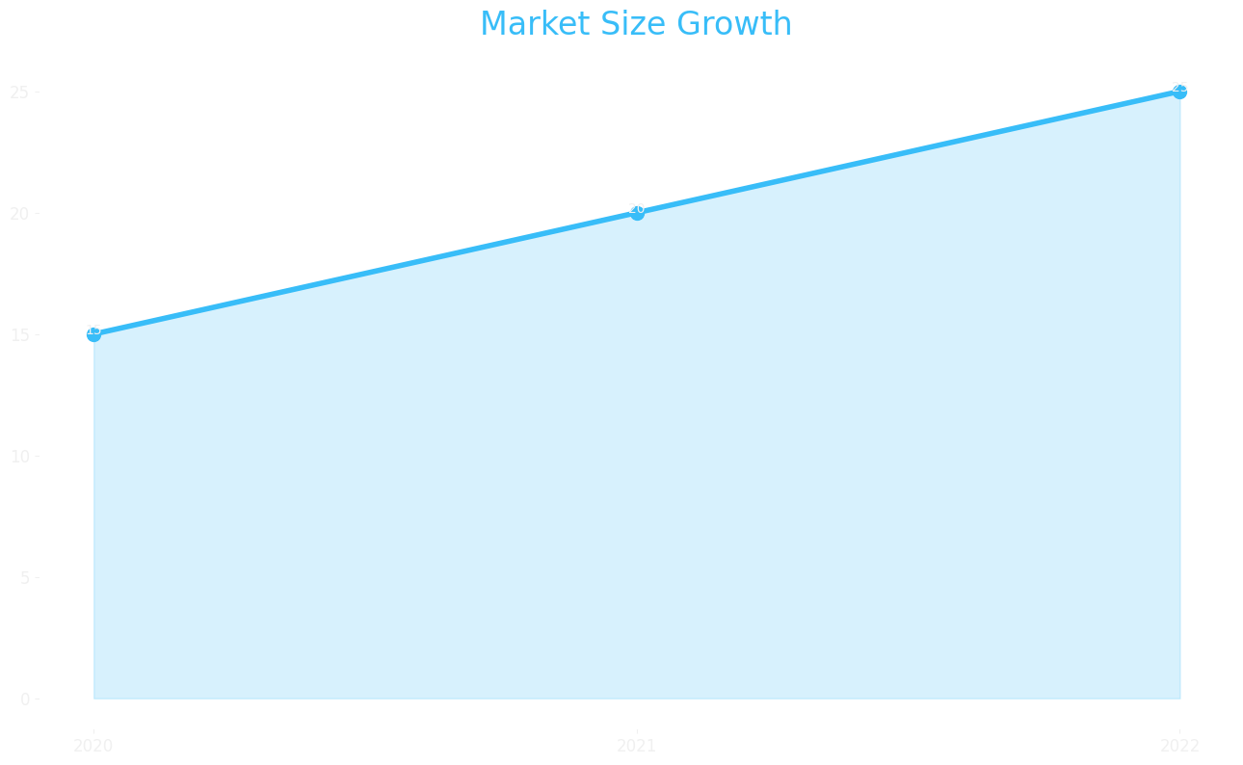
Market Size

Slide 19
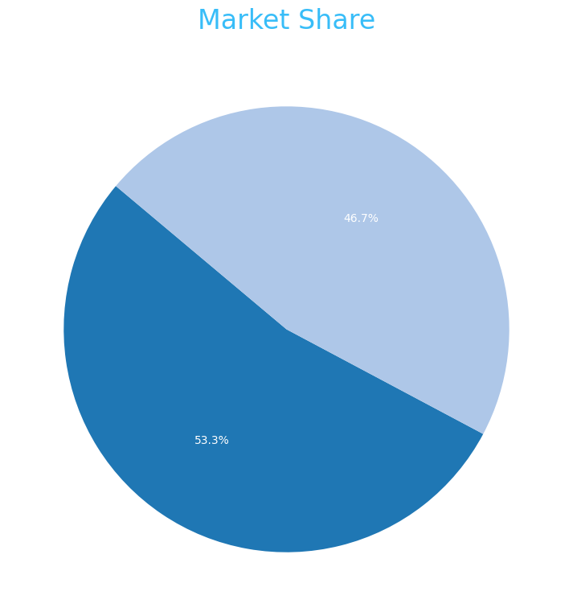
Market Share

Slide 20
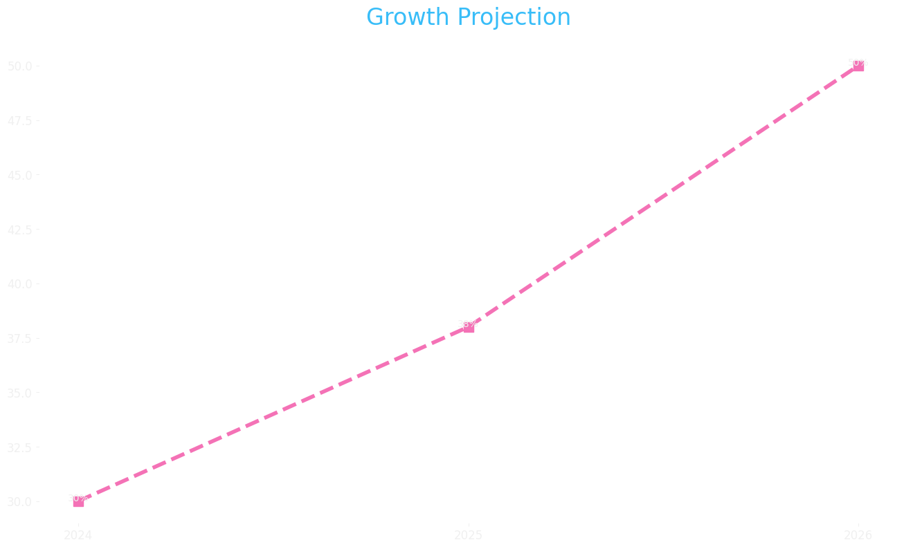
Growth Projection

