Slide 1
AI in Healthcare
Transforming Patient Outcomes and Operational Efficiency

Slide 2
Introduction to AI in Healthcare
• Overview of AI technologies in healthcare.
• Importance of AI for enhancing diagnostic precision.
• Privilege of real-time data analytics.
• Emerging trends and innovations in AI.

Slide 3
Market Overview
• AI in healthcare market projected at USD 36.1 billion by 2025.
• CAGR of 41.8% signifies robust growth.
• Key players driving market advancements.
• Investment trends in AI healthcare solutions.

Slide 4
Key Benefits of AI
• Enhances diagnostic accuracy up to 30%.
• Accelerates patient outcome predictions.
• Improves operational efficiencies.
• Supports drug discovery processes.

Slide 5
Technological Advancements
• Machine learning algorithms in practical applications.
• AI integration in Electronic Health Records (EHRs).
• Wearable technologies powered by AI.
• Telemedicine enhancement through AI.

Slide 6
Current Trends
• Rise of virtual care solutions post-pandemic.
• Increased use of AI in personalized medicine.
• Adoption of AI-powered diagnostics.
• Growing interest in remote patient monitoring.

Slide 7
Regulatory Landscape
• Challenges of data privacy and security.
• Need for defined regulatory standards.
• Balancing innovation with compliance.
• Ongoing discussions in healthcare policies.

Slide 8
Challenges in AI Deployment
• Integration with existing healthcare systems.
• Data quality and robustness issues.
• Resistance from traditional medical practitioners.
• Understanding AI model limitations.

Slide 9
Opportunities for Growth
• Expansion in personalized genomic medicine.
• Improving efficiencies leading to cost reductions.
• AI solutions targeting underserved communities.
• Partnerships between tech and healthcare firms.

Slide 10
Success Stories
• Case studies showcasing AI success in diagnostics.
• Improved patient outcomes through AI applications.
• Millennium Health's AI-driven drug discovery.
• Collaborative projects between hospitals and tech firms.

Slide 11
Investment Opportunities
• Where venture capital is focusing in AI healthcare.
• Emerging startups making impacts.
• Predictions for future investments.
• Long-term sustainability and ROI considerations.

Slide 12
Global Impact of AI in Healthcare
• Changing healthcare delivery models worldwide.
• Cross-border collaborations in AI tech.
• Universal improvement in health outcomes.
• Equity in health innovations via AI.

Slide 13
Future Prospects
• Forecasted AI market growth beyond 2025.
• Expected technological advancements.
• Visualization of AI in future healthcare.
• Long-term societal implications of AI.

Slide 14
Key Takeaways
• AI stands as a guiding force in the healthcare revolution.
• Strategic investments and collaborations will be crucial.

Slide 15
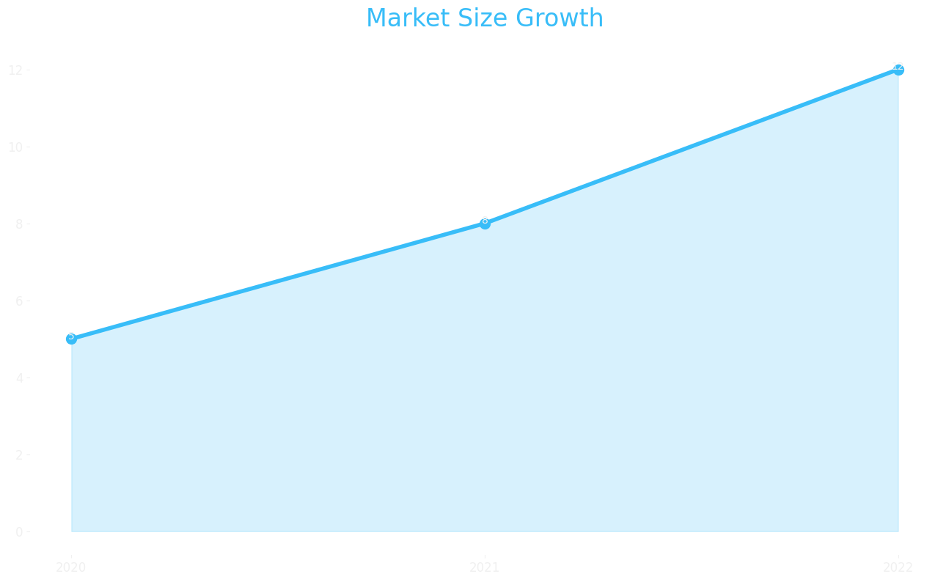
Market Size

Slide 16
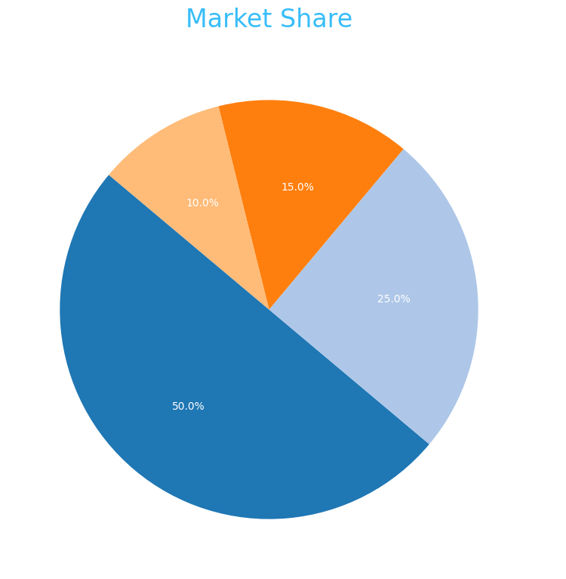
Market Share

Slide 17
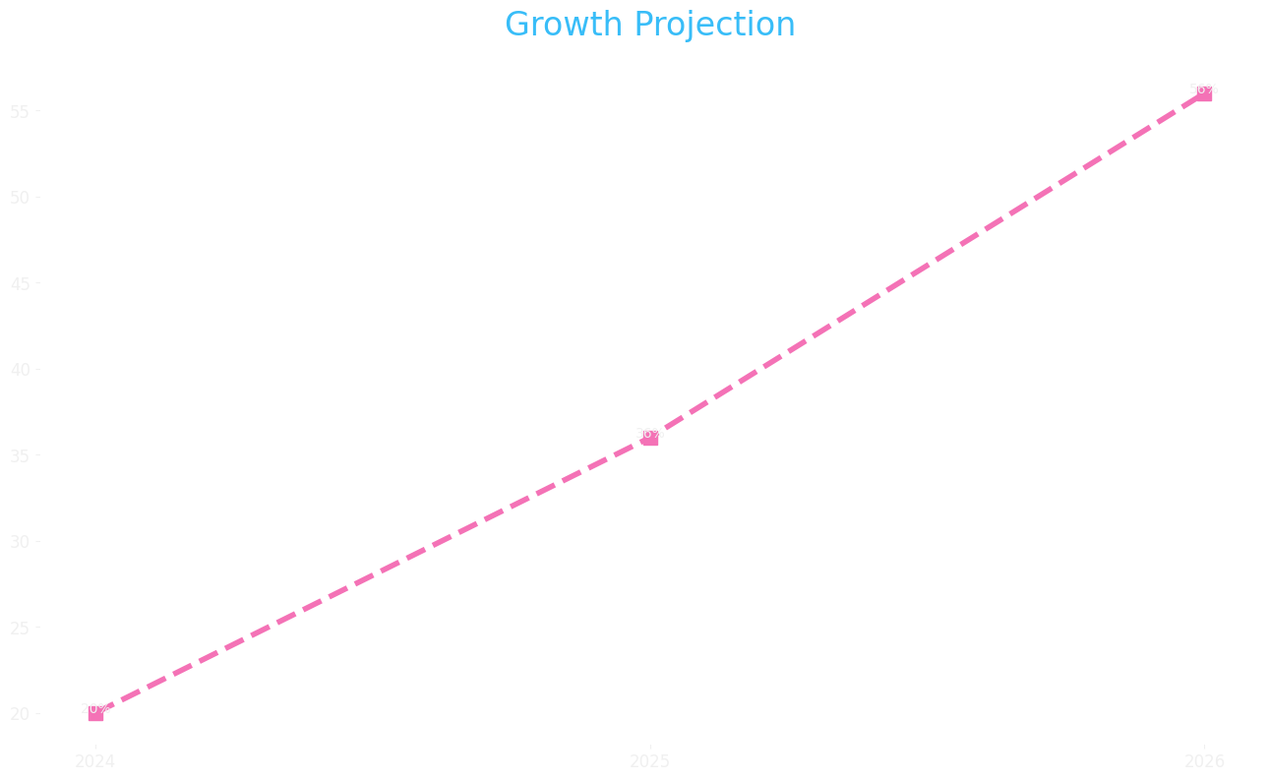
Growth Projection

