Slide 1
AI Research Agent Market in India
An Overview of Growth, Trends, and Opportunities

Slide 2
Market Overview
• Significant growth in AI technology adoption.
• Increasing demand for efficient data analysis.
• Integration of AI in research processes.
• Robust startup ecosystem fostering innovation.

Slide 3
Key Growth Drivers
• Rapid advancements in AI and machine learning.
• Government initiatives to boost AI R&D.
• Rising investments in AI-focused startups.
• Emerging applications in diverse sectors.

Slide 4
Market Statistics
• Market growth projected at 25% CAGR over five years.
• More than 200 AI startups operating in India.
• Investment surpassing $500 million in 2022.
• High potential revenue growth from various sectors.

Slide 5
Trends in the Market
• Increased adoption of AI in academic institutions.
• Focus on ethical AI development and compliance.
• Growth of collaborations between academia and industry.
• Research into AI's societal impacts gaining traction.

Slide 6
Challenges Facing the Market
• Shortage of skilled workforce in AI domains.
• High implementation costs and entry barriers.
• Data privacy issues creating hurdles.
• Rapid technology changes leading to talent gaps.

Slide 7
Opportunities Ahead
• Growing demand for AI solutions in legacy industries.
• Potential for global collaborations in AI research.
• Expansion driven by digital transformation efforts.
• Support from government initiatives to attract investments.

Slide 8
Key Market Players
• Company A and Company B leading market share.
• Emerging startups disrupting traditional models.
• Collaborations among tech giants and academic institutions.
• Investment strategies focusing on innovation.

Slide 9
Regulatory Landscape
• Government frameworks guiding AI implementation.
• Ethical guidelines shaping the future of AI.
• Need for robust data protection laws.
• Potential regulatory challenges affecting growth.

Slide 10
Investment Landscape
• Impact of venture capital on AI startup growth.
• Growing interest from foreign investors.
• Funding trends favoring innovative solutions.
• Strategic investments and acquisitions on the rise.

Slide 11
Technological Advancements
• Emerging technologies powering AI research.
• Role of cloud computing in enhancing capabilities.
• AI tools improving data processing efficiency.
• Advances in natural language processing gaining momentum.

Slide 12
User Adoption Insights
• Rapid uptake of AI tools by businesses.
• Changing attitudes toward AI in research sectors.
• User segment shifts towards younger demographics.
• Increased training and awareness programs available.

Slide 13
Future Projections
• Market expected to grow substantially by 2026.
• Growth projections indicating robust sector expansion.
• Emergence of novel sectors utilizing AI technology.
• Increased competition driving innovation and efficiency.

Slide 14
Key Takeaways
• AI research market in India presents vast opportunities.
• Strategic investments and collaborations are essential for growth.

Slide 15
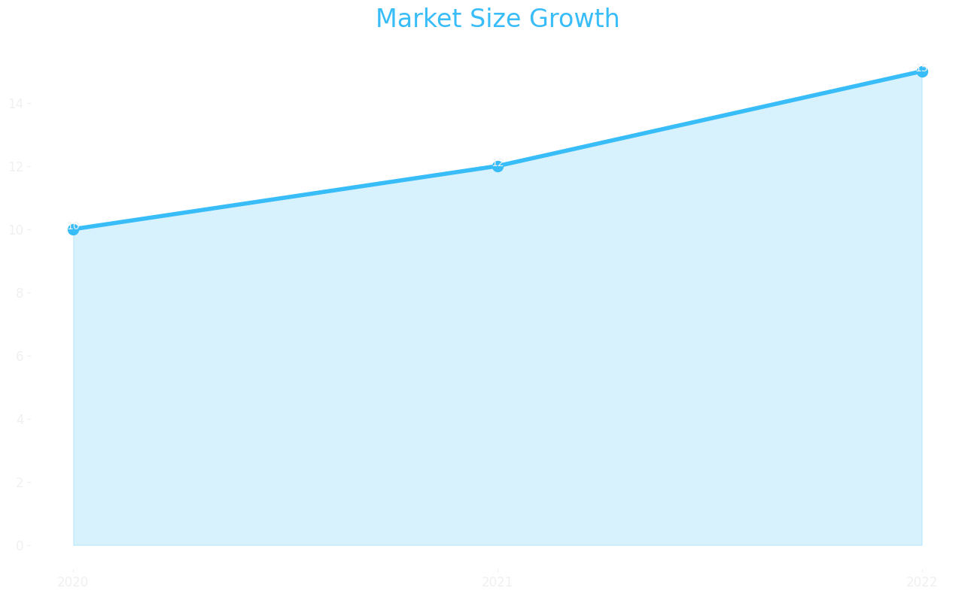
Market Size

Slide 16
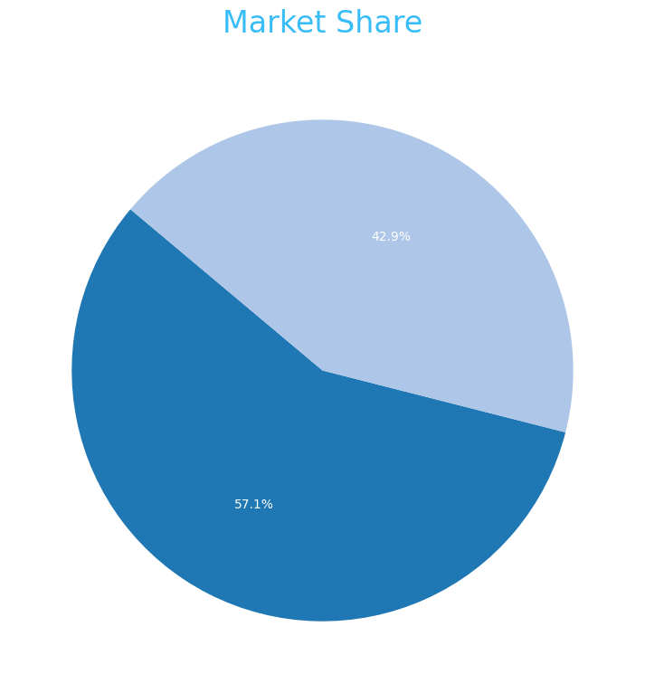
Market Share

Slide 17
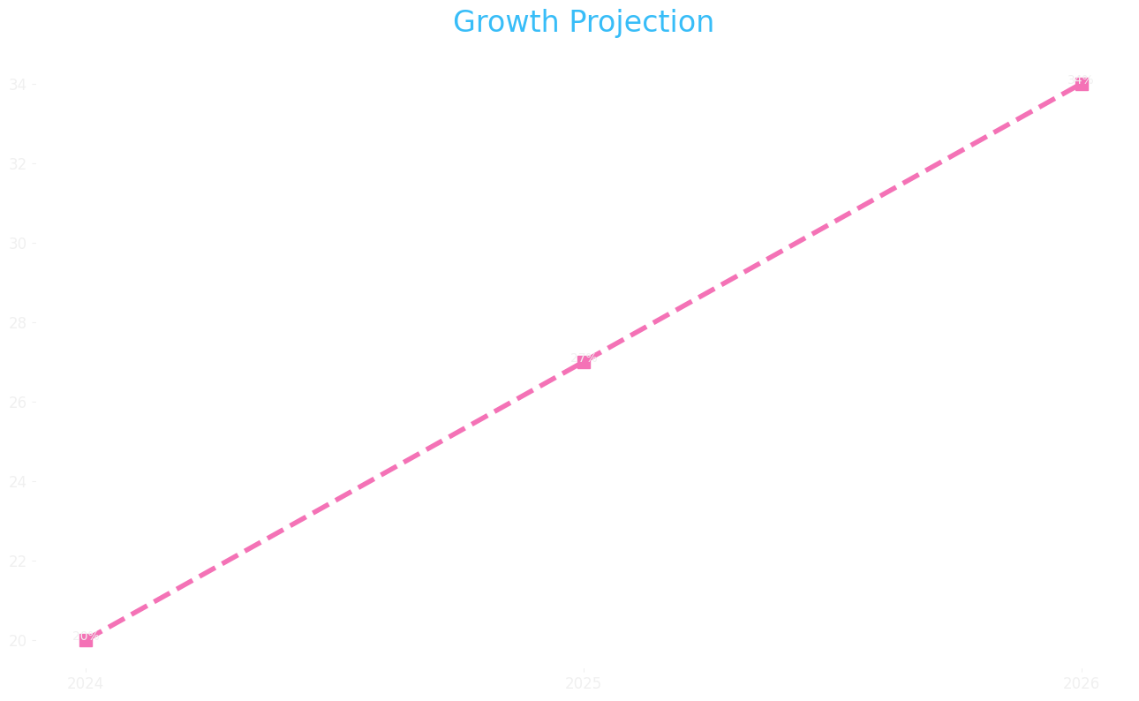
Growth Projection

