Slide 1
AI Research Agent Market in India
Exploring Growth, Opportunities, and Challenges

Slide 2
Market Overview
• Rapid growth driven by AI advancements
• Increased demand for automation
• Startup ecosystem fostering innovation
• Key industries include healthcare, finance, education

Slide 3
Market Size & Growth Rate
• Estimated market size: $15 billion in 2023
• Projected growth to $45 billion by 2030
• CAGR of 20% from 2023 to 2030
• Diversified investments across sectors

Slide 4
Key Players
• Significant investments from both government and private sectors
• Emerging startups enhancing competitive landscape
• Focus on developing industry-specific AI solutions
• Strategic partnerships driving growth

Slide 5
Trends Shaping the Market
• Increased adoption of AI in research methodologies
• Growing focus on AI ethics
• Collaboration between academia and industry
• Real-time data analytics for enhanced outcomes

Slide 6
Challenges Facing the Industry
• Data privacy and security concerns
• Shortage of skilled professionals
• Regulatory uncertainties affecting growth
• Resistance to adopting new technologies

Slide 7
Opportunities Ahead
• Expansion in emerging industries such as agriculture
• Government initiatives to promote R&D
• Potential for international collaborations
• Innovation in AI-driven research tools

Slide 8
Investment Landscape
• Significant angel and venture capital funding
• Public funding initiatives supporting startups
• Growing M&A activities in AI sector
• Increasing interest from global investors

Slide 9
Technology Trends
• Rise of machine learning algorithms
• Enhancements in natural language processing
• Integration of AI with IoT technologies
• Advancements in cloud computing platforms

Slide 10
Regulatory Environment
• Government policies encouraging AI development
• Data protection regulations impacting operations
• Need for compliance with international standards
• Frameworks for ethical AI development

Slide 11
Market Share Analysis
• Company A holds 40% of the market share
• Company B follows with a 30% share
• Emerging players are capturing niche segments
• Potential for consolidation in the near future

Slide 12
Competitor Strengths
• Competitor A: 80/100 in innovation
• Competitor B: 65/100 in customer loyalty
• Multiple companies mastering niche solutions
• Investments in R&D to maintain competitive edge

Slide 13
Market Forecast
• Projected market size: $20 billion by 2024
• Increased expenditure on AI technologies
• Growth projections of $27 billion by 2025
• 34 billion forecasted for 2026

Slide 14
Conclusion
• The AI research market in India is ripe with opportunities
• Together, innovation and investment can drive success

Slide 15
Key Takeaways
• Focus on overcoming challenges for sustained growth
• Strategic collaborations will enhance market positioning

Slide 16
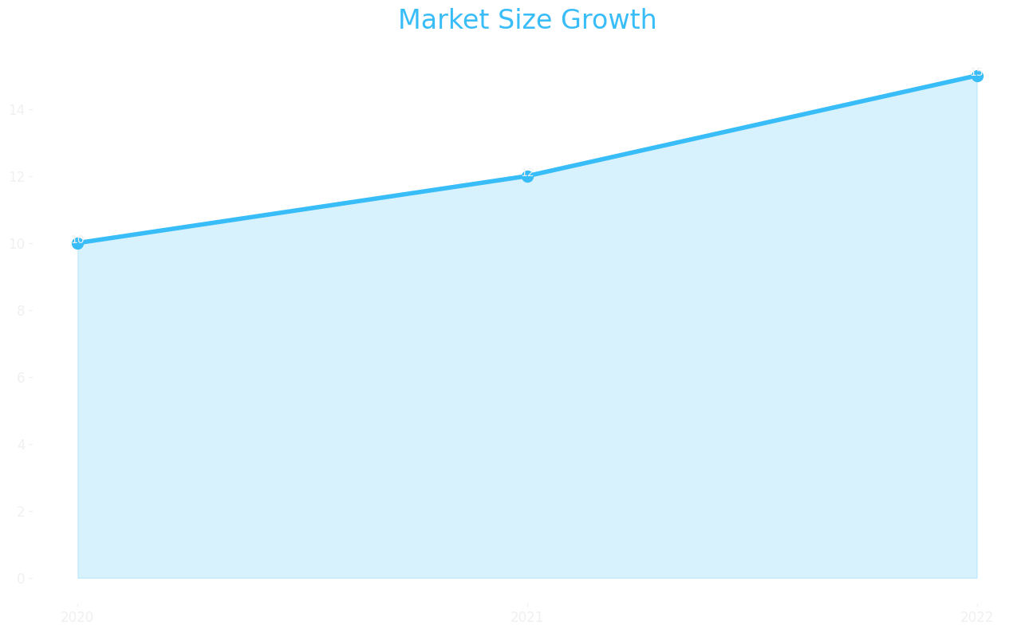
Market Size

Slide 17
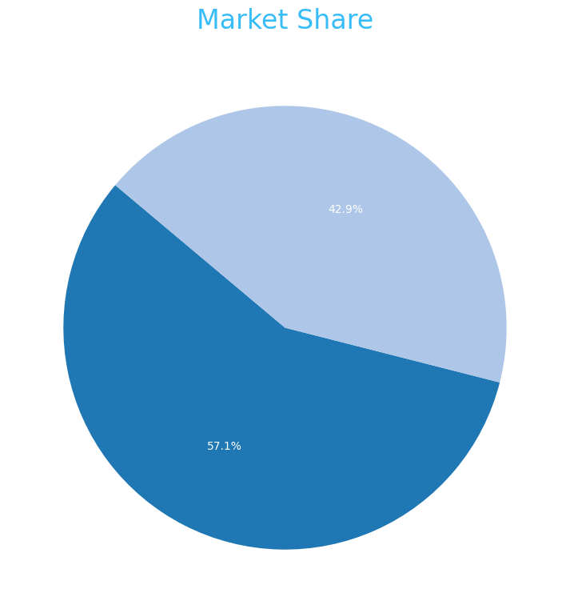
Market Share

Slide 18
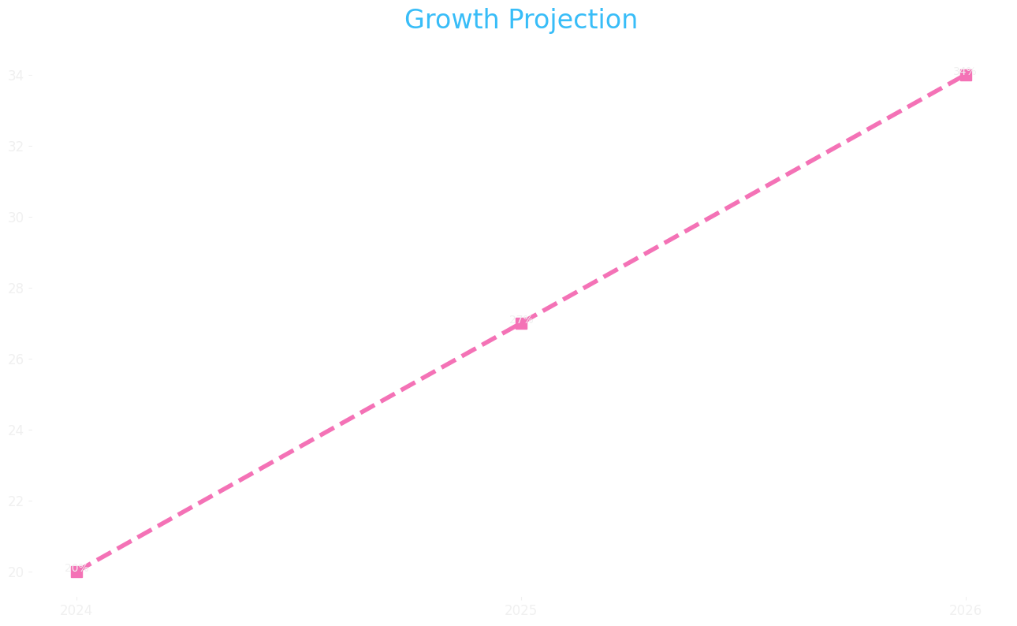
Growth Projection

