Slide 1
AI Research Agent Market in India
Market Trends, Challenges and Opportunities

Slide 2
Market Overview
• Rapid growth driven by advancements in AI technologies.
• Key sectors: healthcare, finance, education.
• Expected 25% CAGR from 2023 to 2028.
• Projected USD 2 billion investments by 2025.

Slide 3
Market Statistics
• 2020 market size: USD 8 billion.
• 2021 market size: USD 9 billion.
• 2022 market size: USD 10 billion.
• 50% enterprises incorporating AI research agents.

Slide 4
Market Share Analysis
• Company A holds 40% of the market share.
• Company B has 30% share.
• Remaining 30% is divided among other players.
• Potential growth opportunities for new entrants.

Slide 5
Growth Projections
• Projected growth: USD 15 billion by 2024.
• Expected growth to USD 18 billion by 2025.
• Further growth forecast to USD 22 billion by 2026.
• Long-term growth driven by technology adoption.

Slide 6
Competitive Landscape
• Competitor A strength score: 80.
• Competitor B strength score: 65.
• Opportunities for strategic partnerships.
• Focus on innovation to capture market share.

Slide 7
Current Market Trends
• Increased automation in data analysis.
• Rise of NLP tools enhancing research capabilities.
• Focus on ethical AI and responsible research.
• Integration of AI with IoT for expanded data collection.

Slide 8
Challenges Facing the Market
• Talent shortage in AI and machine learning fields.
• Data privacy and regulatory compliance concerns.
• Difficulties in integrating with existing systems.
• Need for continuous upskilling in evolving technologies.

Slide 9
Opportunities for Growth
• Growing demand for AI solutions in emerging sectors.
• Collaboration possibilities with global AI leaders.
• Government initiatives promoting AI innovation.
• Increased application of AI in diverse segments.

Slide 10
Ethical AI Considerations
• Importance of ethical AI practices in decision-making.
• Addressing data privacy concerns proactively.
• Need for transparency in AI-driven processes.
• Establishing guidelines for responsible AI use.

Slide 11
Talent Development Strategies
• Invest in training programs for employees.
• Collaborate with universities for talent development.
• Focus on continuous learning in AI fields.
• Boost retention through career advancement opportunities.

Slide 12
Investment Landscape
• Highlight significant government and private sector investments.
• Explore funding avenues for AI startups.
• Engagement in venture capital for innovation.
• Facilitating access to funding for emerging tech companies.

Slide 13
Future Projections
• Anticipated increase in market demand over the next decade.
• Potential for AI to transform traditional industries.
• Emphasis on adapting to competitive market conditions.
• Strategic planning essential for long-term success.

Slide 14
Key Takeaways
• AI Research Agent Market in India is primed for significant growth.
• Investment in partnerships and talent is crucial for capturing opportunities.

Slide 15

Market Size

Slide 16
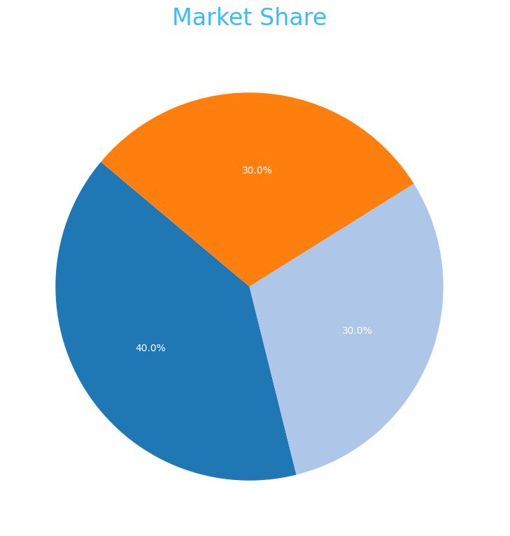
Market Share

Slide 17

Growth Projection

