Slide 1
AI Research Agent Market in India
Growth, Trends, and Strategies

Slide 2
Market Overview
• Rapid growth in AI research agent market in India.
• Estimated market growth rate: 25% CAGR.
• Investment in AI reached $1 billion in 2022.
• Over 500 startups operating in the AI sector.

Slide 3
Key Growth Drivers
• Increased AI adoption in healthcare, finance, education.
• Government initiatives supporting AI development.
• Rise of AI-focused startups.
• Collaboration between academia and industry.

Slide 4
Current Market Dynamics
• Market size growth from 8M in 2020 to 10M in 2022.
• Investment trends highlighting significant funding influx.
• Strong competition with Company A holding 40% market share.
• Others accounting for 30% market share.

Slide 5
Future Growth Projections
• Projected market size of 22M by 2026.
• Expected growth to rise to 15M in 2024.
• Sustained demand for AI solutions across sectors.
• Forecasted growth supporting additional investments.

Slide 6
Emerging Trends
• Increased collaboration between academia and industry.
• Focus on ethical AI and research integrity.
• Emergence of AI research hubs in metropolitan areas.
• Trend towards automation and advanced analytics.

Slide 7
Challenges Faced
• Shortage of skilled professionals in AI.
• Data privacy concerns affecting industry growth.
• Need for improved research infrastructure.
• Regulatory challenges hindering innovation.

Slide 8
Opportunities in the Market
• Growing demand for AI solutions across various sectors.
• Potential for international collaborations.
• Increasing consumer acceptance of AI technologies.
• Opportunities for investment in AI startups.

Slide 9
Competitor Analysis
• Competitor A strengths rated at 80.
• Competitor B strengths rated at 65.
• Understanding competitor strategies is crucial.
• Opportunities are ripe for emerging entrants.

Slide 10
Key Recommendations
• Invest in talent development programs.
• Establish partnerships with academic institutions.
• Focus on ethical AI practices.
• Develop market strategies aligned with trends.

Slide 11
Action Plan
• Create a roadmap for talent acquisition.
• Launch industry-academia collaboration initiatives.
• Develop a compliance framework for ethical AI.
• Conduct workshops to raise awareness among stakeholders.

Slide 12
Expected Impact of Recommendations
• Aligning strategies to leverage growth opportunities.
• Mitigating skill shortages and regulatory challenges.
• Enhancing operational effectiveness through AI.
• Building trust through ethical practices.

Slide 13
Conclusion
• The AI research agent market in India is on a growth trajectory.
• Strategic alignment with current trends is essential for success.

Slide 14
Key Takeaways
• The AI research agent market in India is poised for explosive growth.
• Addressing skill shortages and regulatory challenges will be key to success.

Slide 15
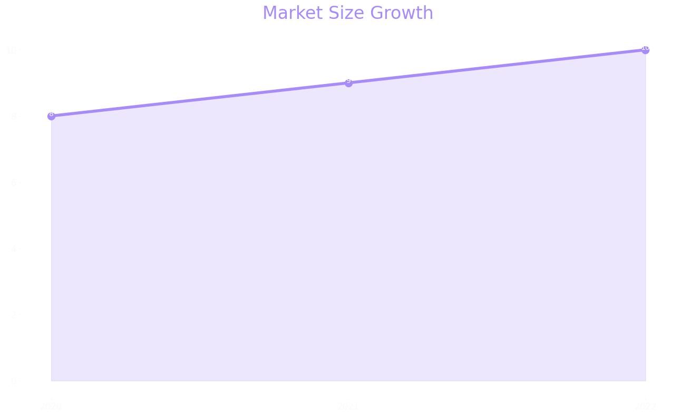
Market Size

Slide 16
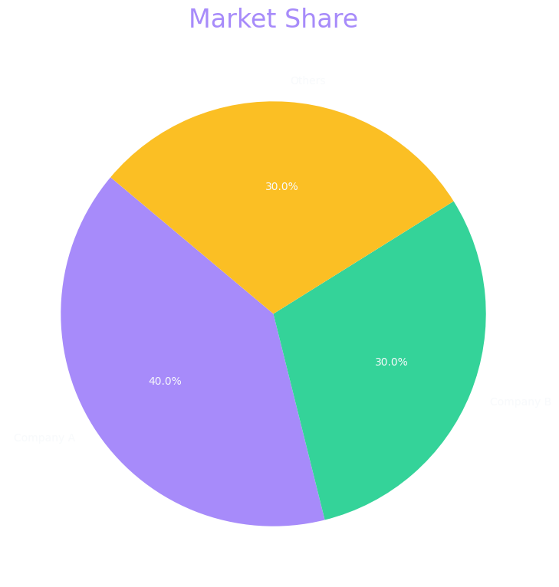
Market Share

Slide 17
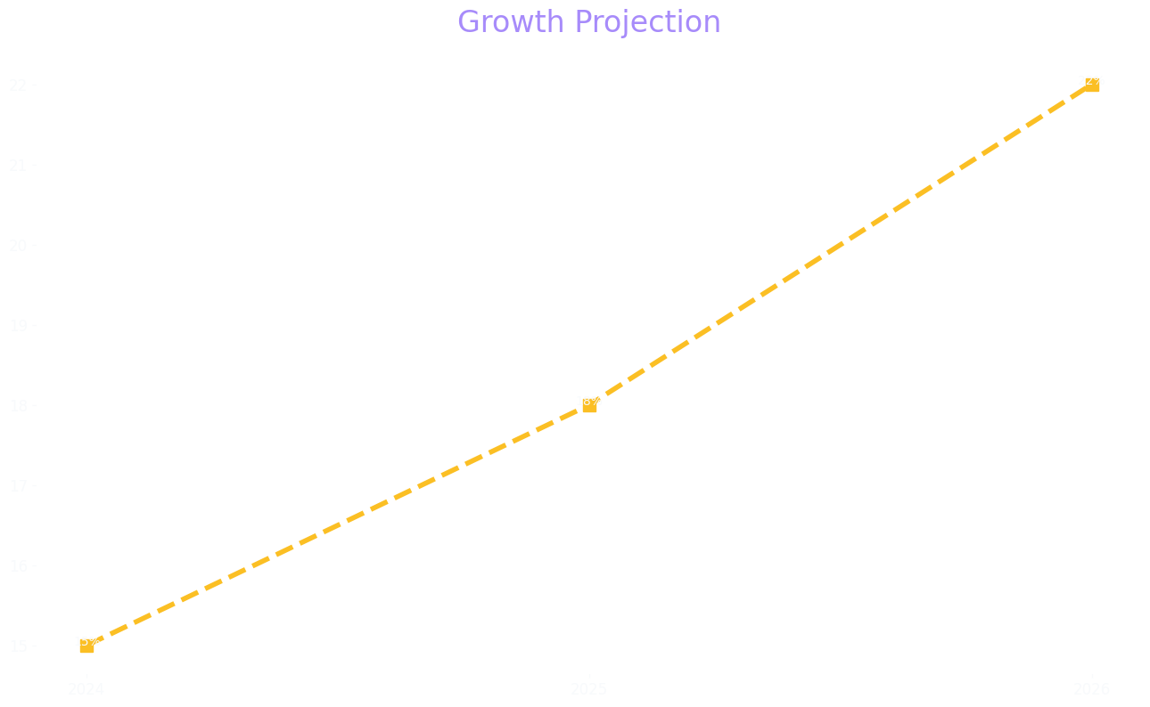
Growth Projection

