Slide 1
AI Research Agent Market in India
Overview and Strategic Insights

Slide 2
Market Overview
• Significant growth in AI research investment.
• Forecasted market size of USD 3.2 billion by 2025.
• CAGR of 32% from 2023 to 2025.
• Diverse applications across various sectors.

Slide 3
Key Market Drivers
• Increased automation demand in industries.
• Government initiatives supporting AI development.
• Surge in startup innovations.
• Rising investments from the private sector.

Slide 4
Market Trends
• Integration of AI with big data.
• Emergence of personalized AI solutions.
• Focus on ethical AI applications.
• Growing importance of sustainability in AI.

Slide 5
Challenges in AI Research
• Skill shortages in AI professionals.
• Data privacy and regulatory challenges.
• Limited infrastructure for AI deployment.
• Need for continuous innovation.

Slide 6
Opportunities for Growth
• Collaborations between academia and industry.
• Increased funding for innovative AI startups.
• Expansion into uncharted sectors.
• Development of specific AI applications.

Slide 7
Competitor Landscape
• Key players include Company A and Company B.
• Competitor A strengths score: 80.
• Competitor B strengths score: 65.
• Potential disruptions from emerging startups.

Slide 8
Market Size Evolution
• Value reached USD 10 million in 2022.
• Projected growth to USD 15 million in 2023.
• Long-term forecast to exceed USD 3 billion by 2025.
• Steady annual growth rates anticipated.

Slide 9
Market Share Breakdown
• Company A holds 40% market share.
• Company B commands 30% of the market.
• Others contribute the remaining 30%.
• Competitive strategies driving market distribution.

Slide 10
Future Growth Projections
• Anticipated market size of USD 20 million by 2024.
• Projected growth to USD 27 million by 2025.
• Estimated market reach of USD 34 million by 2026.
• Stable demand expected across sectors.

Slide 11
Trend Impacts on Market
• Automation trend frequency: 22 occurrences.
• Analytics trend frequency: 14 occurrences.
• Growing trend of personalized AI applications.
• Higher demand for ethical AI solutions.

Slide 12
Investment Landscape
• Increase in venture capital funding for AI startups.
• Government incentives boosting R&D.
• Corporate investments in AI research tools.
• Potential for sustainable technology funding.

Slide 13
Regulatory Framework
• Government policies promoting AI innovation.
• Emphasis on data regulation and compliance.
• Support mechanisms for AI infrastructure.
• Strategies for overcoming regulatory hurdles.

Slide 14
Ethical AI Considerations
• Growing focus on responsible AI development.
• Integration of ethical considerations in research.
• Public discourse on AI usage guidelines.
• Balancing innovation with ethical responsibilities.

Slide 15
Conclusion & Key Takeaways
• AI research agent market shows robust growth potential.
• Collaboration between sectors essential for advancement.
• Challenges exist but can be mitigated.
• Strategic investments will drive future innovation.

Slide 16
Key Takeaways
• Embrace collaborations between stakeholders.
• Focus on ethical research and infrastructure development.

Slide 17
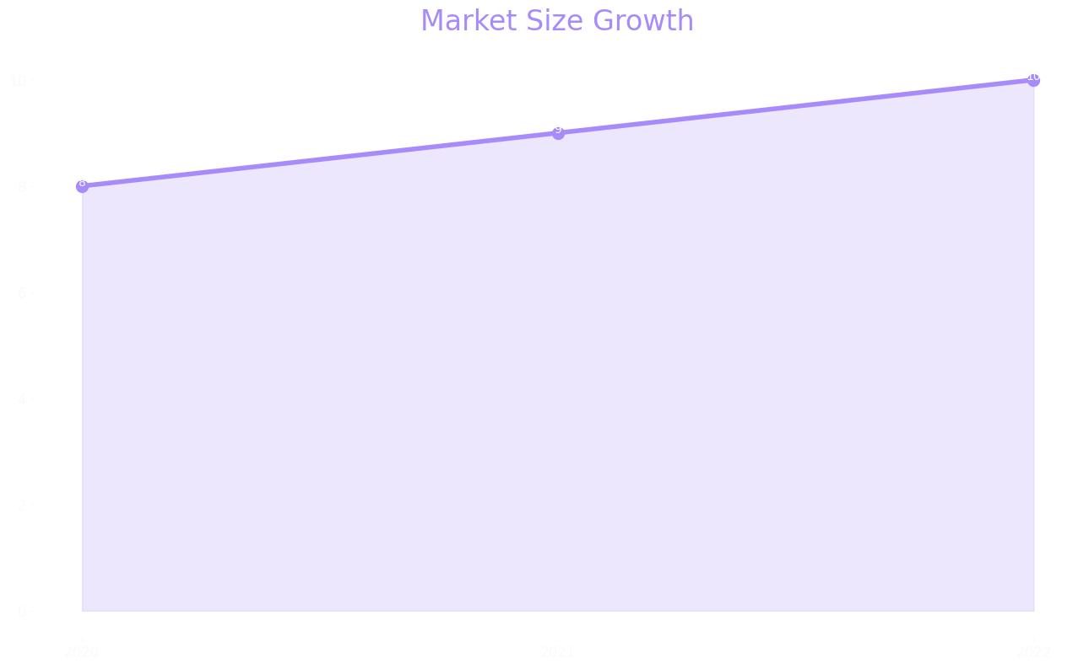
Market Size

Slide 18
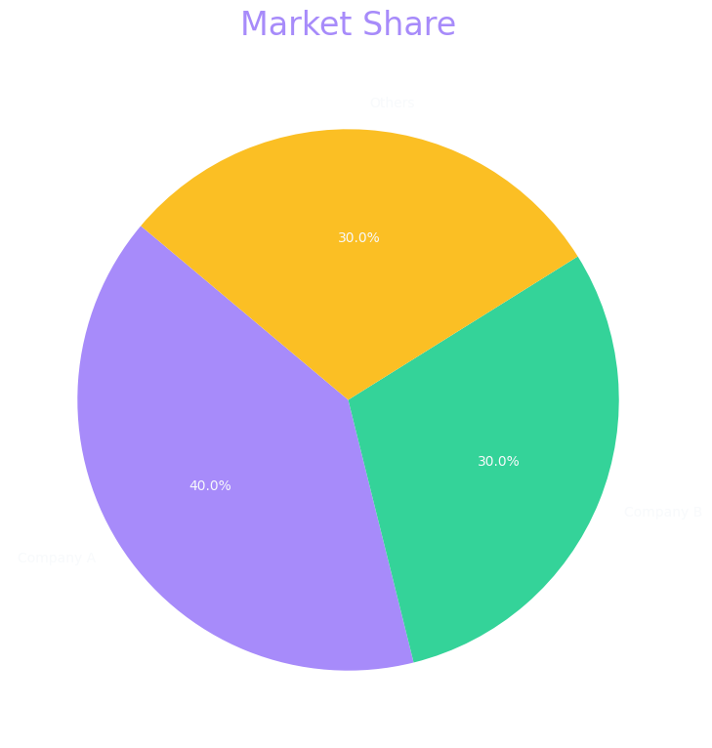
Market Share

Slide 19
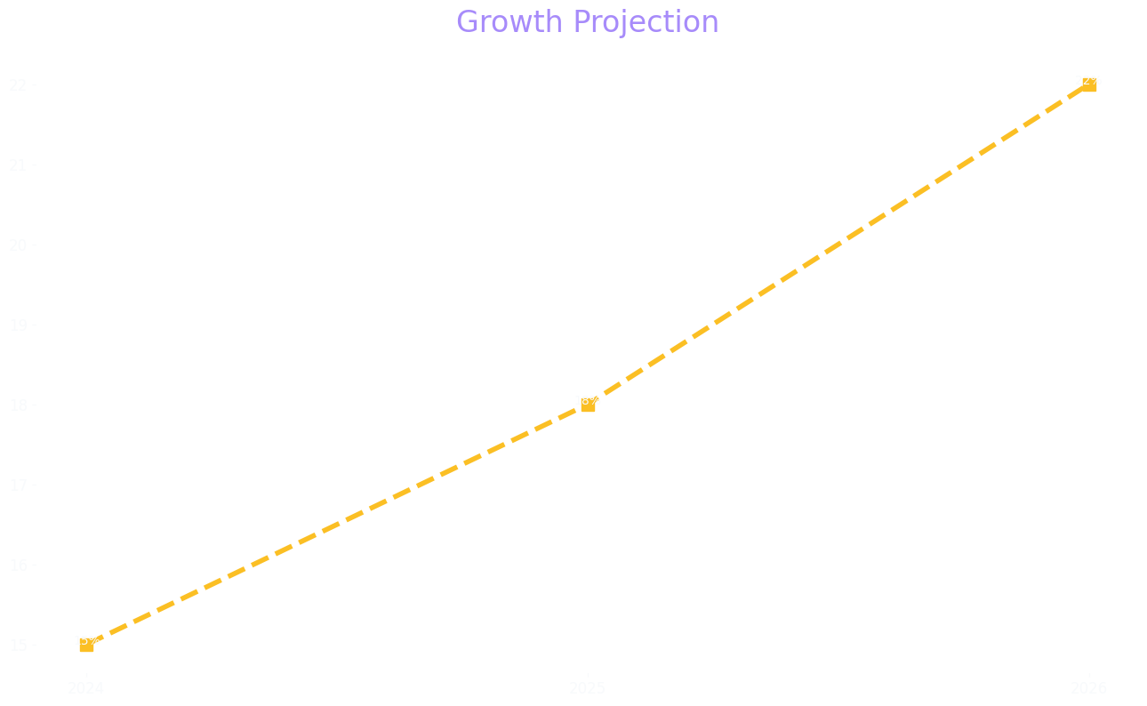
Growth Projection

