Slide 1
Artificial Intelligence in Healthcare
Transforming Patient Care and Operational Efficiency

Slide 2
Overview of AI in Healthcare
• AI revolutionizes healthcare delivery.
• Enhances diagnostic accuracy and efficiency.
• Broad applications from predictive analytics to automation.
• Critical in patient management and operational processes.

Slide 3
Current Market Landscape
• AI market projected to reach $188 billion by 2030.
• Over 50% of healthcare organizations utilize AI tools.
• Competitive growth among leading companies.
• Investment trends in AI technology.

Slide 4
Key Benefits of AI
• Improved diagnostic accuracy by up to 20%.
• Personalized treatment plans enhance patient outcomes.
• Operational efficiencies through task automation.
• AI-driven engagement through chatbots.

Slide 5
Emerging Trends in AI
• Increased remote patient monitoring technologies.
• Focus on personalized medicine powered by analytics.
• Growing demand for administrative workflow automation.
• Integration of AI in telemedicine.

Slide 6
Challenges in AI Integration
• Data privacy and security issues must be addressed.
• Need for integration with existing healthcare IT systems.
• Regulatory frameworks required for safety and efficacy.
• Resistance to change within organizations.

Slide 7
Opportunities for Growth
• Expansion of telemedicine capabilities.
• AI can reduce costs and improve access to care.
• Potential in drug discovery and development processes.
• Enhancement of patient monitoring systems.

Slide 8
Competitive Analysis
• Top competitors include Company A and Company B.
• Strengths assessed based on technology and market share.
• Market dynamics and competition intensity.
• Innovations driving competitive advantage.

Slide 9
Market Size Overview
• Market size from 2020 to 2022 shows steady growth.
• Factors contributing to market expansion.
• Future growth projections indicate robust demand.
• Impending market trends and consumer behavior.

Slide 10
Growth Projections (2024-2026)
• Projected growth from $10 billion in 2022 to $22 billion by 2026.
• Expectations driven by technological advancements.
• Demand in personalized healthcare solutions.
• Investment in AI research and development.

Slide 11
Statistical Insights
• AI improves accuracy in diagnostics significantly.
• 50% of healthcare organizations using AI.
• Investment in AI expected to showcase exponential growth.
• Emerging statistics drive industry stakeholders.

Slide 12
Recommendations for Implementation
• Invest in AI diagnostic tools to minimize errors.
• Embed predictive analytics in clinical workflows.
• Utilize chatbots for enhancing patient engagement.
• Align budget with AI integration strategies.

Slide 13
Action Plan
• Allocate resources for AI technology acquisition.
• Partner with AI tech providers for solutions.
• Formulate a task force for navigating compliance.
• Train staff on AI technology applications.

Slide 14
Conclusion
• AI is vital for future healthcare delivery.
• Emphasis on operational and diagnostic efficiencies essential.
• A strategic approach can yield significant benefits.
• Continual learning is imperative for stakeholders.

Slide 15
Key Takeaways
• AI's potential in healthcare is transformative.
• Strategic investment is necessary for future growth.

Slide 16
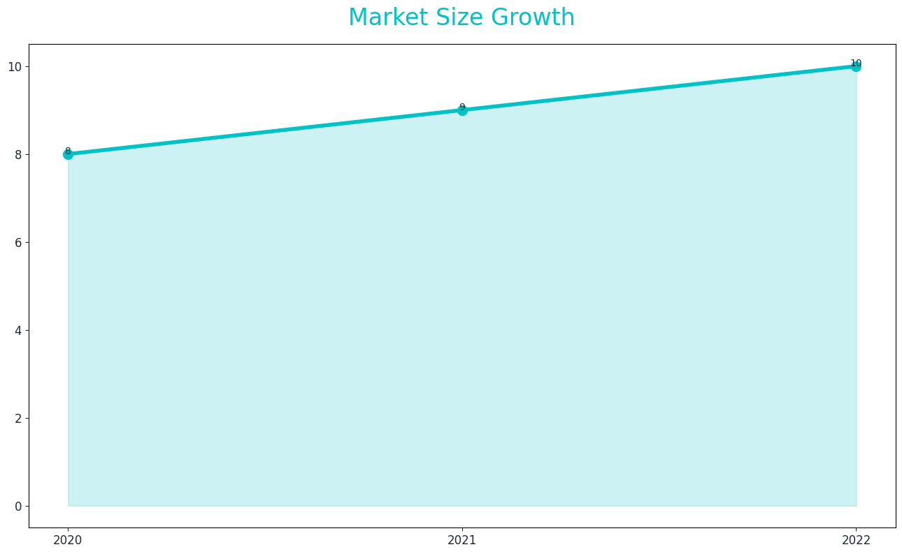
Market Size

Slide 17
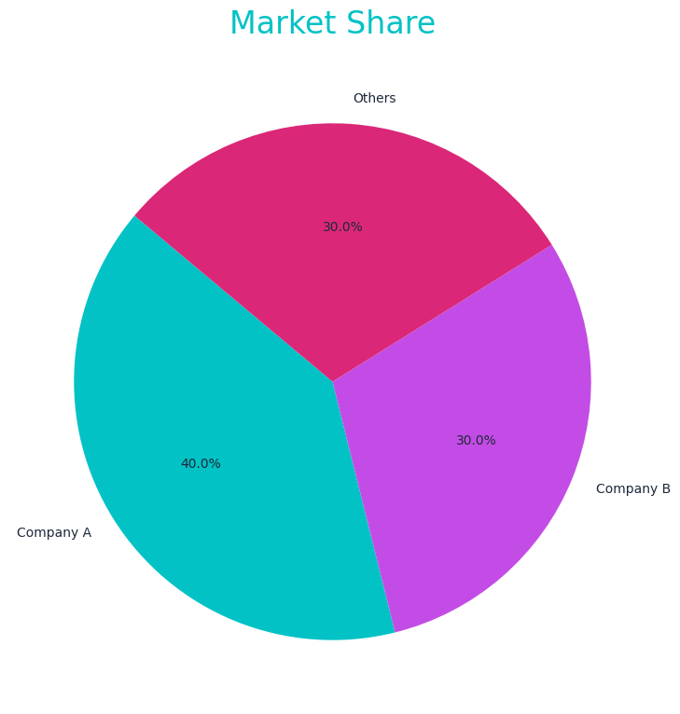
Market Share

Slide 18
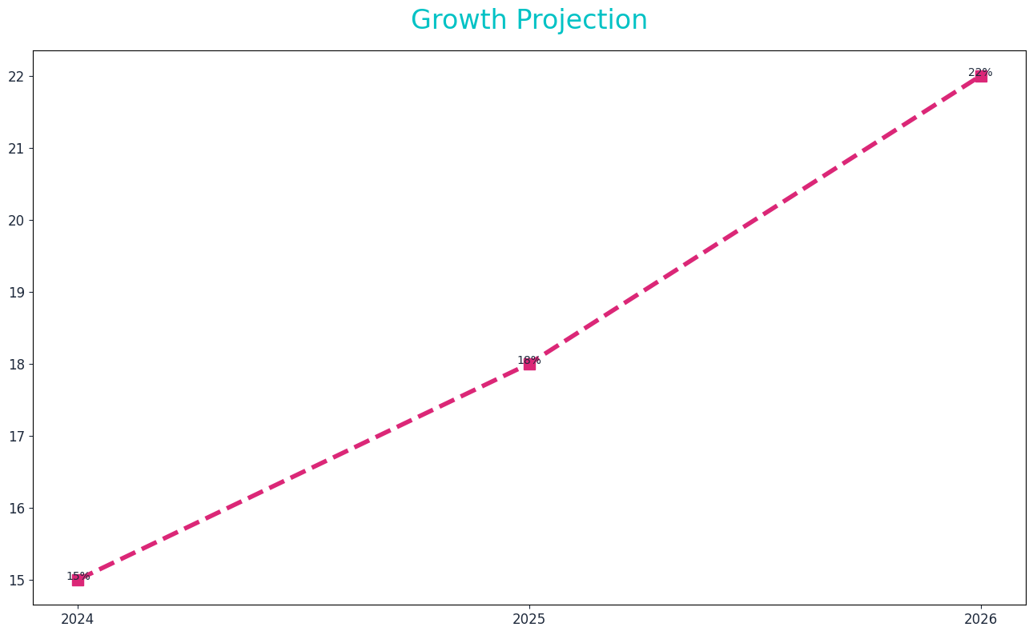
Growth Projection

