Slide 1
Best Phone under 25k Rupees
Market Analysis and Recommendations

Slide 2
Market Overview
• Focus on mobile phones under 25,000 rupees
• Key brands: Xiaomi, Realme, Samsung, Vivo
• Average market price: 22,000 rupees
• Growing consumer interest in specifications and features

Slide 3
Key Competitors
• Xiaomi holds 30% market share
• Realme follows with 25% market share
• Samsung: 20% market share
• Vivo: 15% and others: 10%

Slide 4
Customer Ratings
• Average customer rating: 4.2 out of 5
• Importance of user reviews in decision making
• Consumer preference for performance and camera quality
• Brand reputation influences purchasing behavior

Slide 5
Performance Metrics
• CPU/GPU performance is a critical factor
• Growing demand for 5G-capable devices
• Battery life as a major consumer concern
• Software experience impacts overall satisfaction

Slide 6
Current Trends
• Shift towards enhanced camera capabilities
• Increasing demand for gaming-oriented smartphones
• Consumer preference for longer battery life
• Emergence of 5G technology in mid-range segment

Slide 7
Market Challenges
• Highly competitive landscape with frequent launches
• Consumer confusion over specifications versus brand loyalty
• Price fluctuations caused by local manufacturing
• Impact of import duties on pricing strategies

Slide 8
Opportunities for Growth
• Launch of limited editions or special models
• Targeting the rising middle class with premium features
• Exploitation of increased online sales channels
• Collaboration with influencers for brand visibility

Slide 9
Consumer Insights
• Survey data indicates preference for camera and performance
• Feedback analysis highlights brand loyalty patterns
• Consumer willingness to pay for enhanced features
• Strategic importance of post-purchase support

Slide 10
Sales Channels
• Growing online sales platforms
• Importance of retail partnerships
• Promotion strategies for effective market penetration
• Utilization of social media for brand engagement

Slide 11
Regional Analysis
• Regional differences in brand preferences
• Impact of local competition on pricing strategies
• Demographics influencing purchasing decisions
• Opportunities in Tier 2 and Tier 3 cities

Slide 12
Future Projections
• Market is projected to grow at 15% CAGR by 2025
• Expected growth in consumer demand for smart features
• Potential for advances in mobile technology
• Increasing importance of sustainability in consumer choices

Slide 13
Conclusion
• Strategic positioning of brands crucial for success
• Understanding consumer needs enhances market share
• Focus on innovation will lead to new opportunities
• Continued adaptation to market dynamics is essential

Slide 14
Key Takeaways
• Invest in emerging technologies for competitive advantage
• Leverage consumer insights for tailored marketing strategies

Slide 15
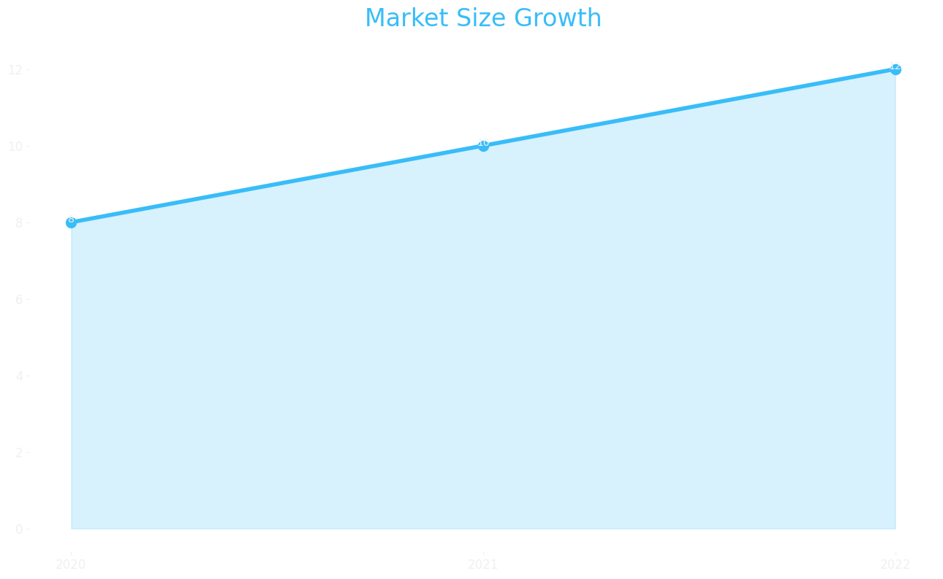
Market Size

Slide 16
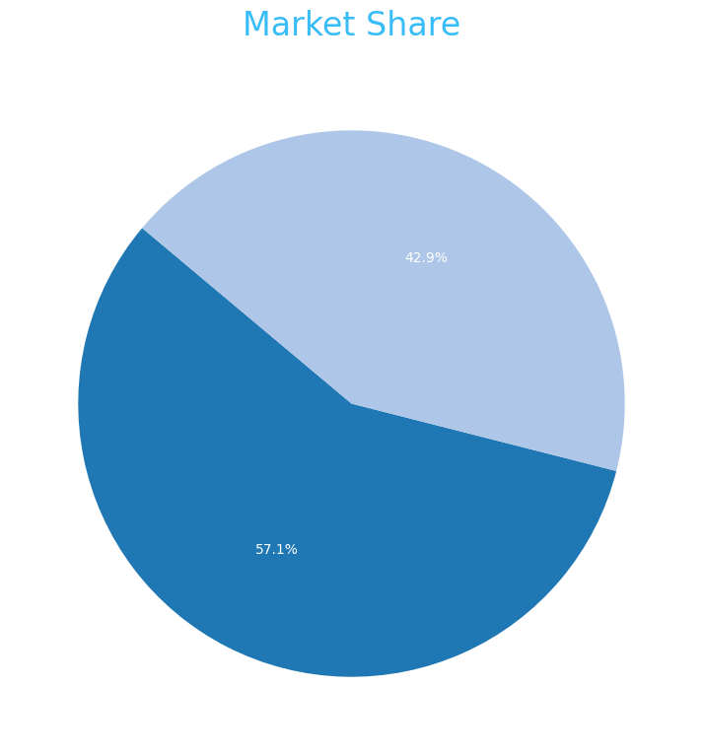
Market Share

Slide 17
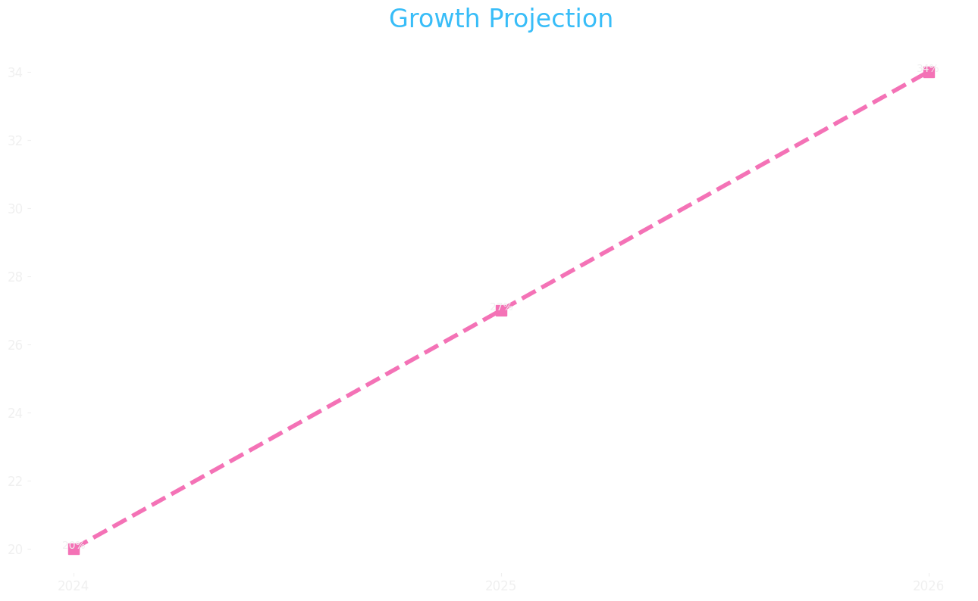
Growth Projection

