Slide 1
Future of Work
Navigating the Evolving Workplace Landscape

Slide 2
Introduction
• Overview of the Future of Work theme.
• Importance of adapting to evolving work environments.
• Impact of technology on job roles.
• Growing relevance of remote work.

Slide 3
Technological Advancements
• AI is reshaping traditional job roles.
• Automation improving efficiency in tasks.
• Need for upskilling in emerging technologies.
• Integration of collaborative tools in workflows.

Slide 4
Remote Work Trends
• 70% of employees prefer flexible working options.
• Hybrid models becoming standard practice.
• Increased reliance on digital communication.
• Impact on employee satisfaction and productivity.

Slide 5
Employee Well-being
• Organizations prioritizing work-life balance.
• Importance of mental health initiatives.
• Programs promoting physical well-being gain traction.
• Flexible work hours contributing to job satisfaction.

Slide 6
Gig Economy Growth
• Freelancers projected to be 50% of the U.S. workforce by 2027.
• Flexibility in workforce engagement.
• Skills diversification among gig workers.
• Implications for traditional employment models.

Slide 7
Challenges in the Modern Workplace
• Rapid technological shifts create adaptation hurdles.
• Maintaining company culture in remote settings.
• Addressing equity in remote work access.
• Navigating cybersecurity challenges.

Slide 8
Opportunities for Growth
• Leveraging global talent pools remotely.
• Innovating business models for flexibility.
• Emphasizing diversity and inclusion initiatives.
• Potential for new service offerings.

Slide 9
Trend Analysis
• Increased frequency of automation in operations.
• Analytics-driven decision making on the rise.
• Sustainability considerations influencing employment.
• Corporate responsibility shaping employer branding.

Slide 10
Market Size and Dynamics
• Market size projected growth trends.
• Analysis of competitive positioning.
• Identifying key market players.
• Strategic recommendations based on insights.

Slide 11
Competitor Landscape
• Strength analysis of key competitors.
• Market share distribution among players.
• Identifying competitive advantages.
• Benchmarking against industry standards.

Slide 12
Statistics Overview
• 70% remote work preference among employees.
• 50% gig economy projection for 2027.
• Growth in new job roles driven by technology.
• Analysis of workforce demographics.

Slide 13
Solution Recommendations
• Invest in employee training programs.
• Develop policies for remote work inclusivity.
• Enhance mental health support systems.
• Leverage technology for effective collaboration.

Slide 14
Conclusion
• Future of work offers diverse opportunities.
• Adaptability will be key to success.
• Emphasizing employee well-being is crucial.
• Strategic foresight can drive growth.

Slide 15
Key Takeaways
• The workplace landscape is transforming rapidly.
• Organizations must embrace change for future success.

Slide 16
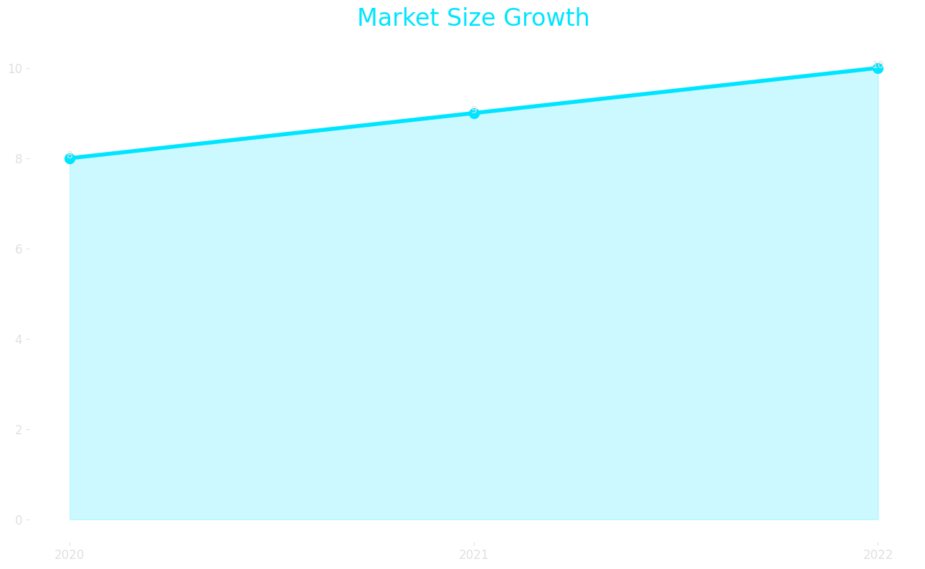
Market Size

Slide 17
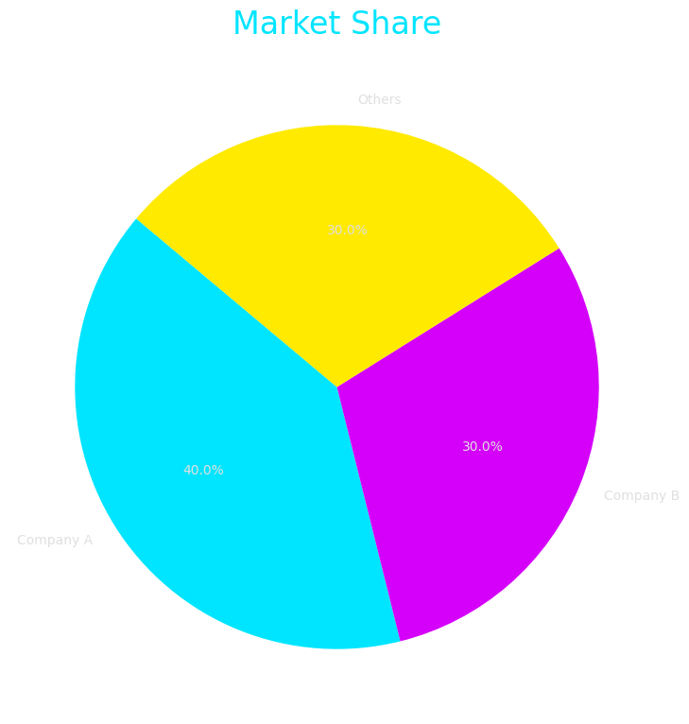
Market Share

Slide 18
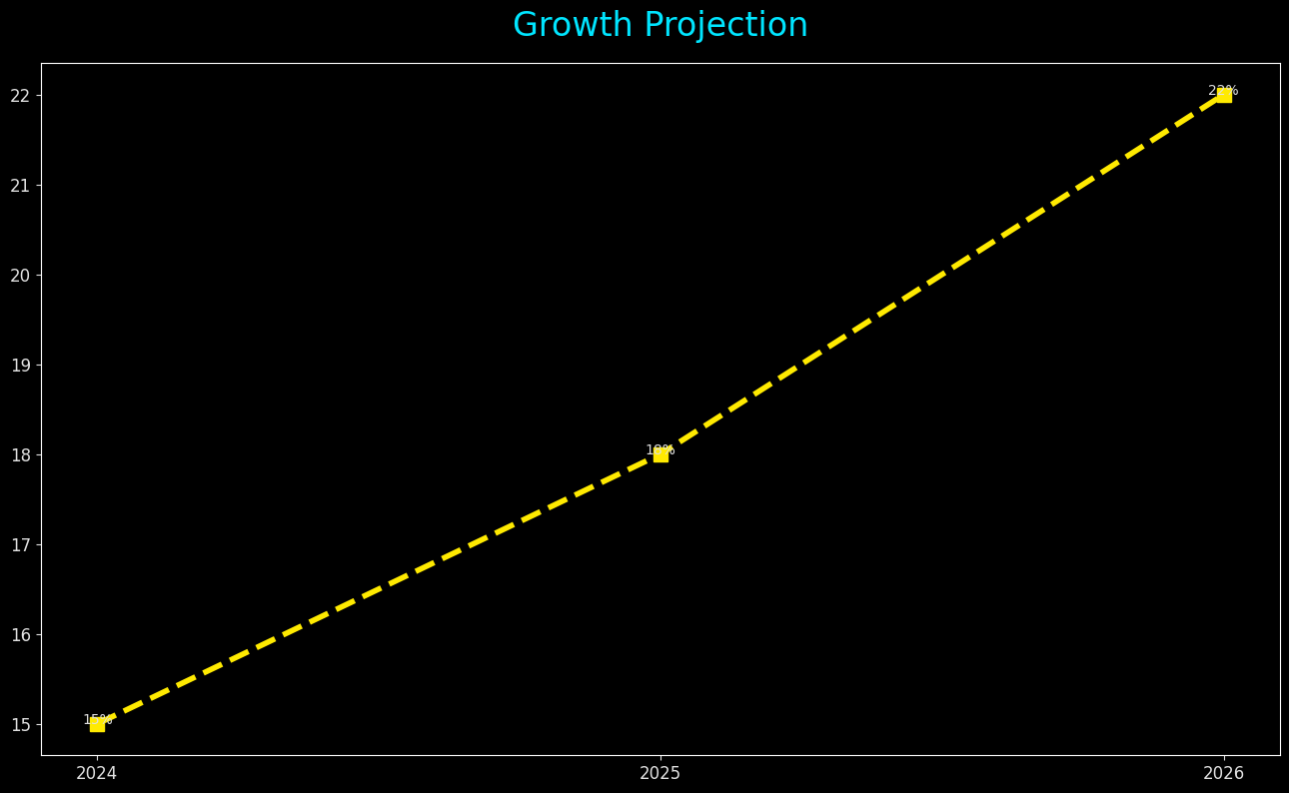
Growth Projection

