Slide 1
Impact Analysis
Exploring Multifaceted Effects on Society, Economy, and Environment

Slide 2
Introduction to Impact
• Definition of impact in various contexts
• Importance of measuring impact
• Overview of factors influencing impact
• Scope of our study

Slide 3
Economic Growth
• Global GDP growth reached 3.5%
• Impactful policies driving growth
• Case studies in economic impact
• Balancing profit and purpose

Slide 4
Social Change
• 25% increase in community engagement
• Role of social initiatives
• Assessing social impact quantitatively
• Connecting social change to corporate strategies

Slide 5
Environmental Sustainability
• 15% reduction in carbon emissions
• Evaluating environmental policies
• Long-term sustainability strategies
• Corporate responsibility in environmental impact

Slide 6
Trends in Impact Analysis
• Focus on sustainability in governance
• Increasing interest in social impact investing
• Technological advancements in impact measurement
• Case examples of emerging trends

Slide 7
Challenges in Measuring Impact
• Quantifying social and environmental impacts
• Industry resistance to regulation
• Lack of standardized measurement metrics
• Addressing skepticism in impact reporting

Slide 8
Opportunities for Improvement
• Emergence of new technologies
• Potential for public-private partnerships
• Rising demand for responsible business practices
• Innovative approaches to enhance impact

Slide 9
Stakeholder Engagement
• Importance of stakeholder involvement
• Methods for effective engagement
• Building trust with communities
• Feedback loops for continual improvement

Slide 10
Data Analysis Techniques
• Quantitative vs Qualitative data
• Data collection methods
• Leveraging analytics for impact assessment
• Tools for measuring impact

Slide 11
Case Studies
• Highlighting successful impactful initiatives
• Lessons learned from failures
• Comparative analysis of impact
• Developing best practices

Slide 12
Chart of Market Trends
• Visual representation of market size
• Projection of growth trajectory
• Market share analysis
• Competitive landscape review

Slide 13
Recommendations Overview
• Integrate sustainability metrics into frameworks
• Invest in measurement technologies
• Foster public-private partnerships
• Actionable steps for implementation

Slide 14
Future Outlook
• Predictions for the next 5 years
• Sustainability as a corporate mantra
• Adapting to changing social expectations
• Emphasizing transparency and accountability

Slide 15
Key Takeaways
• Impact analysis is crucial for sustainable growth.
• Harnessing technology will enhance future efforts.

Slide 16
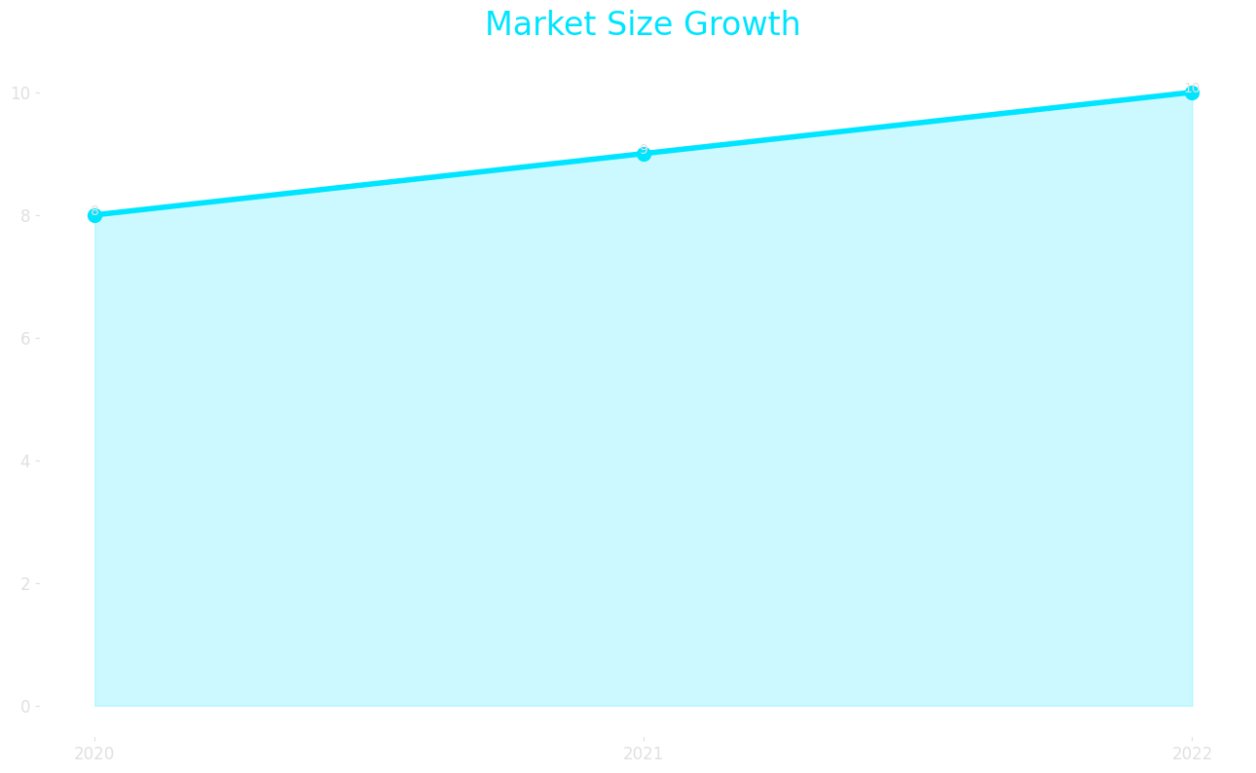
Market Size

Slide 17
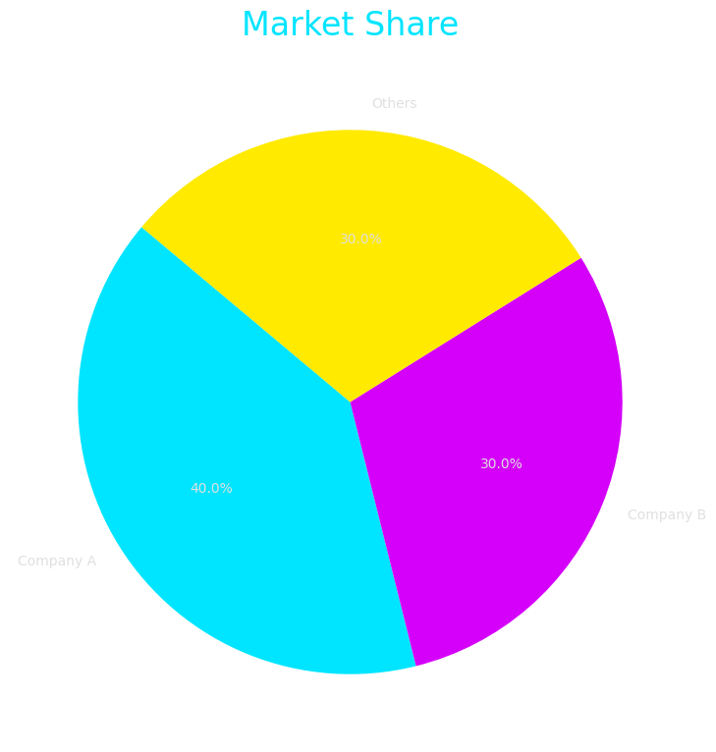
Market Share

Slide 18
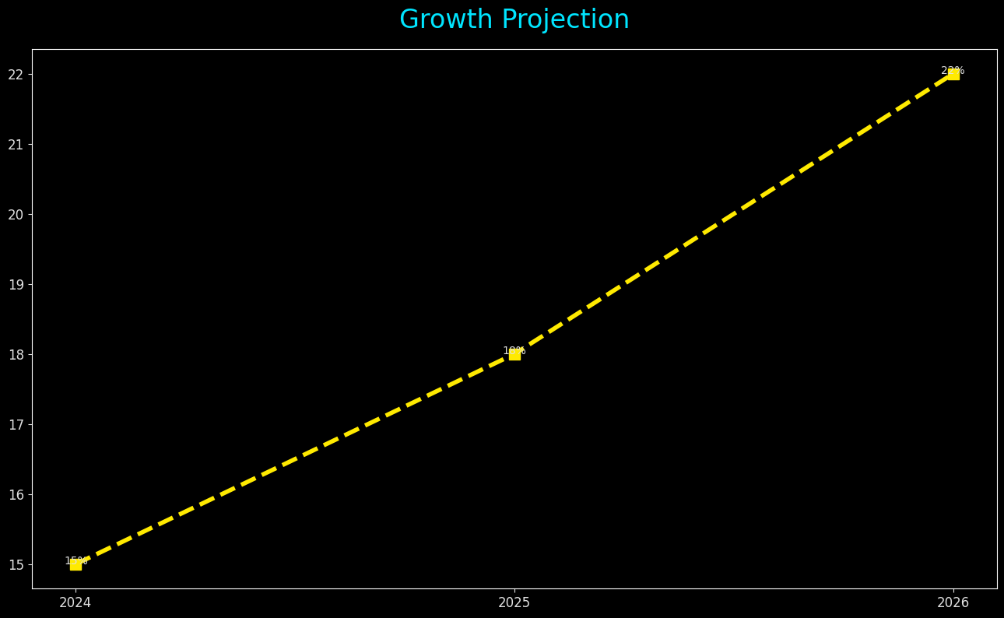
Growth Projection

