Slide 1
Exploring, visualizing, questioning and cleaning the data is 160% of the effort… …the model is the other NAN%
- Cameron Kerr

Slide 2
Background
I’m not a statistician, but I have an interest in Data Science (look out!)
I do have a background in Computer Science; more from systems and networking.
I do use Python regularly and I’ve used Pandas a bit.
…. Let’s hack!

Slide 3
The plan
import pandas as pd
import seaborn as sns
import matplotlib.pyplot as plt
import numpy as np

Slide 4
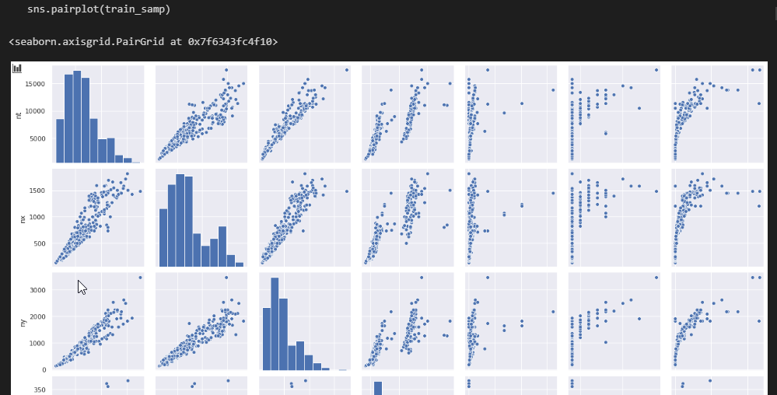
Seaborn has PairPlot!

Slide 5
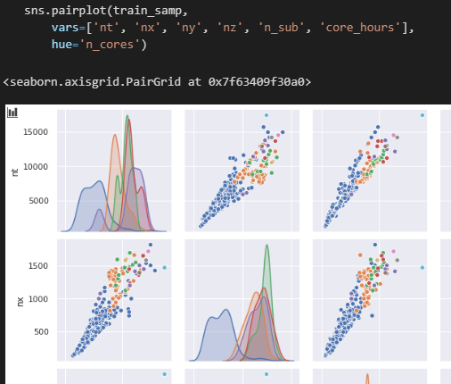
N_sub is interesting
I wanted to explore the outliers, and so wanted to show the effect of different values of n_sub.
Enter seaborn’s ‘hue’, and panda’s cut/qcut to explore deciles of n_sub
Similarly for n_cores
n_sub last decile is very very wide, and core_hours go crazy!

Slide 6

One Key Relationship
Initially expected (early assumption warning) that I might use a Multiple [Linear] Regression …. but features are not linear
Realisation: number of data-points ~= nt*nx*ny*nz, and is pretty linear wrt core_hours
… but n_cores won’t be linear, so that’s still wrong, and n_sub is a mystery at this stage

Slide 7
Explore different n_sub bins
train['n_sub_deciles'] = pd.qcut(train['n_sub'], q=10, precision=0)
sns.pairplot(train_samp, vars=['ntxyz', 'n_sub', 'n_cores', 'core_hours’], hue='n_sub_deciles')
sns.lmplot(data=train, x='ntxyz', y='core_hours’, hue='n_sub_deciles’, ci=None, height=10, scatter_kws={"alpha": .1}, order=2)

Slide 8

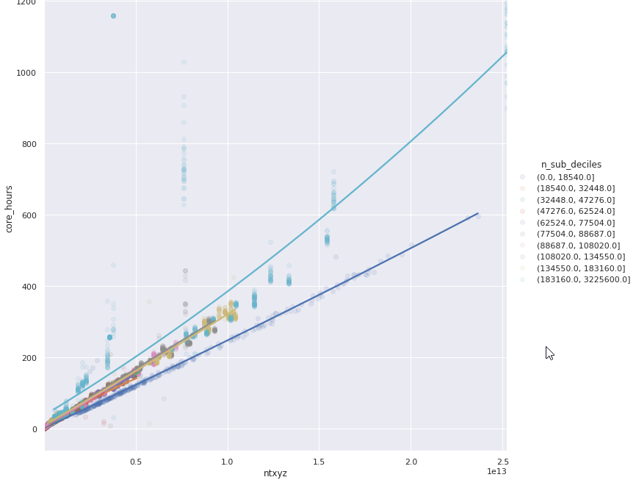

Aha #1
Small values of n_sub look to be very predictable
Very large values much less so
We can minimise loss on the small jobs; maybe do something a bit different for other parts of n_sub

Slide 9
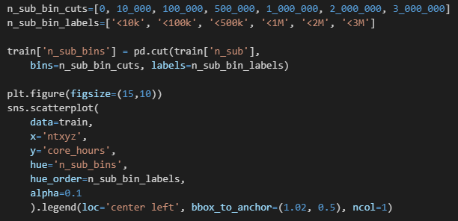
Explore top range of n_sub

Slide 10
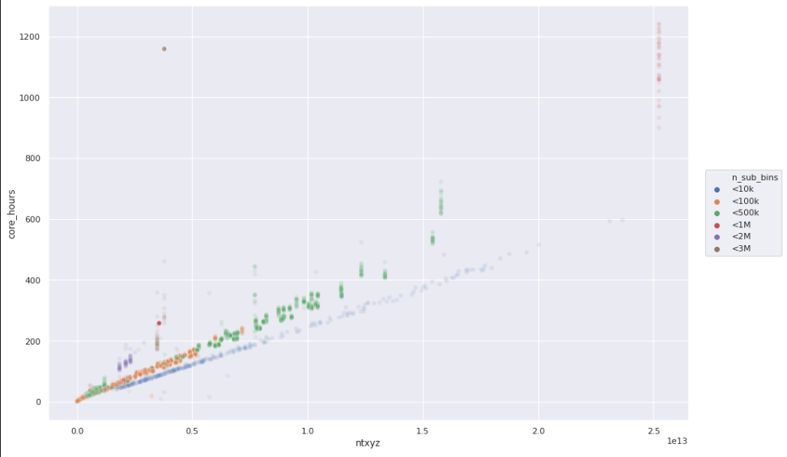
Pathological n_sub?
We can see where the highest level of n_sub have been used.
Using alpha as a poor-mans densibility indicator
More insight around that outlier in the top-left needed

Slide 11
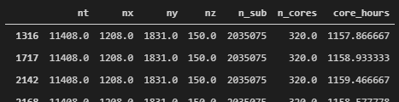
Outlier data
train[ ( train['core_hours'] > 1000 ) & ( train['n_sub_bins'] == '<3M' ) ][['nt', 'nx', 'ny', 'nz', 'n_sub', 'n_cores', 'core_hours’]]
That output was cased by identical inputs (yeah, so?)
But do the same inputs give the same output?

Slide 12
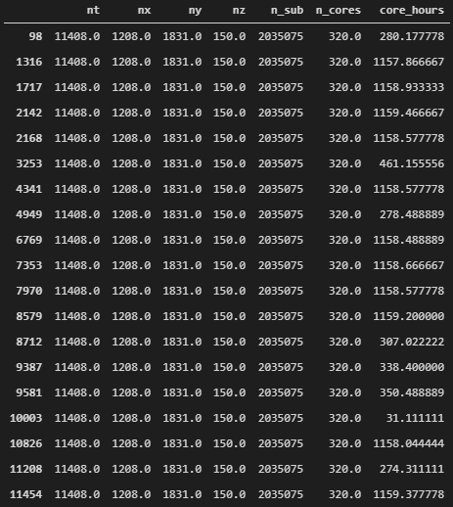
train[ ( train['nt'] == 11408.0 ) & ( train['nx'] == 1208.0 ) & ( train['ny'] == 1831.0 ) & ( train['nz'] == 150.0 ) & ( train['n_sub'] == 2035075 ) & ( train['n_cores'] == 320.0 ) ][['nt', 'nx', 'ny', 'nz', 'n_sub', 'n_cores', 'core_hours']]
SYSTEM ERROR? APPLICATION ERROR? ABORTED?

Slide 13
How bad is this problem?
The input data lacks:
Timing information (was there a systemic error at a particular time(s))
Process result (aborted due to time-exceeded, crashed, operator interrupt, or completed)
Group data into similar inputs (“fingerprints”); get standard deviation for each finger-print.
Drop all data points with fingerprint standard-deviation over a threshold

Slide 14
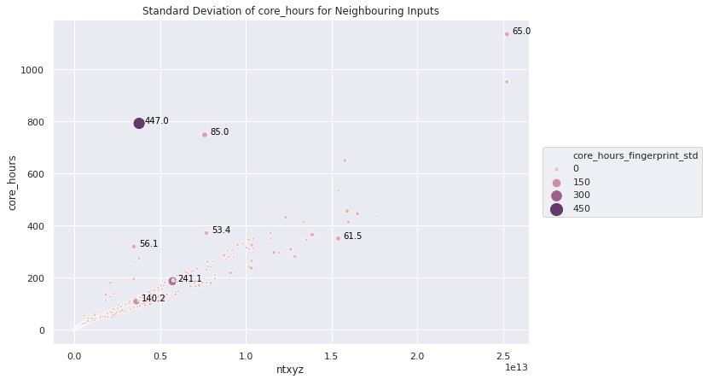
StdDev of each fingerprint

Slide 15
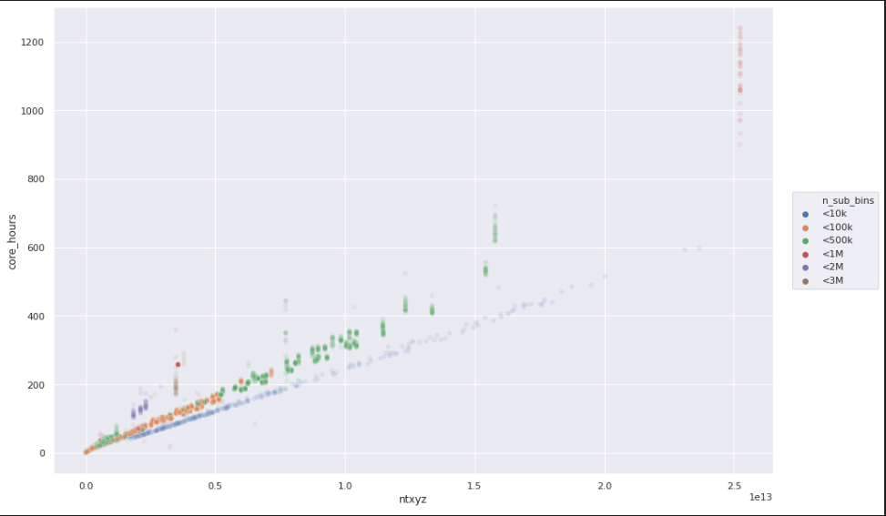
Cleaner Data
Outlier in top-left removed
Still plenty of good data
Perhaps a linear or polynomial regression depending on n_sub_bin
Maybe something different for mega n_subs

Slide 16
Review
Thanks!
Expectation
Reality
Play with data
Learn some seaborn and pandas
Learn some scikit-learn
Generate a model
10 hours they said…
Practiced a lot of Pandas
Practiced a good amount of Seaborn
Caught up a bit on my Udemy courses
Made some good clean data
Had a lot of fun
… but Hackathon is not the best format for discovering Stats/ML on your own

