Slide 1
PSO-GA Hybridization

Slide 2
Contents
GA
PSO
Random Search
Explotation vs Exploration
Two hybrids

Slide 3
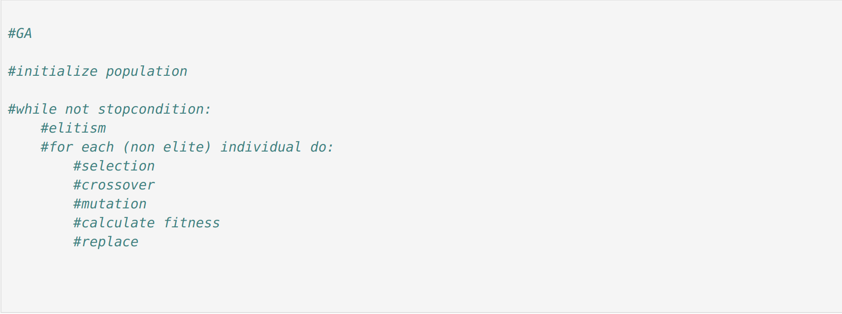
GA

Slide 4
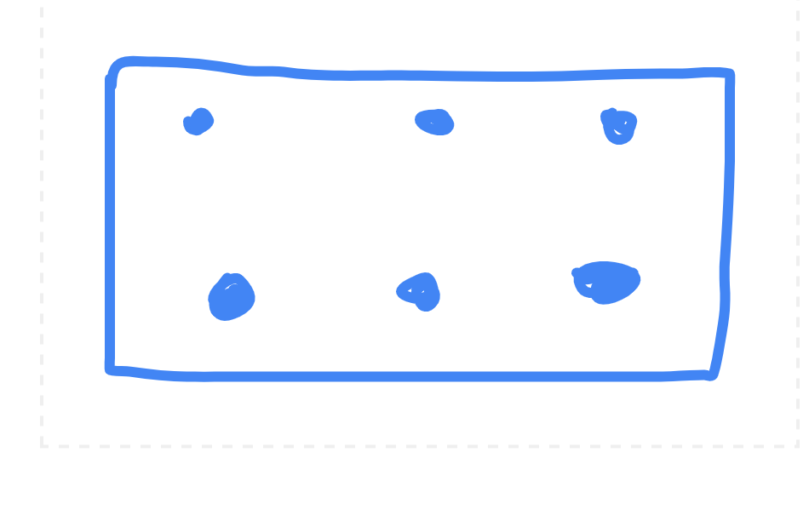
GA

Slide 5
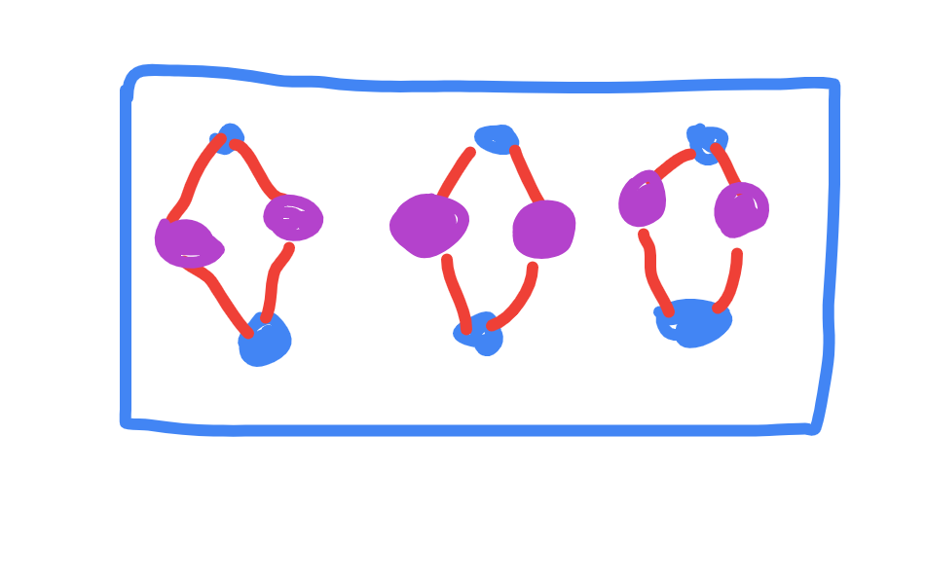
GA

Slide 6
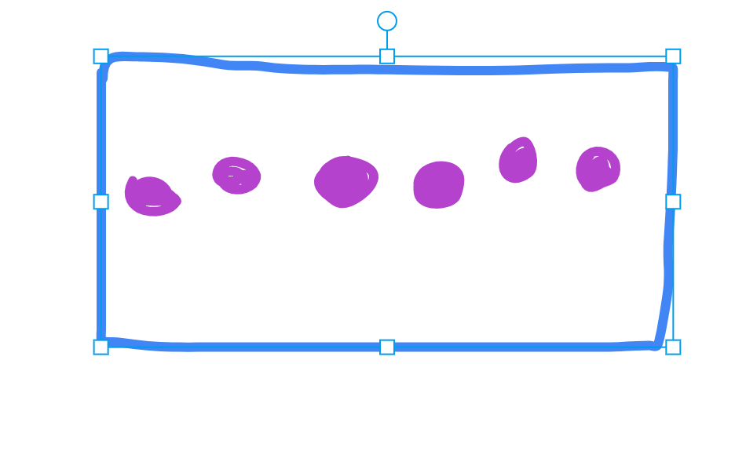
GA

Slide 7
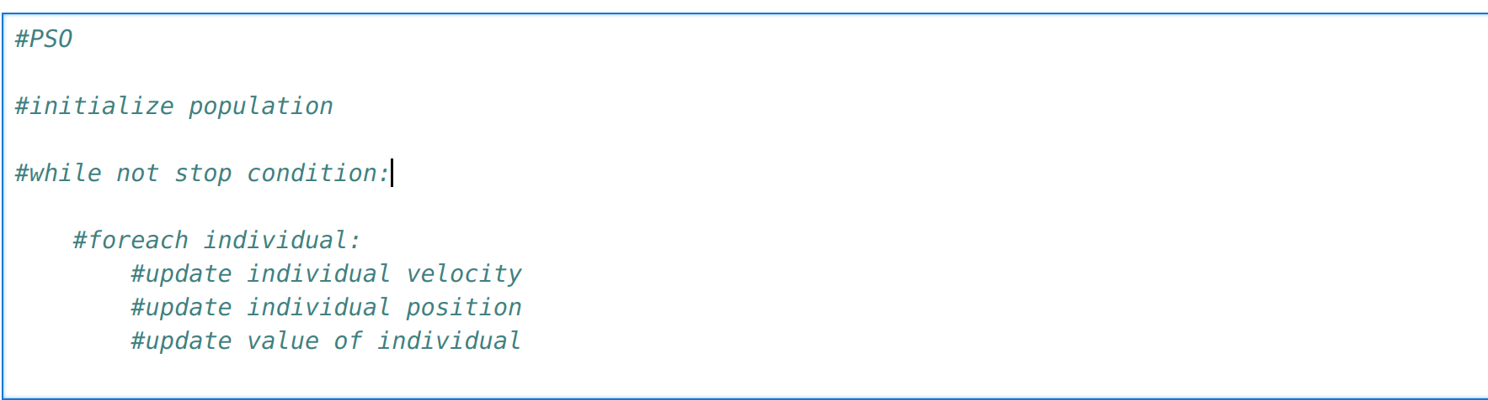
PSO

Slide 8
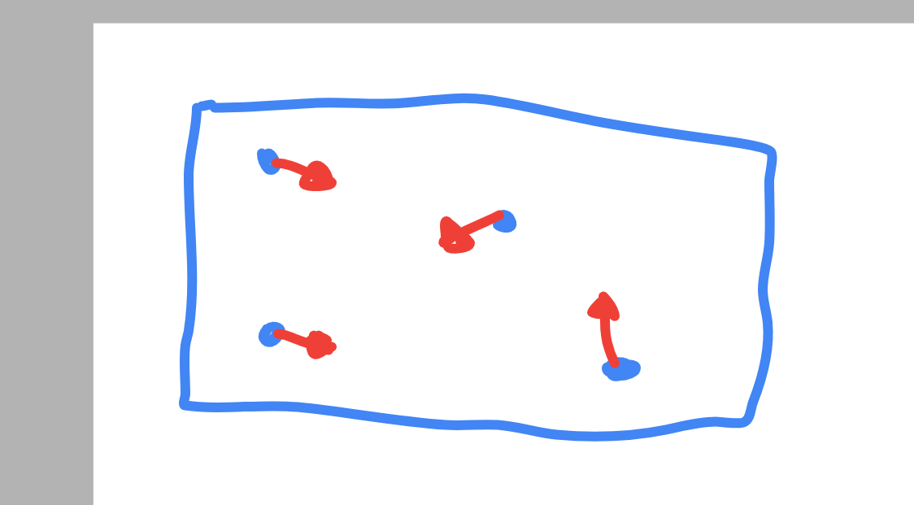
PSO

Slide 9
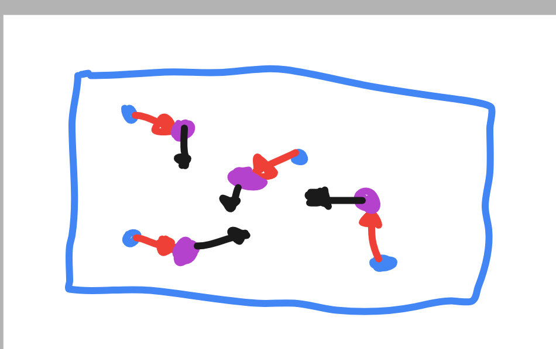
PSO

Slide 10
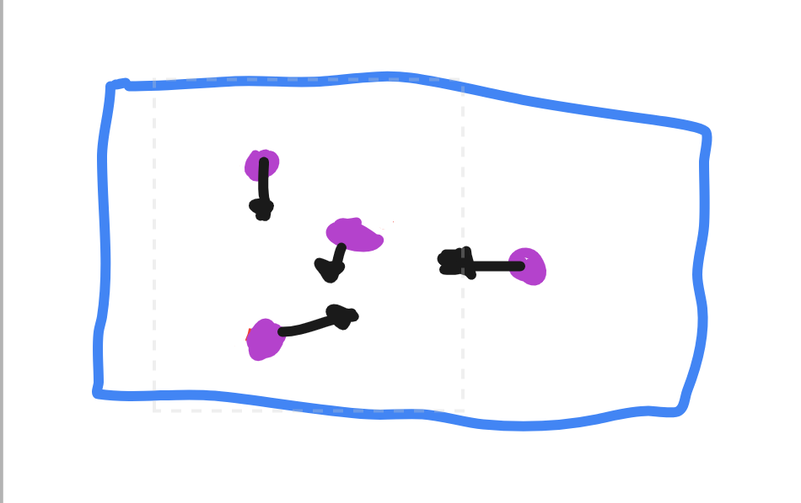
PSO

Slide 11
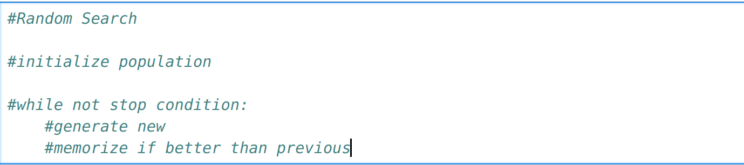
Random Search

Slide 12

Random Search

Slide 13

Random Search

Slide 14
First Conclusion
Plain PSO works better than all tried hybrids
Note all constraints were solved with cliping,non feasable solution is never reached

Slide 15
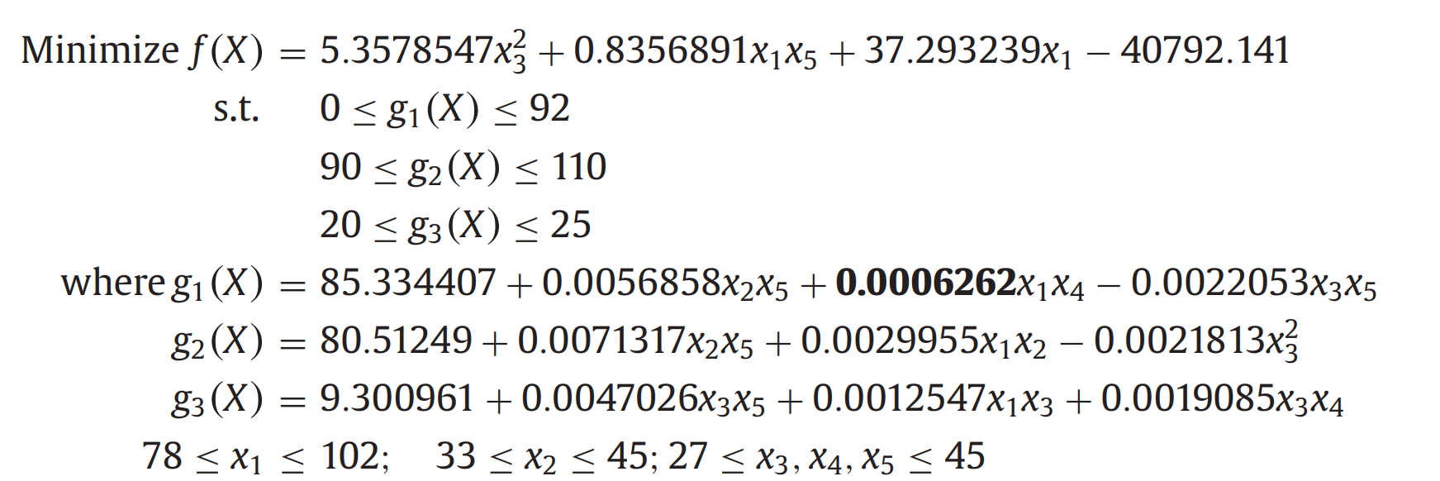
How to deal with complex non linear constraints

Slide 16
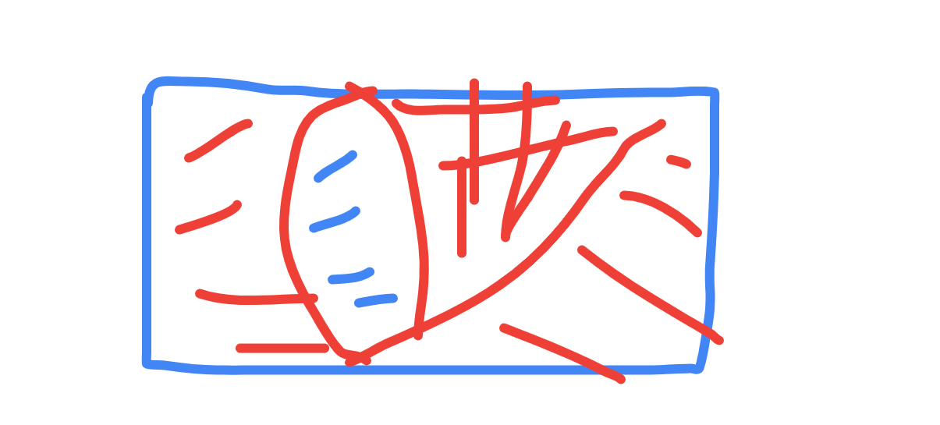
How to deal with non linear constraints
Adding penalties in the fitness function

Slide 17
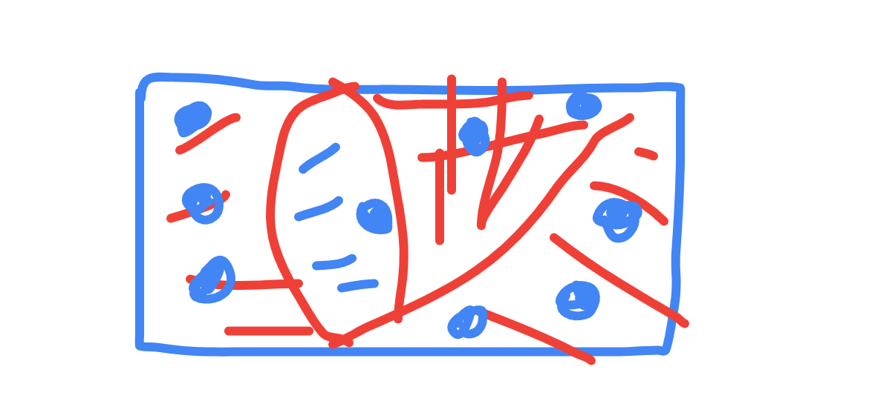
How does pso work now
Now PSO has to many non feasible individuals which may never become feasible and are left to wonder the unfeasable space,pso alone now becomes useless.

Slide 18
Exploration vs Explotation
Lets take a look how PSO,GA and Random Search compare in these fields.

Slide 19
Exploration vs Explotation GA
Excelent exploration through crossover,mutation and initialization.
Reaches Explotation through elitism and selection.

Slide 20
Exploration vs Explotation PSO
Reaches Exploration with initialization,and the early stages ,strugles to find a way out of non feasible search space.
Explotation is excelent,it pushes all the individuals towards the a best solution gradualy.

Slide 21
Exploration vs Explotation Random Search
Random search is pretty much pure exploration asside from remembering the best yet.

Slide 22
What should be the ration of exploration to explotation

Slide 23
What should be the ration of exploration to explotation
Explotation/Exploration=Pall/Pblue

Slide 24
Second Conclusion
When it comes to explotation PSO works amazing
When it comes to exploration GA and Random Search are great

Slide 25
Aproach1
Modified PSO
Give each Individual a life_expectancy and age
Run PSO iterations and for each increase the age of each individual
When an individual reaches its life_expectancy,do crossover, mutation and repcle it with the better child

Slide 26
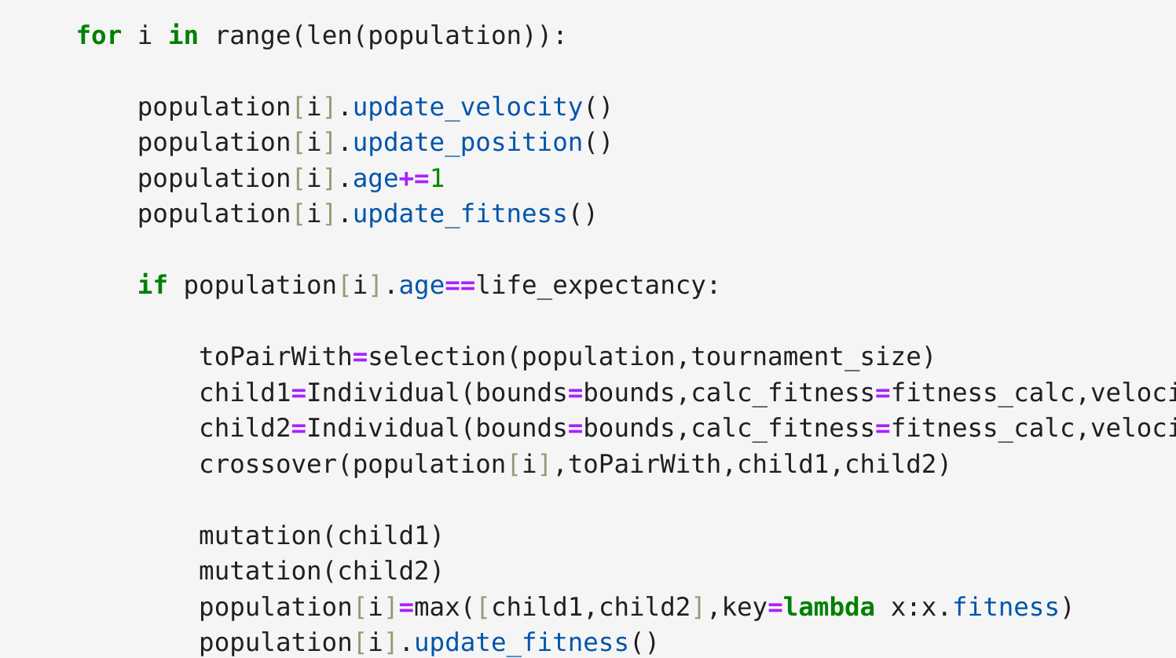
Aproach1

Slide 27
Approach1 what does this mean?
Every life_cycle iterations of PSO we do one GA iteration.More Exploitation that Exploration focused approach .

Slide 28
Approach2
Also a PSO modification
After every PSO iteration we select a couple Individuals ,for each individual selected we put it in a new population and run GA on said population ,and then replace it with the best GA solution.
The PSO is a minor part that only pushes it in the right direction
This approach is much more heavy on exploration than explotation.

Slide 29
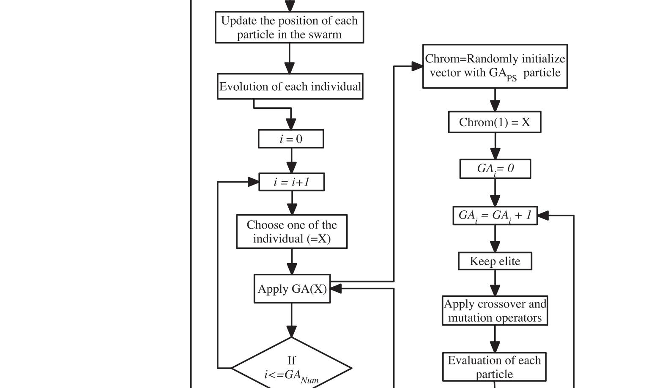
Approach2

Slide 30
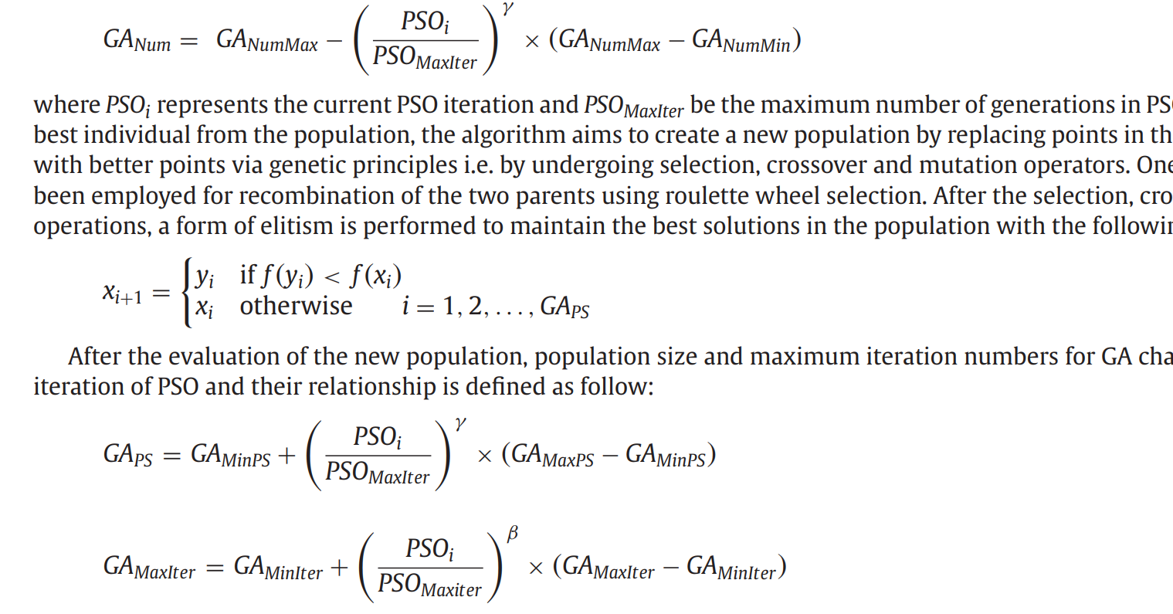
Approach2
The parameters of GA change over time.

Slide 31
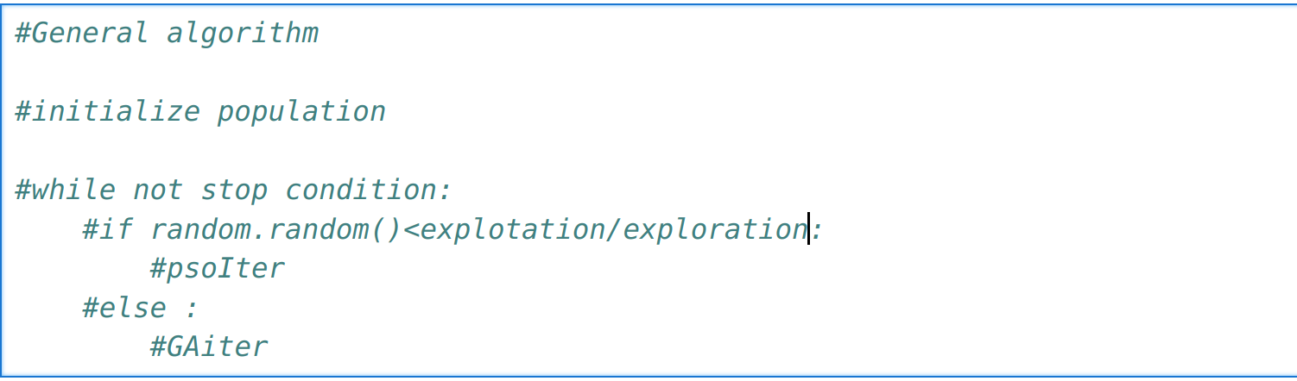
General algorith

Slide 32
Summary
Exploration vs Exploitation

Slide 33
Hvala na paznji!

