Slide 1
Characterization of big.LITTLE scheduler
Arth Shah Farnoosh Javadi
Fall-14 ee202A PROJECT

Slide 2
Outline
Introduction
Motivation
Platform
Results
Conclusion

Slide 3


Introduction
ARM big.LITTLE is a heterogeneous computing architecture. It couples slower, low power processor cores with more powerful and power hungry ones
The intention is to create a multi-core processor that can adjust better to dynamic computing needs and use less power.
Three ways for arranging in a big.LITTLE design:
Clustered switching
In-kernel switcher (CPU migration)
Heterogeneous multi-processing (global task scheduling)

Slide 4
Motivation
Designing high-performance, power-efficient SoCs that optimize mobile device performance is very important
Profiling the power and energy implications of big.LITTLE scheduler will help implement better adaptive scheduling.
ODROIDXU3 is a new platform that implements bit.LITTLE architecture and it is the first ODROID board that features global task scheduling .
To the best of our knowledge there is no work characterizing and profiling the power of the ODROIDXU3 platform

Slide 5
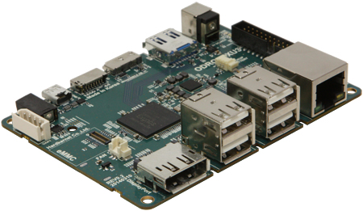
Platform
ODROID-XU3 is a new generation of computing device with more powerful, more energy-efficient hardware
The board can run various flavours of Linux, including the latest Ubuntu 14.04 and the Android 4.4
ODROID-XU3, equipped with four big cores (ARM® Cortex® -A15™ up to 2.0GHz) and four small cores (ARM® Cortex® -A7™ up to 1.4 GHz)

Slide 6
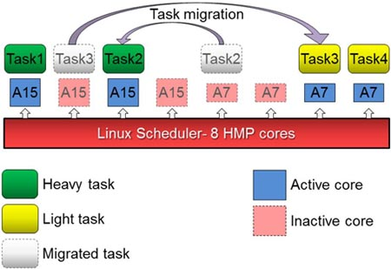
Heterogeneous Multi-Processing (HMP) in ODROID-XU3
With the big.LITTLE™ HMP solution, Exynos-5422 can utilize a maximum of all eight cores to manage computationally intensive tasks.
ODROID-XU3 has the integrated power analysis tool.
4 current/voltage sensors measure the power consumption of the
Big cluster: A15 cores
LITTLE cluster: A7 cores
GPU
DRAM

Slide 7
Results
Fibonacci computation
Android benchmarks
SVM computation
Peeking into a cluster
Multithreading
Frequency scaling

Slide 8
Fibonacci Computation
All cores active
Only Little cores active
4x time
0.7x Energy
0.15x Power

Slide 9

Antutu Benchmark
Task Pinned to Little cores
All cores active
Only Little cores
Total Energy (J) | 758.87 | 278.32 | 394.84
Performance score | 48217 | 27810 | 30654
Performance/Energy | 63.54 | 99.92 | 77.63

Slide 10
SVM Computation
Task Pinned to Little cores
All cores active
Only Little cores
Run-time (s) | 13 | 20 | 20
Avg. cluster Power (W) | 0.89 | 0.26 | 0.24
Total Energy (J) | 43.91 | 15.75 | 29.2

Slide 11
Peeking into a cluster
4 LITTLE cores
Work done per core
1 LITTLE core

Slide 12
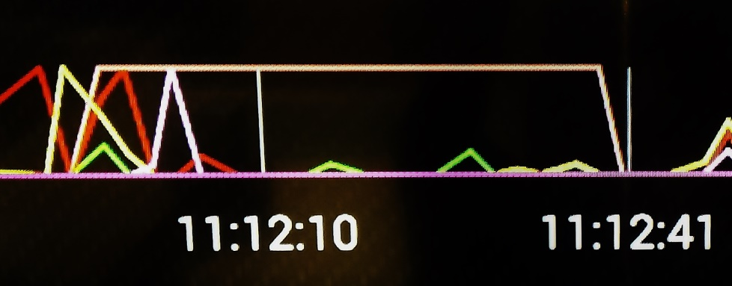
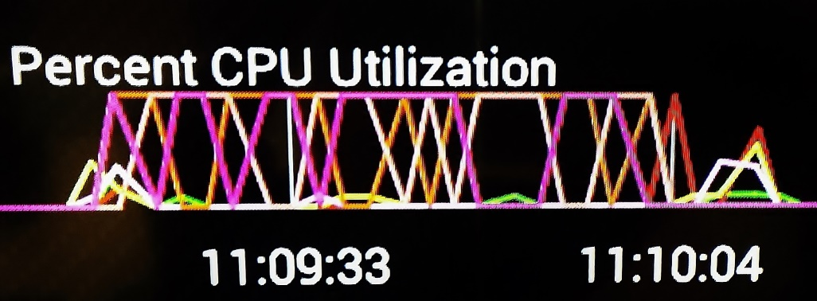
Multithread Experiments
Percent CPU Utilization from CPU Monitor App
No threads
2 Threads
Experiments with affinity
Set_affinity doesn’t work with pthreads
Similar results for browser

Slide 13
Frequency Scaling
Fmax = 1600 MHz
Fmax = 1200 MHz
 | All | LITTLE | Fmax = 1600 | Fmax = 1200
Run-time (s) | 120 | 475 | 143 | 170
Avg. cluster Power (W) | 2.35 | 0.31 | 1.20 | 0.75
Total Energy (J) | 309.35 | 227.46 | 200.62 | 140.63

Slide 14
Conclusions
The scheduler favors performance over energy
By default, a new task runs on a big cpu
All the cores are always “on” in ODROID-XU3
Samsung S4 shuts off cores based on work-load when battery < ~50%
LITTLE cpu typically spends lesser energy than big cpu for a given task (upto 64% reduction observed)
Controlling Frequency can provide better results rather than just turning off cores (upto 55% reduction observed)

Slide 15

THANK YOU!!!

