Slide 1





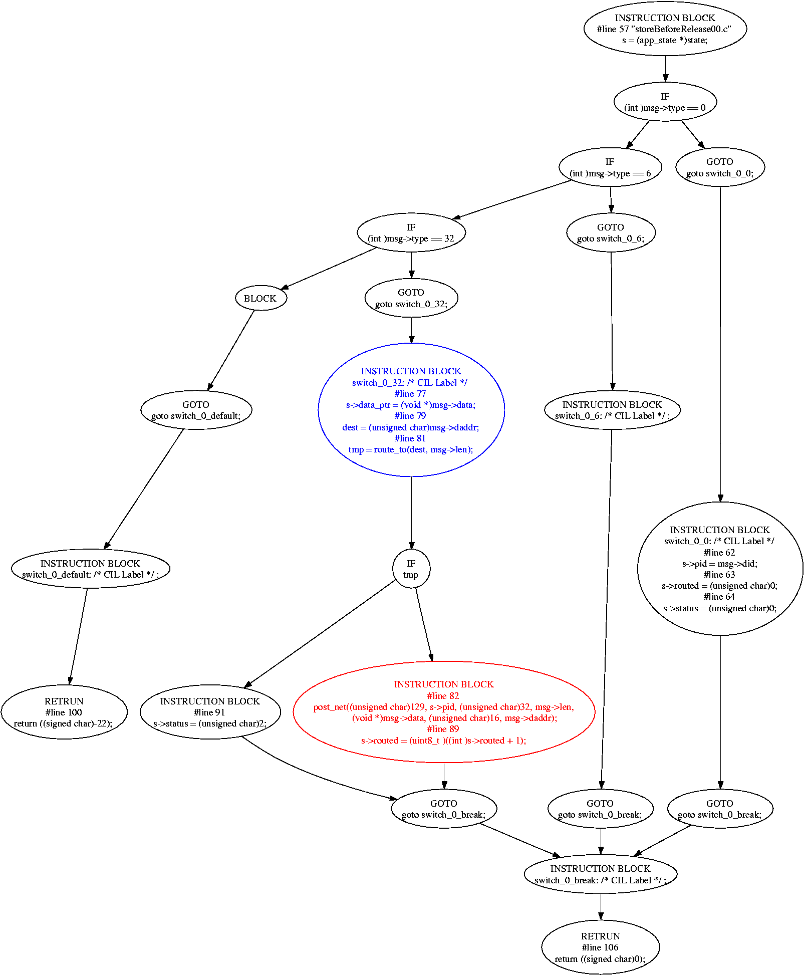
Proactive Software Analysis
Center for Embedded Networked Sensing
Roy Shea, Shane Markstrum, Mani Srivastava, Todd Millstein, Rupak Majumdar
NESL - http://nesl.ee.ucla.edu
Introduction: Early Identification of Errors in Embedded Sensor Network Systems
Using Staged Checks to Identify Errors
Staged checks to detect many classes of errors in sensor networks
  Static checkers verify that code base is compliant with system policies and conventions at compile time
  Load-time checkers examine node hardware and software of deployed nodes during module insertion to ensure safe proper module operation
  Run-time checkers monitor node execution to detect entry into error states and provide runtime permutations to system state
Staged checking complements debugging techniques
  JTAG provides detailed node level debugging
  System analysis from tools such as Sympathy
Staged checking improves software development
  Early error identification eliminates many problems before deployment
  Provides meaningful feedback to systems designers
Current work focuses on static checkers
Approaching the Problem: Static Analysis of Program Source Code
Overview of Statically Analysing Sensor Code
(1) Begin with program code
  Analysis is applied directly to SOS module code
  Same framework should work for other C based systems such as EmStar and TinyOS
(3) Apply domain specific checks to transformed code
  Examine stylistic properties specific to target OS
  Verify that protocols and resource models are followed
(2) Transform code into workable format
  Currently using the C Intermediate Language (CIL)
  Transforms C to an unambiguous low level form
  Maintains types and form or original program
(4) Fix any noted errors and compile code
  Modules generated from verified code can be used without having to worry classes of common errors
Current Status: Stylistic Conventions and Memory Models
Convention and Style Checking
Memory Ownership Verification
System specific conventions are important for overall safety
  SOS maintains its modularity by placing some restrictions on programmers
  Accidental violation of these restrictions can result in runtime bugs
  Static checks are ideal for: identifying illicit use of black listed functions, verifying that return values to system critical kernel functions are properly checked, and alerting users who misuse module state variables
Mote class devices often have scarce memory (4k – 10k bytes)
  SOS provides a simple fixed block memory allocation mechanism that applications can use to allocate memory
  Ownership of data can change as data is passed between SOS modules
  Memory leaks within or between modules can be a serious problem
A simple memory model helps to guide programmers
  Each allocated memory is owned by exactly one module
  An owning must either store a persistent reference to the owned block, release the owned block to another module, or free the owned block
  This model aids modular analysis
Memory model is verified for each module loaded onto a node
  Control flow information is combined with alias analysis to check that data does not escape a release and that released data is treated as dead
  Full data flow analysis is combined with alias analysis to check that data claimed by a node is properly stored, released, or freed
Sample Run of Static Checker
Warning: Data released in statment #line 82 "storeBeforeRelease00.c"
post_net((unsigned char)129, s->pid,
(unsigned char)32, msg->len,
(void *)msg->data,
(unsigned char)16, msg->daddr);
escapes at #line 77
s->data_ptr = (void *)msg->data;
***End of output***
Current Challenges and Future Work
Event based framework is pushing the limits of static analysis
  Many modules are designed to handle events that conform to an established protocol
  Exploring ways to encode this information in programs without burdening the system developer
Formal models of the system
  Current checkers provide a good intuitive model for memory ownership
  Moving forward by developing formal models of such conventions to help insure that the checkers are correctly implemented
Expanding checker framework to other systems
  Systems such as TinyOS and EmStar have properties similar to those of SOS and will benefit from very similar tools
Sample bug similar to that found in the 1700 line AODV implementation for SOS. Output from checker is listed next to a graphical flow diagram of the program.
UCLA – UCR – Caltech – USC – CSU – JPL – UC Merced

