Slide 1

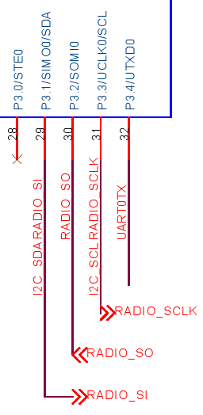
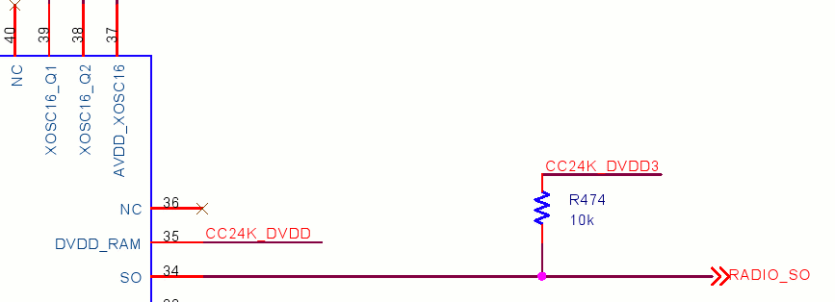

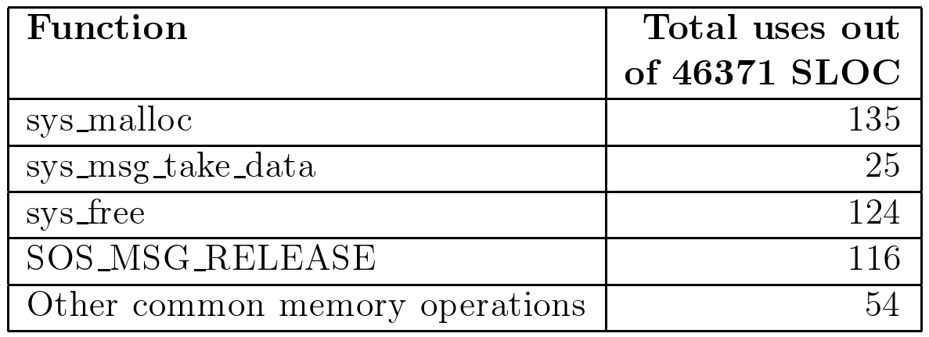
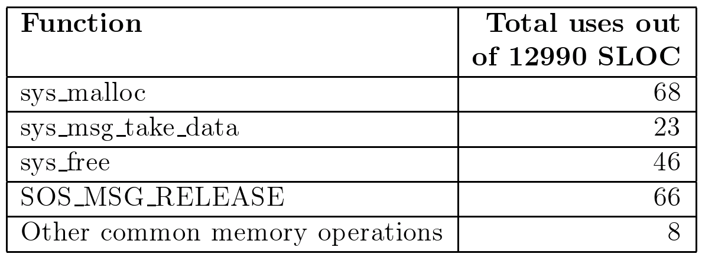
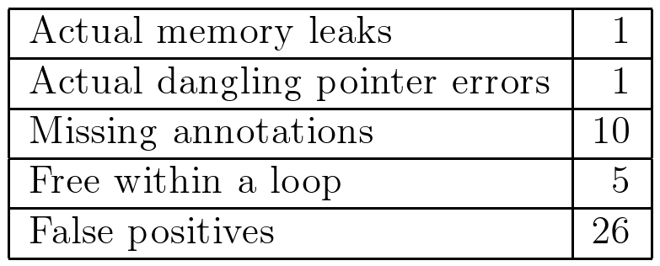

Center for Embedded Networked Sensing
Compile Time Checking of
Runtime Resource Management
Roy Shea, Shane Markstrum, Todd Millstein, Rupak Majumdar, and Mani Srivastava
NESL and TERTL
Introduction: Resource Usage in Sensor Networks
Correct usage of resources is difficult
Low layer access to hardware
Interactions between distributed application components
Complex control flow in distributed system
Resource is an item of limited quantity that used by one or more consuming applications
Buffer pools in TinyOS extensions such as VanGo
Pointer swapping in TinyOS
Dynamic memory in SOS
Access to underlying hardware
Focus on locating memory mismanagement in sensor networks
Models used for memory apply to other resource management problems
Mismanaged memory leads to significant problems
  Memory leaks rapidly exhaust limited memory available to node
  No MMU protection so dereferencing a dangling pointer can crash a node or corrupt state in other applications
Problem Description: Formulating a Model of Correct Memory Usage
Intuitive model for correct memory usage
Memory should only be under the control of one program at any given time
A program controlling memory must either keep track of the data, free the data, or transfer ownership to another program
Formal model for correct memory usage
No memory leaks
No dangling pointers
Memory management API used within the SOS operating system for sensor networks
Transferring ownership of memory
  int8_t sys_post(..., void* data, SOS_MSG_RELEASE)
  void* sys_msg_take_data(void* data)
Allocating and freeing memory
  void* sys_malloc(uint16_t size)
  void sys_free(void* data)
Proposed Solution: Examining Memory Usage and Compile Time
Automated localization of memory mismanagement
Built using C Intermediate Language (CIL)
Combines dataflow and alias analysis
Configured using annotation templates
Compile time feed back for application developers
Incorrect memory usages displayed as compiler warnings
Checker integrated with build process
Evaluation on the SOS operating system for sensor networks
Memory usage in SOS operating system
Memory usage in
SOS user applications
Errors found in SOS kernel
mod_op = (sos_module_op_t*) sys_msg_take_data(msg);
if(mod_op == NULL) return -ENOMEM;
if(mod_op->op == MODULE_OP_INSMOD) {
existing_module = sys_get_module(mod_op->mod_id);
if(existing_module != NULL) {
uint8_t ver = sos_read_header_byte(
existing_module->header,
offsetof(mod_header_t,
version));
if (ver < mod_op->version) {
sys_unload_module(existing_module->pid,
sos_read_header_byte(existing_module->header,
offsetof(mod_header_t, version)));
} else {
return SOS_OK;
}
}
ret = fetcher_request(sys_DFT_LOADER_PID, mod_op->mod_id,
mod_op->version, entohs(mod_op->size), msg->saddr);
s->pend = mod_op;
sys_led(LED_RED_TOGGLE);
return SOS_OK;
}
return SOS_OK;
Errors found in SOS user applications
Limitations
Analysis requires some annotations
  Annotations kept outside of code
  Small set provides significant benefits
Limited accuracy in alias analysis
  Checker can use any external alias analysis engine
Analysis has no concept of state
Future work
Extend verification with a model of the application
Formal type system for inference
Integration with link time and run time checking
UCLA – UCR – Caltech – USC – CSU – JPL – UC Merced

