Slide 1
Making Life a Little Easier or...
Compile Time Checking of Run Time Resource Management
Presented by Roy Shea
With help from Shane Markstrum,
Todd Millstein, Rupak Majumdar, and Mani Srivastava

Slide 2

Making Life a Little Easier...
Developing applications for sensor networks
  Requires writing code
  Low layer access to hardware
  Limited insight into system
Need to provide support for the developer
Back when I was a
stressed programmer.

Slide 3
Focus on Resource Management
Tool that examines source code to help programmers
  Locate memory leaks in applications
  Warn about dereferencing a dangling pointer
Important on sensor node platforms
  Memory leak rapidly exhausts the limited memory available
  No MMU protection so following a dangling pointer can crash your node or worse...

Slide 4
Outline
Overview of resources in sensor networks
Model for proper resource usage
A tool to automate verification
Evaluation of verification
Closing Remarks

Slide 5
...or Compile Time Checking of Run Time Resource Management
Resource management
  An item of limited quantity
  One or more consumers
  Often tied to hardware constraints of memory, buses, or sensors
Run time
  While an application is running (on real hardware)
  Late feedback to developer
Compile time checking
  Early feedback
  Limited visibility
  Type checking in C
typeCheck.c: In function `main':
typeCheck.c:11: warning: passing arg 1 of `add' makes integer
from pointer without a cast

Slide 6
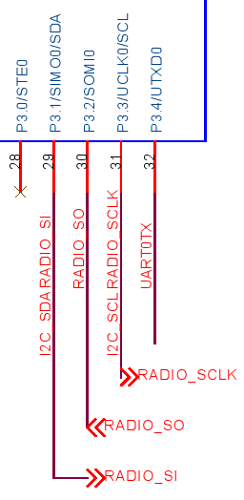

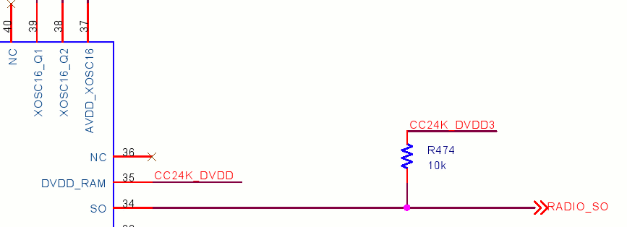
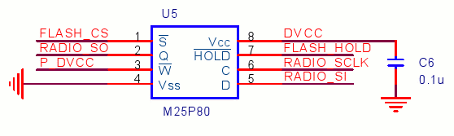
Resource Usage in Sensor Networks
Buffer pools in TinyOS extensions such as VanGo
Pointer swapping in TinyOS communication stack
Dynamic memory in SOS
Emerging resources
  Access to hardware buses
  Access to physical sensors

Slide 7
Outline
Overview of resources in sensor networks
Model for proper resource usage
A tool to automate verification
Evaluation of verification
Closing Remarks

Slide 8
A Shortage of Laptops
Limited number of laptops for too many graduate students
Many potential problems
  Grab a laptop that some is all ready using
  Forget to return laptop
  “But I thought you would grab it...”

Slide 9
Intuitive Resource Model
A laptop should only be under the control of one student at any given time
The student controlling the laptop must either keep track of the laptop, return the laptop, or give the laptop to another student

Slide 10
Intuitive Resource Model
A laptop Memory should only be under the control of one student module at any given time
The student module controlling the laptop memory must either keep track of the laptop memory, return the laptop, memory or give the laptop memory to another student module

Slide 11
Resource Management API from SOS
Memory ownership in SOS
  Module allocating data owns that data
  API exists to transfer ownership to another module
Allocating and freeing memory
  void * sys_malloc (uint16_t size)
  void sys_free (void *ptr)
Transferring and taking memory ownership
  int8_t sys_post (..., uint8_t size, void *data, SOS_MSG_RELEASE)
  void * sys_msg_take_data (void *data)

Slide 12
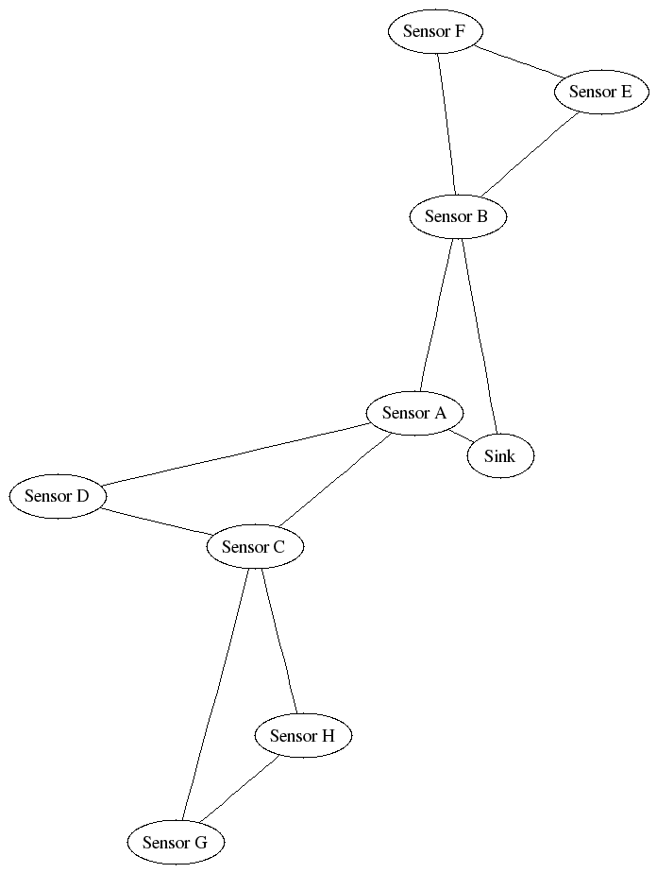
Sample Application: Surge
Nodes sense data and send to sink
Representative of many protocol stack based sensor network applications
  Sensor data
  Routing tree
  Sink application

Slide 13
Surge
int8_t surge_module(void *state, Message *msg) {
surge_state_t *s = (surge_state_t*)state;
switch (msg->type) {
case MSG_DATA_READY: {
SurgeMsg* pkt = (uint8_t*)sys_malloc(sizeof(SurgeMsg));
if (pkt == NULL) break;
pkt->data = ... ; // ... set up message
sys_post(..., sizeof(SurgeMsg), (void*)pkt, SOS_MSG_RELEASE);
break;
}
case MSG_TR_DATA_PKT: {
if (sys_id() == SURGE_BASE_STATION_ADDRESS){
uint8_t *payload = sys_msg_take_data(msg);
sys_post(..., msg->len, payload, SOS_MSG_RELEASE);
return SOS_OK;
}
break;
}
case ...: { ...; break; } // other messages
}
return SOS_OK;}

Slide 14
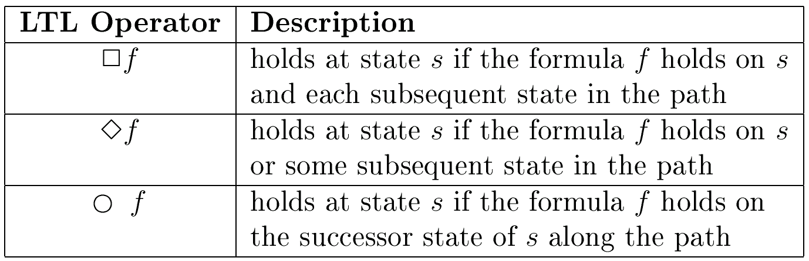
Formal Model
Easily described using Linear Temporal Logic
No Memory Leaks
No Dangling Pointers

Slide 15
Outline
Overview of resources in sensor networks
Model for proper resource usage
A tool to automate verification
Evaluation of verification
Closing Remarks

Slide 16
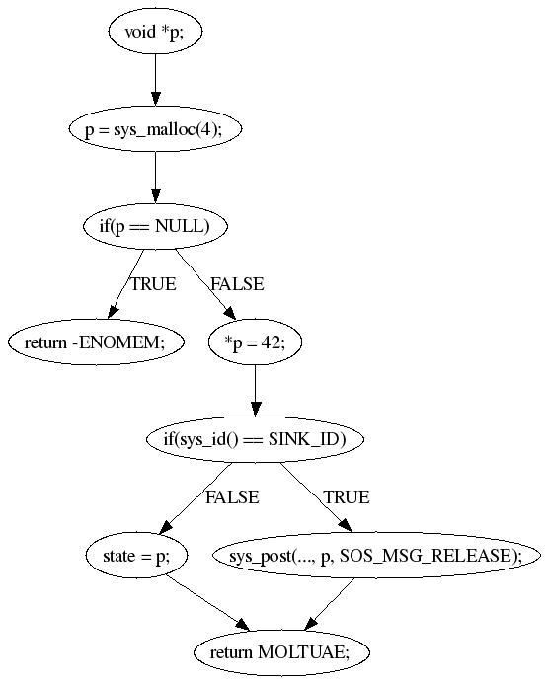
Automated Verification
C Intermediate Language (CIL) written in OCaml
Dataflow analysis
Alias analysis

Slide 17
Preparing Code for Verification
Annotations added to code describe memory manipulations
Allocating resources
  void* __attribute__((sos_claim)) sys_malloc(int size);
Releasing resources
  int *state __attribute__((sos_store));
  void sys_free(void *ptr __attribute__((sos_release)));
  sys_post uses a conditional sos_may_release annotation with extra checker support

Slide 18
Sample Output
Memory Leaks
make check
Warning: Alloced data from instruction #line 7 "oneFish.c"
p = (int *)sys_malloc(__cil_tmp2);
is not stored
Reference to dangling pointer
make check
Warning: Var in #line 12 "twoFish.c"
q = (*p);
should be treated as dead
Warning: Potential access to dead data freed in instruction #line 10
free(__cil_tmp4);

Slide 19
Limitations
Require some annotations for verification
  Base set of annotations can be used to help “seed” iterative annotation of code
  Small set of annotations goes a long ways
Alias analysis has limited accuracy due to complex pointer manipulations in C
  Developed tool can use external alias analysis that can be upgraded
Coders write crazy code!

Slide 20
Outline
Overview of resources in sensor networks
Model for proper resource usage
A tool to automate verification
Evaluation of verification
Closing Remarks

Slide 21
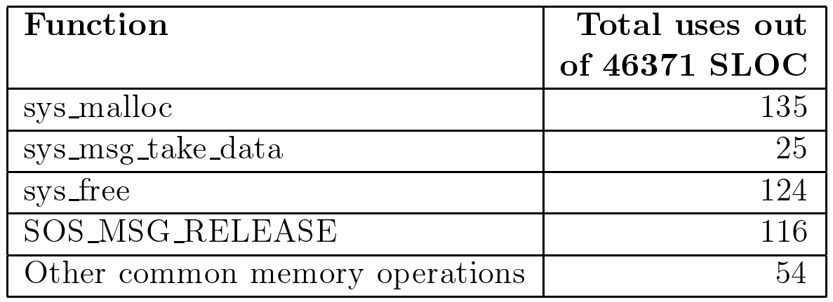
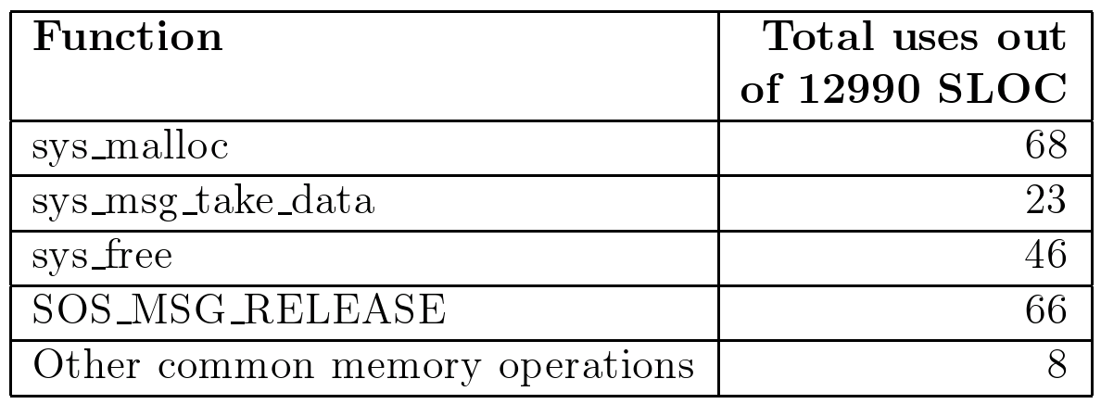
Dynamic Memory Usage in SOS
Memory manipulation in one in 100 lines of code
Mail archive reveals prominent threads on memory usage
Common problem with new users

Slide 22
User Modules In SOS
Pieces of applications similar to “components” in TinyOS
CVS head includes 37 modules (April 2006)
  Few simple applications
  Many drivers to test aspects of the OS
Combined these modules have 207 historic versions
Verified all historic versions using a base set of 20 attribute annotations

Slide 23
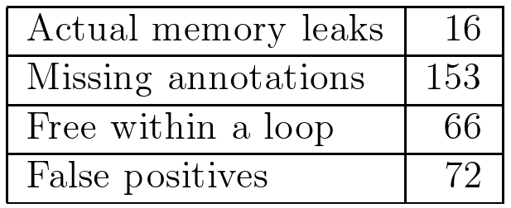
Module Verification Results
False positives...
  Only used a fixed set of 20 annotations despite evaluating historical module versions (API drift)
  Analysis is unable to reason about data freed in a loop
  Complex data structures confuse the alias analysis

Slide 24
Memory Leak in Module Loader (1)
mod_op = (sos_module_op_t*) sys_msg_take_data(msg);
if(mod_op == NULL) return -ENOMEM;
if(mod_op->op == MODULE_OP_INSMOD) {
existing_module = sys_get_module(mod_op->mod_id);
if(existing_module != NULL) {
uint8_t ver = sos_read_header_byte(
existing_module->header, offsetof(mod_header_t, version));
if (ver < mod_op->version) {
sys_unload_module(existing_module->pid,
sos_read_header_byte(existing_module->header,
offsetof(mod_header_t, version)));
} else {
return SOS_OK;
}
}
ret = fetcher_request(sys_DFT_LOADER_PID, mod_op->mod_id,
mod_op->version, entohs(mod_op->size), msg->saddr);
s->pend = mod_op;
sys_led(LED_RED_TOGGLE);
return SOS_OK;
}
return SOS_OK;

Slide 25
Memory Leak in Module Loader (1)
mod_op = (sos_module_op_t*) sys_msg_take_data(msg);
if(mod_op == NULL) return -ENOMEM;
if(mod_op->op == MODULE_OP_INSMOD) {
existing_module = sys_get_module(mod_op->mod_id);
if(existing_module != NULL) {
uint8_t ver = sos_read_header_byte(
existing_module->header, offsetof(mod_header_t, version));
if (ver < mod_op->version) {
sys_unload_module(existing_module->pid,
sos_read_header_byte(existing_module->header,
offsetof(mod_header_t, version)));
} else {
return SOS_OK;
}
}
ret = fetcher_request(sys_DFT_LOADER_PID, mod_op->mod_id,
mod_op->version, entohs(mod_op->size), msg->saddr);
s->pend = mod_op;
sys_led(LED_RED_TOGGLE);
return SOS_OK;
}
return SOS_OK;

Slide 26
Memory Leak in Module Loader: Discussion
Warning: Alloced data from instruction #line 125 "loader.c"
mod_op = (sos_module_op_t *) sys_msg_take_data(msg);
is not stored
Memory is allocated
Program checks to see if node can accept and should accept an incoming module
Two paths corresponding fail to store, free, or release the data

Slide 27
Memory Leak in Module Loader (2)
Two months later the program is restructured
Old memory leaks remain and new leaks appear
sos_module_op_t *mod_op;
if (msg->saddr == sys_id() || s->pend) {
return SOS_OK;
}
mod_op = (sos_module_op_t*) sys_msg_take_data(msg);
if(mod_op == NULL) return -ENOMEM;
switch(mod_op->op){
case MODULE_OP_INSMOD:
return module_op_insmod(s,msg,mod_op);
case MODULE_OP_RMMOD:
return module_op_rmmod(s,msg,mod_op);
}
return SOS_OK;

Slide 28
Memory Leak in Module Loader (3)
sos_module_op_t *mod_op;
if (msg->saddr == sys_id() || s->pend) {
return SOS_OK;
}
mod_op = (sos_module_op_t*) sys_msg_take_data(msg);
if(mod_op == NULL) return -ENOMEM;
switch(mod_op->op){
case MODULE_OP_INSMOD:
return module_op_insmod(s,msg,mod_op);
case MODULE_OP_RMMOD:
return module_op_rmmod(s,msg,mod_op);
}
sys_free(mod_op);
return SOS_OK;
Debugging session a few days later finds and fixes all memory leaks

Slide 29
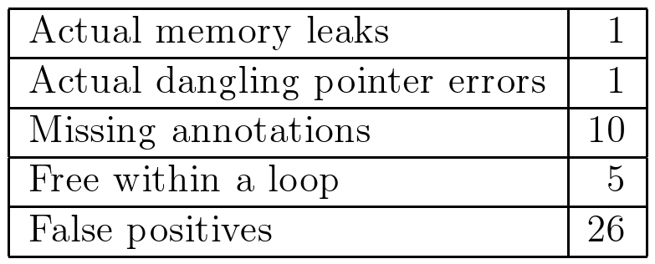
Kernel Verification Results
Kernel verification examined 37 source files (about 15000 SLOC) of which 16 generated warnings
Helped removed bugs in the current version of SOS

Slide 30
Dereference of Dangling Pointer
Module dereferences the fst pointer after releasing it
Is this a bug?
  Violates the model
  However it works with todays implementation of SOS...
  This may soon change
if( sys_post(fst->requester,
KER_FETCHER_PID,
MSG_FETCHER_DONE,
sizeof(fetcher_state_t),
fst,
SOS_MSG_RELEASE) != SOS_OK ) {
...
return;
}
cam = sys_cam_lookup( fst->map.key );
...

Slide 31
Outline
Overview of resources in sensor networks
Model for proper resource usage
A tool to automate verification
Evaluation of verification
Closing Remarks

Slide 32
Related Work
Static checking in sensor networks
  Concurrency in TinyOS
  Typed components in galsC
General reliability in sensor networks
  Components, composition, aggregation...
Formal programing languages
  Ownership types
  Confinement
  Linear pointers

Slide 33
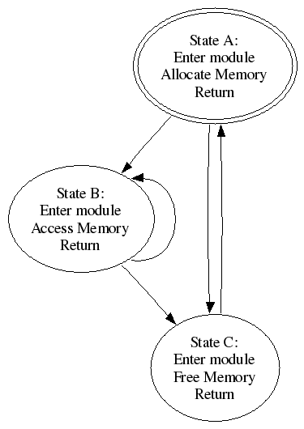
Future Work
Verification with application model
  Current checker does not “understand” the application
  Find low overhead technique to capture this higher level understanding
Formal type systems
Link time and run time checking

Slide 34
Questions?

Slide 35
The End

Slide 36
Really. Nothing to see here.

Slide 37
“Property Number Three”
Access to a “handle” should be preceded by an allocation or retrieval from a store
What would a “get” operator look like in C code?
How about a “set” operator to save data into a store?
Should “get” be destructive? Is “get” destructive?
What is the precise meaning of “access”?

