Slide 1

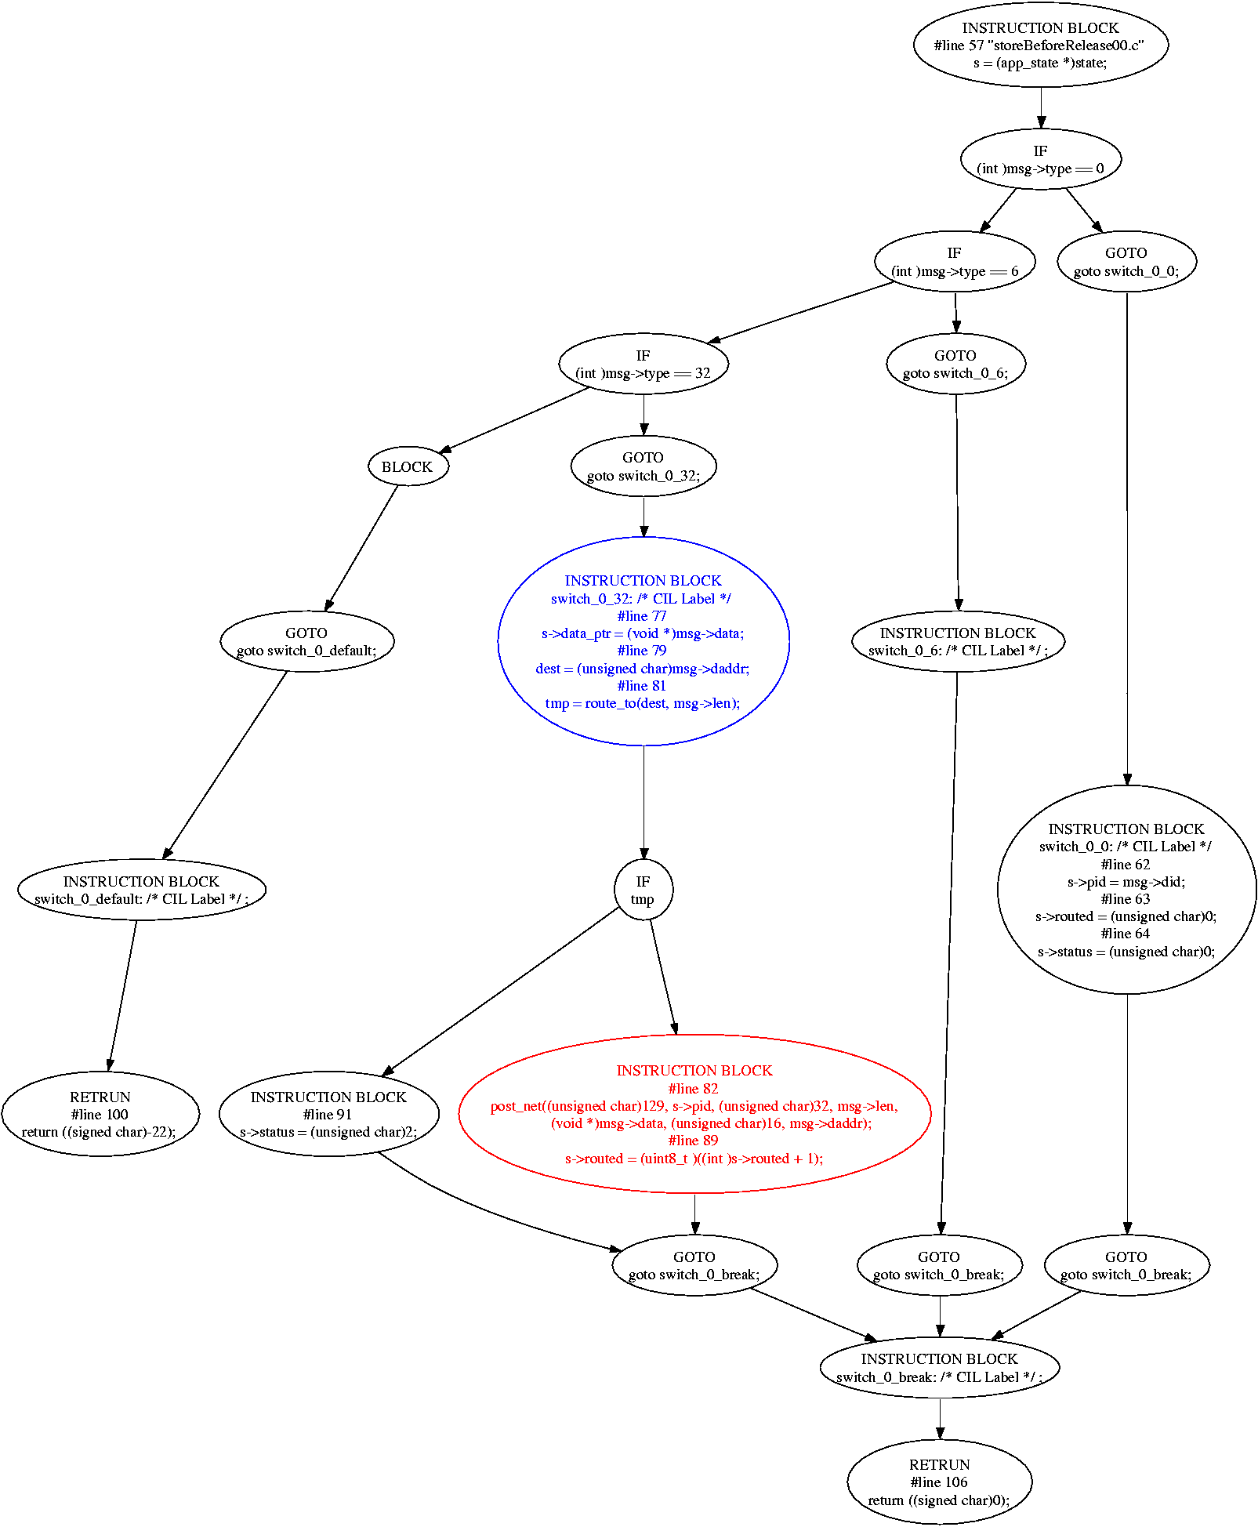
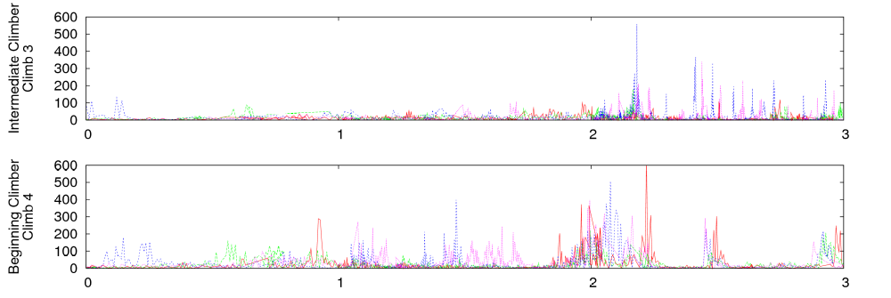
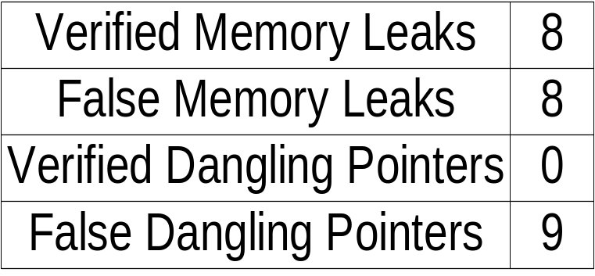
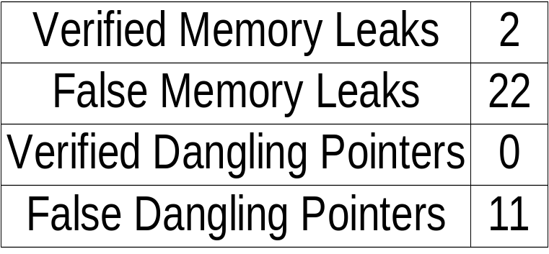
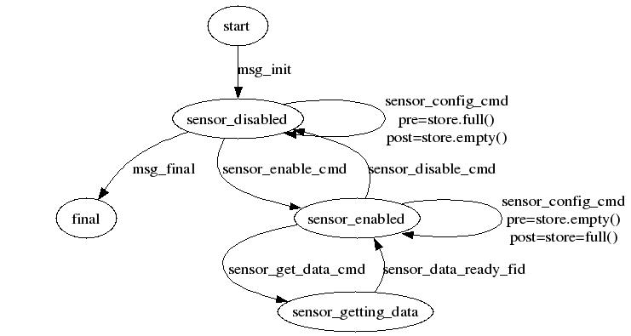
Static Analysis of Bottom Tier Sensor Networks
Center for Embedded Networked Sensing
Roy Shea, Todd Millstein, Rupak Majumdar, and Mani Srivastava
Software Systems Laboratory and Networked and Embedded Systems Laboratory
Motivation: Bringing Accessible Static Analysis To Sensor Network Development
Static Analysis is Cool
Bottom Tier Sensing Devices are Cool
Has the potential to find bugs before they arise
Streamlines the development process
Lower learning curve for new developers
Developer can look at the entire system
All in one hardware is great for hobbyist and students
Show you amazing things about the world we live in
Combination of These?
Difficulties developing sensor network applications
  Limited insight into a running system
  Common failure mode is simply “not working”
  Failures are not well contained
Gain insight by applying static analysis to bottom tier sensing devices
Problem: Mapping Traditional Analysis Onto Very Reactive Systems
Verifying Sensor Network Applications
State:
data = NULL
State:
data = 0x3142
Event handlers react to external events
  Sensor detects an event of significance
  Message is received over the radio
  Timer injects event into the system
Naïve model assumes any event can occur at any time
State:
data = NULL
State:
ERROR
State:
data = 0x3142
Proposed Solution: Drive Static Analysis with Ordering Specifications
Lighthouse
Simple exclusive resource ownership model
  All head memory is owned by exactly one module
  Owner is responsible for releasing the memory or transferring it to another module
  Modules may not free or transfer ownership of heap data that isn't owned
Uses standard dataflow techniques to verify each function
  May / must pointer analysis used to resolve aliases
  Function summaries used to handle function calls
mod_op = (sos_module_op_t*) ker_msg_take_data(msg);
if(mod_op == NULL) return -ENOMEM;
if(mod_op->op == MODULE_OP_INSMOD) {
existing_module = ker_get_module(mod_op->mod_id);
if(existing_module != NULL) {
uint8_t ver = sos_read_header_byte(...);
if (ver < mod_op->version) {
ker_unload_module(...);
} else {
return SOS_OK;
}
}
ret = fetcher_request(KER_DFT_LOADER_PID,
mod_op->mod_id, mod_op->version,
entohs(mod_op->size), msg->saddr);
s->pend = mod_op;
ker_led(LED_RED_TOGGLE);
return SOS_OK;
}
return SOS_OK;
Warnings generated from the
analysis of 213 unique versions of SOS modules totalling 28042 SLOC
Warnings generated from the
analysis of 40 source files making up the SOS kernel totalling 9223 SLOC
Error: Expression mod_op is not stored after instruction #line 125
mod_op = (sos_module_op_t*) ker_msg_take_data((unsigned char)18, msg);
Checkpoint
Lighthouse driven by finite state machine specification
Specification provided by developer describes
  Set of arbitrary states associated with specific source code
  Set of events that cause transitions between states
  Persistent store pre- and post- conditions for stores when a specific event causes a transition between two states
Critical for the reactive sensing environments
Just beginning to evaluate gains of using Checkpoint
Future Work
Specification generation via inference
  Of memory manipulation by functions
  Of interfunction per- / post- state dependencies
Finite state machine specification
  What is the best way to describe the FSM?
  Transitioning from functional specification to slice oriented specification
UCLA – UCR – Caltech – USC – UC Merced

