Slide 1
Low-cost Appliance State Sensing for Energy Disaggregation
- Preliminary results
Notes:
Low-cost Appliance State Sensing for Energy Disaggregation

Slide 2
Outline
System design
Hardware
Event detection algorithm
Network protocol
Network test
Packet collision test
Poisson distribution random event test
Experimental setup
Power disaggregation algorithm
Piece-wise constant (PWC) de-noise
Disaggregation algorithm

Slide 3
Sensor node hardware
L
N
DC Power supply
(Voltage-drop capacitor)
AIN
MCU
(6pin AT-tiny)
RFTX
1mΩ
200x
Low-cost design
Components cost
$4.0 @ 1
$2.3 @ 1k

Slide 4
Event detection algorithm
Sample AC instantaneous current at ~1.6kHz for ~12ms, take the range (max-min, signal maybe clipped)
Take a threshold with hysteresis, get instantaneous binary state
Pass the instantaneous binary states through a de-bouncing smoother (counter), get appliance state
If state changes, initiate transmissions

Slide 5
Network protocol
Initial TX
Group3
Group2
Group1
Group0
Each packet is 16-bit long
1st byte
6b – Device ID
2b – Retransmission group number
2nd byte
4b – Sequence number
3b – Retransmission slot number within group
1b – Appliance state
Each packet’s air-time is 62ms (< 4 AC cycles)
5 transmissions for each event
1st – when event happens
2nd-5th – randomly chosen from 31 slots arranged in 4 groups (8,8,8,7 slots in each group)
Each slot is 4 AC cycles long
Whole 5 transmissions can take ~2.2s (128 AC cycles)
4Cycle x8
4Cycle x7

Slide 6
Outline
System design
Hardware
Event detection algorithm
Network protocol
Network test
Packet collision test
Poisson distribution random event test
Experimental setup
Power disaggregation algorithm
Piece-wise constant (PWC) de-noise
Disaggregation algorithm

Slide 7
Packet collision test
2 events less than 2.2s apart are considered ‘collision’
5 transmissions take at most 2.2s
Test setup
3 sensor nodes
Collided events, 2 at a time on 2 nodes, are generated by an external microcontroller (MBED)

Slide 8
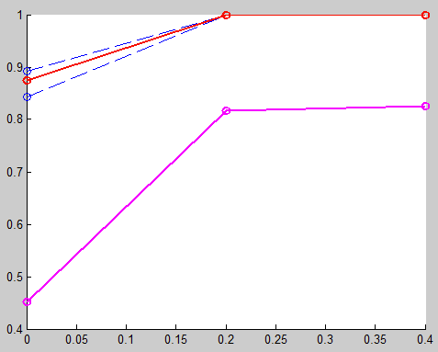
Packet collision test results
Event delivery
Rate
Packet delivery
Time between collided events (s)

Slide 9
Poisson distribution random event test
Test setup
6 sensor nodes
Poisson distributed event sequence
λ= expected # of events in 1 second
1/λ = expected interval between events
Events randomly assigned to 1 of the 6 nodes

Slide 10
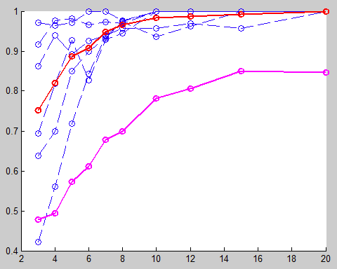
Poisson distribution random event test results
Event delivery
Rate
Packet delivery
1/λ Expected time between events (s)

Slide 11
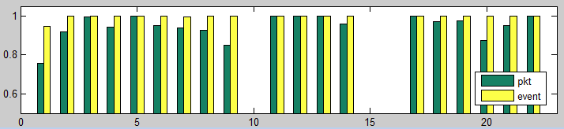
Real data statistics
Rate
Sensor ID
Overall packets
4931/5252 (93.89%)
Overall events
1108/1113 (99.55%)

Slide 12
Outline
System design
Hardware
Event detection algorithm
Network protocol
Network test
Packet collision test
Poisson distribution random event test
Experimental setup
Power disaggregation algorithm
Piece-wise constant (PWC) de-noise
Disaggregation algorithm

Slide 13
Experimental setup
20 nodes deployed
9 LCD monitors
8 Laptops
1 solder station
1 workbench light
1 water dispenser
13 nodes are instrumented with Watts up? PRO meter for ground truth
2s interval
Data collected with Gumstix and logged in database
Aggregated power reading from E30A panel meter
2s interval
Actually sum of 4 circuits

Slide 14
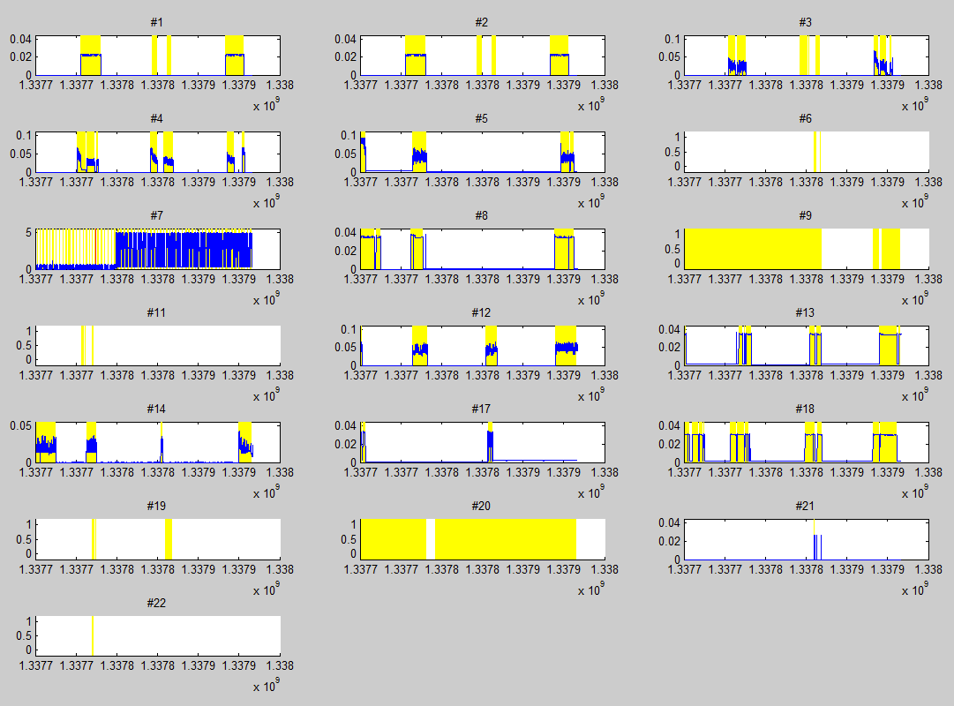

Slide 15
Outline
System design
Hardware
Event detection algorithm
Network protocol
Network test
Packet collision test
Poisson distribution random event test
Experimental setup
Power disaggregation algorithm
Piece-wise constant (PWC) de-noise
Disaggregation algorithm

Slide 16
Piece-wise constant (PWC) de-noise
Adapted from ‘Jump penalization’ algorithm
Can detect step changes smaller than the variance
Online algorithm
Adjustable sensitivity based on sensor events
Need comparison with total variation denoising (TVD)

Slide 17
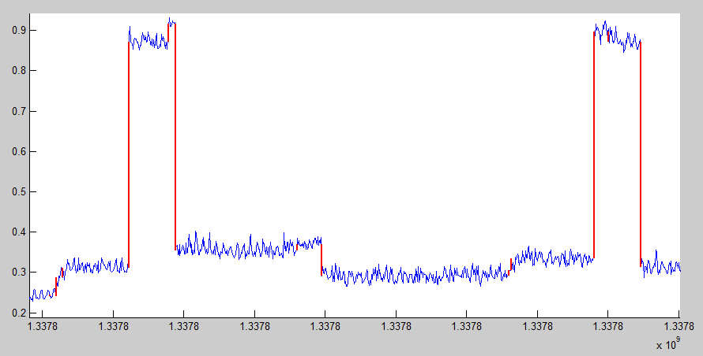
PWC results
Power (kW)
100s
timestamp

Slide 18
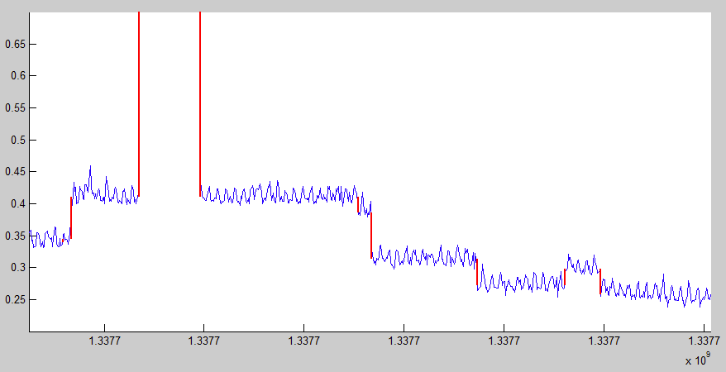
PWC results
Power (kW)
100s
timestamp

Slide 19
Disaggregation algorithm
PWC
(step detection)
Steps
Single event
Disaggregated power log
Central power readings
Sensor network
Event-step match
Detect overlapping events
Resolve overlapping events
Appliances events
Received events
Events with power step
Overlapping events
All appliances are 2-state, on-or-off
Resolving overlapping events
Based on history of the appliances’ power signature

Slide 20
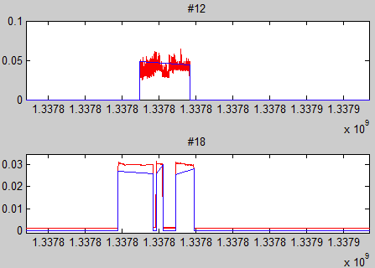
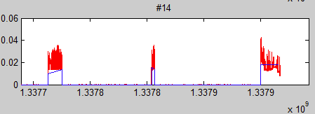
Ground truth
Disagg- output
Selected disaggregation result (without overlapping events)

Slide 21
TODO
Compare Jump-penalization with total variation regulation
Resolve overlapping events
Simulation: not cycle-aligned vs aligned vs full aligned
PWC-only event detection rate
NILM: event detection, device identification, power estimation
Bundle appliances together

