Slide 1
robogaming
Aman Kansal, Jonathan Friedman, Parixit Aghera, Advait Dixit, Balaji Vasu, Mani Srivastava, William J Kaiser, Gaurav Sukhatme, Gregory J Pottie, Deborah Estrin

Slide 2

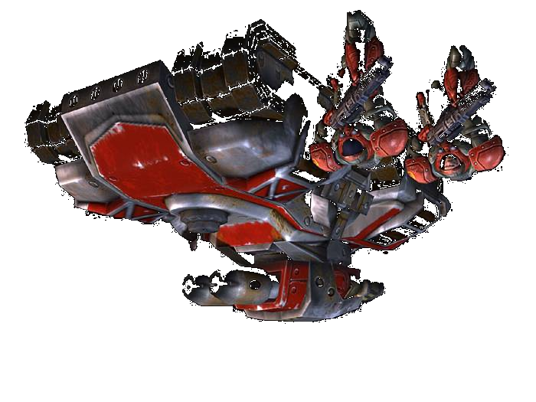
New ways to play!
Localization Camera
Graphic Projector
PicoNIMS Terrain
Control
Energy Replenishment
Autonomous Mobile agents
Reconfigurable Terrain
Distributed Audio Engine
“You can discover more about a person in an hour of
play than in a year of conversation” – Plato, 427-347 BC
Notes:
Description of full game: collection of resources. First game: exploration

Slide 3
Why play?
Just for fun…
Helps adapt to new technology
Flexible design
People at play
  Switch context with ease
  Employ a separate mental cognition
  Are willing to acquire new skills
  Are open to fanciful interpretations

Slide 4
A rich test-bed
research directions not easily exposed by other NIMS applications
  new dimensions in adaptive actuation, coordinated operation,
  authoring
    for non expert users
  create and test unconventional usage paradigms
    may not arise in more rigid apps
isolate test algorithms by shifting other functionality to central server

Slide 5
Education and research
Accessible and manageable
  Several nascent and experimental technologies: not easy to test in real world systems
Fun platform for students to learn embedded robotics
  Provides teaching aids for exposing complex systems
  Speeds up research!

Slide 6
The platform
Consists of three main components
  Terrain and robot hardware
  Software for robot (microcontroller firmware)
  Server side software

Slide 7
Hardware
Several active components:
PicoNIMS: terrain
reconfiguration
Actuated Terrain Components
Robots
Charging Docks
Localization and Game Server

Slide 8
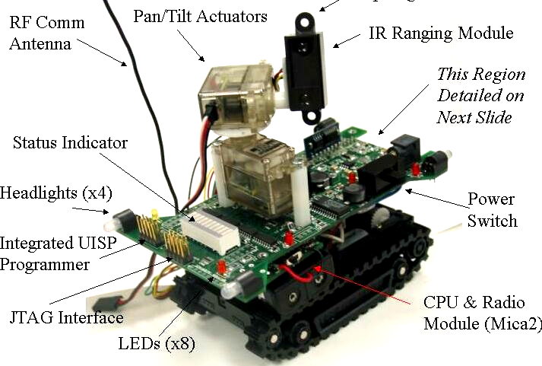
Ragobot: Real Action Gaming Robot
Spotlight mount
Battery charger, monitor, regulator

Slide 9
Hardware design
Robot has two PCB’s for compact design
MICA 2
RADIO + PROCESSOR
Voltage Stabilizer
PCB 1
RC Servo Pan/Tilt
IR Ranger
Two Li+ batteries (7.2V
nominal output)
DC Motor Control Board
Motor shaft encoders
Programming Interfaces: UISP, JTAG
RC Servo Gripper
Dual-axis Gripped Object Detection and Identification
Battery Monitor
Onboard Battery Charger
Annunciation Components (LED display, Damage Indicators)

Slide 10
Hardware design
DSP
Power Filtering and Isolation Networks
IR Receiver Array
PCB 2 for
Additional sensors
IR Emitter and Amplifier
IR Multi-channel Analog Receiver
High Speed ADC
Additional Annunciation Components
Collision Avoidance: Bump Detectors
Attitude / Orientation
Sensors
Solid State
Compass

Slide 11
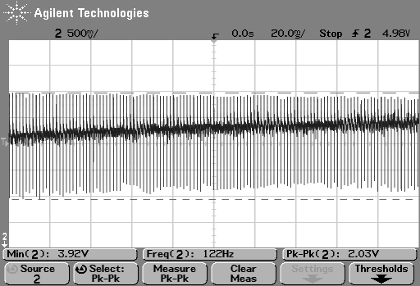
Accurate motion control
Navigation is difficult due to small size, limited sensing and processing capabilities
  Need stable voltage for predictable motor speeds
Synchronous voltage regulator for efficiency
  Noise on power supply
DC motor speed controlled via PWM
  Necessary for efficiency but causes heavy noise injection on power supply rail
Radio cannot operate on noisy power supply

Slide 12
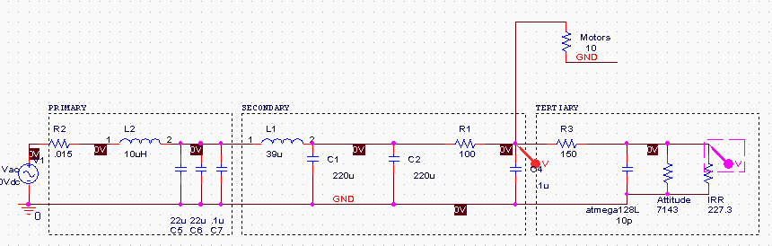
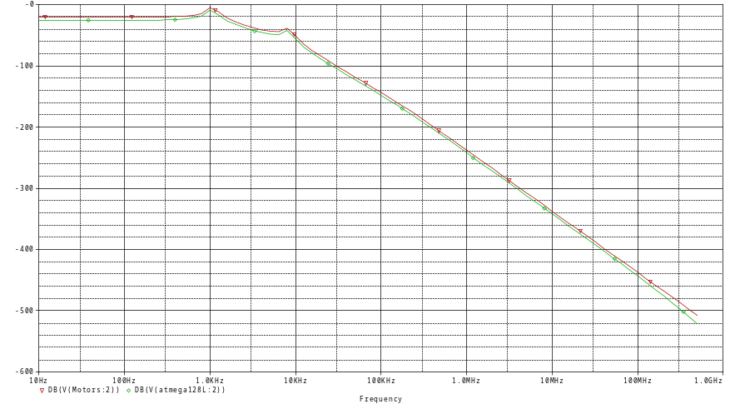
Power supply
Low noise power supply:
  Regulation and filtering
  Isolation on PCB
dB
Frequency

Slide 13
Robot software
Runs on TinyOS
  Uses Mica2 with Atmel ATmega 128L
Most drivers are generic and can be used to control similar modules on any TinyOS capable processor
Open source development
  Public access: http://cvs.nesl.ucla.edu/cvs/viewcvs.cgi/

Slide 14
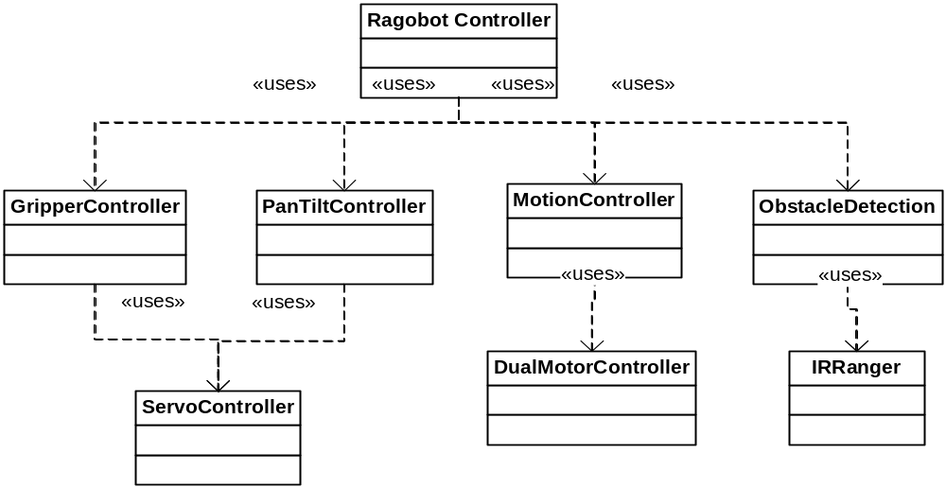
Software block diagram

Slide 15
Basic robot functions
Obstacle detection
  Robot moves while avoiding obstacles
Pan tilt control
  Use the servo drivers to orient the pan tilt head
Gripper Operation
  Use the gripper servo and sensor inputs to grab an object.
Health Monitor
  Use battery monitor and IR weapon detector to generate health state

Slide 16
Higher level function
Move to given coordinates
  Use obstacle avoidance, encoder feedback and motor controller to reach a specified coordinate
  Need to update path due to obstacles
Terrain learning
  Use the IR ranger o learn the terrain maps
Coordinated operation
  Multiple robots to maximize terrain coverage

Slide 17
Server software
PLAYER
CLIENT
PLAYER
CLIENT
PLAYER
CLIENT 1
GAME DEAMON
(Experiment
Console)
GAME ART
(Debugging Visualization)
TERRAIN STATE
CONTROL
(PicoNIMS and Structures)
GAME
MULTIMEDIA
GENERATOR
MULTI-ROBOT STATE
CONTROL
AMBIENT
PROJECTIONS
MOTE
COMMUNICATION
LOCALIZATION
MULTIMEDIA
HARDWARE
IMAGER
INTERFACE

Slide 18
Ongoing work…
Remaining hardware components being developed
  Terrain, active structures
Robot navigation being calibrated for hardware
  Higher level navigation functionality under development
  Localization system under test
Robot communication protocol
  Between server and robots
    Currently based on ID based packet transfer
  Among robots
Multi-robot control primitives
  Collaborative team operation

