Slide 1
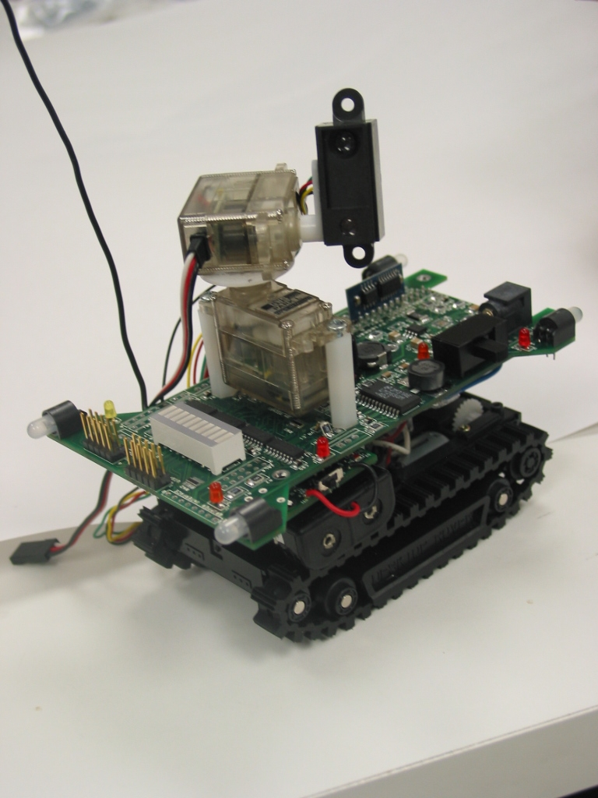
Jonathan Friedman, GSR
Lead Hardware Designer, Ragobot
Spotlight Mount
RF Comm
Antenna
Pan/Tilt Actuators
IR Ranging Module
This Region
Detailed on
Next Slide
Status Indicator
Headlights (x4)
Power
Switch
Integrated UISP
Programmer
CPU & Radio
Module (Mica2)
JTAG Interface
LEDs (x8)

Slide 2
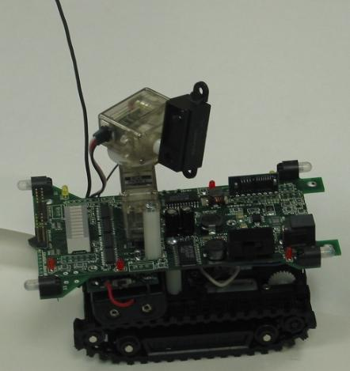
Jonathan Friedman, GSR
Lead Hardware Designer, Ragobot
3.3V Regulated
Supply
Battery
Charger &
AC
Adapter
Line
Regulation
This Region
Detailed on
Previous Slide
Backup Power
Source (x4)
5V Regulated
Supply
Battery Energy
Data Logger &
Information System
Dual Motor
Controller
External
Power
Connector
Temperature
Sensor
Traction
Platform
Tripod
Mounting
System

