Slide 1
Ragobot Hardware
Jonathan Friedman
David Lee

Slide 2
system components
PicoNIMS
Overhead Camera
Actuated Structures
Robots
Charging Docks
Game Server

Slide 3
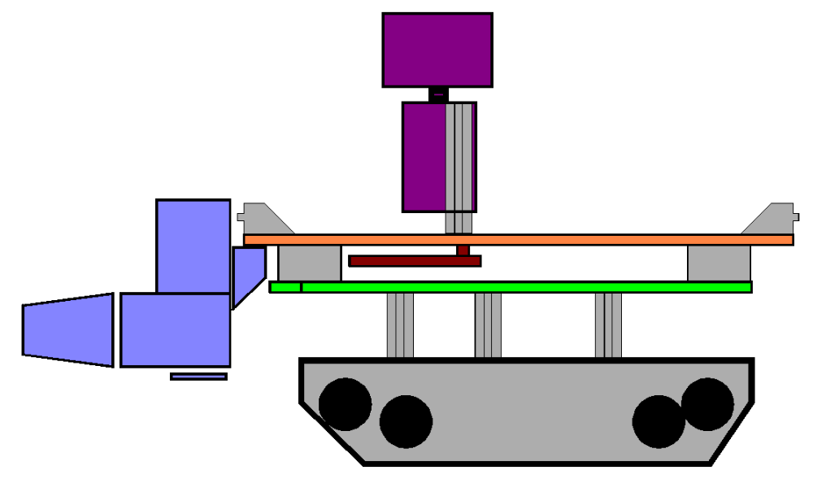
Robot
IR Module
Tilt Servo
Mote
Pan Servo
Observation
Layer
LED’s
RFID Reader
Ragobot Layer
Redloc Layer
Traction Layer
Electrical
Interconnects
Note: drawn to scale

Slide 4
Ragobot Layer
Onboard Battery Charger
Battery Monitor
DC Motor Control Board
Twin DC motor Traction
Two Li+ batteries (8.4V→5.5V, 7.2V nominal output)
Annunciation Components (Headlights, Tail lights, Damage Indicators, etc)
LED Spotlight
MICA 2
RC Servo enabled Pan/Tilt
RFID Object Detection
Temperature Sensor
IR Ranger

Slide 5
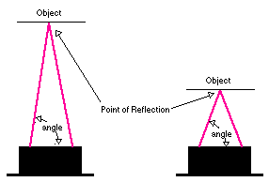
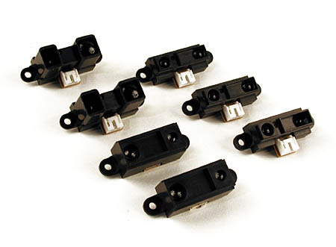
IR Ranger (IRR)
Images courtesy Acroname, Inc. and Sharp, Inc.
All rights reserved.

Slide 6
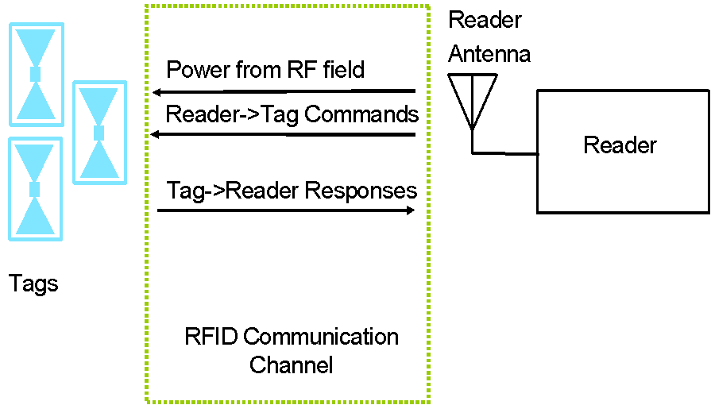
What is RFID?
Radio Frequency Identification
Non-contact Identification
Similar to barcodes, but does not require line-of-sight
Can contain more information than conventional barcodes

Slide 7
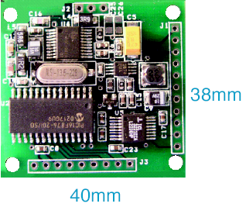
Skyetek RFID Reader
Frequency 13.56 MHz
45mA @ 5V
Serial Interface
Compatible with many standards (ex. ISO 15693)
Typical Read Range:
  Vertical: 5-8 cm
  Horizontal: < 1 cm

Slide 8
RFID on the Ragobot
Coordinate tags store localization information
  Create grid on game board
  Tags placed on grid and note the current coordinate
  Tags must be placed at least 6 cm apart to avoid detecting 2 coordinates simultaneously
Treasure tags store
  Total amount of treasure available nearby
  Total amount of treasure available at current location

Slide 9

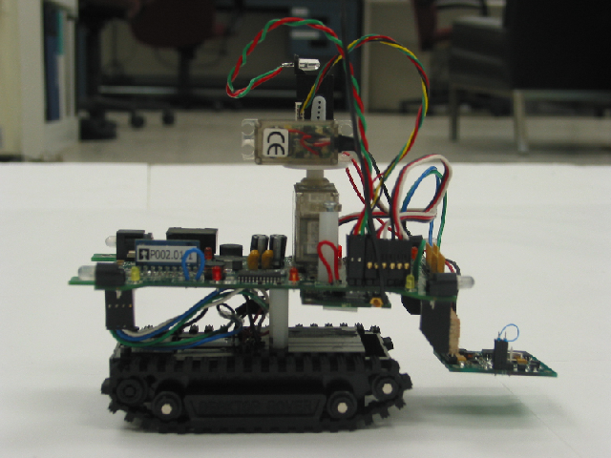
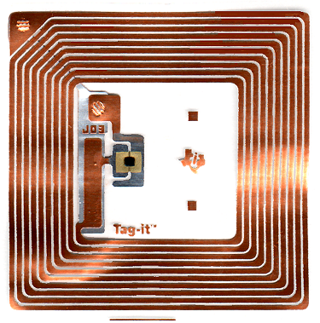
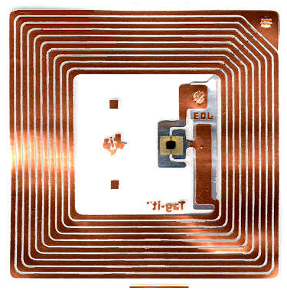
RFID on the Ragobot
TREASURE
3 Others Nearby
$100000
TAG ID: E0192039
Find ID
Read Tags
TAG ID: E0191235
COORDINATE (15, 32)

Slide 10
TinyOS RFID Driver
/**
* This interface provides control to an RFID reader.
*/
interface rfid_controller
{
command result_t init();
command result_t findTags(int8_t numTags);
event result_t findTagsDone(uint8_t numTagsFound);
command uint8_t* getIDs(uint8_t idnum);
command result_t readData(uint8_t *ID);
event result_t readDataDone(uint8_t bytesRead);
command uint8_t *getData();
command result_t writeData(uint8_t *ID, uint8_t block_num, uint8_t *data);
}

Slide 11
Future Work: Redloc Layer (Sensor Board)
Power Filtering and Isolation Networks
Additional Annunciation Components
IR Receiver Array
High Speed ADC
DSP
IR Emitter and Amplifier
IR Multi-channel Analog Receiver
Collision Avoidance Ultrasound
Attitude / Orientation
Sensors
Solid State
Compass
Precision Odometers
Camera
Microphone and Audio Processing

Slide 12
Implementing Controlled Mobility in Sensor Networks

Slide 13
Designing Mobile Hardware in Sensor Networks
Noise degrades sensor performance! (far worse than calibration error)
Noise interferes with communications (radio)!
Need high efficiency given energy constraints
Need AC quiet power rails for best sensor performance
THESE GOALS CONFLICT! Must find a compromise

Slide 14
Protecting Our Purpose (Sensing)
Sources of Noise
Oscillators
Digital data edges
(V/U)HF RF interference
Hall effect
Cross-talk
Techniques to Counter
Min-routing
Bypass capacitors
C stores
RC filters (1st order)
RLC filters (2nd order)
Planing
Regulating

Slide 15
Power Supply Design Objectives
High efficiency over a wide range of load conditions (motors on full vs. sleep – huge range)
High stability over a wide range of load conditions (loading and unloading can not be allowed to cause sensing disruptions)
High resistance to surge current (prevent battery heating and loss of lifespan)
Low noise output (less work later!)

Slide 16
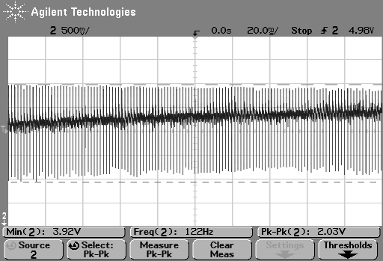
Surge and Noise: Propulsion
2V drop in line supply (both @ full)
Heavy noise injection (~600Hz)
Motors are run IN PHASE!!!
FM is a problem, but necessary for efficiency

Slide 17
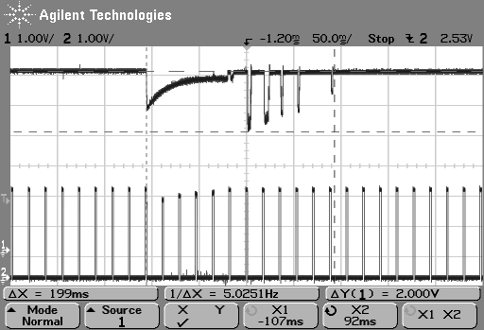
Surge and Noise: Servo
2V drop in line supply
0.5V drop in PWM output
Power Supply is top, Servo PWM input is bottom

Slide 18
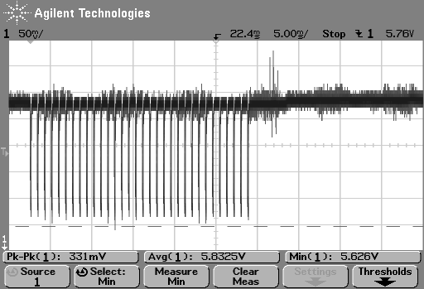
Surge and Noise: IRR
0.3V drop in line supply
IRR makes approximately ~36 measurements and performs smoothing in hardware
Subsequent data transfer also injects noise

Slide 19
Other Major Sources of Noise
Mote Oscillators (32Khz, 8Mhz)
Mote Radio (433Mhz)
Synchronous Power Supply (90kH x2 & 3.2Mhz)

Slide 20
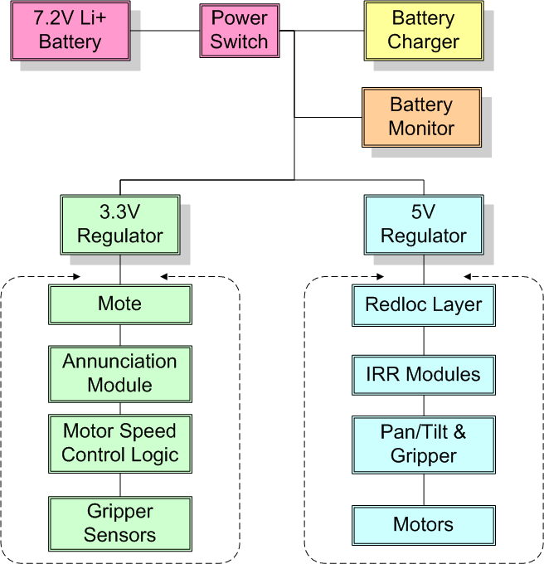
RFID

Slide 21
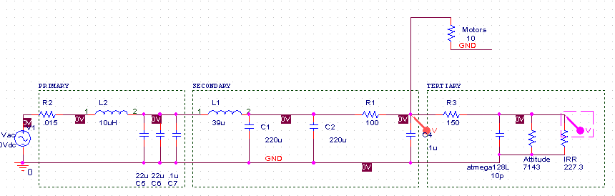
Filtering for Stability and Noise Rejection
@ nominal full load (motors, sensors)

Slide 22
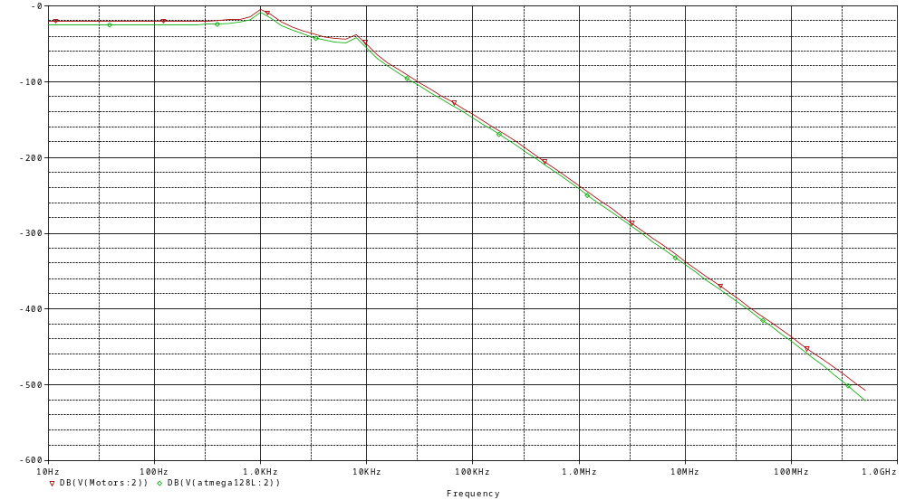
Frequency Response
After 2nd
After 3rd
dB
@ nominal full load (motors, sensors)

Slide 23
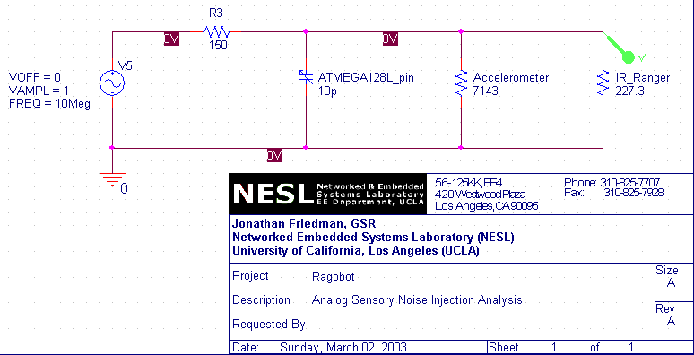
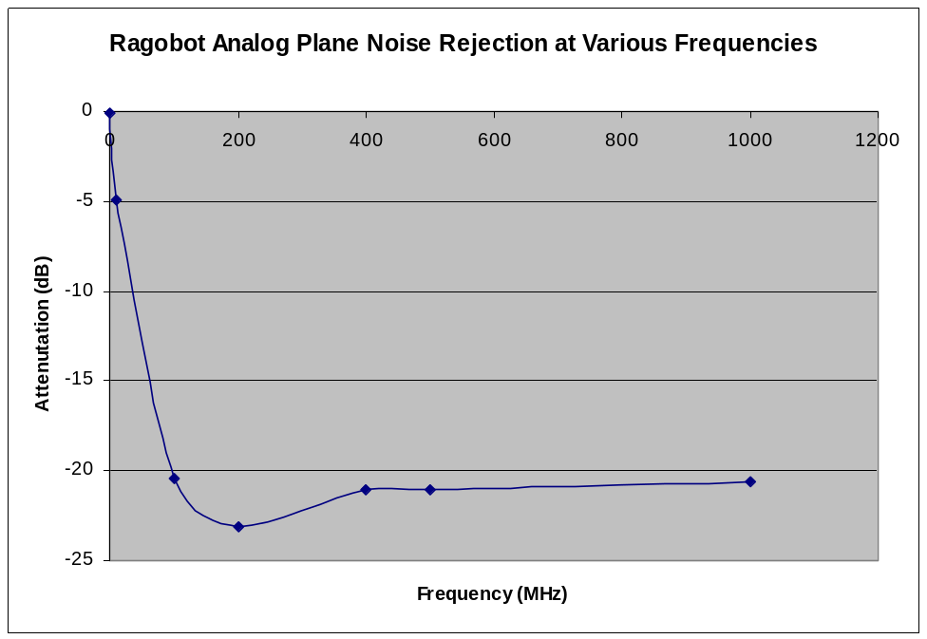
Tertiary Analog Filter

Slide 24
Mixed Signal PCB Layout
Noise travels on the shortest route to the lowest point in the circuit (Battery-)
Minimize distance where possible
Keep noisy circuits midline on the PCB
Route quiet signals to the periphery
RAGOBOT SENSORS
(Analog, quiet)
Power
Ground
POWER SUPPLY
Motor, Batt, Charger
Connectors (noisy)
RAGOBOT LOGIC
(Digital, noisy)
MICA2 LOGIC
(Digital, noisy)
Ground
Ground
Ground
POWER SUPPLY
(Analog, quiet)
Batt Charging Sensors
MICA2 RADIO
(Analog, quiet)
Ground
Ground

Slide 25
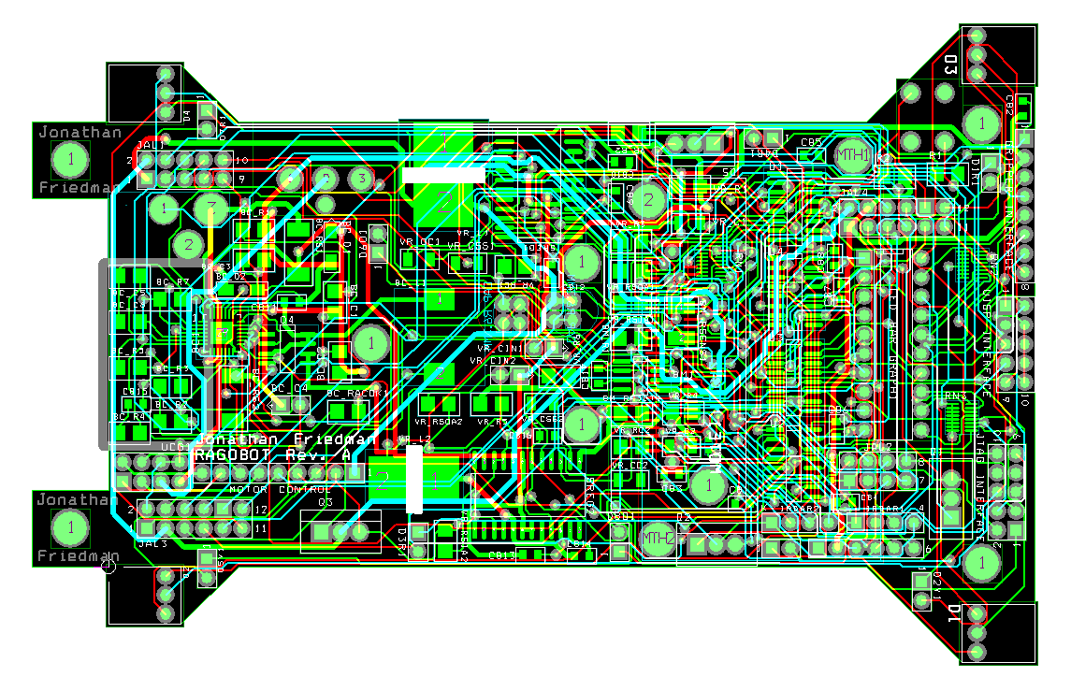
Ragobot Layer PCB

Slide 26
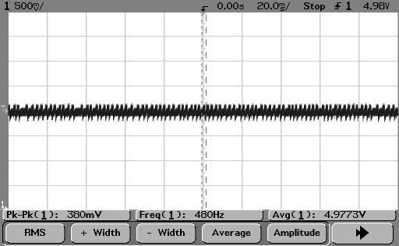
Main Propulsion Isolation
These images are on the same scale!
Under full motor drive (500mA), motor power plane maintains only +/- 3.8% error

Slide 27
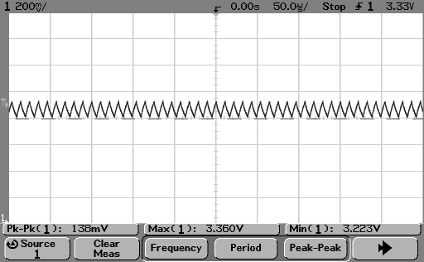
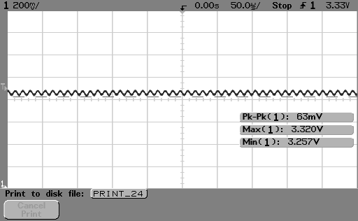
Tertiary Filter into Mote
With about 95% efficiency we get only
+/- 0.9% load regulation error!

Slide 28
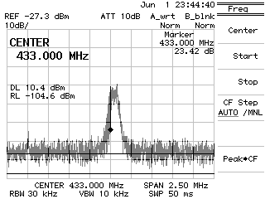
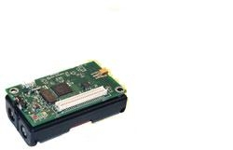
But was all this effort worth it?
Mica2 in isolation,
transmitting at medium power,
433 MHz

Slide 29
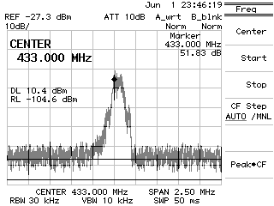
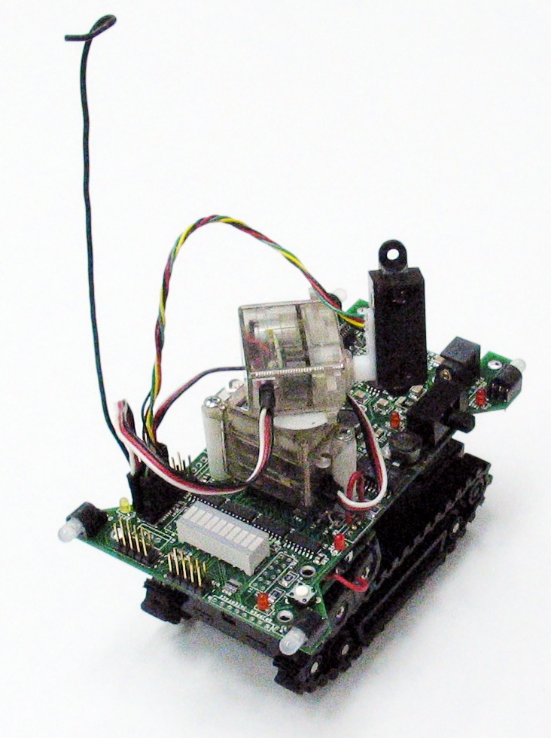
But was all this effort worth it?
Mica2 on the Ragobot,
same conditions
No clock drift!
SUCCESS!
Still in-band!
Noise floor is unchanged!

