Slide 1
RagoWorld: The Next Generation in RoboGaming
Jonathan Friedman, David Lee, Advait Dixit,
Parixit Aghera, Aman Kansal, Sophia Wong,
William J. Kaiser, Greg J. Pottie, and Mani Srivastava
http://nesl.ee.ucla.edu

Slide 2
Behind the Bot: A RagoStory
Entertainment
  Provide new interactive gaming environment
  Visual interesting and new potential games
Education
  Fun platform for students to learn about embedded robots
  Provide teaching aids for complex systems
Research
  Provide reconfigurable mobile platform for embedded research
  New directions in adaptive actuation and coordinated operation
  Isolate test algorithms by shifting other functionality to central server

Slide 3

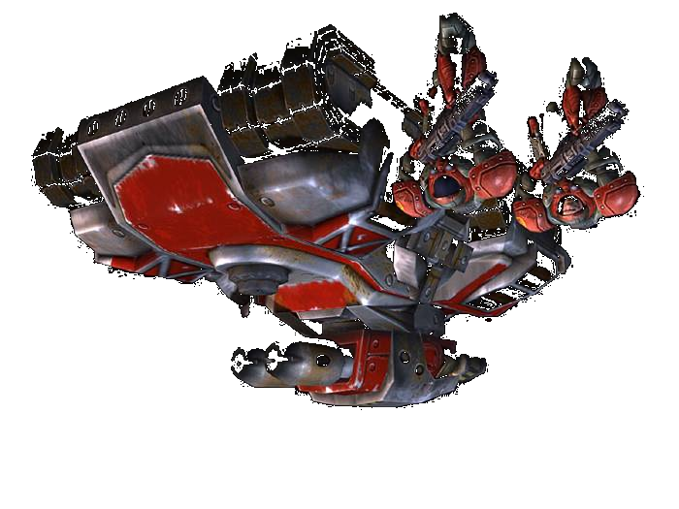
RagoWorld: Robogaming Environment
Localization Camera
Graphic Projector
PicoNIMS Terrain
Control
Energy Replenishment
Autonomous Mobile agents
Reconfigurable Terrain
Distributed Audio Engine

Slide 4
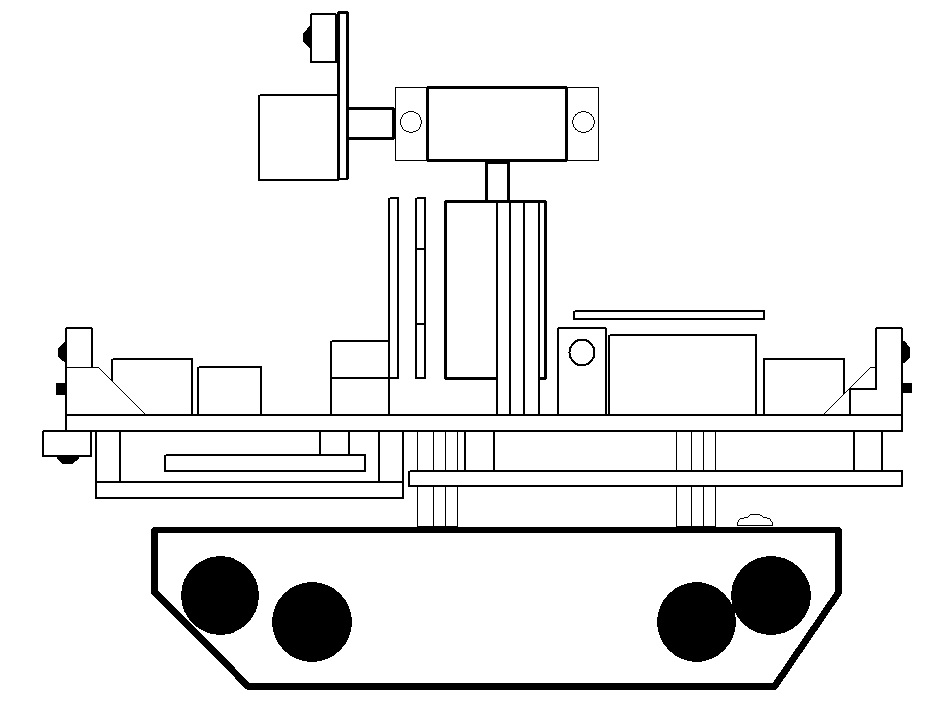
Now Presenting: Ragobot
Head Board
(Camera, IR, Microphone, Blue LED)
Pan Servo
Tilt Servo
IRDAR
Neck Board
(Antenna Tuner, Z-Axis Accelerometer, USB Control)
LED Light Bar
IR Obstacle
Detector
RFID Reader
Ultrasound
Speaker
IR Obstacle
Detectors
IR Edge
Detector
Sensor Board
(INS, DSP, Other Sensors)
CPU & Radio Module
(XYZ or Mica2)
RFID Antenna
(below platform)
Traction Platform

Slide 5
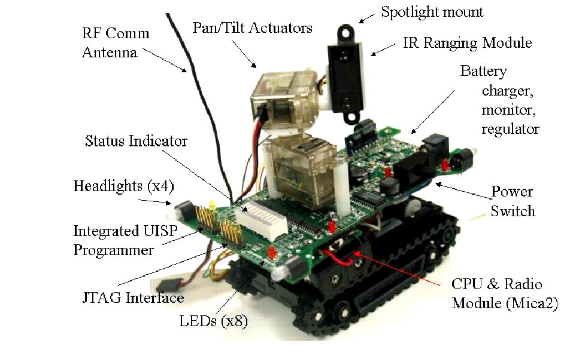
Ragobot Rev. 1, Say Cheese

Slide 6
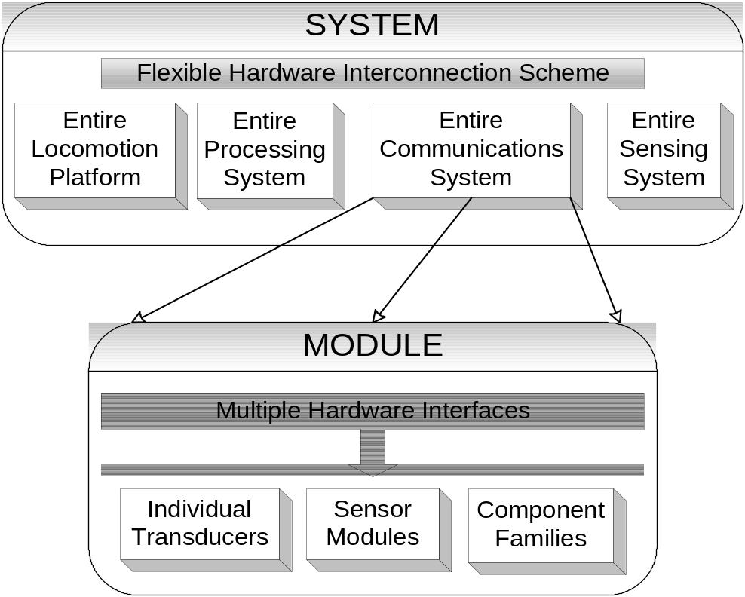
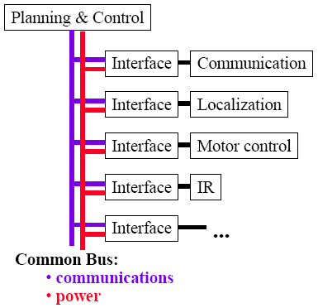
Hierarchy of Modularity: Concept
Advancing Small-Scale Robotics!
Static Modules
(modularity only at
highest level)
Dynamic Modules
(modules within modules)
Source: L. Navarro-Serment, R. Grabowski, C. Paredis, P. Khosla. Robotics Institute, Carnegie Mellon University, Modularity in Small Distributed Robots

Slide 7
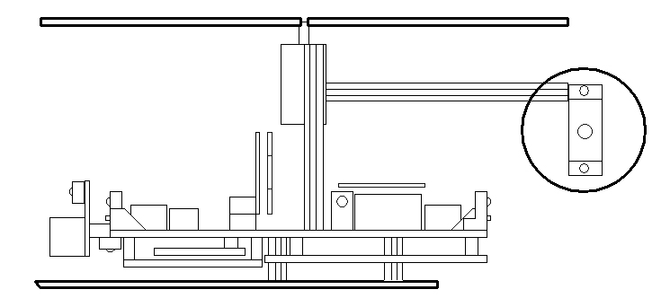
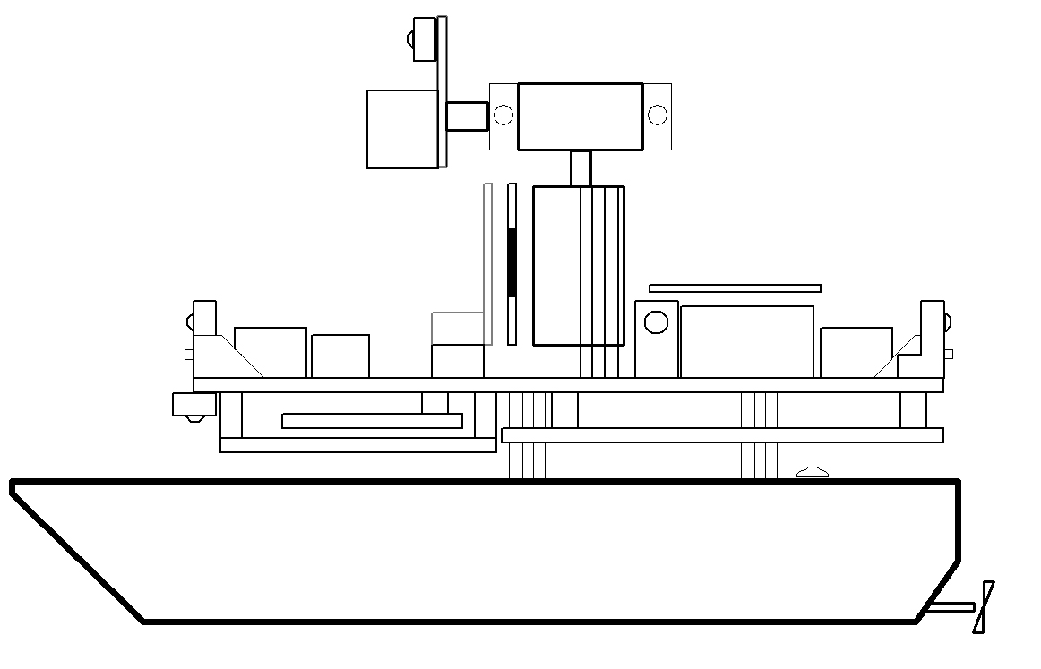
Hierarchy of Modularity: The RagoFamily
RECONFIGURABLE!

Slide 8
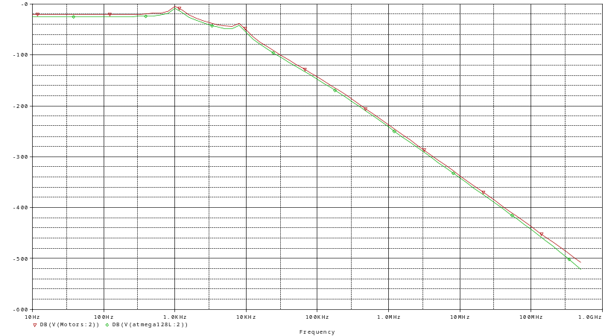
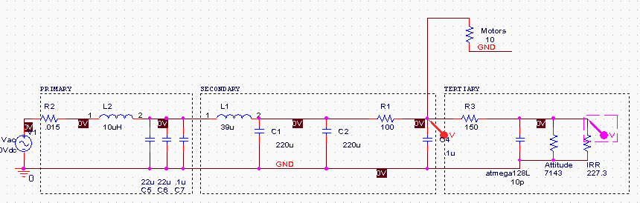
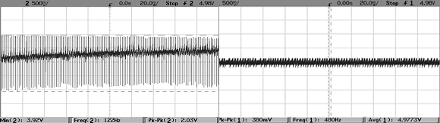
State-of-the-Art Design: Power Supply
Analog analysis…
…matches actual hardware!
Output without power supply…
…and output with our design
Worst case performance is only 3.8% fluctuation to high-current systems and only 0.9% fluctuation to sensors, processor, and radio under ½ Amp surge at 94% efficiency!

Slide 9
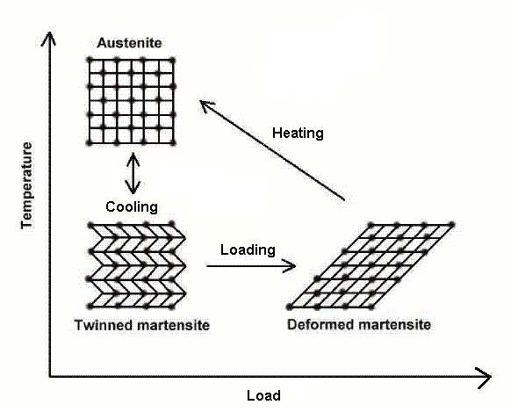
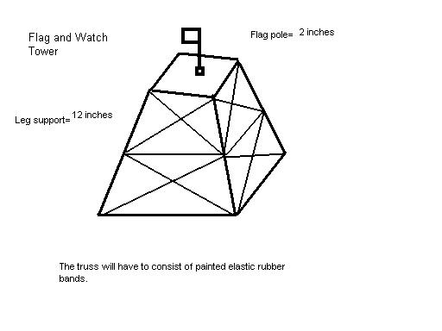
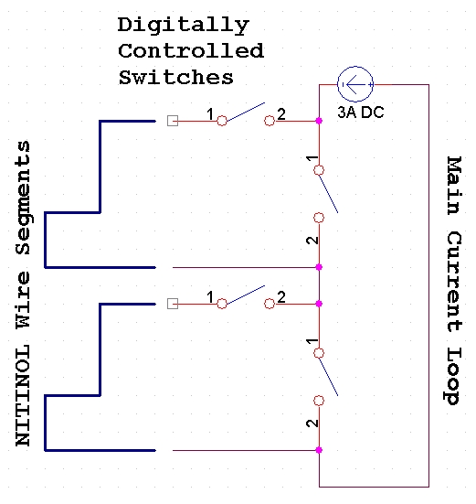
Actuated Structures
Shape Memory Alloys (Ni-Ti
Alloy) allow electronic control of
physical game structures and
obstacles

Slide 10
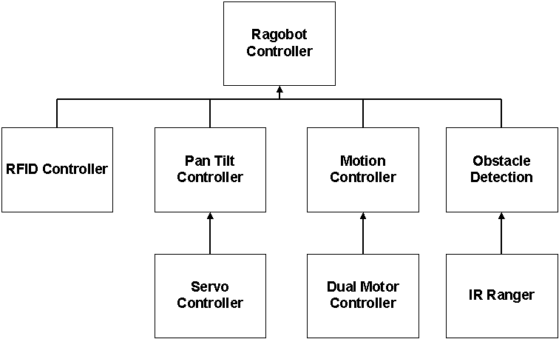
Software Architecture

Slide 11
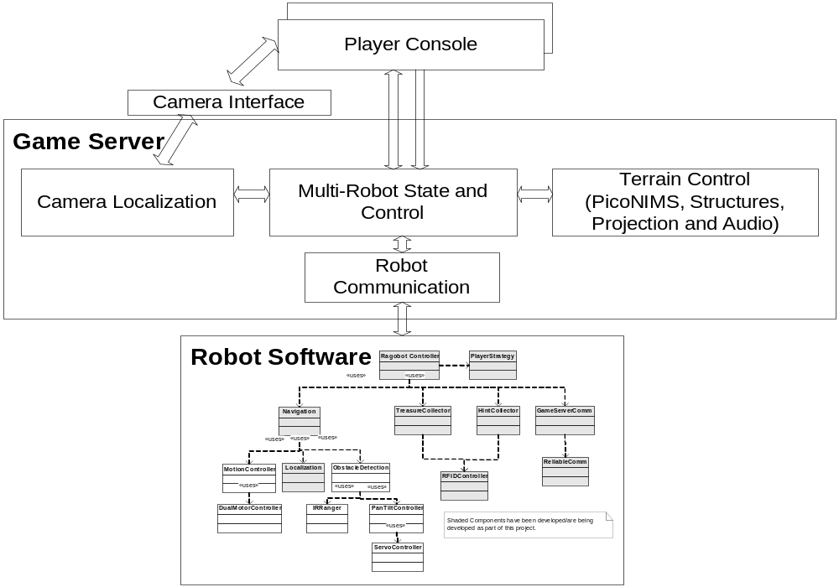
Software Architecture

Slide 12
Ongoing Work
Remaining hardware components being developed
  Low noise ultrasound localization
  Video sensor
  Inertial navigation system
  Microphone and speaker system
Robot navigation
  Higher level navigation functionality under development
Robot communication protocol
  Between server and robots
    Currently based on ID based packet transfer
  Among robots
Multi-robot control primitives
  Collaborative team operation

