Slide 1

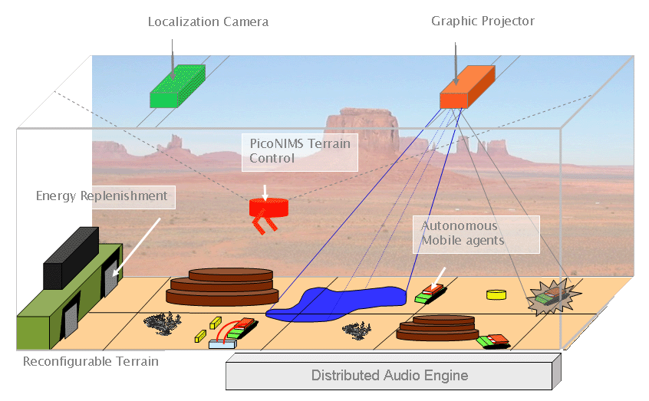
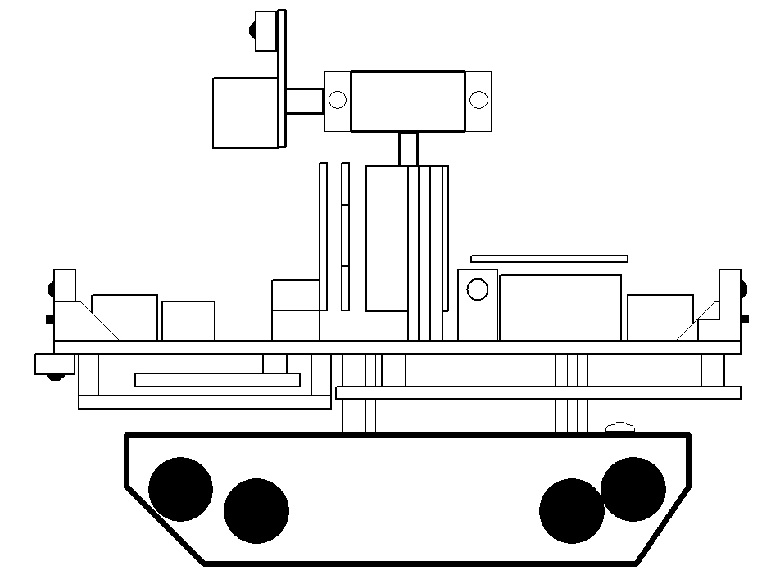
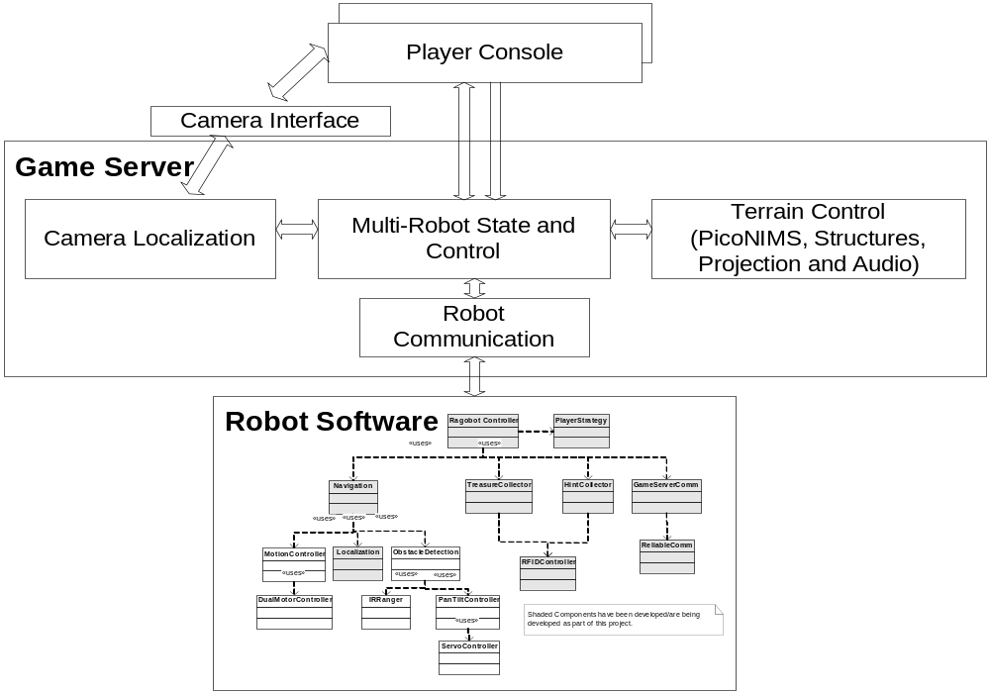
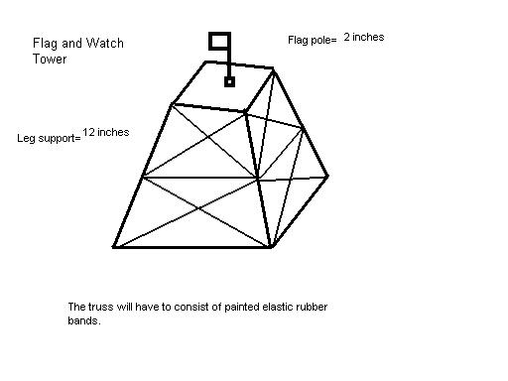
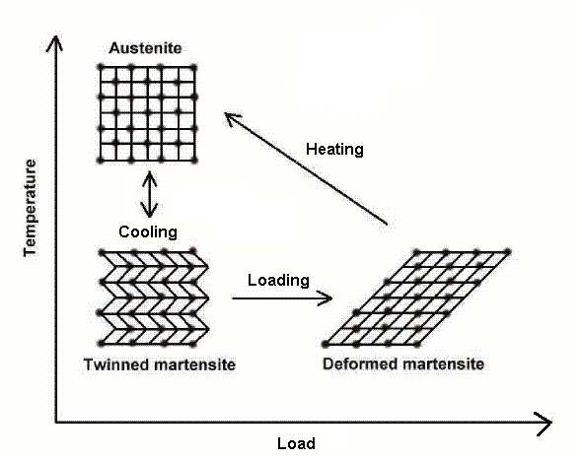
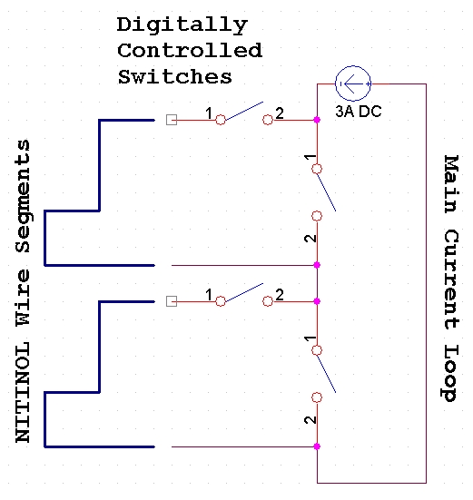
Real Action Gaming Robots
Center for Embedded Networked Sensing
Jonathan Friedman, David Lee, Parixit Aghera, Advait Dixit, Aman Kansal,
Deborah Estrin, William J Kaiser, Mani B Srivastava, and Gaurav Sukhatme
Networked and Embedded Systems Laboratory – http://nesl.ee.ucla.edu
Introduction: Importance of Robogaming in Entertainment, Education, and Research
Entertainment and Education
Mobile Sensor Network Research
Provides new interactive gaming environment
  Creates opportunities for social interaction
Promotes creativity
Provides a flexible design platform
Engages students to learn about robots and embedded mobile sensor networks
Provides a teaching aid for complex systems
Provides reconfigurable mobile platform for embedded research
  Static sensor nodes may not be sufficient
  Mobility allows nodes to reconfigure into optimal sensing and communications topologies
Allows adaptive actuation and coordinated operation
Problem Description: Creation of a Test Platform for Mobile Sensor Network Research
A fully capable, reconfigurable mobile platform to interface with sensor nodes
Customizable sensor suite on mobile robots
Simple programming interface for expert and non-expert users
Real-time response to environmental stimuli
Flexible, reconfigurable, interactive terrain
Proposed Solution: Ragobot and its Gaming Terrain
Ragobot Hardware
  Hierarchy of modularity: robot divided into 5 PCBs:
    DSP sensor “Nerve” board,
    Processor “Brain” board,
    Motile sensor “Head” board,
    Vertical sensor mount “Neck” board, and
    Main interface “Body” board
  Large sensor array: 1) ultrasound, 2) RFID, 3) IR obstacle detection, 4) inertial navigation system , 5) microphone, and 6) camera
  Custom power supply to reduce noise on mixed signal board
Ragobot Software
  Game Server: 1) provides global services such as localization, 2) maintains state and provides robot control, 3) controls terrain configuration
    Platform independent GUI for player console ( Java )
    Components communicate using TCP/IP sockets (modularity)
  Robot Software (in TinyOS) 1) controls actuators and sensors, 2) communicates with game server and other Ragobots, 3) performs local tasks such as navigation, obstacle avoidance and treasure collection
    Different levels of abstractions to isolate hardware changes from upper layers
    Modular software design allows selection of different sets of functionalities
Ragobot Terrain
  Electronically-controlled actuated structures using Ni-Ti shape memory alloys
  Modular terrain pieces with natural obstacles created from Insulfoam
  Reconfigurable to create new terrain environments
  Global localization system using camera (CMVision) or ultrasound
Head Board
(Camera, IR, Microphone, Blue LED)
Tilt Servo
Pan Servo
IRDAR
Neck Board
(Antenna Tuner, Z-Axis Accelerometer, USB Control)
IR Obstacle
Detector
LED Light Bar
Ultrasound
RFID Reader
Speaker
IR Edge
Detector
IR Obstacle
Detectors
CPU & Radio Module
(XYZ or Mica2)
RFID Antenna
(below platform)
Sensor Board
(INS, DSP, Other Sensors)
Traction Platform
UCLA – UCR – Caltech – USC – CSU – JPL – UC Merced

