Slide 1

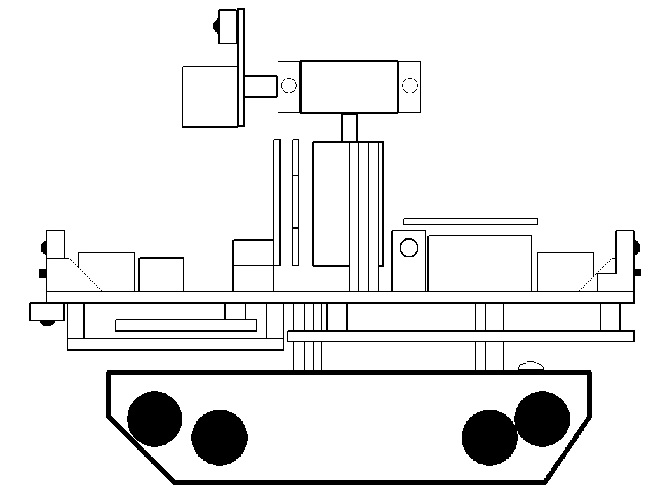
ragoBOT
Real Action Gaming Robot

