Slide 1
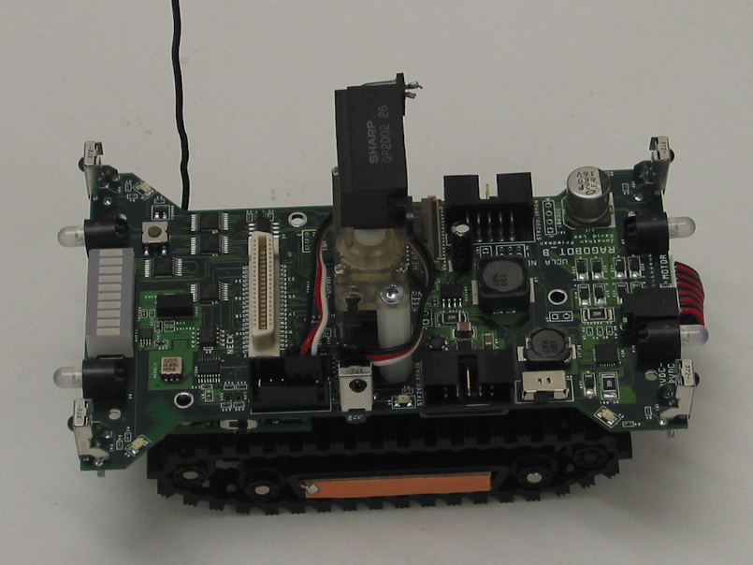
HEAD INTERFACE
(Video, Audio, IR “Weapons”)
Six-element, full-coverage, IR obstacle
detection and short-range communications
array
NECK INTERFACE
(RFID, UID, USB)
…AND MUCH MUCH MORE!
Hardware debounced,
Interrupt driven pushbutton
for user applications
IRMAN
programming
header
Headlights and taillights can
be individually controlled and
can light in 3 different colors
Display up to 10bit
data on LED Array
Single standardized
cable connection to
replaceable
undercarriage
Integrated 3D
Compass
Integrated 2D
Accelerometer
Power robot and
recharge battery
from DC wall supply
Battery charger with
under-voltage,
over-voltage,
reverse polarity,
over-load,
and regulation
Protection
Battery monitor
(on underside of PCB)
Edge detector prevents
falls from cliffs
(not shown)
Program the MOTE
without disconnecting
from robot!
Plug-and-play support for all
xBow Mote compatible devices
Self-docking power transfer plates
for automatic battery recharge

Slide 2
The next generation!
Integrated fully isolated analog sensor suite!
Self-docking with recharge station!
Integrated protected and matched battery charging module!
Lower ride height, better weight distribution, lower power consumption!
Tons of configurations and expansions!

