Slide 1


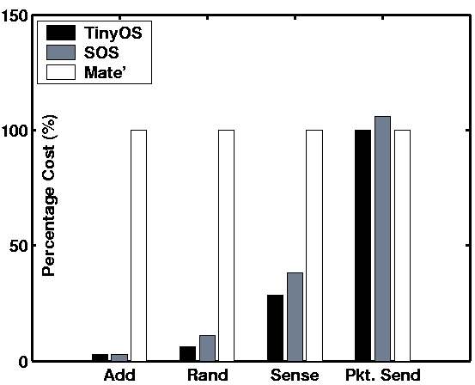
Reconfigurable Sensor Networks with SOS
Center for Embedded Networked Sensing
Chih-Chieh Han, Ram Kumar Rengaswamy, Roy Shea and Mani Srivastava
UCLA Networked and Embedded Systems Laboratory
Introduction: Remote Reconfiguration in Wireless Sensor Networks
Remote and Inaccessible Deployments
Reconfiguration of a Deployment
Deploy and Leave
Sensor networks observe the otherwise unobservable.
Deployments locations are often hazardous, remote, or fragile.
Quotation From the Field
“Sitting here in the middle of nowhere and getting motes to work... I have to walk for 5 minutes on a mine field (they swear they have removed all the mines but who knows?) just because we forgot to initialize some variable!!”
Remote Operation
Operation from afar is essential to the continued success of sensor networks.
Post Deployment Updates
Users need to: add new functionality, remove bugs, and evolve the system in an actively deployed network.
Limits of Physical Reprogramming
Reprogramming a network of 100 or 1000 motes by physically accessing each node is a waste of time and resources.
Related Proposals
XNP and differential updates load new system images but result in an interrupted sensor operation.
Virtual machines provide flexibility at the cost of interpreted languages.
Dynamically loadable kernel modules target a different class of devices.
Proposed Solution: Sensor Network System Support for Loadable Modules
Need a Minimal System Kernel
Need Loadable Binary Modules
System Core Implements Basic Services
Message passing scheduler for messages between parts of the system.
Low layer hardware abstractions for a given system platform.
Fixed-partition dynamic memory mechanism to provide constant time dynamic memory allocation to the SOS kernel and modules.
Dynamic Loadable
Binary Modules
Dynamic Loadable
Binary Modules
Modules Implement Most Functionality
  Everything from sensor drivers to user programs are implemented as modules.
  Modules can be added, modified, and removed at run time. This creates a dynamic system that can change over time to meet new challenges.
  Modifications to modules does not interrupt system operation.
Hardware
Abstraction
Static SOS Kernel
Memory
Manager
Msg Passing
Scheduler
Solution Analysis: Examining the SOS Operating System
Inter-Module Communications
Sample Application
Priority-based asynchronous messaging for inter-node module communication.
Type-safe synchronous function call for intra-node module communication.
Testing a sensing application written in SOS. Uses One Phase Pull to gather sensor data from a network.
Application is composed of five modules that can be customized individually post deployment.
Module A
Module B
Module A
Module B
Post
Indirect Function Call
Application
Message
Buffer
Module Function
Pointer Table
Application
System Communications
Data
Send
Send
Static kernel interface for access system resources such as timers, memory, sensors, and actuators.
Available
Interest
Data
Diffusion
Interest
Interest
Engine
Module A
Available
System Call
System Messages
Get
Subscribe
Data
System
Jump Table
SOS Kernel
High Priority
Message
Buffer
Neighbor
Ready
Neighbor
Discovery
Sensor
Drivers
HW Specific API
Interrupt
Hardware
Competitive Performance of SOS
SOS Combines:
Performance of traditional wireless sensor network operating systems.
Flexibility of virtual machines.
The combination creates a system that supports larger sensor networks that are able to evolve after they have been deployed
UCLA – UCR – Caltech – USC – CSU – JPL – UC Merced

