Slide 1
Sensor Networking with SOS
  Simon Han – simonhan@cs.ucla.edu
  Ram Kumar Rengaswamy – ram@ee.ucla.edu
  Roy Shea – roy@cs.ucla.edu
  Mani Srivastava – mbs@.ee.ucla.edu
  Eddie Kohler – kohler@cs.ucla.edu

Slide 2
SOS Operating System
Problem With Sensor Networks
Require uninterrupted operation indefinitely
Post-deployment software updates are common
  Customizing the system to the environment
  Feature upgrades
  Bug removal
  Re-tasking of the system
Re-programming a deployed system is hard
Remote reprogramming is essential for sustainability
The SOS Solution
Remotely insert binary modules into running kernel
  Software reconfiguration without interrupting system operation
  No stop and re-boot unlike differential patching
Superior performance over virtual machines
Tree
Routing
Surge
Application
Light
Sensor
Dynamically
Loadable
Modules
Light
Sensor
Dynamic Memory
Scheduler
Function Pointer
Control Blocks
Kernel
Services
Timer
Serial
Framer
Comm.
Stack
Sensor
Manager
Device
Drivers
Hardware
Abstraction
Layer
Custom
Components
Clock
UART
ADC
SPI
I2C
Component Library`
Tree
Routing
Surge
Application
Light
Sensor
Dynamically
Loadable
Modules
Write
Light
Sensor
Dynamic Memory
Scheduler
Function Pointer
Control Blocks
Kernel
Services
Timer
Serial
Framer
Comm.
Stack
Sensor
Manager
Device
Drivers
Clock
UART
ADC
SPI
I2C
Hardware
Abstraction
Layer
Test
SOS
Refine
Update
Deployment

Slide 3
Architecture Overview
Light
Sensor
Dynamically
Loadable
Modules
Tree
Routing
Surge
Application
Light
Sensor
Dynamic Memory
Scheduler
Function Pointer
Control Blocks
Kernel
Services
Timer
Serial
Framer
Comm.
Stack
Sensor
Manager
Device
Drivers
Hardware
Abstraction
Layer
Clock
UART
ADC
SPI
I2C
Static Kernel
Hardware abstraction and common services
Costly to modify after deployment
Data structures to enable module loading
Dynamic Modules
Drivers, protocols, and applications
Inexpensive to modify after deployment
Position independent

Slide 4
Basic Services
SOS provides the basic services expected in a sensor operating system
Hardware Abstraction Layer (HAL)
  Clock, UART, ADC, SPI, etc.
Low layer device drivers interface with HAL
  Timer, serial framer, communications stack, etc.
Core kernel services
  Dynamic memory management
  Scheduling
  Function control blocks
Tree
Routing
Surge
Application
Light
Sensor
Dynamically
Loadable
Modules
Light
Sensor
Dynamic Memory
Scheduler
Function Pointer
Control Blocks
Kernel
Services
Timer
Serial
Framer
Comm.
Stack
Sensor
Manager
Device
Drivers
Hardware
Abstraction
Layer
Clock
UART
ADC
SPI
I2C

Slide 5
More Basic Services
Memory Management
Static allocation is inefficient
Use fixed-partition dynamic memory allocation
  Constant allocation time
  Low overhead
Memory management features
  Guard bytes for run-time memory over-flow checks
  Ownership tracking
  Garbage collection on completion
Scheduling
SOS implements non-preemptive priority scheduling using priority queues
Event is served when there is no higher priority event
  Low priority queue used for scheduling most events
  High priority queue used for time critical events including hardware interrupts and sensitive timers
Prevents execution in interrupt contexts
  pkt = (uint8_t*)ker_malloc(hdr_size + sizeof(SurgeMsg), SURGE_MOD_PID);
  post_long(TREE_ROUTING_PID, SURGE_MOD_PID, MSG_SEND_PACKET,
  hdr_size + sizeof(SurgeMsg), (void*)packet, SOS_MSG_DYM_MANAGED);
Light
Sensor
Dynamically
Loadable
Modules
Tree
Routing
Surge
Application
Light
Sensor
Dynamic Memory
Scheduler
Function Pointer
Control Blocks
Kernel
Services
Timer
Serial
Framer
Comm.
Stack
Sensor
Manager
Device
Drivers
Clock
UART
ADC
SPI
I2C
Hardware
Abstraction
Layer

Slide 6
Module Linking
Independent of module distribution protocol
New module is stored into a free module block located in program memory
Kernel stores critical information about the module in the module table
Initialization routine for the module is called
  Publish functions for other parts of the system to use
    char tmp_string = {'C', 'v', 'v', 0};
    ker_register_fn(TREE_ROUTING_PID, MOD_GET_HDR_SIZE, tmp_string,
      (fn_ptr_t)tr_get_header_size);
  Subscribe to functions supplied by other modules
    char tmp_string = {'C', 'v', 'v', 0};
    s->get_hdr_size = (func_u8_t*)ker_get_handle(TREE_ROUTING_PID,
      MOD_GET_HDR_SIZE, tmp_string);
  Set initial timers and schedule events
Surge
Application
Light
Sensor
Dynamically
Loadable
Modules
Tree
Routing
Light
Sensor
Dynamic Memory
Scheduler
Function Pointer
Control Blocks
Kernel
Services
Timer
Serial
Framer
Comm.
Stack
Sensor
Manager
Device
Drivers
Clock
UART
ADC
SPI
I2C
Hardware
Abstraction
Layer

Slide 7
Module Kernel Communication
System Call
Module A
System Messages
System
Jump Table
High Priority
Message
Buffer
SOS Kernel
HW Specific API
Interrupt
Hardware
Kernel provides system services and access to hardware
      ker_timer_start(s->pid, 0, TIMER_REPEAT, 500);
      ker_led(LED_YELLOW_OFF);
Kernel jump table re-directs system calls to handlers
  Upgrade kernel independent of the module
Interrupts and messages from the kernel are dispatched by a high priority message buffer
  Low latency
  Concurrency safe operation
Tree
Routing
Surge
Application
Light
Sensor
Dynamically
Loadable
Modules
Light
Sensor
Dynamic Memory
Scheduler
Function Pointer
Control Blocks
Kernel
Services
Timer
Serial
Framer
Comm.
Stack
Sensor
Manager
Device
Drivers
Hardware
Abstraction
Layer
Clock
UART
ADC
SPI
I2C

Slide 8
Inter-Module Communication
Module A
Module B
Module A
Module B
Indirect Function Call
Post
Module Function
Pointer Table
Message
Buffer
Inter-Module Message Passing
Asynchronous communication
Messages dispatched by a two-level priority scheduler
Suited for services with long latency
Type safe binding through publish / subscribe interface
Inter-Module Function Calls
Synchronous communication
Kernel stores pointers to functions registered by modules
Blocking calls with low latency
Type-safe runtime function binding
Tree
Routing
Surge
Application
Light
Sensor
Dynamically
Loadable
Modules
Light
Sensor
Dynamic Memory
Scheduler
Function Pointer
Control Blocks
Kernel
Services
Timer
Serial
Framer
Comm.
Stack
Sensor
Manager
Device
Drivers
Hardware
Abstraction
Layer
Clock
UART
ADC
SPI
I2C

Slide 9
Module Safety: Lions and tigers and bears! Oh no...
Problem: Modules can be remotely added to, removed from, and modified on deployed nodes
Accessing a module
  If module does not exist, then SOS kernel catches messages for non-existent modules and handles dynamically allocated memory
  If module exists but can't handle the message, then the module's default handler gets message and kernel handles dynamically allocated memory
Subscribing to a module provided function
  Publishing a function includes a type description stored in a function control block (FCB) table
  Subscription attempts include type checks against corresponding FCB
  Type changes or removal of published functions result in subscribers being redirected to system stub handler function specific to that type
  Updates to published functions with the same type are assumed to have the same semantics
Surge
Application
Light
Sensor
Dynamically
Loadable
Modules
Tree
Routing
Light
Sensor
Dynamic Memory
Scheduler
Function Pointer
Control Blocks
Kernel
Services
Timer
Serial
Framer
Comm.
Stack
Sensor
Manager
Device
Drivers
Hardware
Abstraction
Layer
Clock
UART
ADC
SPI
I2C

Slide 10
Programing Model
Custom
Components
Component Library
Light
Sensor
Dynamically
Loadable
Modules
Tree
Routing
Surge
Application
Light
Sensor
Dynamic Memory
Scheduler
Function Pointer
Control Blocks
Kernel
Services
Timer
Serial
Framer
Comm.
Stack
Sensor
Manager
Device
Drivers
Clock
UART
ADC
SPI
I2C
Hardware
Abstraction
Layer

Slide 11
Module Library
Many applications are created by combining already written and tested modules
SOS kernel facilitates loosely coupled modules
  Passing of memory ownership
  Efficient function and messaging interfaces
Current modules in SOS distribution
  Aggregation tree, debugging, flooding, mica sensor board drivers, neighbourhood maintenance, surge, tiny diffusion, tree routing, and demonstration modules
Surge Application
with Debugging
Memory
Debug
Surge
Photo
Sensor
Tree
Routing
Custom
Components
Component Library`
Tree
Routing
Surge
Application
Light
Sensor
Dynamically
Loadable
Modules
Light
Sensor
Kernel
Services
Dynamic Memory
Scheduler
Function Pointer
Control Blocks
Timer
Serial
Framer
Comm.
Stack
Sensor
Manager
Device
Drivers
Clock
UART
ADC
SPI
I2C
Hardware
Abstraction
Layer

Slide 12
Module Design
#include <module.h>
typedef struct {
uint8_t pid;
uint8_t led_on;
} app_state;
DECL_MOD_STATE(app_state);
DECL_MOD_ID(BLINK_ID);
int8_t module(void *state, Message *msg){
app_state *s = (app_state*)state;
switch (msg->type){
case MSG_INIT: {
s->pid = msg->did;
s->led_on = 0;
ker_timer_start(s->pid, 0, TIMER_REPEAT, 500);
break;
}
case MSG_FINAL: {
ker_timer_stop(s->pid, 0);
break;
}
case MSG_TIMER_TIMEOUT: {
if(s->led_on == 1){
ker_led(LED_YELLOW_ON);
} else {
ker_led(LED_YELLOW_OFF);
}
s->led_on++;
if(s->led_on > 1) s->led_on = 0;
break;
}
default: return -EINVAL;
}
return SOS_OK;
}
Accessible
Uses standard C programing language
General kernel provides common services
Reusable module library jump starts projects
Programs created by “wiring” modules together
Clean Modules
Clean interfaces enhance re-usability
Simple structure that developers are familiar with
Custom
Components
Component Library
Tree
Routing
Surge
Application
Light
Sensor
Dynamically
Loadable
Modules
Light
Sensor
Kernel
Services
Dynamic Memory
Scheduler
Function Pointer
Control Blocks
Timer
Serial
Framer
Comm.
Stack
Sensor
Manager
Device
Drivers
Clock
UART
ADC
SPI
I2C
Hardware
Abstraction
Layer

Slide 13
Development Cycle
Rapid Development and Deployment
  Bugs fixed after deployment
  Test and develop in real environment
  Utilize new resources immediately
Write
Write
X
SOS
Other
Solutions
Test
Refine
Test
Hope
Update
Deployment
Deploy

Slide 14
Related Systems
TinyOS
  Compiles components written in nesC into a static binary image
  Uses external tools such as MOAP or Deluge to load updated images on remote nodes
Mate / Bombilla
  Virtual machine generator for use with TinyOS
  Capsules carry concise byte code for execution on remote nodes
Contiki
  Very portable system
  Proof of concept work on dynamic service delivery
Impalla
  Runs on different classes of nodes
  Dynamic component support is in development for mote devices
Mantis
  POSIX for motes

Slide 15
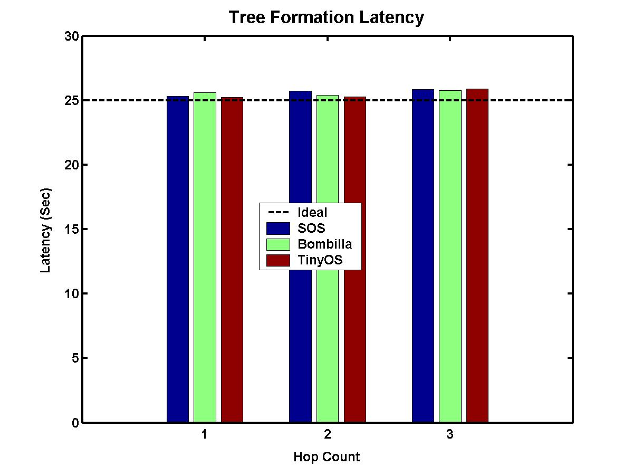
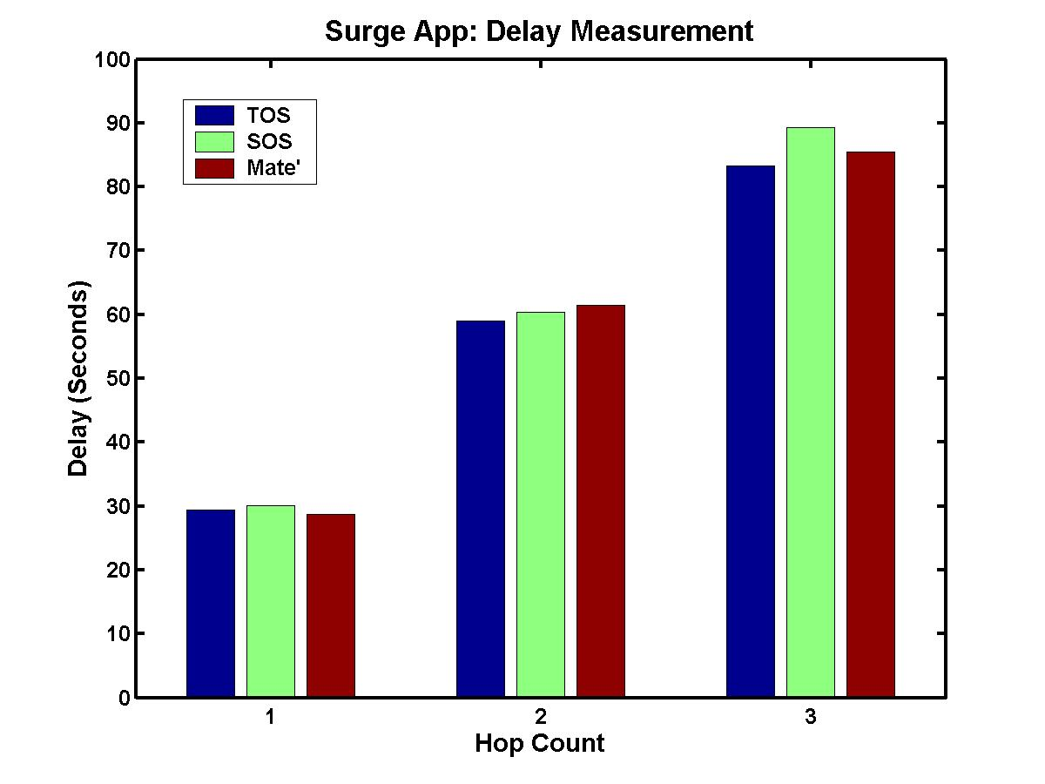
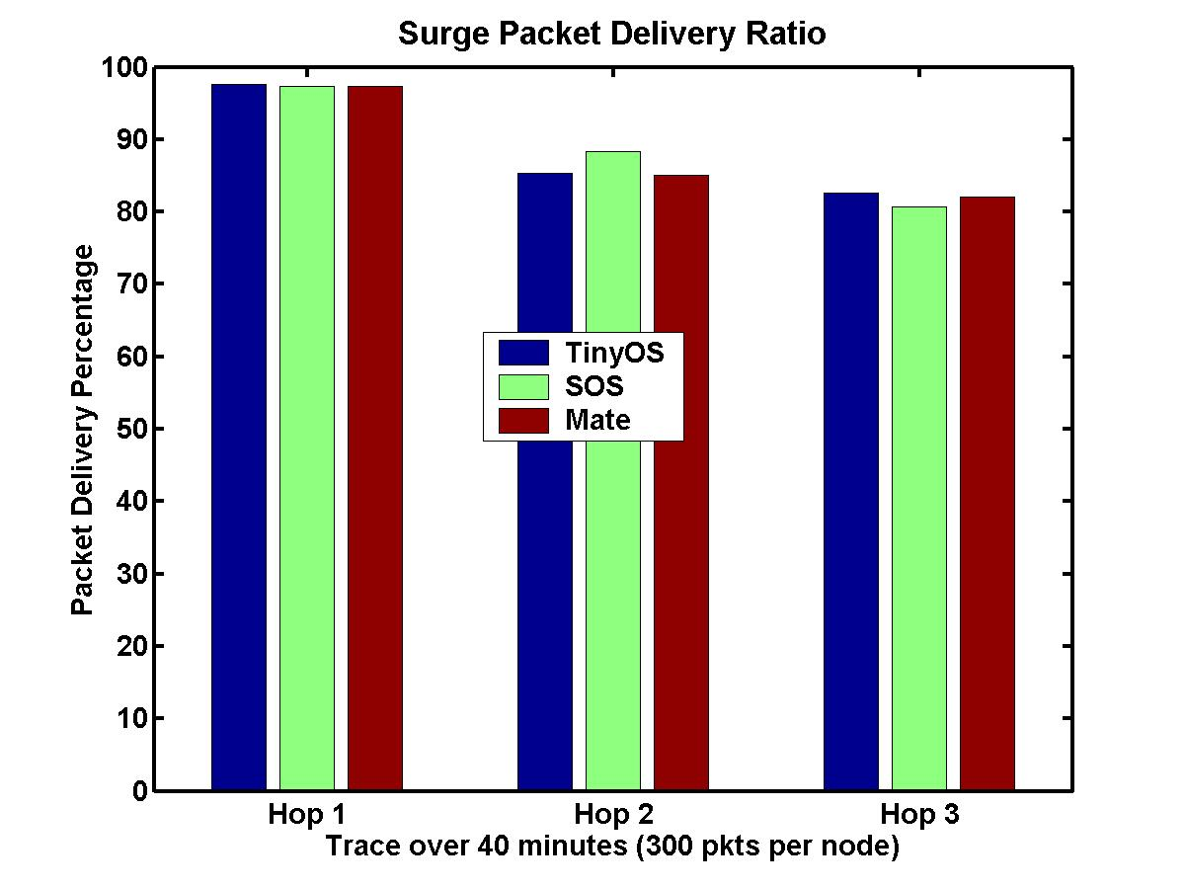
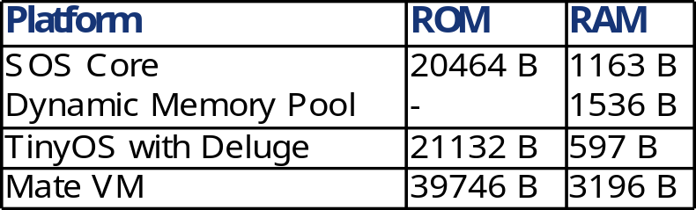
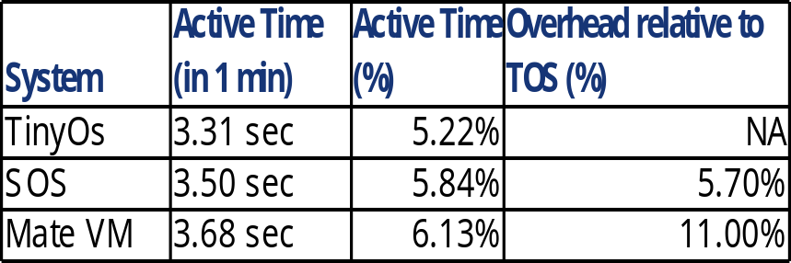
Application Level Performance
Comparison of application performance in SOS, TinyOS, and MateVM
Surge Tree Formation Latency
Surge Forwarding Delay
Surge Packet Delivery Ratio
Memory footprint for base operating system with the ability to distribute and update node programs.
CPU active time for surge application.

Slide 16
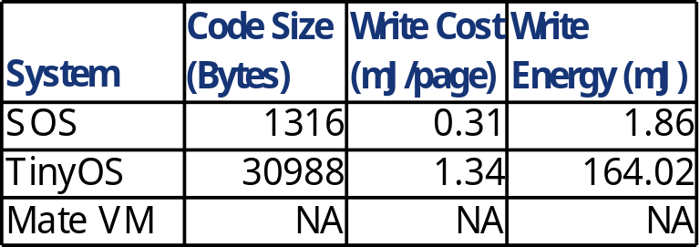
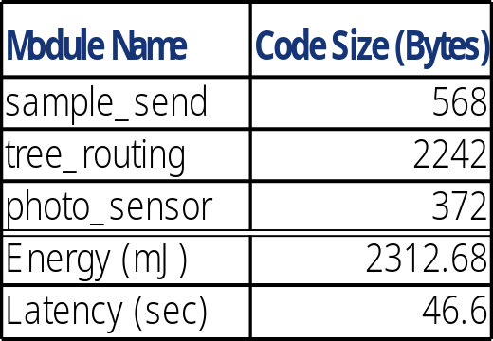
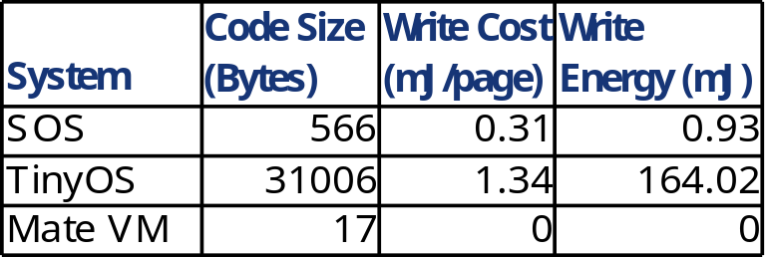
Reconfiguration Performance
Energy cost of light sensor driver update.
Module size and energy profile for installing surge under SOS.
Energy cost of surge application update.
Energy trade offs
  SOS has slightly higher base operating cost
  TinyOS has significantly higher update cost
  SOS is more energy efficient when the system is updated one or more times a week
  Basic optimizations will continue to improve this break even point

Slide 17
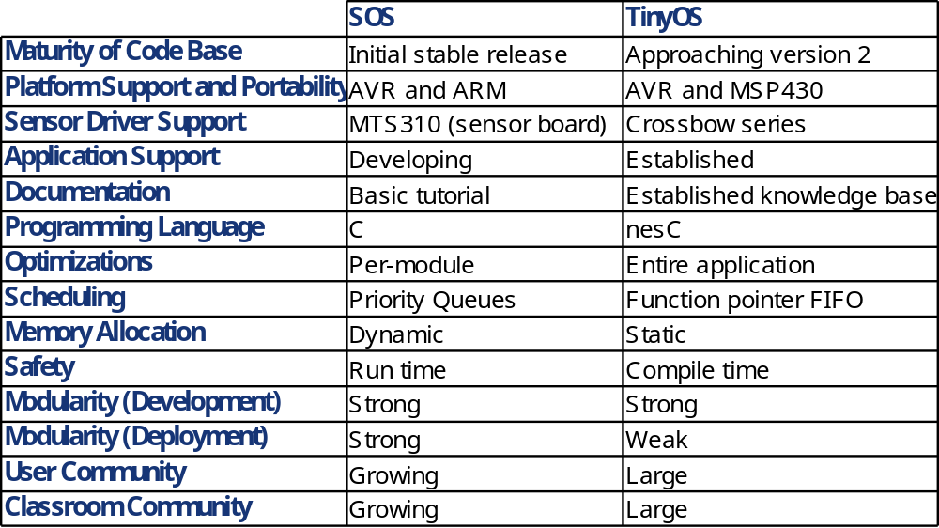
Current Feature Comparison
  TinyOS 2.0 is scheduled for release this coming season but does not appear to support dynamic memory, more flexible scheduling, or modular components

Slide 18
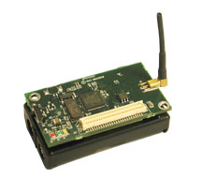
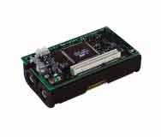
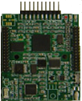
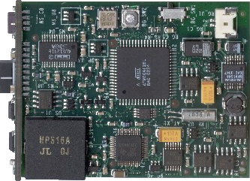
Platform Support
Supported micro controllers
Atmel Atmega128
  4 Kb RAM
  128 Kb FLASH
Oki ARM
  32 Kb RAM
  256 Kb FLASH
Supported Radio Stacks
Chipcon CC1000
  BMAC
Chipcon CC2420
  IEEE 802.15.4 MAC (NDA required)

Slide 19
Simulation Support
Source code level network simulation
  Pthread simulates hardware concurrency
  UDP simulates perfect radio channel
  Supports user defined topology and heterogeneous software configuration
  Useful for verifying the functional correctness
Instruction level simulation with Avrora
  Instruction cycle accurate simulation
  Simple perfect radio channel
  Useful for verifying timing information
  See http://compilers.cs.ucla.edu/avrora/
EmStar integration is under development for use this Spring quarter

Slide 20
Ongoing SOS Development
RATS time synchronization and low power duty cycling
EmSOS and hostmote integration with EmStar
Runtime memory swapping to stable storage
sQualnet integration and simulation
Potential Claremont deployment Summer '05
Continued classroom use at UCLA and Yale

Slide 21
Conclusions
New Architecture for sensor networks
  Eases application development
  SOS closes and tightens the development cycle
  SOS opens new domains of sensor networking
SOS documentation, tutorials, source, and support
  http://nesl.ucla.edu/projects/sos
Questions?

