Slide 1
New Directions in Sensor Networking with SOS
  Simon Han – simonhan@cs.ucla.edu
  Ram Kumar Rengaswamy – ram@ee.ucla.edu
  Roy Shea – roy@cs.ucla.edu
  Mani Srivastava – mbs@.ee.ucla.edu
  Eddie Kohler – kohler@cs.ucla.edu

Slide 2
Sustainable software operation
Require uninterrupted operation indefinitely
Post-deployment software updates are common
  Customizing the system to the environment
  Feature upgrades
  Bug removal
  Re-tasking of the system
Re-programming a deployed system is hard
  System deployed in inhospitable terrains
  Contains a large number of nodes
Remote reprogramming is essential for sustainability

Slide 3
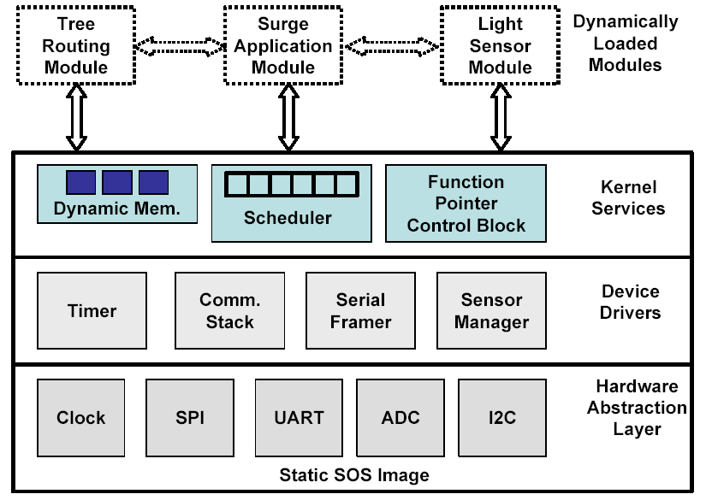
Overview of SOS Architecture
Static Kernel
Hardware abstraction and common services
Costly to modify after deployment
Data structures to enable module loading
Dynamic Modules
Drivers, protocols, and applications
Inexpensive to modify after deployment
Position independent

Slide 4
Dynamic Software Re-Configuration
Remotely insert binary modules into running kernel
  Software reconfiguration without interrupting system operation
  No stop and re-boot unlike differential patching
Superior performance over virtual machines
Dynamic Loadable
Binary Modules
Dynamic Loadable
Binary Modules
Static SOS Kernel
Hardware
Abstraction
Module
Communication
Memory
Manager
Design Challenges
  Dealing with severe resource constraints
    Only 4 KB of RAM and 15 mW of active power consumption
  Reliable operation of the dynamically evolving system

Slide 5
Inter-Module Communication
Module A
Module B
Module A
Module B
Indirect Function Call
Post
Message
Buffer
Module Function
Pointer Table
Inter-Module Message Passing
Asynchronous communication
Messages dispatched by a two-level priority scheduler
Suited for services with long latency
Example: FFT Computation
Inter-Module Function Calls
Synchronous communication
Kernel stores pointers to functions registered by modules
Blocking calls with low latency
Type-safe runtime function binding
Example: Neighbourhood Information

Slide 6
Module Kernel Interaction
System Call
Module A
System Messages
System
Jump Table
High Priority
Message
Buffer
SOS Kernel
HW Specific API
Interrupt
Hardware
Kernel provides system services and access to hardware
Kernel jump table re-directs system calls from modules to kernel handlers
  Upgrade kernel independent of the module
Hardware interrupts and messages from the kernel to modules are dispatched through a high priority message buffer
  Low latency
  Concurrency safe operation

Slide 7
Memory Management
Modules need memory to store state information
Problems with static allocation
  Worst case memory allocation – every variable is global
Problems with general purpose memory allocation
  Non-deterministic execution delay
  Suffers from external fragmentation
Use fixed-partition dynamic memory allocation
  Memory allocated in blocks of fixed sizes
  Constant allocation time
  Low overhead
Memory management features
  Guard bytes for run-time memory over-flow checks
  Ownership tracking of memory blocks
  Garbage Collection - Automatic free-up upon completion of usage

Slide 8
Sensor Manager
Enables sharing of sensor data between multiple modules
Presents a uniform data access API to many diverse sensors
Underlying device specific drivers register with the sensor manager
Device specific sensor drivers control
  Calibration
  Data interpolation
Sensor drivers are loadable
  Enables post-deployment configuration of sensors
  Enables hot-swapping of sensors on a running node
Module A
Module B
Periodic
Access
Signal
Data Ready
Polled
Access
Sensor
Manager
getData
dataReady
MagSensor
ADC
I2C

Slide 9
Network Simulation Support
Source code Level Network Simulation
  Pthread simulates hardware concurrency
  UDP simulates perfect radio channel
  Supports user defined topology and heterogeneous software configuration
  Useful for verifying the functional correctness
Avrora: Instruction Level Simulation
  Instruction cycle accurate simulation
  Simple perfect radio channel
  Useful for verifying timing information
  See http://compilers.cs.ucla.edu/avrora/

Slide 10
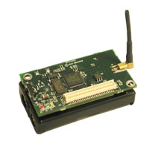
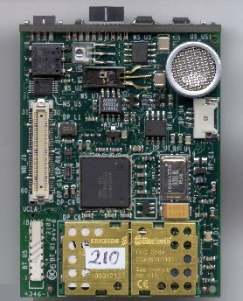
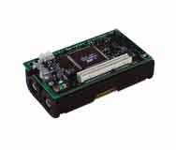
Easily Portable Operating System
MicaZ
Mica2
iBadge
Supported micro controllers
Atmel Atmega128
  4 Kb RAM
  128 Kb FLASH
Oki ARM
  32 Kb RAM
  256 Kb FLASH
Supported Radio Stacks
RFM radio stack
Chipcon CC1000 stack
IEEE 802.15.4 MAC
  Chipcon CC2420 radio

Slide 11
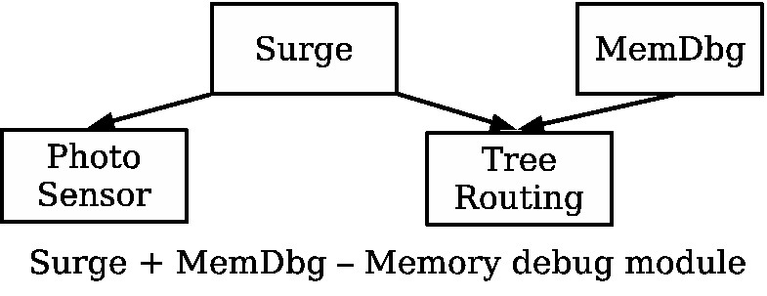
Programing Networks with SOS
Accessible
  Uses standard C programing language
  General kernel provides common services
  Reusable module library jump starts projects
  Programs created by “wiring” modules together
Clean Modules
  Clean interfaces enhance reusability
  Simple structure that developers are familiar with

Slide 12
SOS Development Cycle
Rapid Development and Deployment
  Bugs fixed after deployment
  Test and develop in real environment
  Utilize new resources immediately
Write
Write
X
SOS
Other
Solutions
Test
Refine
Test
Hope
Update
Deployment
Deploy

Slide 13
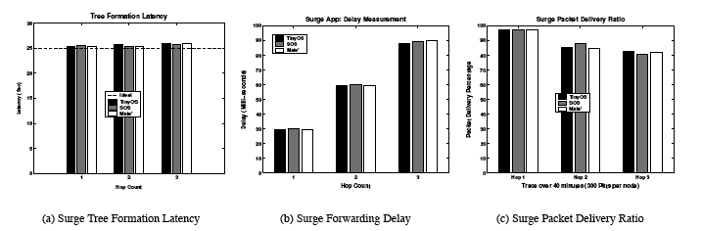
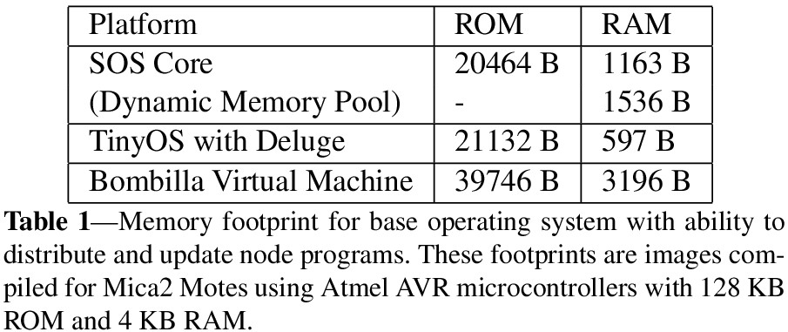
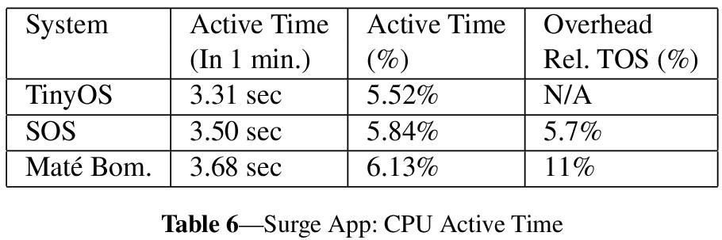
Application Level Performance
Comparison of application performance in SOS, TinyOS, and MateVM

Slide 14
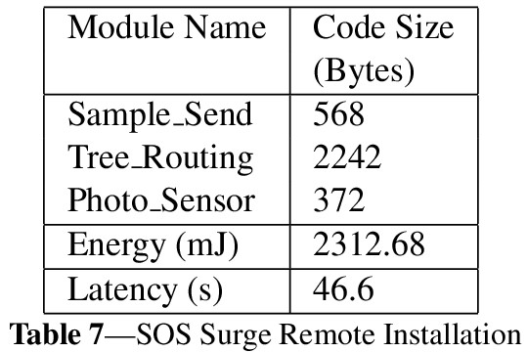
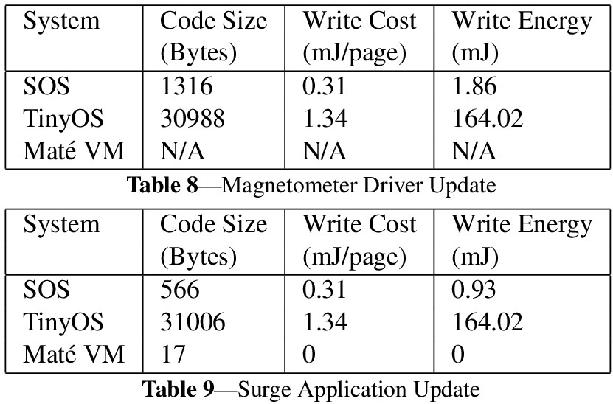
Reconfiguration Performance
Even Energy Usage
  SOS has slightly higher base overhead operating cost
  TinyOS has significantly higher update cost
  SOS is more energy efficient when the system is updated one or more times a week
  Basic optimizations will continue to improve this break even point

Slide 15
New Directions
Update Deployed Networks
  Bug fixes
  Retasking
  Optimizing
Pluggable Modules
  Module libraries
  Improved stability
  Rapid development
Heterogeneity
  Multiple users
  Mobile code
  Module caches

Slide 16
Conclusions
New Architecture for Sensor Networks
  Eases application development
  SOS closes and tightens the development cycle
  SOS opens new domains of sensor networking
SOS documentation, tutorials, and source
  http://nesl.ucla.edu/projects/sos
Magnetometer Demo: Utilizing New Resources
Ceiling Demo:
Bringing a Network to Life

