Slide 1
SOS - Dynamic operating system for sensor networks
Simon Han, Ram Kumar, Roy Shea, Eddie Kohler and Mani Srivastava
http://nesl.ee.ucla.edu/projects/sos

Slide 2










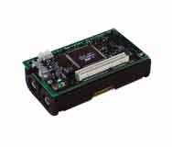

Embedded Sensor Networks
Habitat Monitoring
Structural Monitoring
Emergency Response
Resource Constrained Nodes
Design Goal - Long lifetime
Large scale ad-hoc networks
Notes:
Sensor networks are large scale wireless ad-hoc networks of resource constrained embedded nodes.
They are an exciting area of systems research.
Sensor networks have applications in diverse areas from monitoring of habitats and structures to emergency response applications (and a lot more)
An important design goal for sensor networks is to maximize lifetime with minimal energy supply

Slide 3
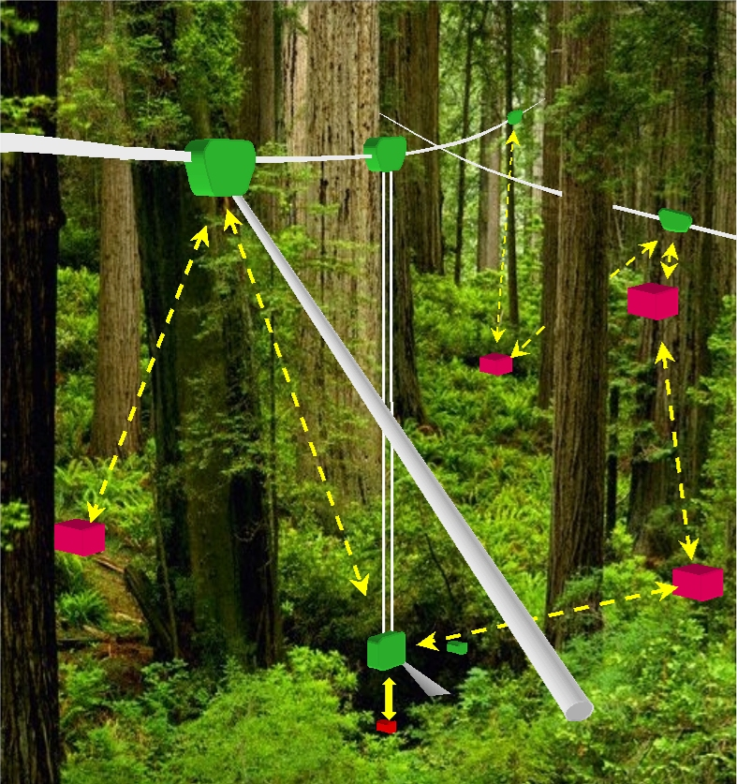


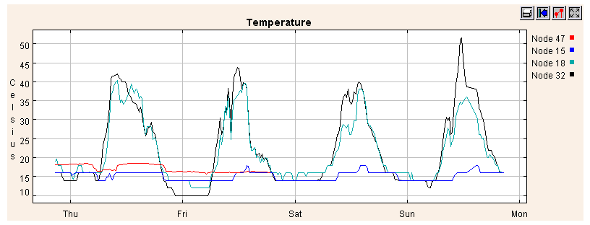
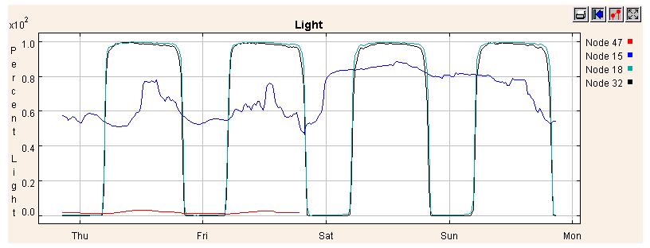
Re-tasking sensor networks
Re-tasking a deployed network
Data Gathering
Bird Localization
Fire Emergency
Requires in-situ re-programming
Notes:
A usage model of such networks is to re-task them multiple times during their lifetime.
Re-tasking refers to installing a new application on the network.
As an example, a network deployed in the forest for gathering data could be re-tasked to localize certain species of birds.
During an emergency, such as the breakout of a fire, the network could be re-tasked to localize regions that require immediate service.
Re-tasking requires techniques to efficiently re-program sensor networks after their deployment.

Slide 4
Re-programming Challenges
Severe resource constraints on nodes
  4 KB RAM, 128 KB FLASH, 2 AA batteries
Avoiding crashes
  Unattended operation - Crashed node is useless
  No architecture support for protection e.g. MMU
Balancing flexible and concise updates
  Update applications, services and drivers
  Energy efficient distribution and storage
Notes:
In-situ re-programming is a well-studied problem for mobile devices such as cell-phones for bug fixes and upgrades in the firmware.
But the severe resource constraints of sensor nodes preclude the application of the existing techniques to sensor networks.
Typical sensor nodes contain a few 100 KB of FLASH and a few KB of RAM.
Crash-proof execution of the software is an important requirement for any embedded system.
The unattended operation of sensor networks for long durations makes the safety requirement even more severe.
A crashed node in the network is useless.
This requirement becomes very difficult to attain on sensor nodes because the microcontroller architecture on the sensor nodes do not have any protection features such as MMU.
As I just mentioned, Re-programming of sensor networks could require updating or installing new applications
Sometimes, services such as routing, time-synchronization etc. also need to be changed to support the new applications
The updates to sensor networks should be flexible to permit software modifications at any layer.
At the same time the updates should be concise to ensure energy efficient distribution and storage
A crucial design decision is to maintain the correct balance between flexible and concise updates

Slide 5
Sensor Network OS State of the Art
TinyOS - Application specific OS
  Application, OS and drivers are NesC components
  Select app components, statically analyze and optimize
  Extensive set of well-tuned components
  Supports full binary upgrades
Maté - Application specific Virtual Machine
  Domain specific bytecode interpreter on TinyOS
  Programs are small scripts containing VM instructions
  Better suited for application specific tuning
  Interpreter updates require fallback to TinyOS
Notes:
Currently, there are two main systems that support sensor network reprogramming.
Lets review both of them briefly.
TinyOS is the de-facto operating system for sensor nodes.
It is a framework for generating application specific operating system
TinyOS consists of a collection of application, OS and driver components.
An application is created by choosing and wiring components appropriately.
The application is statically analyzed and optimized for performance.
The only way to reprogram TinyOS is through an full binary upgarde.
In contrast, Mate is an application specific virtual machine that on top of TinyOS that is designed for efficient reprogramming.
The virtual machine is programmed using scripts that contain high level instructions supported by the VM.
The scripts are interpreted by a domain specific bytecode interpreter
The set of functions supported by the virtual machine are fixed at compile time.
Any changes to those require fallback to the TinyOS update mechanism.

Slide 6
Towards general purpose sensor OS
TinyOS and Maté
  Application and OS are tightly linked
Design Goal: An application independent sensor OS
  Independently written & deployed apps run on one network
  Towards traditional kernel space/user space programming model
Re-programming via binary modules
  Risk: Lose safety provided by static analysis or dynamic interpreter
Design Challenge
  Provide general purpose OS semantics on resource constrained embedded sensor nodes
Notes:
TinyOS and Mate closely couple the application to the operating system
Any major modifications to the application results in changes to the OS.
An interesting alternative is to develop application generic operating system
The primary design goal is to support the execution of independently written and deployed applications on a single network
Support for reprogramming via binary modules is required to achieve this goal.
By adopting this approach, we run the risk of losing all the safety benefits provided by static analysis or interpreted execution
The semantics of this system are very close to the general purpose operating systems such as Linux that provide clean interfaces for loading and unloading application binary.
The design challenge is to enable the general purpose os semantics on resource constrained embedded nodes.

Slide 7
SOS Operating System
Dynamic operating system for sensor networks
  Kernel and dynamically-loadable modules
  Ported to Mica2, MicaZ, XYZ and Telos
Convenient, yet compact, kernel interface
  Dynamic function links - 10 bytes overhead/function
Safety features through run-time checks
  Type safe linkage, Memory overflow checks
Performance
  No worse than TinyOS for real world applications
Notes:
SOS is a dynamic operating system for sensor nodes that provides general purpose OS semantics on resource constrained sensor nodes
SOS consists of a portable kernel and a collection of dynamically loadable modules
The main contribution of SOS is to design a kernel interface that is convenient to program and yet has a very compact implementation
Also the performance of the real world applications is not affected by SOS.
They continue to perform no worse than TinyOS

Slide 8
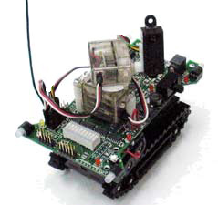
SOS Application
Navigation
Obstacle Detection
Motor Controller
Localization
Ragobot - Mobile Sensor Node Software
All modules are dynamically loadable
Install new robot behaviors by updating navigation module
Future ragobot versions will support hot-swap of peripherals
SOS provides automatic driver updates
Notes:
Currently, a major application of SOS is Ragobot, a mobile sensor node platform.
The block diagram here shows a portion of the overall software framework of Ragobot.
All the modules in this system are dynamically loadable
Due to modular updates, ragobots pick up new behaviors as they move around the field by simply updating their navigation module
Future versions of ragobot will support hot-swap of hardware peripherals and SOS will provide support for automatic driver updates

Slide 9
Contributions
Framework for binary modular re-programming
  Dynamic linking
  Message Passing
  Dynamic Memory
Inexpensive safety mechanisms for an embedded OS
  Type safe linking
  Monitored memory allocation
  Garbage collecting scheduler and error stub
  Watchdog mechanism
General purpose OS semantics on sensor nodes
Notes:
The main contribution of the SOS project has been to develop a framework for modular binary reprogramming
The kernel provides mechanisms for inter-module communication and dynamic memory
Inexpensive safety mechanisms are built into the kernel through a set of run-time checks such as type safe linking and watchdog
SOS demonstrates that sensor Oses can support general purpose semantics

Slide 10
Outline
Introduction
SOS Architecture
Evaluation
Conclusion

Slide 11
Architecture Overview
Tree Routing
Module
Data Collector
Application
Photo-sensor
Module
Dynamically
Loaded modules
Static SOS Kernel
Dynamic
Memory
Message
Scheduler
Dynamic
Linker
Kernel
Components
Sensor
Manager
Messaging
I/O
System
Timer
SOS
Services
Radio*
I2C
ADC*
Device
Drivers
* - Drivers adapted from TinyOS for Mica2
Notes:
All the nodes in the network are installed with a static SOS kernel
Like all operating systems, the SOS kernel comprises of drivers that provide access to the hardware.
The drivers for the Mica2 platform in SOS have been ported from TinyOS
SOS kernel makes use of these drivers to provide higher level services such as message passing.
Finally, the kernel contains core components such as the dynamic linker that enable dynamic binary modules.
The application level functions are implemented by the modules.
------------------------------------------
Ack. TinyOS drivers for MICA2.

Slide 12
SOS Overview
Programmed entirely in C
Co-operatively scheduled system
Event-driven programming model
System provides no memory protection
Notes:
SOS kernel is programmed entirely in C
SOS is a cooperatively scheduled system where the modules are expected to relinquish control of the CPU on their own
SOS system provides no form of memory protection.
The kernel data structures can be corrupted an application
All the interrupts generated by the hardware are trapped by the kernel

Slide 13
Designing Safety Features
Dynamically evolving system
  Unspecified behavior resulting from transient states
Goals
  Ensure system integrity
  Graceful recovery from failures
Design
  Minimal set of run-time checks
  Designed for low resource utilization
  Does not cover all failure modes
Notes:
SOS is an evolving system and the dynamic addition and removal of binary modules can potentially trigger unspecified behavior
The main objective of the safety features is to ensure that the integrity of the system is preserved and that it recovers gracefully from any failure modes
The design decision in building the safety features has been to come up with a minimal set of run-time checks that can ensure system integrity
The checks are designed to use minimum resources
These checks are not comprehensive and this is an active area of current research

Slide 14
Installing Dynamic Modules
Modules implement specific function or task
Position independent binary
Loader stores module at arbitrary program memory location
Minimal state maintenance
  8 bytes per module
  Stores module identity and version
FLASH Layout
SOS Kernel
<Empty Space>
Module 1
<Empty Space>
Bootloader
Notes:
All the application level functionality in SOS resides in the modules
Modules are dynamically loadable position independent binaries that implement a specific function
The SOS kernel receives the modules over the air and stores them at a known location in the program memory
Upon loading, the kernel initiaalizes the modules
The kernel maintains minimum state information about every module
It stores the identity of the module, the location in the program memory and other information which require only 8 bytes of storage space

Slide 15
Inter-module Communication
Module A
Module B
Dynamic Linking
  Synchronous communication
  Blocking function calls that return promptly
Dynamic
Linking
Module Function
Pointer Table
Module A
Module B
Message
Passing
Message Passing
  Asynchronous communication
  Long running operations
Message
Buffer
Notes:
Modules implement very specific functions and services and in any application, they need to communicate with one another.
SOS architecture allows two forms of communication between modules.
Synchronous communication via direct function calls is possible through dynamic linking
This is suited for blocking calls that return promptly
Modules can also pass messages to one another for communication.
This form of communication is asynchronous.
The message is buffered and delivered at a later time.

Slide 16
Dynamic Linking Overview
Goals
  Low latency inter-module communication comparable to direct function calls
  Functional interface is convenient to program
Challenges
  Safety features to address missing and updated modules
Constraints
  Minimize RAM usage

Slide 17
Dynamic Linking Design
Publish functions for the other parts of system to use
Subscribe to functions supplied by other modules
Indirection provides support for safety features
Dynamic function call overhead
  21 cycles compared to 4 cycles for direct function call
Subscribe
Publish
Module A
Module B
<foo, B, FOO_ID, Type>
Function Control Block Table (FCB)
Notes:
Design of the dynamic linking component is based on a publish subscribe mechanism
A module B wishing to share the function foo with the other parts of the system does so by publishing the address of the function, its identifier and its type.
The state information is stored in a function control block in the kernel which is made available to another module upon subscription
This design based on an indirection through the function control block was motivated by safety reasons
If a module providing the function were to disappear, the kernel will trap these exceptions due to the indirection through the kernel
I will explain the detailed mechanism later.
The actual implementation of this mechanisms has many optimizations to minimize the RAM usage

Slide 18
Dynamic Linking Safety Features
Module A
Module B
<foo, B, FOO_ID, Type>
Function Control Block Table
Error Stub
Run-time Type Checking
  Module updates can introduce new function prototype
  Type mismatches are detected, error flag is raised
Notes:
Updating or removing binary modules can lead to lots of inconsistencies in the linkage between modules.
For example, consider a module A which is linked to module B through the Function control block
If module B were to be removed, all the references of Module A would be left dangling.
To protect against such a situation, the SOS kernel automatically re-directs the references of module A to a generic error stub in the kernel.
The stub performs garbage collection of the dynamic memory and informs the module A that module B is no longer present in the system
Updates to a module could result in a new implementation of a function which could have different syntax
A run-time type checker checks for any type mismatches due to the new syntax
It flags an error to module A in case it detects a mismatch

Slide 19
Message Passing System
Data Collector
Application
Inter-module communication
Tree Routing
Module
Kernel - module communication
MESSAGE
<Dest. Addr>
<Dest. Mod. Id>
<Message Type>
<Payload> …
System
Timer
System Scheduler
Scheduler looks up handler of destination module
Handler performs long operations on message payload
Notes:
Message passing is used for latency in-sensitive communication between modules and also between the kernel and the module
SOS kernel implements a message whose header includes the destination module ID field.
The scheduler looks up the address of the message handler of the destination module
The handler performs long running operations on the message payload
A common way to program in SOS is to pass around messages containing data through a chain of modules

Slide 20
Messaging Safety Features
High priority messaging
  Signal timing sensitive events (For e.g. hardware interrupts)
  Prevent interrupt chaining into the modules
  Concurrency management by kernel
  Eliminates race conditions in modules
Watchdog support
  Co-operatively scheduled system
  Long running message handlers trigger watchdog reboot
  Kernel terminates execution of the buggy module
Notes:
In addition to messaging, SOS implements high priority messaging for signaling timing sensitive events
A common usage is to signal the occurrence of hardware interrupts to the modules
This prevents the chaining of the interrupts into the modules and enables the kernel to do all the concurrency management
This eliminates bugs that could be introduced due to manual concurrency management
SOS is a cooperatively scheduled system where a long running message handler could trigger a watchdog reset
Upon reboot from a watchdog reset, the kernel automatically detects the buggy module responsible for the reboot and terminates its execution

Slide 21
Module-Kernel Communication
Data Collector Module
System Call
System Messages
System
Jump table
SOS
Kernel
Priority
Scheduler
HW specific API
Interrupt Service
Hardware
Kernel services available as system calls
Jump table redirects system calls to handlers
Update kernel independent of modules
System Call Overhead - 12 clock cycles
Notes:
Kernel provides useful services through system calls
The modules access the system calls through a jump table
The jump table re-directs the calls to the handlers.
This extra level of indirection enables changes to the kernel possible without requiring to change the modules as long as the consistency of the jump table is maintained.
The communication between the kernel and the modules takes place through message passing.

Slide 22
Dynamic Memory Allocation
Need to allocate module state at run-time
Design Choice - Fixed-partition allocation
  Performance - Constant low allocation time (69 cycles)
  Resources - 1 byte overhead per block, 52 blocks
SOS provides memory safety features
  Guard bytes detect memory overflow
  Ownership tagging to track buggy modules
Guard Byte
16 byte blocks
32 byte blocks
128 byte blocks
Notes:
Explain the safety features in more detail
All modules need to maintain specific state information
The memory required to store the state information is not available at compile time as it is not known where the module would be located in the system
Therefore, all the modules need to allocate memory dynamically at run-time to store their state information
Modules carry the size of their state information as a meta-data and the kernel reserves a memory block of the requisite size
Even within the SOS kernel, the data-structures to store state are dynamically allocated as it is more efficient than static allocation
Given that the sensor nodes have only 4 KB of RAM, temporal re-use through dynamic allocation is very useful
SOS divides the memory into fixed sized blocks and allocates them in chunks of fixed sizes
Such a scheme reduces the overhead of allocation process and therefore does not affect execution performance of modules
Also, the amount of state information required is much less for such a scheme as compared to a general purpose malloc
Finally, the microcontroller architecture does not provide any memory protection and therefore the SOS kernel has built-in safety mechanisms that I will talk about later

Slide 23
Garbage Collection
Memory leakage problem
Garbage collection on failed message delivery
Destination module needs to signal ownership
  Use the return code of the message handler
  SOS_OK - Kernel frees the dynamic memory
  SOS_TAKEN - Destination module owns memory
Message Passing
Module A
Module B
Message
Payload
Dynamic
Memory

Slide 24
Outline
Introduction
SOS Architecture
Evaluation
Conclusion
Notes:
In the remaining portion of the talk, I am going talk about the evaluation of SOS.

Slide 25
Evaluation
Design Goal
  Provide general purpose OS semantics
  Low resource utilization
Hypothesis
  Performance no worse TinyOS
  Update cost closer to Maté
Experiment Setup
  Surge data collection and tree routing on 3 hop network
  Low duty cycle application
  Mica2 motes: AVR 8-bit microcontroller
Notes:
The design objective of SOS was to enable general purpose OS semantics with a very low resource utilization
We compare SOS against TinyOS and Mate to judge if the design goals have been achieved
Our hypothesis is that SOS would have a performance that is comparable to TinyOS and an update cost that is comparable to Mate VM.
The experimental setup consists of a three hop network of Mica2 motes.
Surge was chosen to be the benchmark application.
Surge is a data-collection application.
Sensor nodes periodically sample data and transfer it to the base-station through a tree-topology
Surge is a low duty cycle application
The implementation of the Surge application in SOS was ported from TinyOS and Mate.

Slide 26
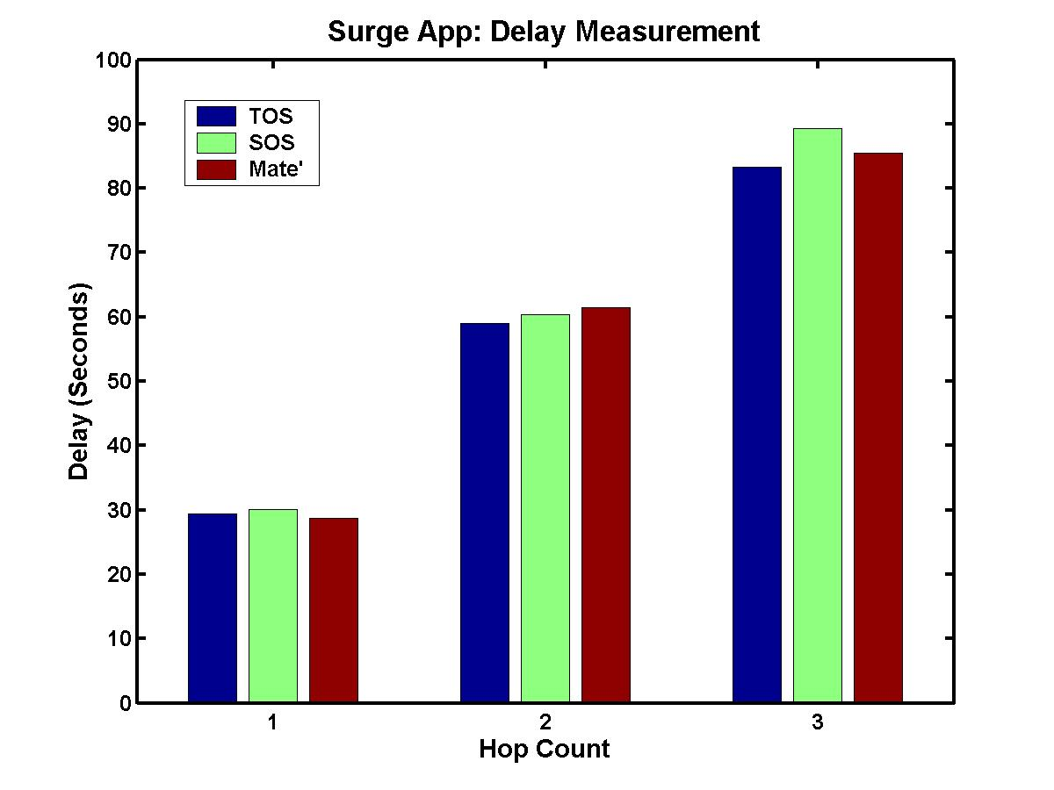
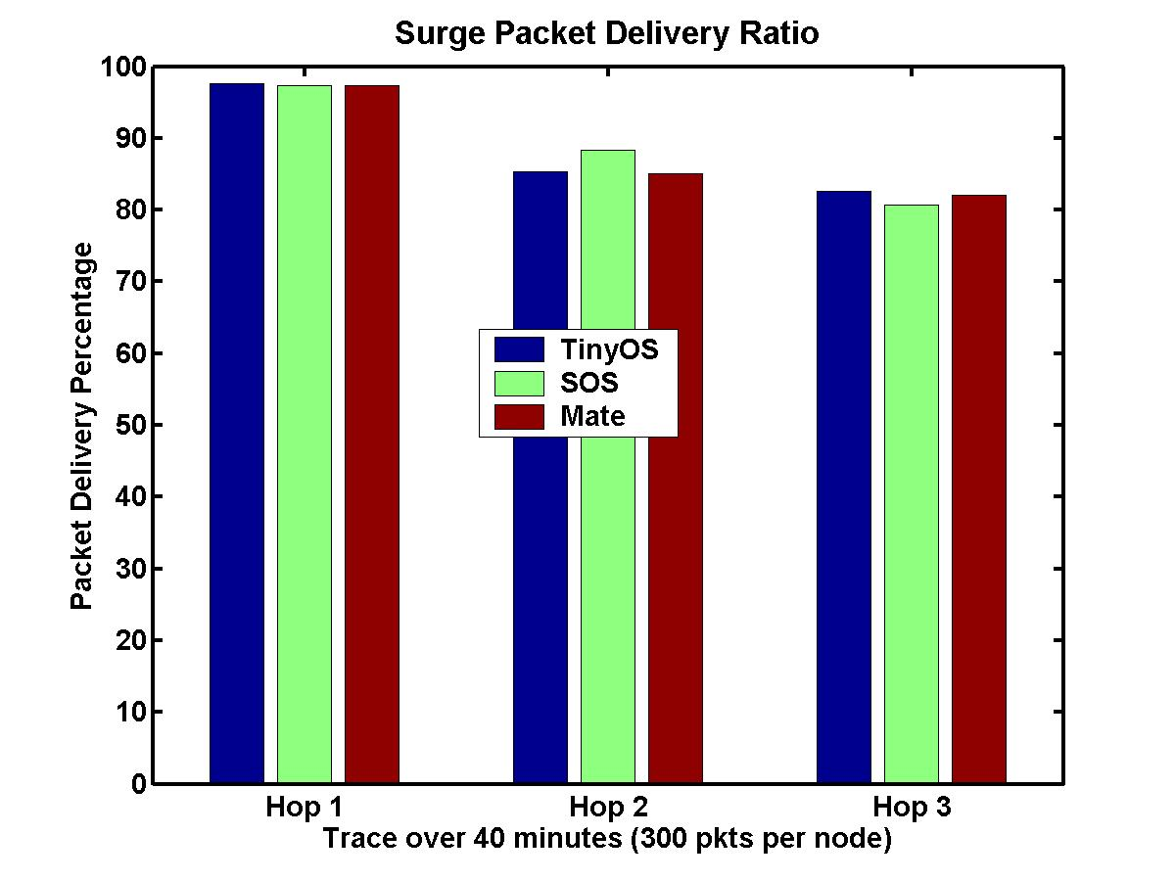
Application Performance Comparison
Application performance is nearly identical for TinyOS, SOS and Mate
Data Transfer Delay
Packet Delivery Ratio
Notes:
The graph on the left shows the delay in the transfer of data from a particular node in the network to the base-station
The delay was observed to be nearly identical for the three systems.
In a separate experiment, the packet delivery ratio for the three systems was also measured to be nearly the same.
Therefore, it leads us to the conclusion that the application level performance of the three systems is nearly identical
Another important conclusion is that it validates the port of the Surge application from TinyOS to SOS

Slide 27
Performance Overhead
TinyOS | SOS | Maté
4.58% | 4.64% | 5.13%
29.92 | 29.94 | 30.02
Active Time (%)_x0003_
Average Power(mW)
CPU Active Time - Metric to measure OS overhead
  Measured by profiling Surge for 1 min. on real nodes
  Averaged over 20 experiments for each system
SOS has 1% overhead relative to TinyOS
  Surge has minimal application level processing (“worst” case OS overhead)
Insignificant variation of average power consumption
  Surge application has a very low CPU utilization
  System level energy: E(CPU) << E(Radio)
  Duty Cycling - Idle energy dominates over active energy
Notes:
Having established that the application level performance is identical across the three systems, the next step was to evaluate the overhead required to support the added flexibility of SOS.
CPU active time was chosen as a metric to evaluate the overhead
The rationale was that any OS related overhead would directly translate into an increased CPU workload
The Surge application was profiled for a minute on a real node and the active time of the CPU was measured
The results indicated very minor variations in the CPU active time across the three systems
This suggests that the differences in OS overheads is not significant
SOS has only 1% overhead relative to TinyOS
Surge has minimal application level processing and most of the processing takes place in the OS.
It is fair to say that this is the worst case for SOS as in most of the other applications, the amount of application level processing would be higher.
The difference in the average power consumption of the node due to the added OS overhead is negligible.
The energy of the CPU is a very small portion of the overall system energy budget.
The Surge application has a very low CPU utilization and the active power consumption of the CPU is lower than the peripherals such as radio.
The sensor nodes are always duty cycled and the idle energy in the nodes dominates over the active energy

Slide 28
Update Costs
Method | Energy | Cost
Entire binary upgrade (TinyOS) | 784.14 mJ | High
Modular binary upgrade (SOS) | 12.25 mJ | Moderate
Virtual Machine scripts (Maté) | 0.34 mJ | Low
Re-programming cost involves
  Communication Energy - Transfer the new code
  Storage Energy - Write the code to RAM/FLASH etc.
Impact on system level energy
  Depends significantly upon frequency of updates
  Difference in update cost amortized over the interval between updates
  Idle energy in the interval between updates dominates
  Idle energy consumption does not depend on the OS
Notes:
Our last experiment was to evaluate the update cost in the three systems.
The update cost consists of energy to transfer the code update and the energy required to store it.
The results indicate the the update cost of SOS is closer to Mate as compared to TinyOS.
The interesting observation is the impact on the overall system energy due to the difference in the update costs
It turns out that the update cost plays a role only if the frequency of the updates is high
The difference in the update cost can be amortized over the interval between the updates
However, the idle energy of the nodes tends to dominate in those intervals and the idle energy consumption is independent of the operating system.
It depends solely upon the duty cycling of the peripherals.

Slide 29
Lessons Learnt
Focus on duty cycling all parts of the system
  Standardize the API for power management of peripherals
  Performance optimization of the CPU is secondary
Account for update energy and frequency
Choose an OS based on the features it provides
  SOS - Flexibility of general purpose OS semantics
  TinyOS - Full system static analysis
  Mate VM - Efficient scripting interface
Notes:
Important lessons learnt from the evaluation experiment are that maximal energy savings come from the duty cycling of the different parts of the system
The performance optimization of the CPU is a secondary concern
As OS designers, we should provide a standardized API for the power management of the peripherals.
While designing a complete system, the frequency of the updates should also be taken into account along with the update energy
TinyOS provides benefits of static analysis
Modular binary updates of SOS provide the flexibility to change arbitrary functionality
VM provides a powerful and concise scripting environment

Slide 30
Summary
SOS enables dynamic binary modular upgrades
Design choices minimize resource utilization
Run-time checks for safe code execution
Ported to AVR, ARM, TI MSP
Users at UCLA, Yale, Notre Dame, Harvey Mudd …

Slide 31
Future Work
New models for application development
  Independent re-usable loadable binary modules
Hierarchy of re-configuration
  Maté VM ported to SOS - Extensible virtual machines
  Upgrade SOS kernel using TinyOS whole image technique
Staged checkers
  Combination of static and run-time checks for code safety
FLASH wear and tear management using SOS
Notes:
Mention the wear and tear management of FLASH by SOS
Use TinyOS mechansim for upgrading the kernel
Hierarchy of reconfigurability - Mate running on SOS

Slide 32
Questions ?
THANK YOU !
Check out SOS at
http://nesl.ee.ucla.edu/projects/sos

Slide 33
Extra Slides

Slide 34
Programming
Programmed in C
Function Registration
  char tmp_string = {'C', 'v', 'v', 0};
  ker_register_fn(TREE_ROUTING_PID, MOD_GET_HDR_SIZE, tmp_string,(fn_ptr_t)tr_get_header_size);

Slide 35
Memory Footprint
Platform | ROM | RAM
SOS Core (Dynamic Memory Pool) | 30716 B | 1255 B 1536 B
TinyOS with Deluge | 21132 B | 597 B
Bombilla VM | 39746 B | 3196 B

Slide 36
Micro Benchmarks
Communication Method | Clock Cycles
Posting a message | 252
Dispatch message | 310
Call to a published dynamic function | 21
Call using system jump table | 12
Direct function call | 4

Slide 37
Re-programming Cost
Entire Image
Modular Binary
Update Cost
(Transport + Storage)
Differential
Binary
Patching
VM Scripts
Parameter Changes
Flexibility
Notes:
Annotate the graph
Performace is evened out
The choice is between flexibility and update cost.
We believe that SOS provides the sweet spot.
So far we have established that the overheads introduced by SOS do not impact performance or the average power consumption
However, the three systems have different techniques for updating code which may have an impact on the energy consumption
Re-programming cost involves the energy required to transmit and receive updates over the air and the energy required to store and install them in the system
Based upon the sizes of the binary and the power numbers of the various peripherals, we confirmed an obvious result that the re-programming cost of SOS is significantly lower than the TinyOS entire image update but it is higher than the Mate scripts
What is interesting is that the impact of the differences in the update costs on the overall system energy depends a lot upon the frequency of updates
If a system is not updated frequently, then the update cost is amortized over the long intervals between successive updates thereby leading to a very negligible difference in the total energy

Slide 38
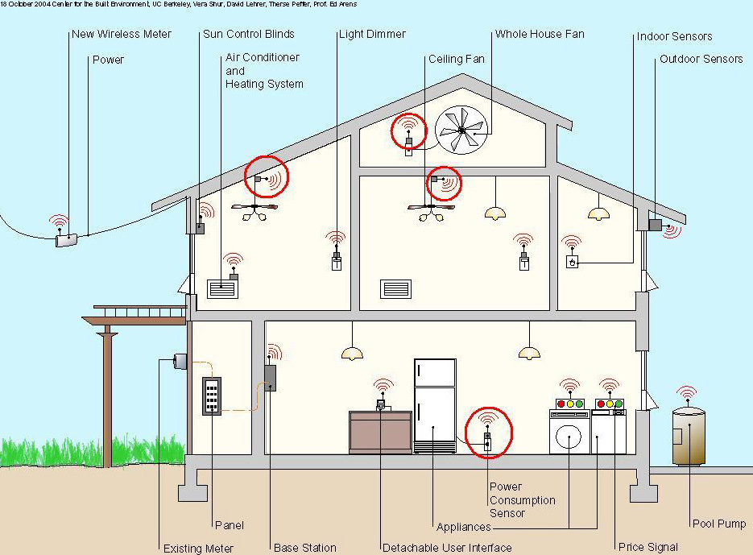
SOS Applications
Ragobot - Mobile Sensor Node
Building Automation
Dynamically installing new
behavior modules on ragobot
Remote operation and management
of the sensor network infrastructure
Mobile agent applications and a lot more …

