Slide 1

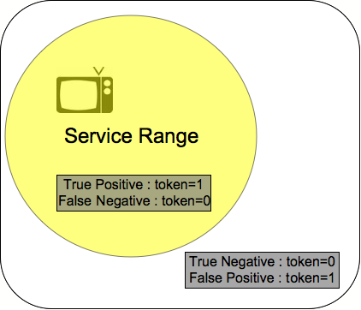
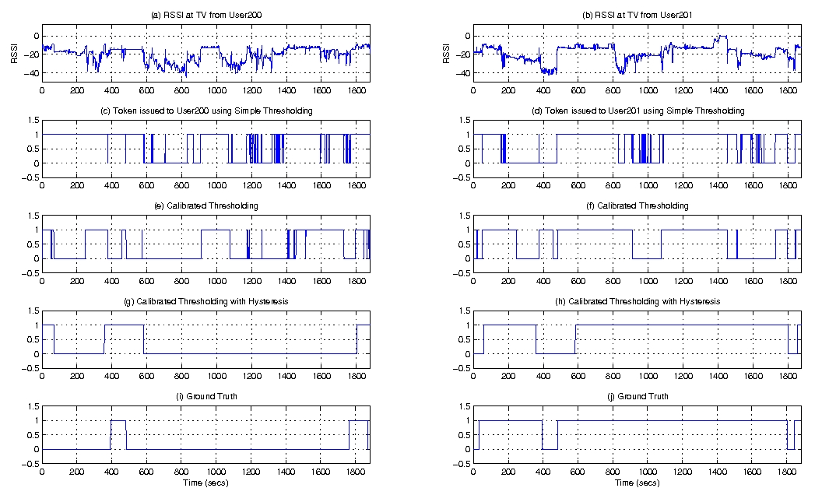
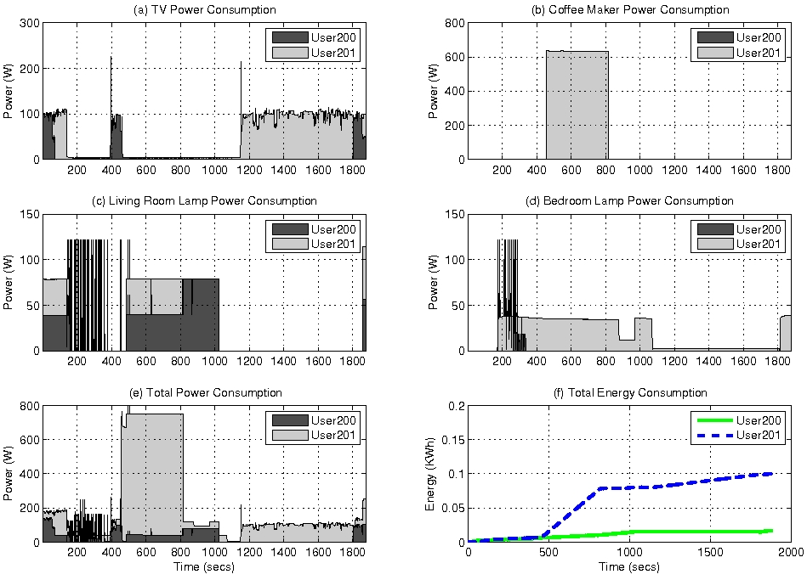
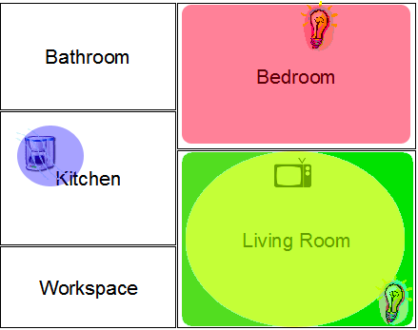
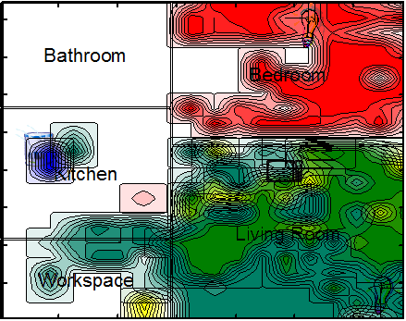
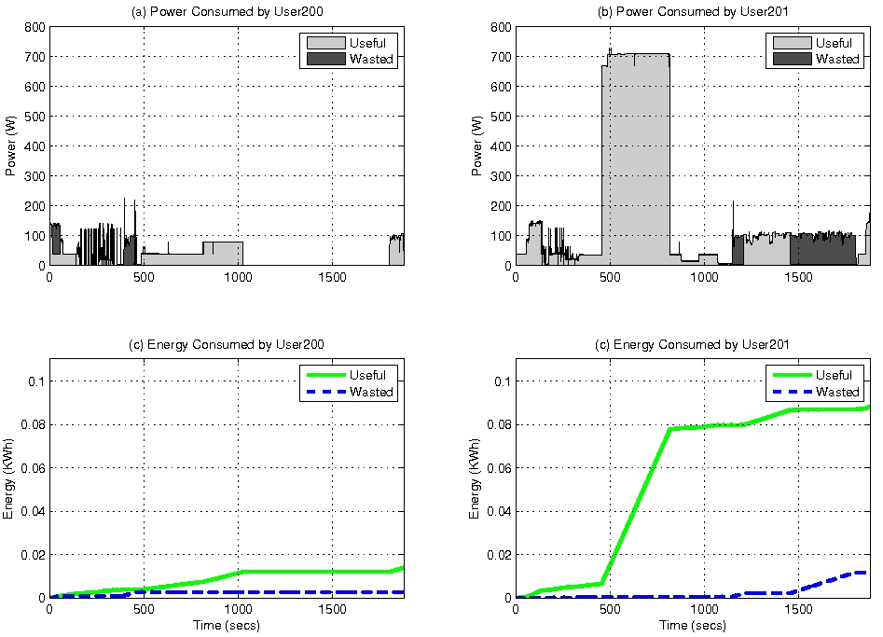
Spotlight: Focusing on Energy Consumption of Individuals
Center for Embedded Networked Sensing
Younghun Kim, Zainul Charbiwala, Akhilesh Singhania, Mani Srivastava
Networked & Embedded Systems Laboratory - http://nesl.ee.ucla.edu
Introduction: Monitoring electrical energy consumption at the granularity of individuals
Traditional monitoring systems
Benefits of finer granularity monitoring
Coarse grained at the level of location and time
Electrical energy consumption is recorded in terms of location and time. The information provided in terms of amount over a period of days. Essential information such as breakdown in terms of appliances and individuals is missing. This is important in pinpointing energy wastage and improving consumption patterns.
Real time
The measurement is not provided in real time either. Users are not aware about significant patterns about their usage which could be identified if the information is provided in real time. There are several projects to implement this feature overseas.
Can monitor individual appliances
  Identify usage patterns, efficiency, and service to cost tradeoff at the level of individual appliances.
Can monitor individuals
  Another dimension in measuring energy consumption. Can pinpoint to areas of energy wastage.
  Inform users of the cost of their behavior in real time.
  Help a conscientious user in fine tuning the tradeoffs between their consumption choices and the cost of the choices.
Approach: Location-based accounting
Appliance Classification
Class I: Serviced inside a physical vicinity. E.g. Television, coffee machine. Focus of our work
Class II: Serviced without physical vicinity. E.g. servers, networked printers
Class III: Always-on appliances. E.g. Refrigerator, alarm clocks
Token System
Token Issuing and expiration policy
- Receive token on entering range
- Expire token on exit if another user in range
- Upon entrance of a user, expire outstanding tokens
Solution Analysis: Prototype deployment & Analysis
System Architecture
Users carry a RFID tag
Appliances instrumented with a power meter and RFID reader
Backend server to collect data
Token Issue Algorithms
RSSI is unreliable
Unified Threshold: simple threshold to issue expire tokens
Calibrated Threshold: Calibrated for individual tags and readers
Hysteresis Threshold: token expiration is set by hysteresis constant
Evaluation
Ground Truth
Instrumented the apartment with cameras
Images withheld for privacy
Token Scheme
Comparing the three schemes
Energy Consumption Reports
Usage of appliances and comparison with ground truth
System Prototype
MICAz motes as RFID tag and reader
Using RSSI for vicinity information
COTS Watts up? pro power meter
User desired service range
Performance of various Token Schemes
Appliance power and energy consumption
Measured RSSI values
Useful and wasted consumption for appliances
UCLA – UCR – Caltech – USC – CSU – JPL – UC Merced

