Slide 1
Power Measurement
Power Meter Selection
Hardware Interfacing
Software Interfacing

Slide 2
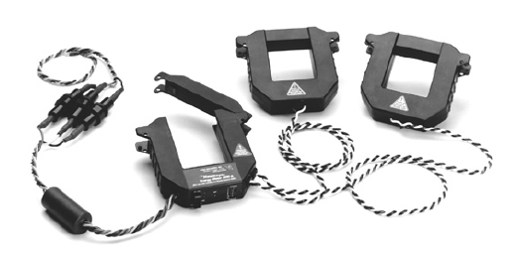
Power Meter Selection
Choice A: Veris Hawkeye 8035/8036
Current Transformer based Industrial quality meter for accurate instrumentation
RS-485 based interface with MODBUS protocol at 9600 baud
Capable of sensing up to 100A with 100mW precision and 6 Hz sampling rate

Slide 3
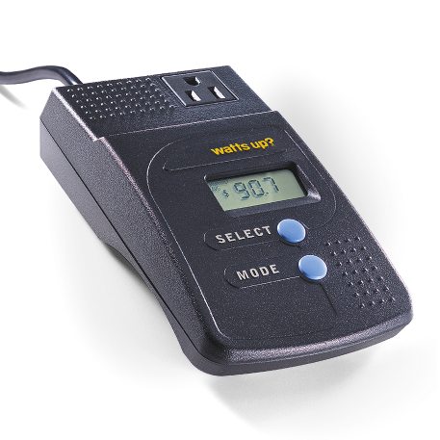
Power Meter Selection
Choice B: Watts Up? PRO
Consumer grade plug and play device using in-line current sensing
USB interface with proprietary (documented) protocol
Capable of sensing up to 15 Amps with 100mW precision at 1 Hz sampling rate

Slide 4
Meter of Choice - Watts Up? PRO
﻿Veris device requires to strip off cable cladding to get the clamps on the wires
Watts Up? Pro has LCD display reducing development time of the communication protocol and drivers
Veris device has an RS485 interface mandating custom board whereas Watts? Up has a USB interface
Protocol documentation and source code for the Watts Up? Pro are both available from the manufacturer
Veris device is over 6 times more expensive than the Watts Up? Pro

Slide 5
Hardware Interfacing
﻿MicaZ mote has no USB interface
Choice A: Use a mote with a USB host interface, the iMote2
  Pins for USB host are present on the advanced 40-pin connector
  Using it would require to build a small custom board
Watts Up? Pro USB interface implemented using a common UART to USB chip from FTDI - FT232RL
Choice B: Intercept UART signals directly on the circuit board
  UART voltage levels are 3.3V LVTTL like MicaZ
  ﻿ADI ADuM1201 Digital Isolator used for power isolation
  Disconnect the tracks between the FT232RL and ADuM1201
  Connect Vdd, Rx, Tx, Gnd to 51-pin mote connector
  Power ADuM1201 from mote - 2mA drain from mote supply
  Be careful not to connect signals on uP of the ADuM1201
    Will blow up Watts Up? meter - learnt lesson the hard way

