Slide 1

SpotLight : Focusing on Individuals
Younghun Kim
Zainul Charbiwala
Akhilesh Singhania
Mani B. Srivastava
Notes:
Hi, I’d like to introduce the system called SpotLight which aims to profile individual’s energy consumption. Since this is ongoing work and there are several issues needed to be addressed, any comments on those will be appreciated.

Slide 2
Overview
Motivation
Problem Statement
Proposed Solutions
Observations
Evaluations
Future works
Notes:
First I want to give you the motivation for us to develop this system. And show problem statement, solutions, observations, and evaluations. And will close this talk with the future works.

Slide 3
Motivation
Energy Saving is a concern
People are unaware of their energy usage pattern
  Let them know that and help them modify their inefficiency
Notes:
The motivation was simple. Basically we wanted to know how much energy an individual is using. You know, energy saving is a big concern those days. But people are usually unaware of their energy usage patterns. So we wanted to let them know the information and help them modify their inefficiency.

Slide 4
Classes of appliances
Class I : you need to be there to use them (TV, Light, Iron, Coffee Machine, Vacuum, and most of appliances, HVAC)
Class II : you don’t need to be there to benefit from them (Server, Router)
Class III : you are benefiting from them (fridge, fire-alarm, roomba)
Notes:
Before I talk about our system and underlying algorithm that enables us to know one’s energy profile, I’d like to show some classes of appliances. Okay, here we can think of the class I appliances, for example TV, light, iron, coffee machine, vacuum HVAC and etc. If you want to use those, you’d need to at least near that appliances although the distance between you and appliance varies, say distance between iron and you would be shorter than distance between TV and you, probably.
Things become more complicated for those two different classes of appliances. The class II appliances include printer, server and router kind of appliances. Since they are networked, you’d use them remotely. So vicinity information might not be able to tell us who is using the appliances. But, you could somehow know who is using it based upon log information. But is still challenging.
The class III appliances include fridge, roomba, fire-alarm and etc. For those appliances, you don’t need to be near them to use them. Those appliances are just there and consuming some energy and you are benefiting from them somehow. For example, your food is in the fridge and you are not there. But still benefiting from it.

Slide 5
More issues on classification
But, you MIGHT NOT use an appliance even you are near it. (e.g. Reading a book in front of TV)
Or you may not be allowed to use them, (other’s noteBook PC and etc).
Notes:
With the previous classification, we could also imagine more issues regarding “Who is actually using appliances”.
For example, for the class I appliances, even though you are within its range, you might not be using the energy consumed by the appliance. Say, you are reading a book in front of TV, you are not benefiting from the TV at all. Well, this is really hard to know who is using it in such cases. But, we are thinking that the pairing problem that David is working on could somehow help answer to this issue.
Also, you could imagine that some appliances are only allowing a subset of individuals to use them. But, this is not a critical issue because you could define token algorithm that we will see a little later.

Slide 6
Tokens and Service Range
For the class I appliances, we could define their service range as distance information between a user and an appliance
Introduce the notion of tokens to avoid a case where users leave appliances on and are not responsible for it
Notes:
Okay, one fundamental question we have to answer to is that who is responsible for energy consumption or resource consumption.To answer to it, I wanted to bring a notion of a token and service range.The service range implies that each appliance has its own service range and individuals who are within the range are actually consuming its service and are responsible for the energy or resource. So, if people are within its service range, they are responsible for it.
Even with the notion, it might be problematic, imagine the case that if one turns on an appliance, forgets turning it off, and leaves the service range. In that case, the system might assume that the energy is consumed by nobody since nobody is within its service range.
The notion of the token could solve the problem and the idea is the following. An appliance will give a token to an individual who is within its service range and those who have tokens are responsible for energy consumption. By carefully issuing and expiring the tokens, the system could avoid the case.
So, tokens are issued and expired by the following policy.

Slide 7
Token issuance and expiration policy
If someone is within its service range, it issues a token for him/her.
If someone is within its service range and a token holder has left the service range, it will expire the token holder’s token
If someone was within its service range and he/she has just left the range, it will NOT expire the token right away if there is nobody left. It will expire the token when other one has came its service range
Notes:
The first line says that if you are within its service range, you are responsible for it.
The second line says that if you’ve left the range and someone is there, you are free then.
The third line gives you a sense that, if you are the last one who has left the appliance on, you are responsible for it until someone has came to the place.
So, if there are more than two individuals who have tokens, they are responsible for the energy consumed by the appliances.

Slide 8
Extended tokens
Class III appliances issue infinite life-time tokens which don’t rely on service range for affiliated users so that they fairly distribute energy consumption
Multi-layer tokens could handle idle power consumptions
Notes:
Even the previous says that tokens are issued and expired by vicinity information, you could also extend the notion.
Like for example, for the class III appliances you could issue infinite life-time tokens to affiliated users so that they could be responsible for the class III appliances. But, I’ve not implemented this yet, wanted to see though.

Slide 9
Range Information and RSSI
Why active RFID?
  Passive one is not suitable for human being
  Don’t require users to explicitly tag themselves
MicaZ Mote as Active RFID Tags and Readers
  RSSI values give a kind of range information
Note : Home and office setting is kind of static
Notes:
At the first time, instead of using range information and RSSI values, we thought and actually used passive RFID with explicit tagging scheme. Say, if someone wants to use an appliance, he/she should tag it. Of course, this is very tedious and users don’t want to do that. So, we also planned to use long range passive RFID to see their range information because for passive tags you don’t need to have batteries. And the passive ones are usually lighter. But, they are not suitable for human being because human being consists mostly of water, say about 80 % and passive RFID tags don’t work if they are close to water. So we decided to use active RFIDs. As you know, Motes are out there and give us RSSI values without using any special hardware such as laser range, ultra sonic and etc.
Okay, go back to the story. In order to issue a token of an appliance, you’d need to know vicinity information. And we’d like to make use of RSSI values. As most of you already know that RSSI values are sort of range information although they are not that reliable. But, there you could do something smart because home and office setting is kind of static and well-known. So, you could calibrate them somehow and we will see it a little later.

Slide 10
Challenges
RSSI values vary depending upon Antenna characteristics, users movement, obstruction of LOS and others
Simple threshold may not good
In any case, hopefully,
  Calibration helps
  Hysteresis helps
Notes:
Although, you could do something right to RSSI values. It’s still obvious that there are many challenges that could be or could not be addressed.
First of all, RSSI values are not just a function of range information but also a function of antenna characteristics, obstruction of line of sight, multi-path, user movement and some others.
So, we saw simple threshold to issue and expire tokens is not good at all. But could do better with calibration and hysteresis.

Slide 11
System Configuration
4 PowerMeasurement and RFID reader Motes
  Watts Up? Pro + MicaZ
  Three SOS modules : PM module, RFID reader module and UART module
2 Active RFID tag Motes
  MicaZ
  One SOS module : RFID tag module
1 BaseNode Mote
  MicaZ
  One SOS module : Snooping
Notes:
Okay, before we see our deployment setting and evaluation. Let me introduce the system configuration. I basically used 7 MicaZ motes. Four of them are used for power measurement motes which consists of MicaZ and watts up pro off the shelf Power measurement device. On the software side, we implemented those three SOS modules such as pm module, rfid reader module and uart module. UART module is implemented to avoid SOS message structure because watt up pro needs to communicate with micaz via raw uart communication. PM module takes care of transmitting power measurement information. Here rfid reader module takes care of rfid tags meaning as soon as rfid reader receives rfid tag id, it makes a message consists of its address, rssi value at that instance, and the tag id as well. Then forward it to the base node.
Active RFID tag is just a kind of blink module that broadcasts its tag id every one second. And we are thinking of doing a little better. Let say, instead of broadcasting the id every second, it broadcasts its id when acceleration is greater than a certain threshold. And it shouldn’t be that hard but would reduce energy consumption of tags, hopefully. But, not there yet.
We, of course, has one base node for snooping

Slide 12
Evaluation Setting
Kitchen
BedRoom
Lamp
Coffee
LivingRoom
TV
WorkSpace
Lamp
Notes:
Although we’ve deployed those at the lab as some of you saw before, I didn’t stored the data for analysis. So I’d like to show this real deployment setting at my place. Okay, this is the bird eye view of my place. Well, I deployed four PM motes here at livingroom lamp, tv, bedroom lamp and coffee machine. Oh, well I forgot to add my bathroom, but no big deal at all. :)

Slide 13
Evaluation Setting : Service Range
Kitchen
BedRoom
Lamp
Coffee
LivingRoom
TV
WorkSpace
Lamp
Notes:
As I mentioned before, each appliance has its own service range. Those little ugly shades show their service range. I’m not that comfortable with MacMachine and PowerPoint drawing, so apology for those ugly pictures. :) Anyway, the coffee machine has the shortest service range. Here like purple shade is its service range. Lamps have wider service range like here and here. And tv has mid kind of service range.

Slide 14
Some Observations
RSSI value
  Varies about from 12 to -50
  But, has some variance among MicaZs
Service Range
  about -26 for the Lamps
  about -20 for the TV
  about -5 for the Coffee machine
Notes:
While deploying those, I saw some observations regarding RSSI values.
First of all, RSSI value varies about from 12 to -50 as distance between antennas increases, and it has some variance among MicaZs.
The service ranges in RSSI values are -26 for lamps, -20 for TV and -5 for coffee machine. Meaning if RSSI value between user’s tag and lamp’s reader is greater than -26, the system assumes he is using it. And those values are used for the basic token algorithm.

Slide 15
Basic Token Algorithm
Define a service range as a single RSSI value
  Issue a token when a user is within its range
  Expire a token when a user has left the range if at least other one is within the range otherwise DO NOT expire the token until someone come
Values are
  TV : -20, Lamp : -26, Coffee : -5
Notes:
So hereafter, I’m going to introduce three algorithms that issue and expire tokens. The first one is based upon simple thresholding with a single RSSI service range value.
So if a user is within its range it issues a token for him.
If a user has left the range and there is at least other one is within the range, it expires the token so that he could be free.
But, if there was nobody, it doesn’t expire the token until someone come to the place. Then he is responsible for the energy consumed by the appliance until someone comes

Slide 16
Calibrated Token Algorithm
Define a service as a set of RSSI values among TAGs and READERs
  The same as the basic one but it has look up table for each tag holders
RSSI Values
  User200
    TV : -12, Lamp1 : -23, Coffee : -10, Lamp2 : -16
  User201
    TV : -14, Lamp1 : -22, Coffee : -8, Lamp2 : -18
Notes:
As I mentioned before, since each micaZ has its antenna characteristics and radio characteristics. Using a single threshold is not a good solution. So we wanted to see how better the system is if we compensate MicaZs radio characteristics using calibration.
So, after deploy those PM motes. I measured RSSI values along the margin of physical service range. It gives me those values.
RSSI values between user200 and tv was about -12.

Slide 17
Hysteresis Token Algorithm
Define a service range as same as the Calibrated Token Algorithm
But, expires a token if the RSSI value is less than (ServiceRange - Hysteresis Constant)
Hysteresis Constant : 5
Notes:
There was some strange behavior of RSSI values, also. Meaning, if you slightly shake MicaZs, RSSI values are changed a lot (about 3~8). So we wanted to add hysteresis to expire tokens. So, it issues a token if a user is within its service range. And expires the token if the RSSI value is less than (service range rssi value - hysteresis constant).
Right now, setting up hysteresis value and service range RSSI value is manually done, but planning to do it more automated ways except defining physical service range and others.

Slide 18
Ground Truth
Using Campaignr with a local sensorbase
Took Pictures and annotated users’ status
  Sampling rate : 10s
Ground Truth tells us
  Who is/are using appliances
  Who has/have left appliances on/off
Notes:
To confirm whether those three algorithms work fine, we also needed to know groudtruth.
So we used compaignr with a local sensorbase to take pictures of the living room and the beddroom.
They took pictures every ten seconds. And based upon those images, I annotated the information that
Who is/are using appliances and who has/have left appliances on/off.

Slide 19
Evaluation
 | (1) TV |  | (2) LivLamp |  | (3) BedLamp |  | (1)&(2)&(3)
 | U200 | U201 | U200 | U201 | U200 | U201 | U200 | U201
Basic | 73 | 135 | 178 | 176 | 138 | 127 | 57 | 82
Cali | 109 | 118 | 175 | 171 | 182 | 184 | 104 | 105
Hys | 163 | 167 | 177 | 176 | 182 | 185 | 153 | 158
Table : Number of successful token issuance of appliances
out of 185 ground truth
Notes:
After that, I issued tokens to each user based upon the ground truth and compared those 185 points of ground truth with those tokens issued by the three token issuance schemes. Overall you see the TV shows bad behavior.
That is because User200 spent a lot of time slightly out of TV’s service range. (Give them figure and point out).
In any case, you see those numbers. This is quiet poor here, here less than 50%. Except the LivingRoomLamp. That’s because lamps’ service range is quite wide and therfore RSSI value is usually above the threshold value.
After calibration, you see the numbers became a little better for TV. And significantly better for bedroomlamp.
And with hysteresis, you could also see the numbers for TV gets much better. Is more than 90% of successful rate.

Slide 20
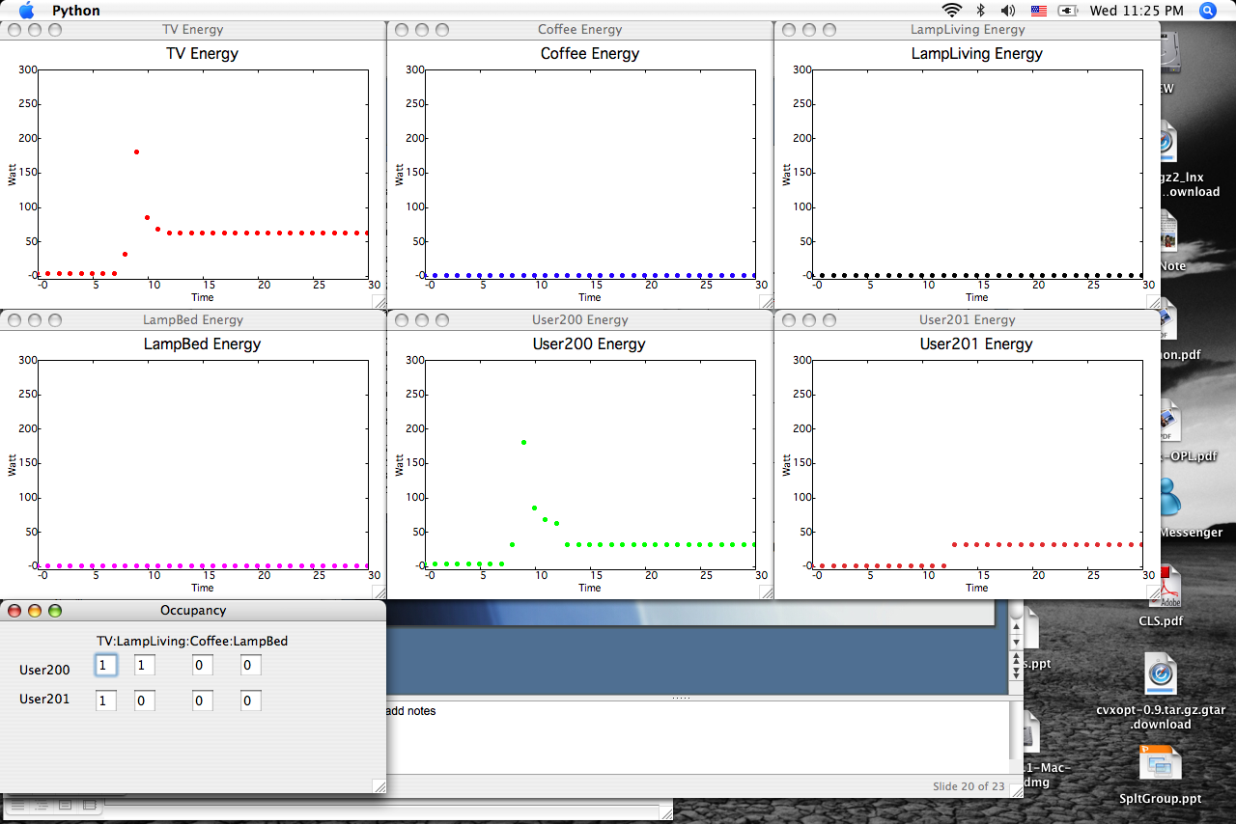
Notes:
Just to give you a sense that how the system gives you individual’s energy profile, I’d like to show you this figure.
This is real-time monitoring system that gives you animated plots like kind of oscilloscoope. Okay, At this point User200 turned on the televetion and you see here the energy increases as time increases. Since user200 turned on the TV, he is also consuming the same amount of energy that TV is consuming. As user201 joins to watching it, they start sharing energy consumed by the TV at this point and after.

Slide 21


Slide 22
Future works
Profile individual’s energy efficiency
Cope with various RSSI uncertainties
Optimize active RFID tag modules to increase battery life
Control Status of Appliances based upon RSSI and Token information
Notes:
Alright, until now, we have focused on determining how well the system works with those RSSI values and token issuance algorithm. We’d like to see what other interesting aspects we could see using those tokens, rssi values and energy profile.
First of all, not only see individual’s energy consumption, but also see how efficient they are.
Along with that we also need to cope with various RSSI uncertainties that might increase error rate.

