Slide 1
Student Presentation #N: TITLE

Slide 2
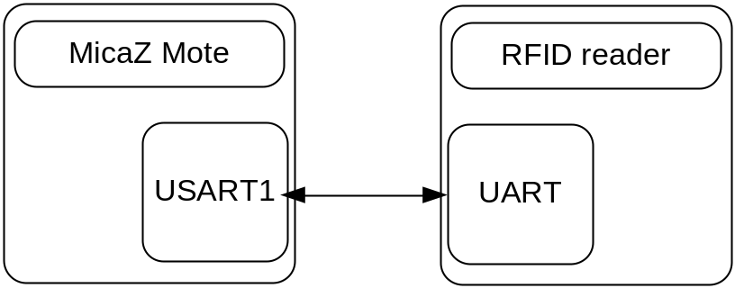
RFID Mote – H/W
Connected through UART
Serial setting
  BAUD rate 9600bps
  Frame Format 8N1
Notes:
Hardware side is actually simple. They are connected over serial lines, say ground, Tx, Rx and VCC.
The problem was that the SOS doesn’t support RAW serial communication. So we needed to write a UART driver and make some changes of SOS.

Slide 3
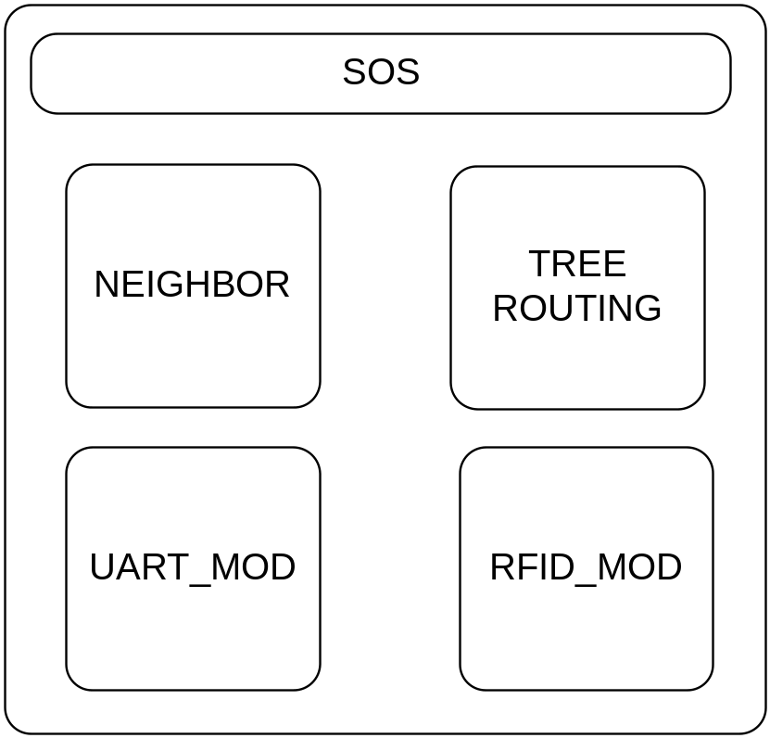
RFID Mote – S/W
Neighbor and Tree Routing
  Support Multi-hop communication
UART_MOD_RFID
  Supports RAW serial communication
  Makes RAW data as a standard SOS message
RFID_MOD
  Initializes RFID reader
  Handles RFID TAG data
Notes:
RFID motes follows standard SOS modules. For the multi-hop requirement, we inserted the tree routing module and the neighbor module.
UART_MOD basically support
In the RFID_MOD, firstly it initializes RFID reader so that it starts with the continuous reading mode. And then it waits until UART_MOD passes RFID TAG packets, as soon as they are received the RFID_MOD forwards them to the tree-routing.

Slide 4
RFID Mote - Protocol
Support Continuous TAG reading mode
<LF>TAG ID<CR><LF>

Slide 5
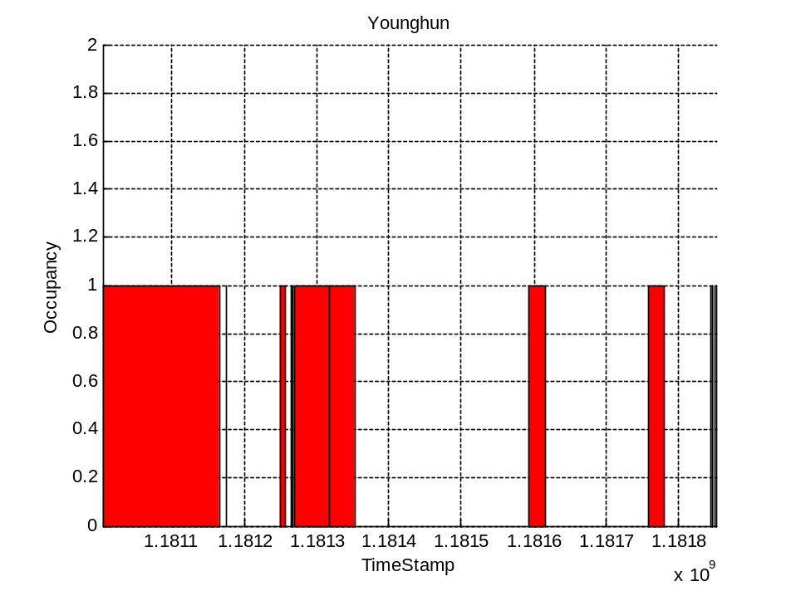
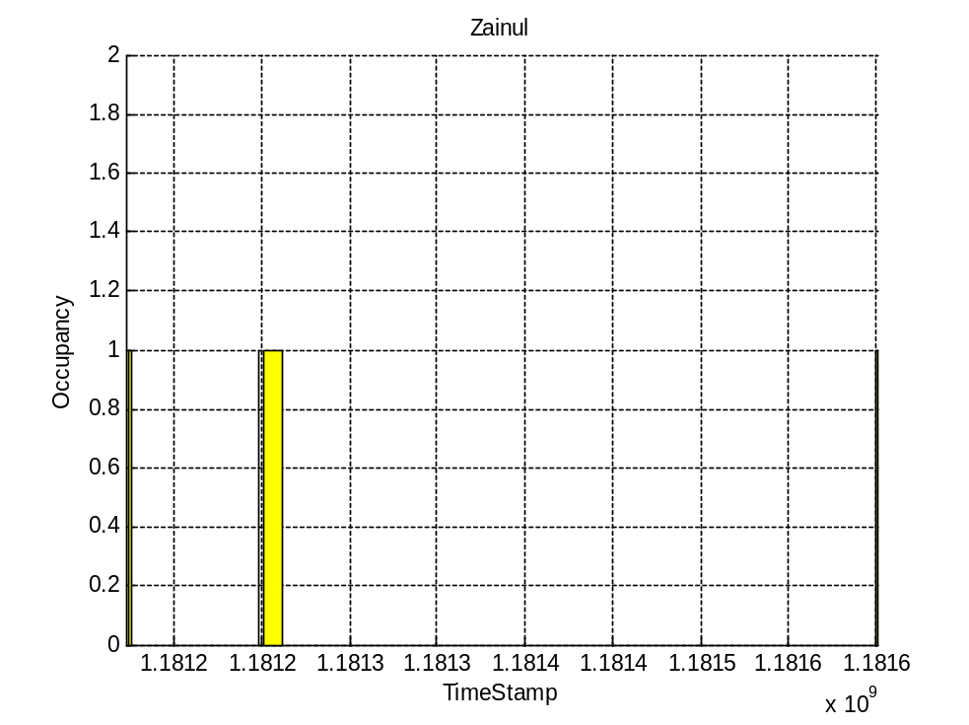
Result (Sharable)

Slide 6
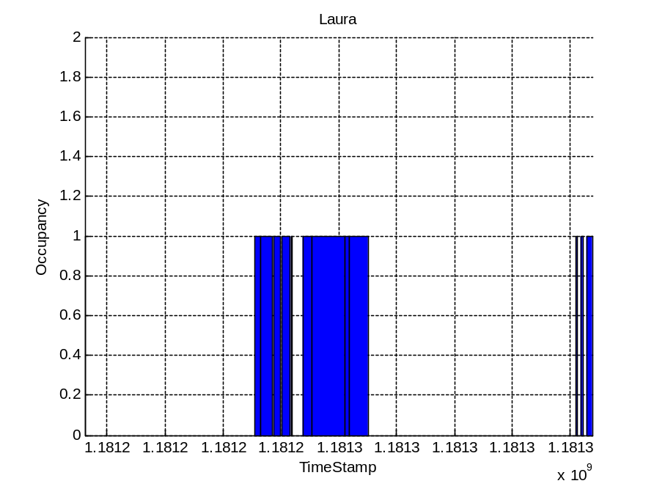
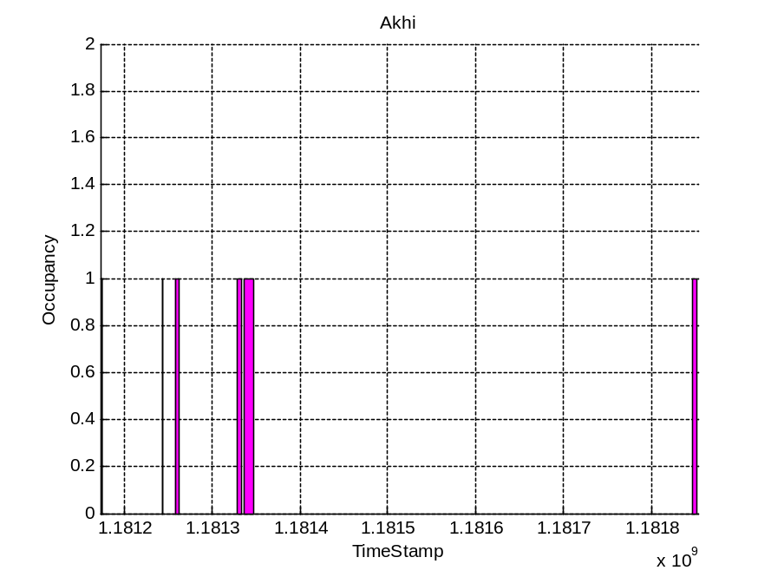
Result (Sharable)

Slide 7
Some Interesting Findings
SensorBase
  Even though we can download the stored data using SOAP it returns “Fatal error: Allowed memory size of 67108864 bytes exhausted” on the webpage if the data size exceeds 100s of thousands of rows

Slide 8
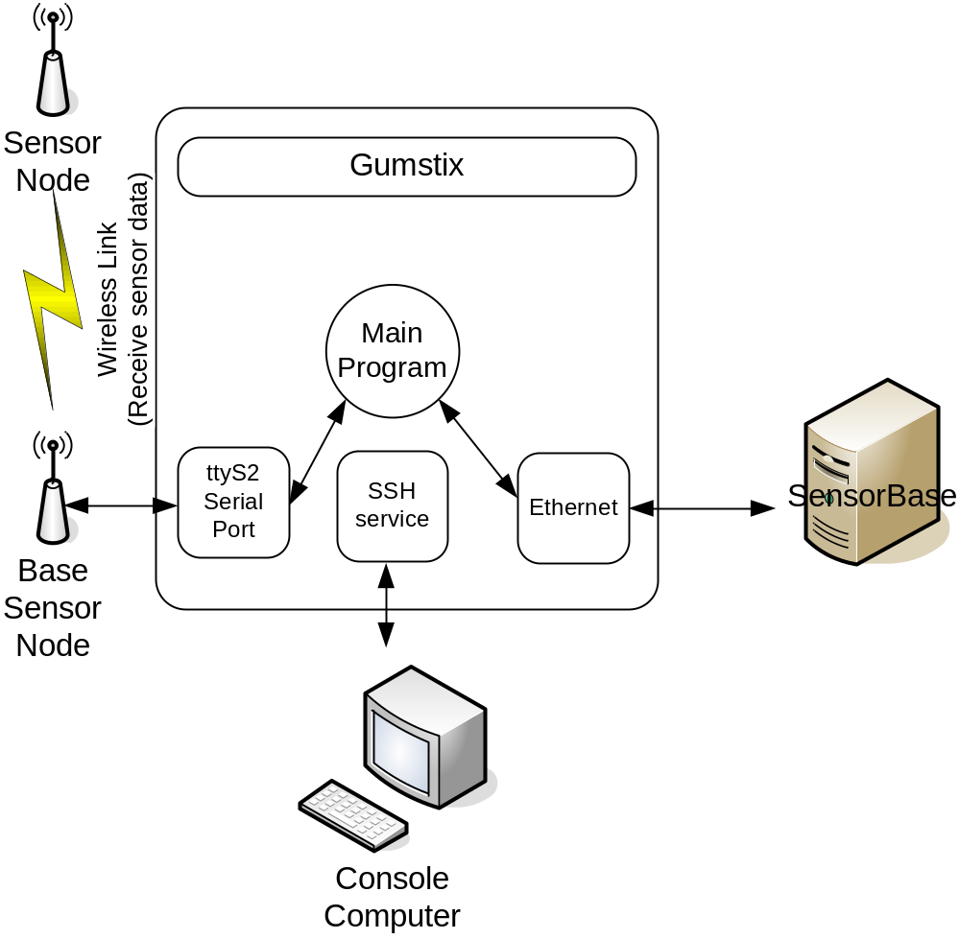
Backend – H/W
Components
  Gumstix, EthernetStix, Breakoutgs, MicaZ Mote
Notes:
For the backend, we chose the gumstix platform. It basically consists of the gumstix, the ethernetstix, breakout-gs and a MicaZ base node.
What we did for the backend hardware is a simple wiring between the MicaZ mote and the gumstix. And stacked the gumstix, ethernetstix and breakout-gs.
The gumstix is the main processor board and guns the main program. And the ethernetstix provides the interface to the back-bone network.
We used breakoutgs for interfacing the gumstix and the micaz mote.

Slide 9
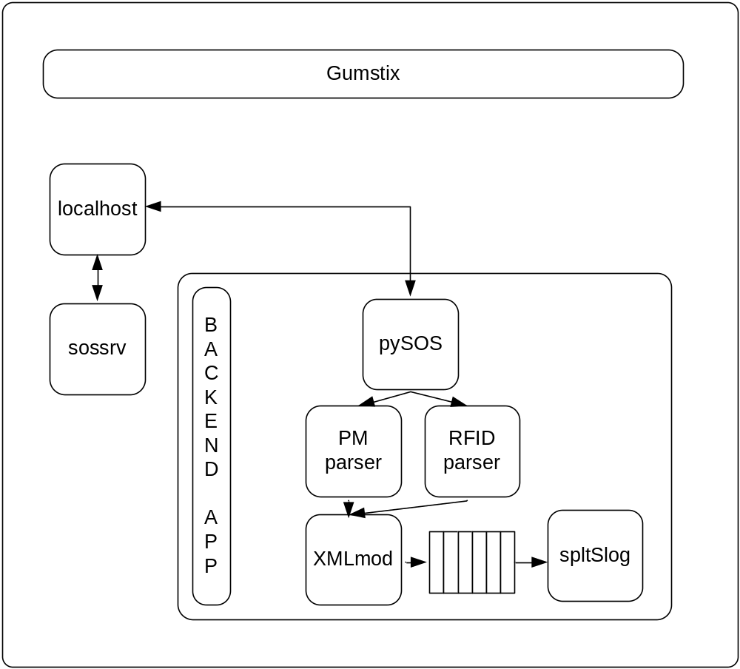
Backend – S/W
Components
  Sossrv, pySOS, Pmparser, RFIDparser, XMLmod, and spltSlog
Services
  Receive all data packets
  Translate them packets
  Make them to sensorbase XMLform
  Send them to the sensorbase
Notes:
On the gumstix, we run two main applications. The first one is actually the sos-server which most of us are familiar with.
And the second one is the backend application. It’s a python program which includes several modules.
pySOS comes from the YALE university. And it provides nice APIs which are sossrv_socket client, sos_listen, and sos_post.
We use the sossrv_socket and sos_listen.
Once it receives sos_packets, it tries to interpret the data. And of course, PowerMeasurement Parser translates the PMpackets. And RFID parser translates RFID packets. And then they pass the data to the XMLmodule and it makes them appropriate XML data format and puts into a queue.
While they are doing all those, the spltSlog continuously checks this queue and send the data to the sensorbase if there is some data.

