Slide 1
Spotlight: Evaluating power consumption at an individual basis
Zainul Charbiwala
Younghun Kim
Akhilesh Singhania

Slide 2
Introduction
Current standards in consumption profiling
  Can determine where and when the consumption took place
  Very coarse grained profiling
Proposed technique for consumption profiling
  Additional dimension of who consumed the energy
  More finer grained profiling
  Opens up an entire new outlook on power consumption and optimizations

Slide 3
Related Work
Berkeley’s Demand Response system
  ﻿Utility providers vary rate of electricity based on load
  Customers have option of deferring usage of appliance based on rate information
  DR-enabled thermostats proposed with metering, communications and automatic response mechanisms
Samsung’s Smart Building
  New building at Samsung equipped with RFID based occupancy level system for air conditioning and light level control
  Each employee and visitor is required to carry an RFID tag
  System also helps the authorities track visitors’ movements and avoid information theft

Slide 4
Application Details
Non-sharable appliances
  Only one user at a time
  Using a power-meter and a RFID reader
  Two motes each
  Coffeemaker and printer
Sharable appliances
  Many users at a time
  Instrument a confinement space
  All users in the space share the consumption
  Instrument the entry and exit points
  Lights in the lab

Slide 5
Application Limitations
Not all appliances are characterized by sharable and non-sharable
  Can use a logging mechanism for profiling
No policing
  User may not register RFID or forget
  User may pick up printer job after another job printed
No power profile for lights in the lab

Slide 6
Outline
Introduction
Power Measurement
RFID Reader
Backend System
Data Analysis Algorithm
Results
Conclusion

Slide 7
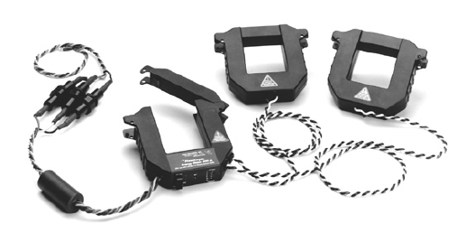
Power Meter Selection
Choice A: Veris Hawkeye 8035/8036
Current Transformer based Industrial quality meter for accurate instrumentation
RS-485 based interface with MODBUS protocol at 9600 baud
Capable of sensing up to 100A with 100mW precision and 6 Hz sampling rate

Slide 8
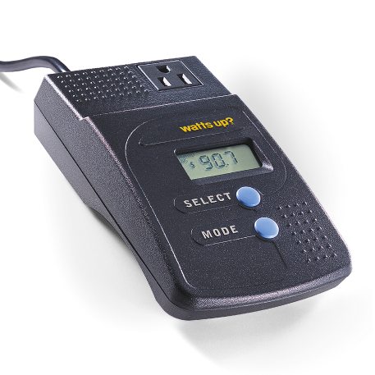
Power Meter Selection
Choice B: Watts Up? PRO
Consumer grade plug and play device using in-line current sensing
USB interface with proprietary (documented) protocol
Capable of sensing up to 15 Amps with 100mW precision at 1 Hz sampling rate

Slide 9
Meter of Choice - Watts Up? PRO
﻿Veris device requires to strip off cable cladding to get the clamps on the wires
Watts Up? Pro has LCD display reducing development time of the communication protocol and drivers
Veris device has an RS485 interface mandating custom board whereas Watts? Up has a USB interface
Protocol documentation and source code for the Watts Up? Pro are both available from the manufacturer
Veris device is over 6 times more expensive than the Watts Up? Pro

Slide 10
Hardware Interfacing
﻿MicaZ mote has no USB interface
Choice A: Use a mote with a USB host interface, the iMote2
  Pins for USB host are present on the advanced 40-pin connector
  Using it would require to build a small custom board
Watts Up? Pro USB interface implemented using a common UART to USB chip from FTDI - FT232RL
Choice B: Intercept UART signals directly on the circuit board
  UART voltage levels are 3.3V LVTTL like MicaZ
  ﻿ADI ADuM1201 Digital Isolator used for power isolation
  Disconnect the tracks between the FT232RL and ADuM1201
  Connect Vdd, Rx, Tx, Gnd to 51-pin mote connector
  Power ADuM1201 from mote - 2mA drain from mote supply
  Be careful not to connect signals on uP side of the ADuM1201
    Will blow up meter - learnt lesson the hard way

Slide 11
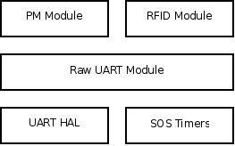
Software Interfacing
SOS provides UART driver with SOS messages and HDLC framing
Need to develop a new “raw” UART driver
Reuse of UART HAL and Timers from SOS
Raw UART module developed with messaging interface to RFID and PM modules
RFID and PM modules implement device specific protocol communication
  Device initialization
  Message parsing

Slide 12

Raw UART Module
How would frames be delimited on a raw channel?
Discovered that every device has an inter frame delay (IFD)
  Can use the IFD as an implicit framing mechanism
  Use of SOS timers to set byte timeout
    Restart timer upon reception of byte
    Timer expiry indicates end of packet
  Use of SOS messaging to bundle data and post to higher layer (PM or RFID)
  IPG is device dependent, so API needs to be provided

Slide 13
Raw UART Module Contd…
SOS Timer API has 500+ cycle latency
  62.5 us on a 8MHz AVR
  UART interrupts processor every byte
  At 115.2 Kbps, that’s an interrupt every 86 us
Use counter based API to measure arrival time between bytes
  Only 50 cycle latency
  Posts message at first byte of subsequent packet
  Problem if next packet comes too late
  Need to use a combination of timer and counter mechanism
Use device specific header/trailer bytes or knowledge of frame size (for fixed sized frames)
  Technique used in the current implementation

Slide 14
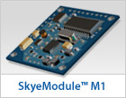
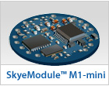
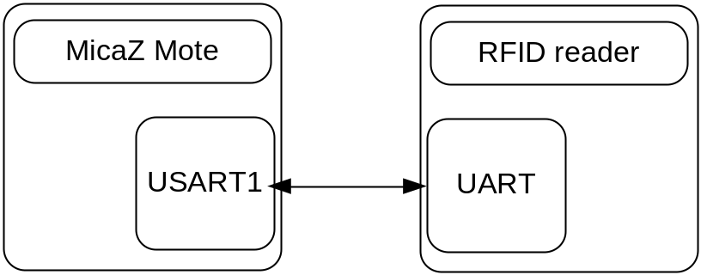
RFID Mote – H/W
RFID reader
  Two choices: SkyTek M1 and SkyTek M1-mini
  M1-mini accepts Vcc 1.8V-5V and can be powered by Mote!
  Have 12 of them
  Small
Connected through TTL-level UART
  Direct interfacing possible
Serial setting
  BAUD rate 9600bps
  Frame Format 8N1
Notes:
Hardware side is actually simple. They are connected over serial lines, say ground, Tx, Rx and VCC.
The problem was that the SOS doesn’t support RAW serial communication. So we needed to write a UART driver and make some changes of SOS.

Slide 15
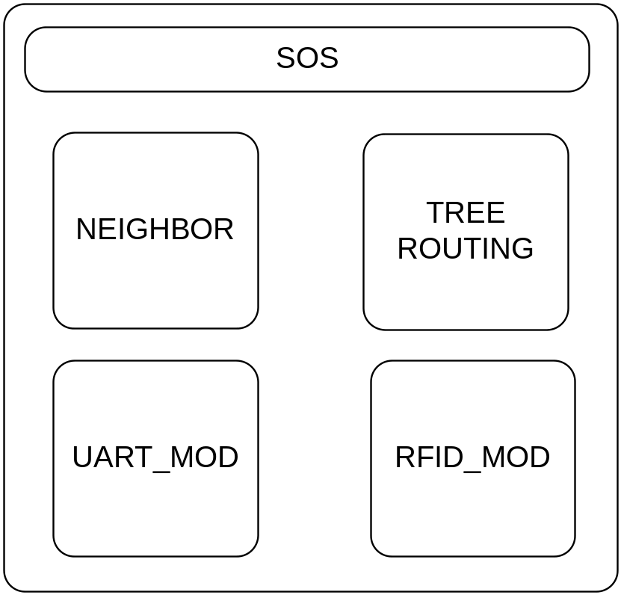
RFID Mote – S/W
Neighbor and Tree Routing
  Support Multi-hop communication
UART_MOD_RFID
  Supports RAW serial communication
  Makes RAW data as a standard SOS message
RFID_MOD
  Initializes RFID reader
  Handles RFID TAG data
Notes:
RFID motes follows standard SOS modules. For the multi-hop requirement, we inserted the tree routing module and the neighbor module.
UART_MOD basically support
In the RFID_MOD, firstly it initializes RFID reader so that it starts with the continuous reading mode. And then it waits until UART_MOD passes RFID TAG packets, as soon as they are received the RFID_MOD forwards them to the tree-routing.

Slide 16
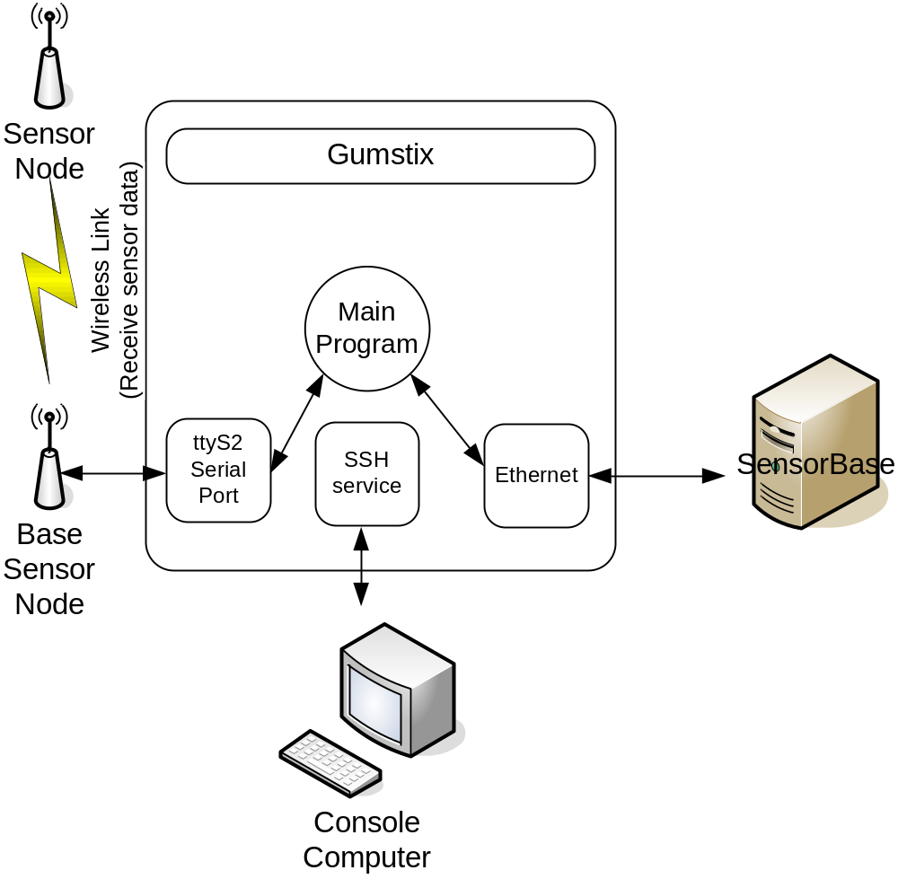
Backend – H/W
Components
  Gumstix, EthernetStix, Breakoutgs, MicaZ Mote
Notes:
For the backend, we chose the gumstix platform. It basically consists of the gumstix, the ethernetstix, breakout-gs and a MicaZ base node.
What we did for the backend hardware is a simple wiring between the MicaZ mote and the gumstix. And stacked the gumstix, ethernetstix and breakout-gs.
The gumstix is the main processor board and guns the main program. And the ethernetstix provides the interface to the back-bone network.
We used breakoutgs for interfacing the gumstix and the micaz mote.

Slide 17
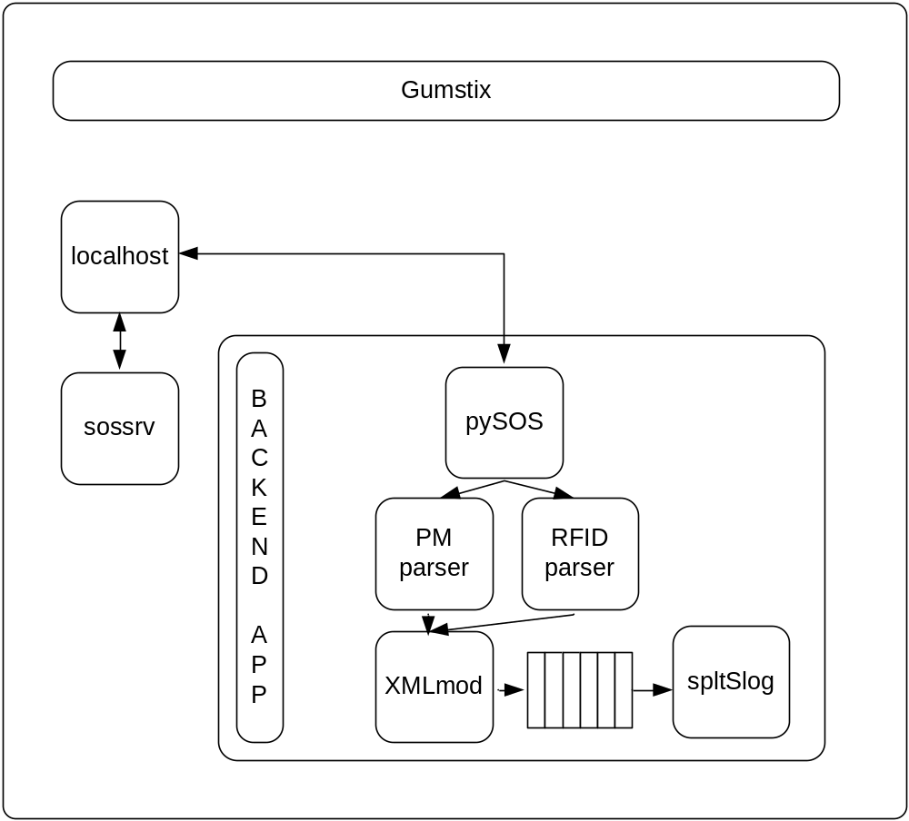
Backend – S/W
Components
  Sossrv, pySOS, Pmparser, RFIDparser, XMLmod, and spltSlog
Services
  Receive all data packets
  Translate them packets
  Make them to sensorbase XMLform
  Send them to the sensorbase
Notes:
On the gumstix, we run two main applications. The first one is actually the sos-server which most of us are familiar with.
And the second one is the backend application. It’s a python program which includes several modules.
pySOS comes from the YALE university. And it provides nice APIs which are sossrv_socket client, sos_listen, and sos_post.
We use the sossrv_socket and sos_listen.
Once it receives sos_packets, it tries to interpret the data. And of course, PowerMeasurement Parser translates the PMpackets. And RFID parser translates RFID packets. And then they pass the data to the XMLmodule and it makes them appropriate XML data format and puts into a queue.
While they are doing all those, the spltSlog continuously checks this queue and send the data to the sensorbase if there is some data.

Slide 18
R Algorithms: Sharable appliances
Require a stream of detected RFID readings
Assume all users are not in the lab in beginning
Assume no data lost and users do not forget
At first reading, user entered lab and at second reading, user left the lab
At each reading, based on number of people in the lab, increment the power consumption for each user

Slide 19
R Algorithms: Non-sharable Appliances
Use Exponential Weighted Moving Average to filter transients
Compute idle power using a smaller alpha and another stream using a bigger alpha
Define edge as a transition from less than 125% to more than 125%
Detect the closest usage whenever for every tag reading
Integrate and add to total power consumption

Slide 20
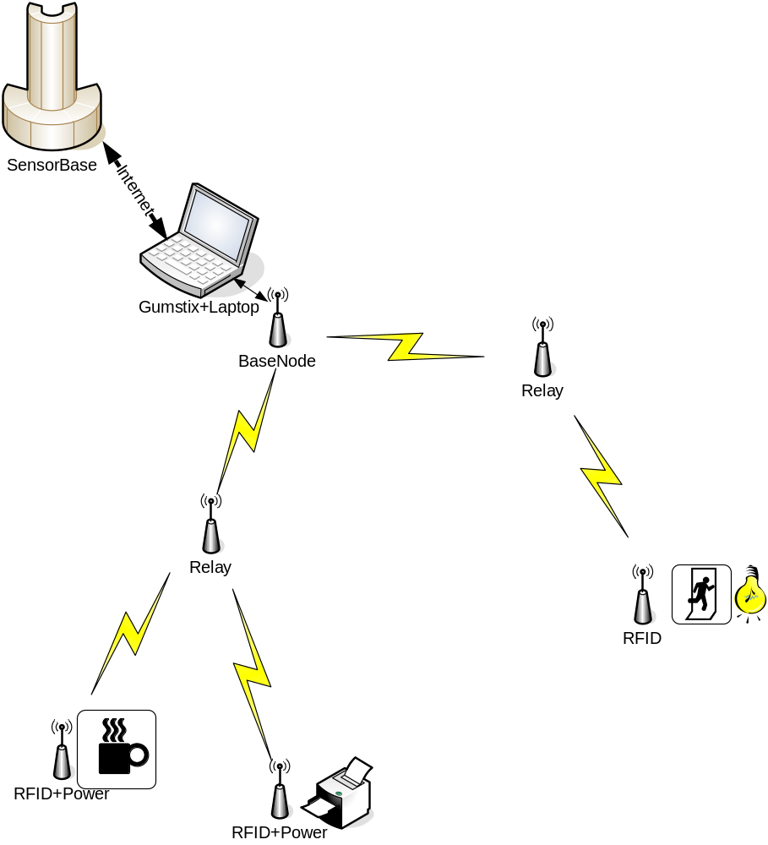
Final Deployment Topology
Backbone
  Gumstix running the spltMain App
One RFID mote on the door
One RFID mote and one PM mote for the printer and the coffee machine
Placed Relay Mote among those

Slide 21
Results
Successfully estimated the consumption profile for a user
Able to estimate the correct occupancy profile if robustness of data transmission is maintained
Able to estimate non-sharable appliances even if data is lost

Slide 22
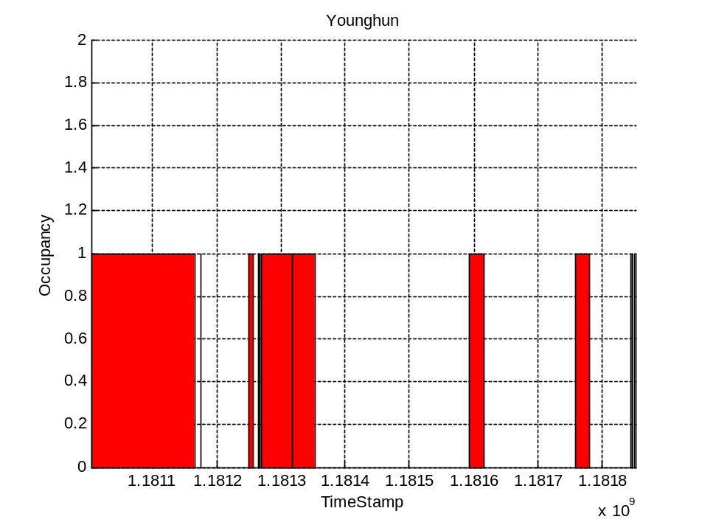
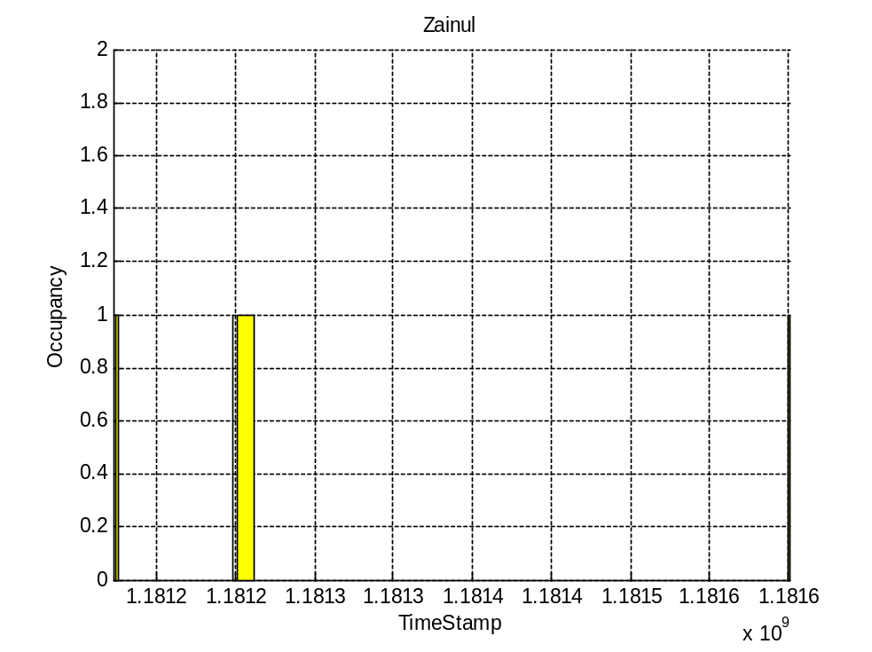
Result (Sharable)
Notes:
This figure shows the occupancy of individuals based upon the TAG IDs.
X-axis is time line and is about three days.
As see here, younghun came at this time and left for a while then shortly came by.
On the right figure, we see that zainul usually forget tagging ☺.

Slide 23
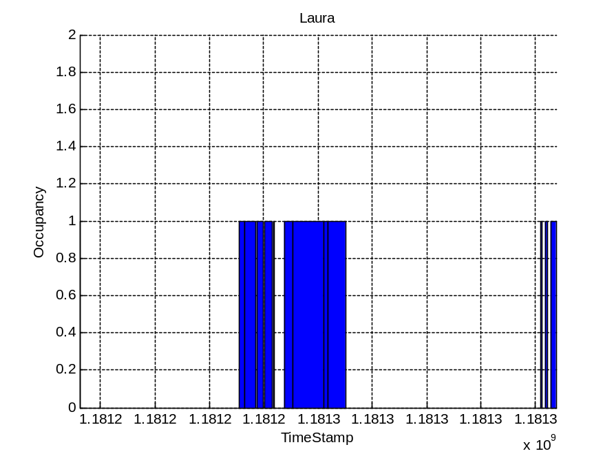
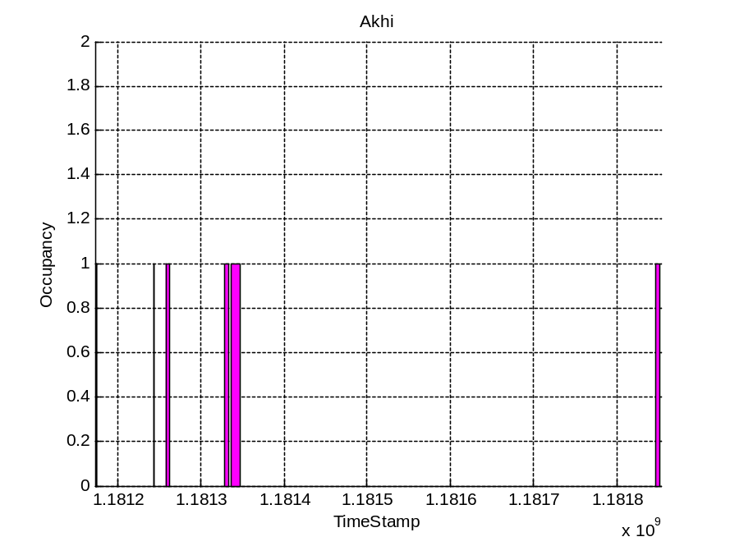
Result (Sharable)

Slide 24
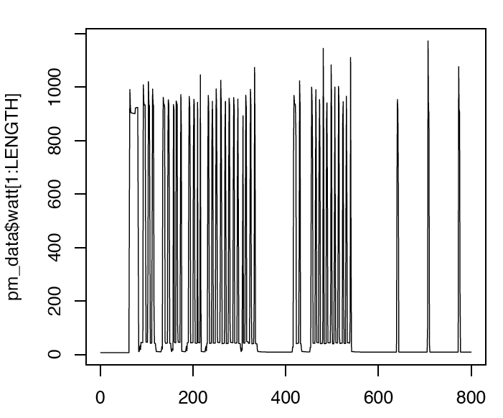
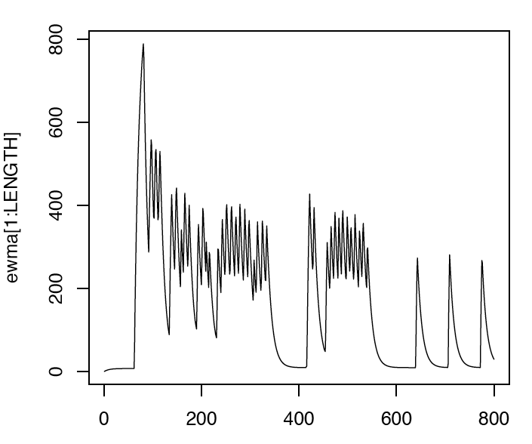
Results: Cont…
Original stream
Filtered stream

Slide 25
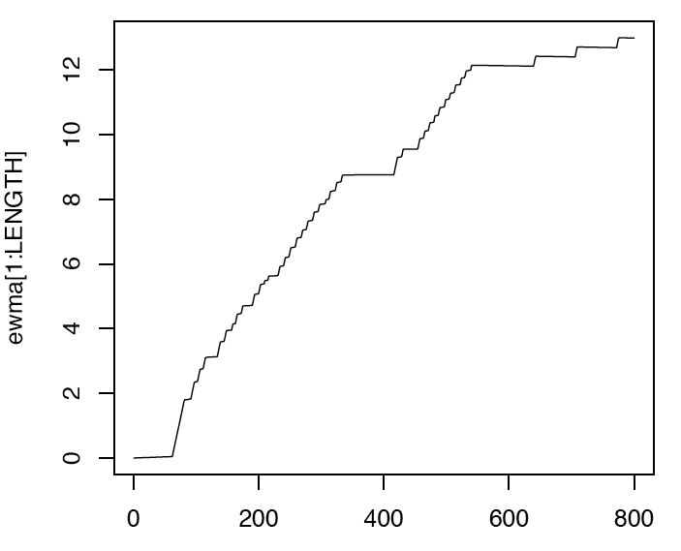
Results: Cont…
Filter stream for idle power calculations

Slide 26
Interesting Observations
SensorBase
  Even though we can download the stored data using SOAP it returns “Fatal error: Allowed memory size of 67108864 bytes exhausted” on the webpage if the data size exceeds 100s of thousands of rows
SOS kernel panic
  When using multi-hop topology with neighbor and tree routing modules
  Possibly due to MAC level retransmission
Notes:
After a long-time deployment, we found that the sensorbase webpage returns fatal error when we try to get all data.

Slide 27
Conclusion
Implemented Spotlight project and deployed intermittently for over 3 weeks
Current system tested with 2 appliances and occupancy measure
  System capable of scaling to other shared and unshared appliances
Results show interesting individual behavior
  More thorough data analysis to be included in the final report
Require to build algorithms for more sophisticated data processing
  Special attention to robustness against missing data and inaccurate readings

